Slide 1
Conjunctions
Recognising a Sentence

Slide 2
Key Information
A sentence is a group of words which makes sense by itself. It starts with a capital letter and ends with a full stop.
A verb is a doing word. For example: jump, skip, shout
A noun is a naming word. It is the name of a person, animal, place or thing. For example: mum, dog, school, book

Slide 3
Let’s start with a question about verbs, which is linked to the new learning later in this lesson.

Slide 4
Identify the verb in this sentence.
The hamster runs round the wheel.

Slide 5
Identify the verb in this sentence.
The hamster runs round the wheel.
A verb is a doing word. The word ‘runs’ tells us what action the hamster is doing.

Slide 6
Now that we are ready to move on, we can learn how to recognise a sentence

Slide 7
A sentence is a group of words which makes sense by itself.
The squirrel
This is not a sentence as it does not make sense by itself. We need more information.

Slide 8
Now we have a sentence.
The squirrel is jumping.
We know who the sentence is about – a squirrel.
We also know what the squirrel is doing – jumping.

Slide 9
A sentence must include a verb.
A koala a tree.
A koala climbs a tree.

Slide 10
We also need to know who or what a sentence is about.
Sings a song.
This group of words does not make sense by itself.

Slide 11
Now we have a sentence.
A clown sings a song.

Slide 12
It is usually a noun that tells us who or what a sentence is about.
The girl dances.
A bird flies.
A flower grows.

Slide 13
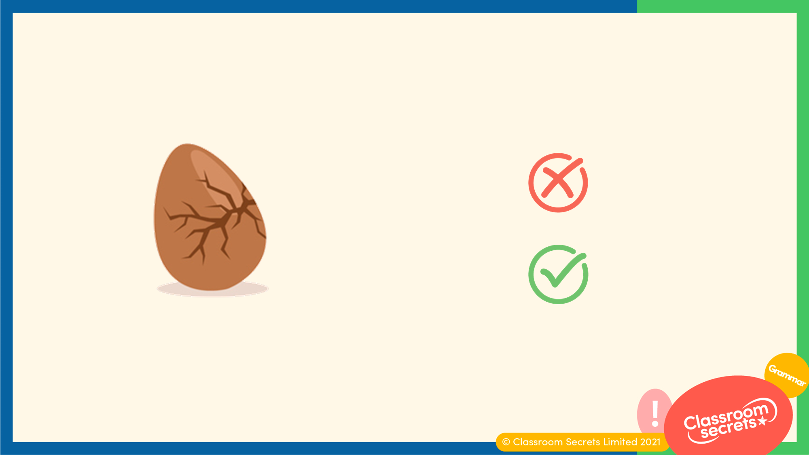
The words must be arranged in an order that makes sense.
Egg the cracks.
The egg cracks.

Slide 14
Select the sentences.
The dog the bone.
The dog licks the bone.
Licks the bone.
The dog finds a bone.

Slide 15
Select the sentences.
The dog the bone.
The dog licks the bone.
Licks the bone.
The dog finds a bone.

Slide 16
Rearrange the words to make a sentence.
hen
lays
A
some
eggs.

Slide 17
Rearrange the words to make a sentence.
The correct sentence is:
A
hen
lays
some
eggs.

Slide 18
Complete the sentence below.
The boy is on a...

Slide 19
Complete the sentence below.
The boy is on a swing.

Slide 20
Sentences can be long or short.
The girl paints.
The young girl paints a picture of a tree.
Both examples are sentences. They both contain a verb and they both make sense.
However, the second sentence contains more information.

Slide 21
Now that we have learnt to recognise a sentence, let’s apply our learning to a reasoning question.

Slide 22
Elsie and Jacob have been asked to write a sentence about a cat.
The cat sleeps.
The brown cat
sleeps in front of
the fire.
Elsie
Jacob
Who is correct? Explain your answer.

Slide 23
Elsie and Jacob have been asked to write a sentence about a cat.
The cat sleeps.
The brown cat
sleeps in front of
the fire.
Elsie
Jacob
Who is correct? Explain your answer.
Elsie and Jacob are both correct. They have both written a group of words
that makes sense and they have both included a verb.

Slide 24
You’re ready to progress!
Now apply your learning by trying some questions.

Slide 25
Tick the sentence that makes sense.
The bird has nest a made.
The bird has made a nest.
Varied Fluency 1

Slide 26
Tick the sentence that makes sense.
The bird has nest a made.
The bird has made a nest.
✓
Varied Fluency 1

Slide 27
Select the correct words from the word bank to complete the sentences below.
sleeps tails jumps eggs
The frog into the pond.
The tadpoles have long .
Varied Fluency 2

Slide 28
Select the correct words from the word bank to complete the sentences below.
sleeps tails jumps eggs
The frog jumps into the pond.
The tadpoles have long tails.
Varied Fluency 2

Slide 29
Write a sentence about this image.
Application 1

Slide 30
Write a sentence about this image.
Various answers, for example:
The mouse is eating the cheese.
Application 1

