Slide 1
LIFE/work balance
We have started a #LIFEworkbalance campaign and we need your help to complete our LIFE/work balance survey.
We hope to publish the results soon, so please give 15 minutes of your time to help us get a true picture of school life.
Want to be a part of this campaign? Take the survey on our website and share it with your colleagues!
© Classroom Secrets Limited 2020

Slide 2
Year 1 – Spring Block 2 – Exclamations – One Word Only
About This Resource:
This PowerPoint has been designed to support your teaching of this small step. It includes a starter activity and an example of each question from the Varied Fluency and Application and Reasoning resources also provided in this pack. You can choose to work through all examples provided or a selection of them depending on the needs of your class.
National Curriculum Objectives:
English Year 1: (1G5.4) Introduction to exclamation marks to demarcate sentences
English Year 1: (1G5.4) Beginning to punctuate sentences using an exclamation mark
More resources from our Grammar, Punctuation and Spelling scheme of work.
Did you like this resource? Don’t forget to review it on our website.
© Classroom Secrets Limited 2018

Slide 3
Year 1 – Spring Block 2 – Exclamations – One Word Only
Notes and Guidance:
Some children may have seen exclamations and exclamation marks in texts they have studied in class. Children may not know the meaning of the term exclamation.
An exclamation mark expresses emotion or emphasises the subject of the sentence. For example, Stop! or I love chocolate!
An exclamation mark can be used to end a variety of sentence types. The four types of sentence are covered in depth in Year 2. Please note: an exclamation sentence (not covered in this block) is different to using an exclamation mark for emotion or emphasis.
In this step, children are introduced to one-word exclamations and the use of an exclamation mark to demarcate them. For example, Help! or Sit!
One-word exclamations are usually interjections which are said in surprise or urgency.
Some common one-word exclamations include: Hurrah! Hey! Ouch! Oops! Ah! Wow! Oh! Okay!
Focused Questions:
Add an exclamation mark to this.
What is an exclamation mark used for?
What punctuation mark should be at the end of this word?
© Classroom Secrets Limited 2018

Slide 4
Year 1 – Spring Block 2 – Exclamations
Step 1: One Word Only
© Classroom Secrets Limited 2018

Slide 5
Introduction
Read these words. When might you use them?
What is the same about all of them?
Wow! |  |  |  | Oops!
 |  | Run! |  |  |  | Ouch!
Help! |  |  |  | Look!
 |  | Snap! |  |  |  | Yum!
© Classroom Secrets Limited 2018

Slide 6
Introduction
Read these words. When might you use them?
What is the same about all of them?
They all have a capital letter and an exclamation mark. They are all one word. They can all be said in surprise, fear, joy or excitement.
Wow! |  |  |  | Oops!
 |  | Run! |  |  |  | Ouch!
Help! |  |  |  | Look!
 |  | Snap! |  |  |  | Yum!
When you are amazed.
When you have made a mistake.
When you are in danger and need to get away.
When you are hurt.
When you need help quickly.
When you have seen something amazing.
When you wear the same as someone else.
When food is delicious.
© Classroom Secrets Limited 2018

Slide 7
Varied Fluency 1
Circle the words which could have an ! at the end.
oi |  | milk
frog |  | phew
lamp |  | hey
© Classroom Secrets Limited 2018

Slide 8
Varied Fluency 1
Circle the words which could have an ! at the end.
oi |  | milk
frog |  | phew
lamp |  | hey
© Classroom Secrets Limited 2018

Slide 9
Varied Fluency 2
Insert the exclamation marks.
Whoopee
Thanks
Good
© Classroom Secrets Limited 2018

Slide 10
Varied Fluency 2
Insert the exclamation marks.
Whoopee!
Thanks!
Good!
© Classroom Secrets Limited 2018

Slide 11
Varied Fluency 3
Which word could have an ! after it?
Fantastic
Swimming
© Classroom Secrets Limited 2018

Slide 12
Varied Fluency 3
Which word could have an ! after it?
Fantastic
Swimming
© Classroom Secrets Limited 2018

Slide 13
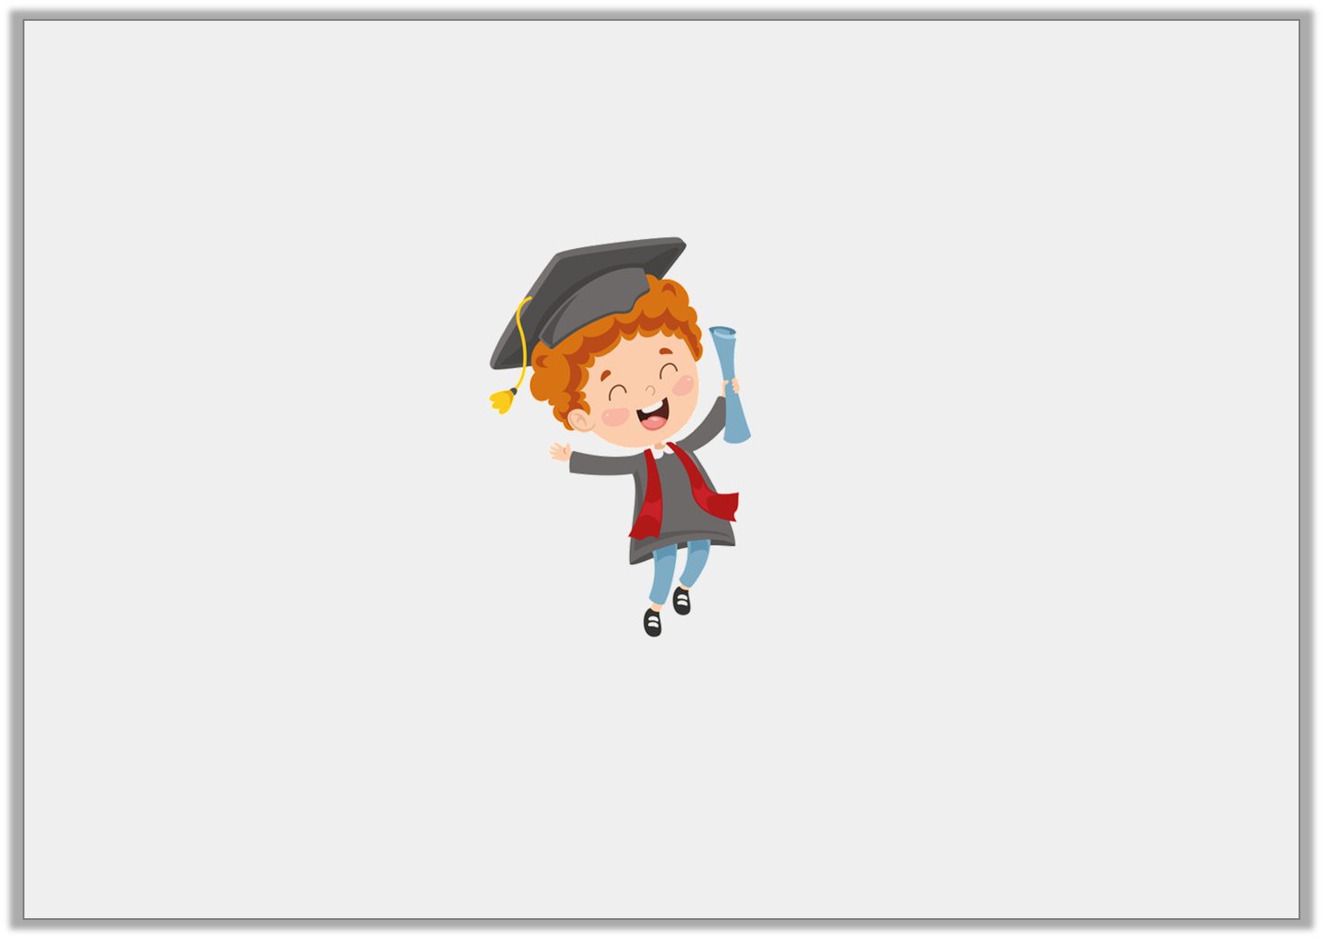
Varied Fluency 4
Look at the picture.
Circle the matching exclamation.
Ouch! | Yippee! | Quick!
© Classroom Secrets Limited 2018

Slide 14
Varied Fluency 4
Look at the picture.
Circle the matching exclamation.
Ouch! | Yippee! | Quick!
© Classroom Secrets Limited 2018

Slide 15
Reasoning 1
Fiaz thinks his one-word exclamation is correct.
Explain his mistake.
Happy!
© Classroom Secrets Limited 2018

Slide 16
Reasoning 1
Fiaz thinks his one-word exclamation is correct.
Explain his mistake.
Fiaz is incorrect because…
Happy!
© Classroom Secrets Limited 2018

Slide 17
Reasoning 1
Fiaz thinks his one-word exclamation is correct.
Explain his mistake.
Fiaz is incorrect because he has used a word that names a feeling instead of a word that you say or shout suddenly to show surprise, fear or joy.
Happy!
© Classroom Secrets Limited 2018

Slide 18
Application 1
Sort the words into the table.
upset | ow | draw | whoops
One-word exclamations | Not one-word exclamations
© Classroom Secrets Limited 2018

Slide 19
Application 1
Sort the words into the table.
upset | ow | draw | whoops
One-word exclamations | Not one-word exclamations
Ow! Whoops! | upset draw
© Classroom Secrets Limited 2018

Slide 20
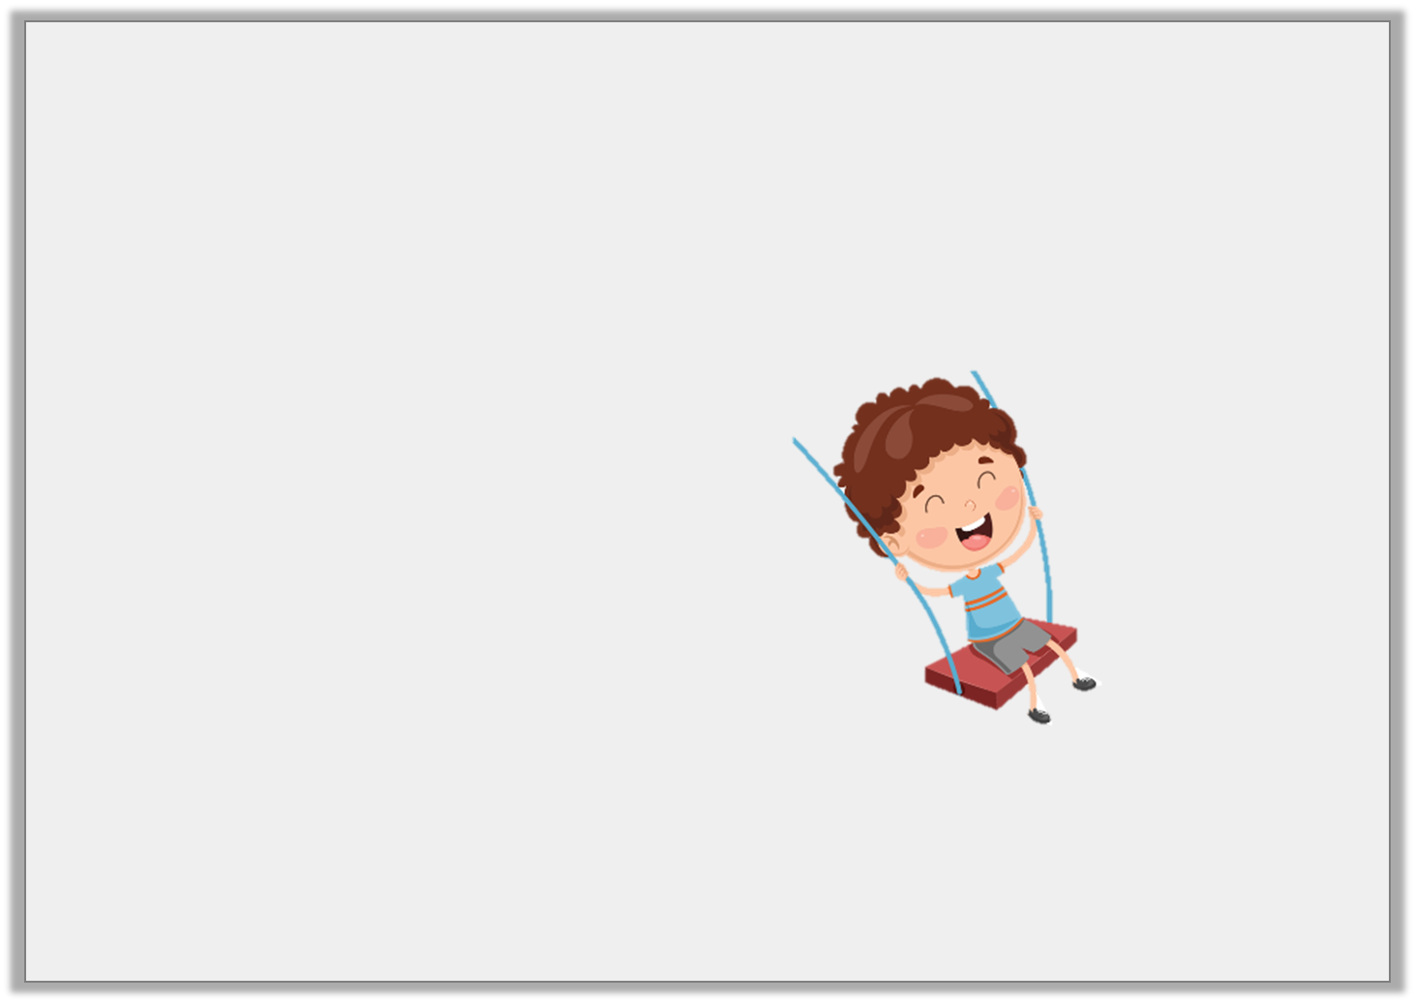
Application 2
Choose a word that the character could be saying.
Remember the correct punctuation.
gosh | whee | hey
© Classroom Secrets Limited 2018

Slide 21
Application 2
Choose a word that the character could be saying.
Remember the correct punctuation.
Whee!
gosh | whee | hey
© Classroom Secrets Limited 2018

