Slide 1
LIFE/work balance
We have started a #LIFEworkbalance campaign and we need your help to complete our LIFE/work balance survey.
We hope to publish the results soon, so please give 15 minutes of your time to help us get a true picture of school life.
Want to be a part of this campaign? Take the survey on our website and share it with your colleagues!
© Classroom Secrets Limited 2019

Slide 2
Year 1 – Summer Block 2 – Singular and Plural – Single Nouns
About This Resource:
This PowerPoint has been designed to support your teaching of this small step. It includes a starter activity and an example of each question from the Varied Fluency and Application and Reasoning resources also provided in this pack. You can choose to work through all examples provided or a selection of them depending on the needs of your class.
National Curriculum Objectives:
English Year 1: (1G6.3) Regular plural noun suffixes –s or –es [for example, dog, dogs; wish, wishes], including the effects of these suffixes on the meaning of the noun
Terminology for pupils:
(1G6.3) singular
(1G6.3) plural
More resources from our Grammar, Punctuation and Spelling scheme of work.
Did you like this resource? Don’t forget to review it on our website.
© Classroom Secrets Limited 2019

Slide 3
Year 1 – Summer Block 2 – Singular and Plural – Single Nouns
Notes and Guidance
Children should have an understanding of nouns from work done in previous blocks using capital letters for names, people, places, days and months.
In this step, children will learn that a singular noun is a word used to name a person, place or object and is used to describe only one of these, for example: chair, mum, bathroom.
Children will identify singular nouns and practise using these in their writing with some pictorial support.
Focused Questions
Match the image to the correct word.
Which words are nouns?
© Classroom Secrets Limited 2019

Slide 4
Year 1 – Summer Block 2 – Singular and Plural
Step 1: Single Nouns
© Classroom Secrets Limited 2019

Slide 5
Introduction
Which words need a capital letter?
Why?
jill |  | egg |  | june
thursday |  | london |  | moon
© Classroom Secrets Limited 2019

Slide 6
Introduction
Which words need a capital letter?
Why?
The names of people, places, days and months need a capital letter.
Jill |  | egg |  | June
Thursday |  | London |  | moon
© Classroom Secrets Limited 2019

Slide 7
Varied Fluency 1
Circle the singular nouns below.
were |  | lolly |  | spoon
lamps |  | train |  | like
© Classroom Secrets Limited 2019

Slide 8
Varied Fluency 1
Circle the nouns below.
were |  | lolly |  | spoon
lamps |  | train |  | like
© Classroom Secrets Limited 2019

Slide 9
Varied Fluency 2
Match the picture to the correct singular noun.
sock |  | wings |  | duck
© Classroom Secrets Limited 2019

Slide 10
Varied Fluency 2
Match the picture to the noun.
sock |  | soil |  | duck
© Classroom Secrets Limited 2019

Slide 11
Varied Fluency 3
Tick the sentence that contains singular nouns only.
A. | A house on our street has a broken roof after the storm.
B. | I went to the sweet shop on Saturday and I got some toffees.
© Classroom Secrets Limited 2019

Slide 12
Varied Fluency 3
Tick the sentence that contains singular nouns only.
A. | A house on our street has a broken roof after the storm. |  | ✓
B. | I went to the sweet shop on Saturday and I got some toffees.
© Classroom Secrets Limited 2019

Slide 13
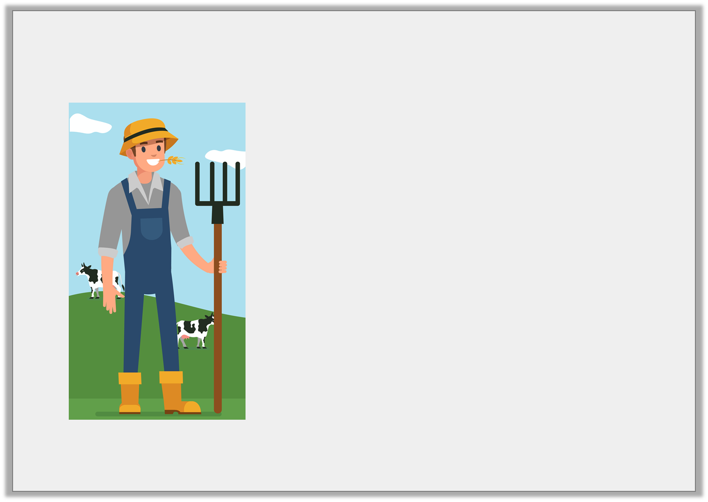
Application 1
Write down 3 singular nouns that you can see in the picture.
© Classroom Secrets Limited 2019

Slide 14
Application 1
Write down 3 singular nouns that you can see in the picture.
Various answers, for example:
farmer
fork
corn
hat
cow
grass
sky
cloud
© Classroom Secrets Limited 2019

Slide 15
Application 2
Add singular nouns to the sentence below.
The ______________ hopped across
the ______________ .
path |  | girls |  | rabbit
© Classroom Secrets Limited 2019

Slide 16
Application 2
Add singular nouns to the sentence below.
The rabbit hopped across the path.
path |  | girls |  | rabbit
© Classroom Secrets Limited 2019

Slide 17
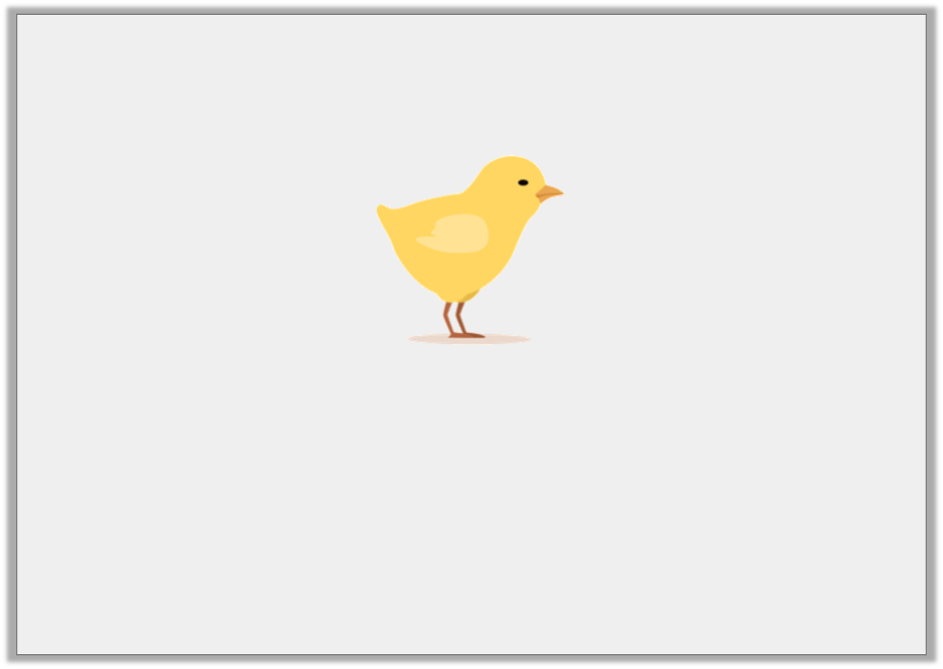
Reasoning 1
What is wrong with the noun under the picture?
Explain your answer.
chicks
© Classroom Secrets Limited 2019

Slide 18
Reasoning 1
What is wrong with the noun under the picture?
Explain your answer.
The noun is wrong because...
chicks
© Classroom Secrets Limited 2019

Slide 19
Reasoning 1
What is wrong with the noun under the picture?
Explain your answer.
The noun is wrong because there is only one chick. It should say chick not chicks.
chicks
© Classroom Secrets Limited 2019

