Slide 1
LIFE/work balance
We have started a #LIFEworkbalance campaign and we need your help to complete our LIFE/work balance survey.
We hope to publish the results soon, so please give 15 minutes of your time to help us get a true picture of school life.
Want to be a part of this campaign? Take the survey on our website and share it with your colleagues!
© Classroom Secrets Limited 2019

Slide 2
Year 2 – Autumn Block 1 – Ready to Write – Capital Letters
About This Resource:
This PowerPoint has been designed to support your teaching of this small step. It includes a starter activity and an example of each question from the Varied Fluency and Application and Reasoning resources also provided in this pack. You can choose to work through all examples provided or a selection of them depending on the needs of your class.
National Curriculum Objectives:
English Year 1: (1G5.1) Using a capital letter for names of people, places, the days of the week, and the personal pronoun ‘I’
English Year 2: (2G5.1) Use of capital letters to demarcate sentences
More resources from our Grammar, Punctuation and Spelling scheme of work.
Did you like this resource? Don’t forget to review it on our website.
© Classroom Secrets Limited 2018

Slide 3
Year 2 – Autumn Block 1 – Ready to Write – Capital Letters
Notes and Guidance
To build on skills learnt in Year 1, children need to be able to use capital letters to demarcate sentences consistently. They should know from Year 1 that capital letters are also used for proper nouns (names of people, places, days of the week and months of the year) as well as for the personal pronoun ‘I’.
It is important that children can recognise when a capital letter has been used correctly and when it has been used incorrectly.
Focused Questions
What type of letter should we always use for the start of a sentence?
When do we use capital letters? Is it just at the start of a sentence?
© Classroom Secrets Limited 2018

Slide 4
Year 2 – Autumn Block 1 – Ready to Write
Step 1: Capital Letters
© Classroom Secrets Limited 2018

Slide 5
Introduction
Circle the matching lowercase letters.
A | c | n | a | g
B | d | b | p | q
D | b | p | q | d
E | o | c | e | a
G | g | p | q | b
H | k | f | l | h
N | m | n | w | r
Q | d | b | p | q
R | n | c | r | m
T | l | h | t | j
© Classroom Secrets Limited 2018

Slide 6
Introduction
Circle the matching lowercase letters.
A | c | n | a | g
B | d | b | p | q
D | b | p | q | d
E | o | c | e | a
G | g | p | q | b
H | k | f | l | h
N | m | n | w | r
Q | d | b | p | q
R | n | c | r | m
T | l | h | t | j
© Classroom Secrets Limited 2018

Slide 7
Varied Fluency 1
Circle the word with the correct use of the capital letter.
Sister
We
Brother
I’m
© Classroom Secrets Limited 2018

Slide 8
Varied Fluency 1
Circle the word with the correct use of the capital letter.
Sister
We
Brother
I’m
© Classroom Secrets Limited 2018

Slide 9
Varied Fluency 2
Underline the two words that need a capital letter in the sentence below.
across the border is wales.
© Classroom Secrets Limited 2018

Slide 10
Varied Fluency 2
Underline the two words that need a capital letter in the sentence below.
Across the border is Wales.
© Classroom Secrets Limited 2018

Slide 11
Varied Fluency 3
Re-write the sentence with the 2 capital letters needed.
we are going camping in france.
© Classroom Secrets Limited 2018

Slide 12
Varied Fluency 3
Re-write the sentence with the 2 capital letters needed.
We are going camping in France.
we are going camping in france.
© Classroom Secrets Limited 2018

Slide 13
Varied Fluency 4
Circle the sentence which does not use capital letters correctly.
Apples and pears grow on a tree.
My sister Is very kind.
Summer and spring are the warmest seasons.
© Classroom Secrets Limited 2018

Slide 14
Varied Fluency 4
Circle the sentence which does not use capital letters correctly.
Apples and pears grow on a tree.
My sister Is very kind.
Summer and spring are the warmest seasons.
© Classroom Secrets Limited 2018

Slide 15
Application 1
Using the 6 words, re-write the sentence and add 2 capital letters.
my
is
called
friend
julia
best
© Classroom Secrets Limited 2018

Slide 16
Application 1
Using the 6 words, re-write the sentence and add 2 capital letters.
My best friend is called Julia.
my
is
called
friend
julia
best
© Classroom Secrets Limited 2018

Slide 17
Application 2
Which of these words would need a capital letter to complete the sentence below correctly.
The start of the week is ________________.
cold
monday
nice
© Classroom Secrets Limited 2018

Slide 18
Application 2
Which of these words would need a capital letter to complete the sentence below correctly.
The start of the week is ________________.
cold
monday
nice
Monday
© Classroom Secrets Limited 2018

Slide 19
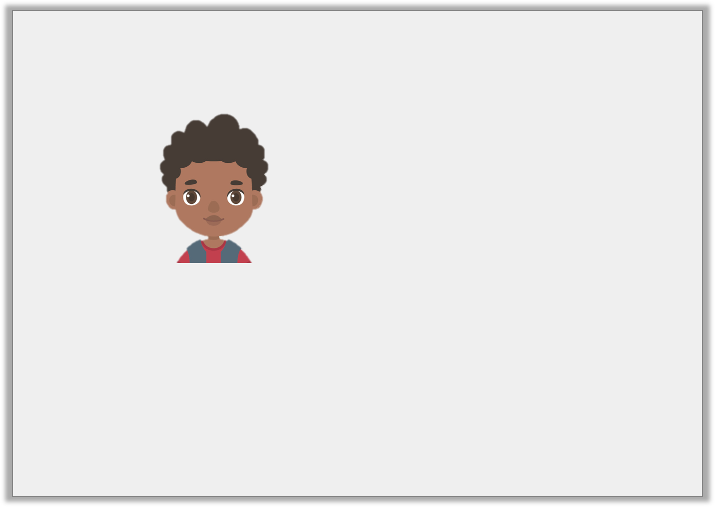
Reasoning 1
Darnell says that his sentence needs 2 capital letters.
Is he correct?
Explain your answer fully.
On weekends, i like to visit my aunty.
© Classroom Secrets Limited 2018

Slide 20
Reasoning 1
Darnell says that his sentence needs 2 capital letters.
Is he correct?
Explain your answer fully.
Darnell is incorrect because…
On weekends, i like to visit my aunty.
© Classroom Secrets Limited 2018

Slide 21
Reasoning 1
Darnell says that his sentence needs 2 capital letters.
Is he correct?
Explain your answer fully.
Darnell is incorrect because he only needs one capital letter for I.
On weekends, i like to visit my aunty.
© Classroom Secrets Limited 2018

