Slide 1
Suffixes
Compound Nouns

Slide 2
Key Information
A common noun is a naming word. It is the name of a type of person, animal, place or thing. For example: doctor, cat, school, book
A proper noun is a specific name for a person, place or thing. It always starts with a capital letter. For example: John, Spain, Friday
A compound noun is made by joining two words together. For example: ‘foot’ and ‘ball’ make ‘football’.

Slide 3
Let’s start with a question about recognising common nouns and proper nouns, which is linked to the new learning later in this lesson.

Slide 4
Underline any common nouns and circle any proper nouns in the sentence below.
The guard blew his whistle and then the train to London left the platform.

Slide 5
Underline any common nouns and circle any proper nouns in the sentence below.
The guard blew his whistle and then the train to London left the platform.
The common nouns are ‘guard’, ‘whistle’, ‘train’ and ‘platform’. The are the naming words for a person, place or thing. The proper noun is ‘London’. This is the specific name of a place.

Slide 6
Now that we are ready to move on, we can learn about compound nouns.

Slide 7
Compound nouns are made by joining two words together.
football
toothbrush
raincoat

Slide 8
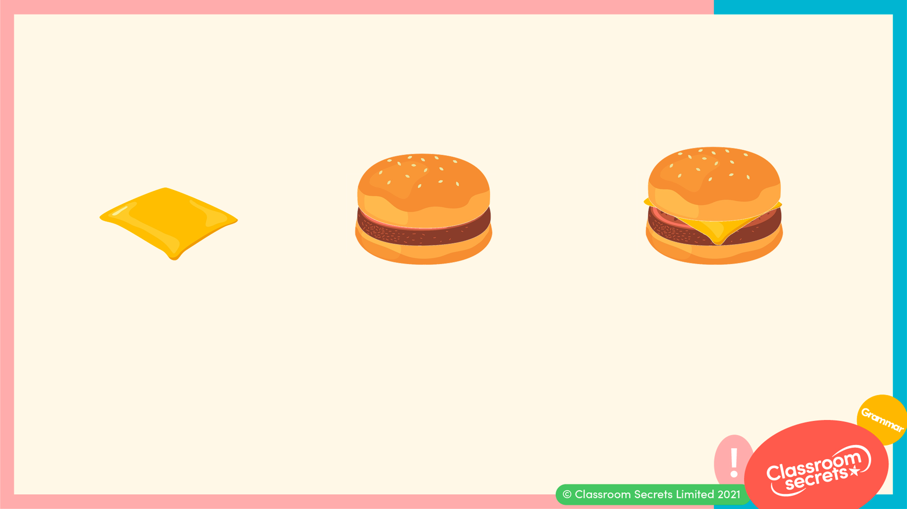
Sometimes, the meaning of the two individual words helps us to understand the meaning of the new compound noun.
+
=
cheese
burger
cheeseburger

Slide 9
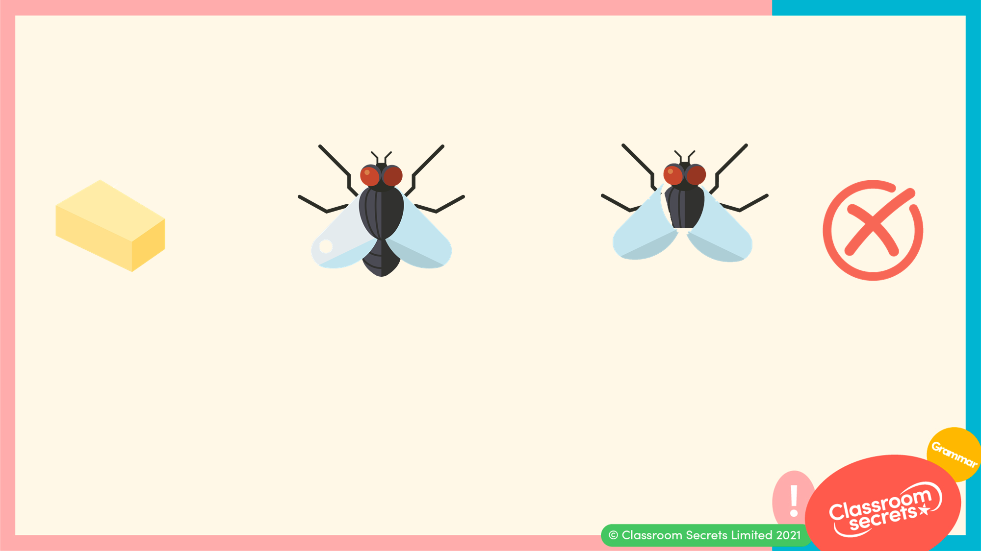
Sometimes, the two words are unrelated.
+
=
butter
fly
butterfly

Slide 10
Often, it is two nouns that are joined together to make a compound noun.
+
=
wheel
chair
wheelchair
+
=
star
fish
starfish

Slide 11
However, other word types such as adjectives can be used.
+
=
green
house
greenhouse
+
=
hot
dog
hotdog

Slide 12
Label the pictures below and create the compound noun.
+
=
+
=

Slide 13
Label the pictures below and create the compound noun.
+
=
jelly
fish
jellyfish
+
=
sea
horse
seahorse

Slide 14
Match the words to make compound nouns. Find the odd ones out.
pan
bird
lady
cakes
sun
bow
rain
ball

Slide 15
Match the words to make compound nouns. Find the odd ones out.
pan
bird
ladybird
lady
cakes
pancakes
sun
bow
rainbow
rain
ball
The odd ones out are ‘sun’ and ‘ball’.

Slide 16
Identify the individual words in the compound nouns below.
sunflower
cowboy
handbag

Slide 17
Identify the individual words in the compound nouns below.
sunflower
cowboy
handbag
sun + flower
cow + boy
hand + bag

Slide 18
Now that we know about compound nouns, let’s apply our learning to some further application and reasoning questions.

Slide 19
Francis has written a compound noun but has dropped some paint. Find 3 words that could be hidden under the paint splat.
eye

Slide 20
Francis has written a compound noun but has dropped some paint. Find 3 words that could be hidden under the paint splat.
Various answers, for example:
ball eyeball, lash eyelash, lid eyelid
eye

Slide 21
Complete the sentences below with a compound noun.
I saw a in the garden.
I made a to eat.
I opened the .

Slide 22
Complete the sentences below with a compound noun.
Various answers, for example:
I saw a sunflower in the garden.
I made a pancake to eat.
I opened the suitcase.

Slide 23
Joe has been asked to think of a compound noun.
He says,
I think ‘children’ is a compound noun.
Is Joe correct? Explain your answer.

Slide 24
Joe has been asked to think of a compound noun.
He says,
I think ‘children’ is a compound noun.
Is Joe correct? Explain your answer.
Joe is incorrect because...

Slide 25
Joe has been asked to think of a compound noun.
He says,
I think ‘children’ is a compound noun.
Is Joe correct? Explain your answer.
Joe is incorrect because ‘children’ cannot be separated into two words. Although ‘child’ is a word, ‘ren’ is not.

Slide 26
You’re ready to progress!
Now apply your learning by trying some questions.

Slide 27
Match the words below to create compound nouns.
earth
berry
straw
body
fire
worm
any
fighter
Varied Fluency 1

Slide 28
Match the words below to create compound nouns.
earth
berry
strawberry
straw
body
anybody
fire
worm
earthworm
any
fighter
firefighter
Varied Fluency 1

Slide 29
Split the compound nouns below to create two words.
grandmother
today
rattlesnake
Varied Fluency 2

Slide 30
Split the compound nouns below to create two words.
grand
mother
to
day
rattle
snake
Varied Fluency 2

Slide 31
Circle all the compound nouns.
playing
playtime
playground
played
Varied Fluency 3

Slide 32
Circle all the compound nouns.
playing
playtime
playground
played
Varied Fluency 3

Slide 33
Add another word to the words below to create compound nouns.
light | + |  | =
basket | + |  | =
fire | + |  | =
Varied Fluency 4

Slide 34
Add another word to the words below to create compound nouns. Various answers, for example:
light | + | house | = | lighthouse
basket | + | ball | = | basketball
fire | + | work | = | firework
Varied Fluency 4

Slide 35
Create a compound noun from the words in the word bank and use it in a sentence.
Remember to punctuate your sentence.
house fly dragon keeper green
Application 1

Slide 36
Create a compound noun from the words in the word bank and use it in a sentence.
Remember to punctuate your sentence.
Various answers that include any of the compound nouns: housekeeper, greenhouse, greenfly, dragonfly. For example:
The dragonfly hovered over the pond.
house fly dragon keeper green
Application 1

Slide 37
Underline any mistakes in the sentences below.
Rewrite the sentence correctly.
I went to the park on my skate board. I had a picnic and played net ball.
Application 2

Slide 38
Underline any mistakes in the sentences below.
Rewrite the sentence correctly.
I went to the park on my skate board. I had a picnic and played net ball.
I went to the park on my skateboard. I had a picnic and played netball.
Application 2

Slide 39
Esme is making compound nouns using the word ‘night’.
She says,
I can make the compound words ‘midnight’, ‘nightmare’ and ‘lastnight’.
Is she correct? Explain your answer.
Reasoning 1

Slide 40
Esme is making compound nouns using the word ‘night’.
She says,
I can make the compound words ‘midnight’, ‘nightmare’ and ‘lastnight’.
Is she correct? Explain your answer.
Esme is incorrect because...
Reasoning 1

Slide 41
Esme is making compound nouns using the word ‘night’.
She says,
I can make the compound words ‘midnight’, ‘nightmare’ and ‘lastnight’.
Is she correct? Explain your answer.
Esme is incorrect because ‘lastnight’ is not a compound word. It is two separate words, ‘last’ and ‘night’.
Reasoning 1

