Slide 1
Year 3 – Spring Block 1 – Adverbs – What is an Adverb?
About This Resource:
This PowerPoint has been designed to support your teaching of this small step. It includes a starter activity and an example of each question from the Varied Fluency and Application and Reasoning resources also provided in this pack. You can choose to work through all examples provided or a selection of them depending on the needs of your class.
National Curriculum Objectives:
English Year 3: (3G1.6) Using adverbs to express time and cause
English Year 3: (3G1.6) Express time, place and cause using adverbs [for example, then, next, soon, therefore]
More resources from our Grammar, Punctuation and Spelling scheme of work.
Did you like this resource? Don’t forget to review it on our website.
© Classroom Secrets Limited 2018

Slide 2
Year 3 – Spring Block 1 – Adverbs – What is an Adverb?
Notes and Guidance
From KS1, children may already know that an adverb is a word that describes more about a verb.
Children need to know that an adverb can be formed by adding -ly to words, but there are exceptions to this rule, e.g. fastly.
This step focuses specifically on identifying adverbs and how they are used to describe a verb and modify a sentence.
Children need to know that adverbs describe verbs in different ways. They describe how, how often, when or where a verb is done.
Children should be able to use their knowledge of word classes to recognise adverbs in sentences and explain how they have been used.
Children should know that adverbs can move location within a sentence.
Focused Questions
Identify the verb in this sentence. What adverb can be added to the verb to give extra detail?
Identify the adverb in this sentence. Is the adverb telling us how or when the verb is done? Is the adverb telling us how often or where the verb is done?
Which adverb tells us where a verb is done?
© Classroom Secrets Limited 2018

Slide 3
Year 3 – Spring Block 1 – Adverbs
Step 1: What is an Adverb?
© Classroom Secrets Limited 2018

Slide 4
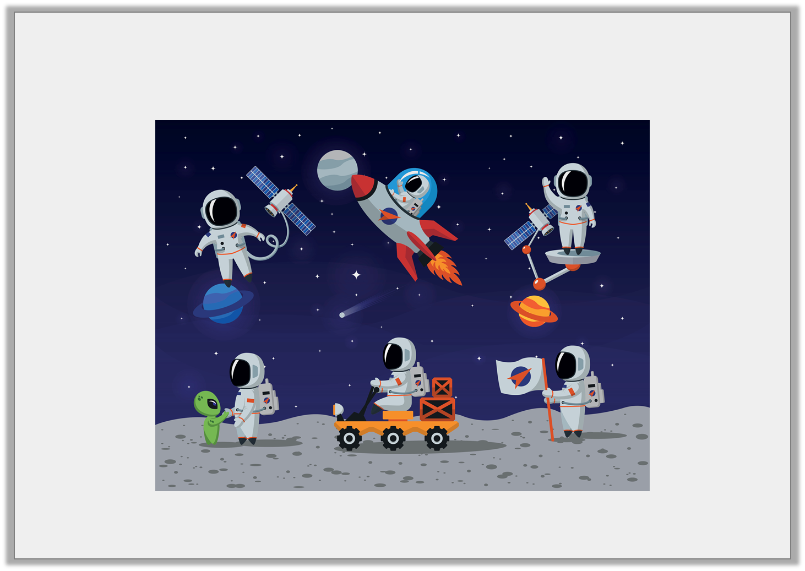
Introduction
Describe an action in the picture below using an adverb.
© Classroom Secrets Limited 2018

Slide 5
Introduction
Describe an action in the picture below using an adverb.
Various answers, for example: The astronaut is driving the truck carefully. The astronaut is floating gently through space.
© Classroom Secrets Limited 2018

Slide 6
Varied Fluency 1
Circle the adverbs below.
plate | new | upstairs
angrily | time | safely
© Classroom Secrets Limited 2018

Slide 7
Varied Fluency 1
Circle the adverbs below.
plate | new | upstairs
angrily | time | safely
© Classroom Secrets Limited 2018

Slide 8
Varied Fluency 2
Underline the verb in the sentence below.
David won an exciting competition recently.
© Classroom Secrets Limited 2018

Slide 9
Varied Fluency 2
Underline the verb in the sentence below.
David won an exciting competition recently.
© Classroom Secrets Limited 2018

Slide 10
Varied Fluency 3
Tick the sentence which contains an adverb.
Milly’s favourite animals are lions and tigers.
I need to get a new coat because it is winter.
Lisa and Frank are going on holiday soon.
© Classroom Secrets Limited 2018

Slide 11
Varied Fluency 3
Tick the sentence which contains an adverb.
Milly’s favourite animals are lions and tigers.
I need to get a new coat because it is winter.
Lisa and Frank are going on holiday soon. | ✓
© Classroom Secrets Limited 2018

Slide 12
Varied Fluency 4
Add the correct adverb to the sentence below.
When Greg heard the dog growl, he ran __________.
once | frequently | away
© Classroom Secrets Limited 2018

Slide 13
Varied Fluency 4
Add the correct adverb to the sentence below.
When Greg heard the dog growl, he ran __________.
once | frequently | away
away
© Classroom Secrets Limited 2018

Slide 14
Application 1
Change the verb and the adverb in the sentence below.
Lisa and her pet dog walk in the park daily.
Make sure your sentence still makes sense!
© Classroom Secrets Limited 2018

Slide 15
Application 1
Change the verb and the adverb in the sentence below.
Lisa and her pet dog walk in the park daily.
Lisa and her pet dog play in the park sometimes.
Make sure your sentence still makes sense!
© Classroom Secrets Limited 2018

Slide 16
Reasoning 1
Tick the sentence which uses an adverb incorrectly.
Explain why the adverb does not make sense.
Kiran and her son put the new flower pots outside.
“I will do it tomorrow,” sighed Derek.
Tom lost his favourite toy so he cried joyfully.
© Classroom Secrets Limited 2018

Slide 17
Reasoning 1
Tick the sentence which uses an adverb incorrectly.
Explain why the adverb does not make sense.
The adverb ‘joyfully’ is incorrect because…
Kiran and her son put the new flower pots outside.
“I will do it tomorrow,” sighed Derek.
Tom lost his favourite toy so he cried joyfully. | ✓
© Classroom Secrets Limited 2018

Slide 18
Reasoning 1
Tick the sentence which uses an adverb incorrectly.
Explain why the adverb does not make sense.
The adverb ‘joyfully’ is incorrect because Tom would be feeling sad if he lost his favourite toy.
Kiran and her son put the new flower pots outside.
“I will do it tomorrow,” sighed Derek.
Tom lost his favourite toy so he cried joyfully. | ✓
© Classroom Secrets Limited 2018

Slide 19
Application 2
Choose a verb and an adverb and use them to create a sentence.
laughed | calmly | shouted
today | kicked | loudly
went | over | angrily
© Classroom Secrets Limited 2018

Slide 20
Application 2
Choose a verb and an adverb and use them to create a sentence.
Various answers, for example: Jason angrily kicked the soft cushion across the room.
laughed | calmly | shouted
today | kicked | loudly
went | over | angrily
© Classroom Secrets Limited 2018

