Slide 1
LIFE/work balance
We have started a #LIFEworkbalance campaign and we need your help to complete our LIFE/work balance survey.
We hope to publish the results soon, so please give 15 minutes of your time to help us get a true picture of school life.
Want to be a part of this campaign? Take the survey on our website and share it with your colleagues!
© Classroom Secrets Limited 2020

Slide 2
Year 3 – Spring Block 2 – Prepositions – What is a Preposition?
About This Resource:
This PowerPoint has been designed to support your teaching of this small step. It includes a starter activity and an example of each question from the Varied Fluency and Application and Reasoning resources also provided in this pack. You can choose to work through all examples provided or a selection of them depending on the needs of your class.
National Curriculum Objectives:
English Year 3: (3G1.7) Using prepositions to express time and cause
English Year 3: (3G1.7) Express time, place and cause using prepositions [for example, before, after, during, in, because of]
Terminology For Pupils:
(3G1.7) preposition
More resources from our Grammar, Punctuation and Spelling scheme of work.
Did you like this resource? Don’t forget to review it on our website.
© Classroom Secrets Limited 2019

Slide 3
Year 3 – Spring Block 2 – Prepositions – What is a Preposition?
Notes and Guidance:
Some children may have seen prepositions in texts they have studied in class and may use them already in their writing. Children may not know the meaning of the term preposition.
A preposition conveys the relationship of a noun or pronoun to another part of a sentence and can be used to express time, place or cause, for example: I will play out after dinner; The cat was under the bed; He tripped over because of the fallen branch.
Children should become familiar with common prepositions, for example: before, after, during, in and because of.
Focused Questions
Which word is the noun? Which word is the preposition?
What other prepositions could be used to change the meaning of this sentence?
How many prepositions can you think of to express where the noun is?
© Classroom Secrets Limited 2019

Slide 4
Year 3 – Spring Block 2 – Prepositions
Step 1: What is a Preposition?
© Classroom Secrets Limited 2019

Slide 5
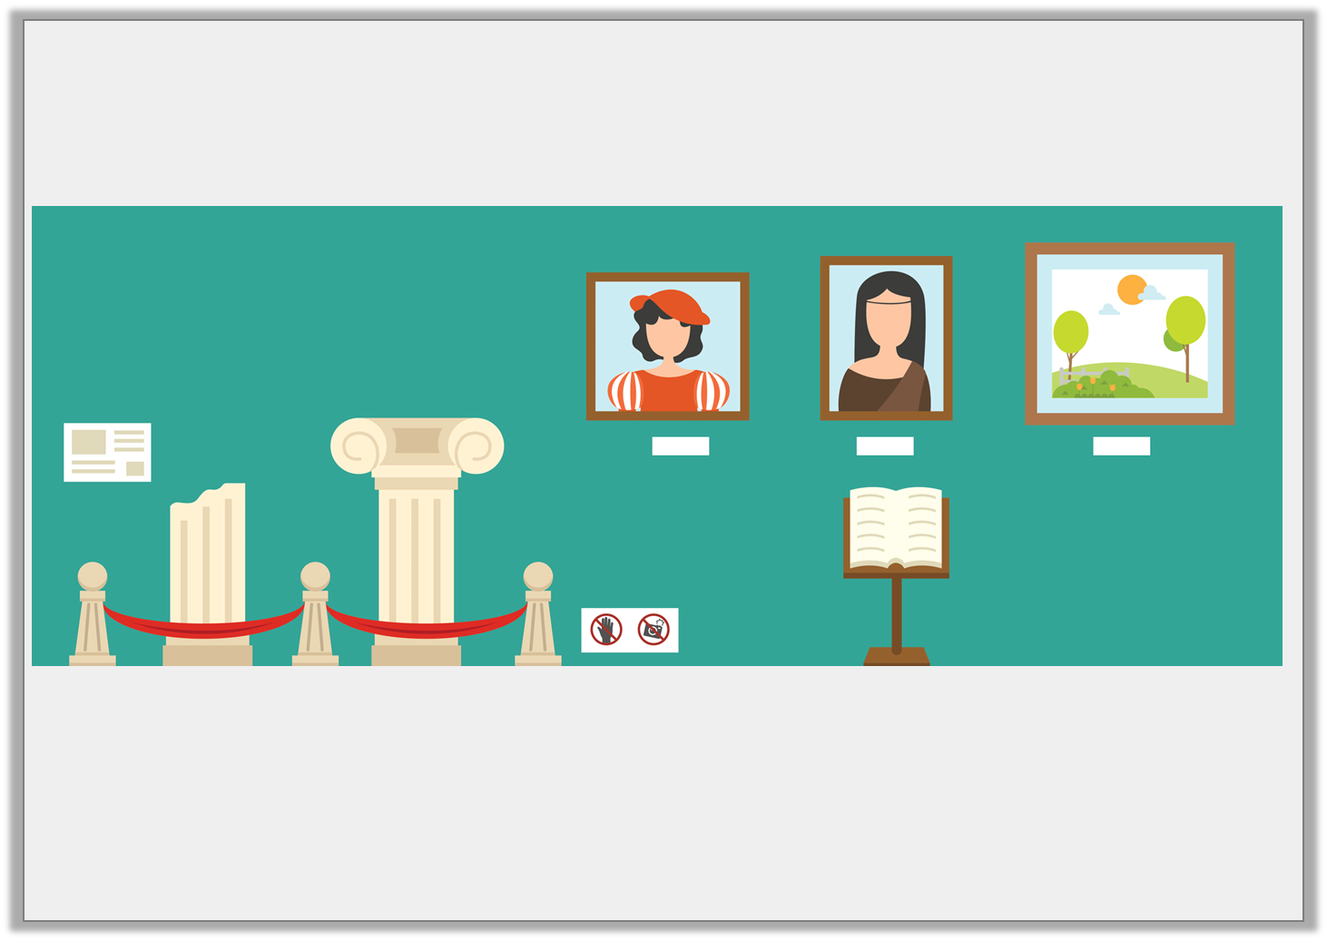
Introduction
Use prepositions to describe the position of people or objects in the picture below.
© Classroom Secrets Limited 2019

Slide 6
Introduction
Use prepositions to describe the position of people or objects in the picture below.
Various answers, for example:
The statues are behind the rope.
The book is near the painting.
The painting is on the wall.
© Classroom Secrets Limited 2019

Slide 7
Varied Fluency 1
Underline the noun in the sentence below.
They sat happily among the flowers.
© Classroom Secrets Limited 2019

Slide 8
Varied Fluency 1
Underline the noun in the sentence below.
They sat happily among the flowers.
© Classroom Secrets Limited 2019

Slide 9
Varied Fluency 2
Circle the preposition in the sentence below.
The water fountain is near the town hall.
© Classroom Secrets Limited 2019

Slide 10
Varied Fluency 2
Circle the preposition in the sentence below.
The water fountain is near the town hall.
© Classroom Secrets Limited 2019

Slide 11
Varied Fluency 3
Sort the nouns and prepositions into the table below.
across | after | bread
snake | behind | church
Nouns | Prepositions
© Classroom Secrets Limited 2019

Slide 12
Varied Fluency 3
Sort the nouns and prepositions into the table below.
Nouns | Prepositions
bread snake church | across after behind
© Classroom Secrets Limited 2019

Slide 13
Varied Fluency 4
Use a preposition from the word bank to complete the sentence.
I have known Andrew ______ last year.
beyond | off | since
© Classroom Secrets Limited 2019

Slide 14
Varied Fluency 4
Use a preposition from the word bank to complete the sentence.
I have known Andrew since last year.
beyond | off | since
© Classroom Secrets Limited 2019

Slide 15
Reasoning 1
Does the preposition make sense in the sentence below?
The children walked carefully across the busy main road.
Explain your reasoning.
© Classroom Secrets Limited 2019

Slide 16
Reasoning 1
Does the preposition make sense in the sentence below?
The children walked carefully across the busy main road.
Explain your reasoning.
Yes because…
© Classroom Secrets Limited 2019

Slide 17
Reasoning 1
Does the preposition make sense in the sentence below?
The children walked carefully across the busy main road.
Explain your reasoning.
Yes because ‘across’ shows where the children were in relation to the busy main road.
© Classroom Secrets Limited 2019

Slide 18
Application 1
Use a different preposition to change the meaning of the sentence below.
Gary the goldfish swam behind his mother in the long fish tank.
© Classroom Secrets Limited 2019

Slide 19
Application 1
Use a different preposition to change the meaning of the sentence below.
Gary the goldfish swam behind his mother in the long fish tank.
Various answers, for example:
Gary the goldfish swam near his mother in the long fish tank.
Gary the goldfish swam by his mother in the long fish tank.
© Classroom Secrets Limited 2019

Slide 20
Application 2
List 3 prepositions which could be used to complete the sentence below.
The talented athletes ran __________ the sports stadium.
© Classroom Secrets Limited 2019

Slide 21
Application 2
List 3 prepositions which could be used to complete the sentence below.
The talented athletes ran __________ the sports stadium.
Various answers, for example: through, around, across.
© Classroom Secrets Limited 2019

