Slide 1
Paragraphs
Sequencing Sentences

Slide 2
Key Information
A sentence is a group of words which makes sense by itself. It starts with a capital letter and ends with a full stop.
A paragraph is a group of sentences that share a common idea. A new paragraph should be started where there is a change of time, place, character or theme.

Slide 3
Let’s start with a question about what a sentence is, which is linked to the new learning later in this lesson.

Slide 4
Identify the sentences below.
A. angel wanted to eat. her ice cream straight after dinner.
B. Tony applied for a job as a lifeguard.
C. Janice couldn’t remember where? she left her wedding ring
D. How do I decide who wins the competition?

Slide 5
Identify the sentences below.
A. angel wanted to eat. her ice cream straight after dinner.
B. Tony applied for a job as a lifeguard.
C. Janice couldn’t remember where? she left her wedding ring
D. How do I decide who wins the competition?
Sentences B and D are complete sentences because they include a noun, verb, capital letter and a punctuation mark.

Slide 6
Now that we are ready to move on, we can learn about sequencing sentences.

Slide 7
Previously, we have used the word classes below to create different sentences.
tenses
conjunctions
nouns
adjectives
adverbs
prepositions
speech

Slide 8
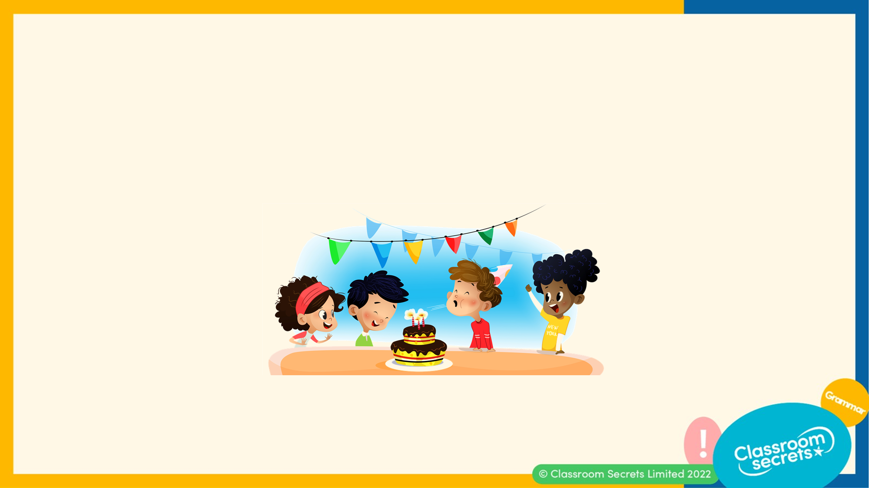
We have seen sentences in different forms and in different ways.
For example:
A. Daniel blew out the candles on his birthday cake.
B. Daniel blew out the candles on his birthday cake. His friends were really excited to eat his delicious chocolate cake.
What do you notice about the two examples?

Slide 9
We can see that example B extends example A with another sentence. It is part of the same theme as it is describing the image, but it tells us more about the picture we are describing.
Daniel blew out the candles on his birthday cake. His friends were really excited to eat his delicious chocolate cake.
We can continue to add more sentences about the image, as shown below:
Daniel blew out the candles on his birthday cake. His friends were really excited to eat his delicious chocolate cake. Daniel’s mum worked really hard on his birthday party. She made all of his favourite snacks and spent all evening make his cake. Daniel had the best day ever and was so grateful to have his friends by his side.

Slide 10
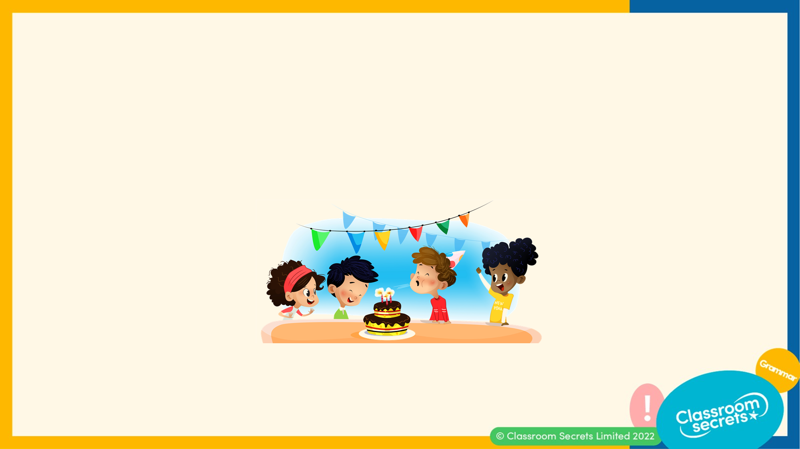
The passage below is linked to the same theme. Therefore, we can write the sentences one after the other. They are arranged in a particular order as they explain when and how things happen.
Daniel blew out the candles on his birthday cake. His friends were really excited to eat his delicious chocolate cake. Daniel’s mum worked really hard on his birthday party, she made all of his favourite snacks and spent all evening make his cake. Daniel had the best day ever and was so grateful to have his friends by his side.
If the sentences were rearranged, would the passage still make sense?

Slide 11
If the passage was rearranged as shown below, it would not make sense because the events aren’t continuous or in order.
His friends were really excited to eat his delicious chocolate cake. Daniel had the best day ever and was so grateful to have his friends by his side. She made all of his favourite snacks and spent all evening make his cake. Daniel blew out the candles on his birthday cake. Daniel’s mum worked really hard on his birthday party.
The order of the passage is incorrect because it starts with ‘His friends’ but we do not know who the text is referring to. Therefore, when writing a passage of text about a theme we should consider describing the characters, setting and events in order.

Slide 12
Read the passage below.
Kevin has been a farmer for over 14 years. He thoroughly enjoys his job. He has learnt many farming techniques from his father and grandfather. Various different vegetables grow and animals live on his farm.
Continue this passage by writing another sentence.

Slide 13
There are various sentences we could add. An example is shown below.
Kevin has been a farmer for over 14 years. He thoroughly enjoys his job. He has learnt many farming techniques from his father and grandfather. Various different vegetables grow and animals live on his farm. As part of his weekly check, he noticed his potatoes were fully grown. Therefore, he used these and the vegetables in his basket to make a delicious, healthy soup.

Slide 14
We can add sentences to a passage whilst ensuring the information is relevant.
The abandoned island was a hidden treasure. Located in the heart of the Caribbean, this island was filled with many elements of peace. From the soft, grainy sand to the tall, thin palm trees, it was a piece of heaven on earth.
A. Unfortunately, this land was known to many due to the lack of internet connection.
B. Unfortunately, many people were unaware of this land because it was surrounded by a litter of kittens.
C. Unfortunately, this exotic island was often visited by vicious pirates who would frighten visitors away.
What is the most suitable sentence that can be added to the passage?

Slide 15
Sentence C is the most suitable sentence because we can see the pirate ship in the image and it supports the existing text.
The abandoned island was a hidden treasure. Located in the heart of the Caribbean, this island was filled with many elements of peace. From the soft, grainy sand to the tall, thin palm trees, it was a piece of heaven on earth.
A. Unfortunately, this land was known to many due to the lack of internet connection.
B. Unfortunately, many people were unaware of this land because it was surrounded by a litter of kittens.
C. Unfortunately, this exotic island was often visited by vicious pirates who would frighten visitors away.

Slide 16
The sentences below describe the image but they are in the wrong order. Sequence them so that the text makes sense.
A. It is estimated that their work will continue till the summer of next year.
B. In February, Skitter’s Construction were contracted to build a hospital in Cotnar village.
C. Nonetheless, they cannot rush the process because it’s no ordinary project, but rather a state-of-the-art assignment.
D. However, the builders are making good process as they are ahead of their schedule.

Slide 17
The sentences below describe the image. Order them in the correct order.
In February, Skitter’s Construction were contracted to build a hospital in Cotnar village. It is estimated that their work will continue till the summer of next year. However, the builders are making good process as they are ahead of their schedule. Nonetheless, they cannot rush the process because it’s no ordinary project, but rather a state-of-the-art assignment.

Slide 18
Swap the sentences to ensure the passage is written in the correct order.
This alarmed Blaze the dragon and he instantly flew towards the old building. On a bright, cloudy morning, the trees rustled as the wind swept briskly through the hillside. Suddenly, a deafening scream came from the grey, stoned castle. Flying in circles within the air, he assessed the situation for danger, before make a quiet landing on the soft, green surface.

Slide 19
Swap the sentences to ensure the passage is written in the correct order.
On a bright, cloudy morning, the trees rustled as the wind swept briskly through the hillside. Suddenly, a deafening scream came from the grey, stoned castle. This alarmed Blaze the dragon and he instantly flew towards the old building. Flying in circles within the air, he assessed the situation for danger, before make a quiet landing on the soft, green surface.
These are the two sentences we must swap to make the passage read in the correct order.

Slide 20
Rearrange the sentences in the correct order to create a passage.
After that long, tiring walk through the forest, Elliot was exhausted.
His backpack was extremely heavy which caused him to walk slower than normal.
He hoped the light shining through the trees was a sign that he was near his meeting point.
Elliot had agreed to meet his friends at the other side of the forest to go camping.

Slide 21
Rearrange the sentences in the correct order to create a passage.
Elliot had agreed to meet his friends at the other side of the forest to go camping. His backpack was extremely heavy which caused him to walk slower than normal. He hoped the light shining through the trees was a sign that he was near his meeting point. After that long, tiring walk through the forest, Elliot was exhausted.

Slide 22
Group the sentences under the suitable heading and in the correct order.
At the circus
At the museum
They were welcomed by a herd of elephants as they entered the big top tent.
Year 3 were going to the circus for their end of year trip.
On the bus, the children were discussing how excited they were to see the dinosaur bones.
They were all very excited to see the different animals and acts of the show.
Year 3 and Mrs. Solomon were welcomed by the friendly tour guide.
Year 3 were going to the museum for their end of year trip.

Slide 23
Group the sentences under the suitable heading and in the correct order.
At the circus
Year 3 were going to the circus for their end of year trip. They were all very excited to see the different animals and acts of the show. They were welcomed by a herd of elephants as they entered the big top tent.
At the museum
Year 3 were going to the museum for their end of year trip. On the bus, the children were discussing how excited they are about seeing the dinosaur bones. Year 3 and Mrs. Solomon were welcomed by the friendly tour guide.
The sentences should be grouped and ordered as shown below.

Slide 24
Now that we can confidently sequence sentences, let’s apply our learning to some reasoning and application questions.

Slide 25
Reena thinks she has ordered her passage correctly.
Find and explain the mistakes with her passage. Correct any mistakes.
On Saturday morning, Hannah was preparing to bake a lemon drizzle cake. Then, she cleaned the dirty dishes and made the tangy topping. After making the batter, she scooped the mixture into a cake tin and placed it in the oven to bake. She took out her equipment and ingredients from her cupboards.

Slide 26
Reena thinks she has ordered her passage correctly.
Find and explain the mistakes with her passage. Correct any mistakes.
Reena has made mistakes with the second and last sentence. She has ordered the sentences incorrectly as the passage should be written as shown below: On Saturday morning, Hannah was preparing to bake a lemon drizzle cake. She took out her equipment and ingredients from her cupboards. After making the batter, she scooped the mixture in a cake tin and placed it in the oven to bake. Then, she cleaned the dirty dishes and made the tangy topping.
On Saturday morning, Hannah was preparing to bake a lemon drizzle cake. Then, she cleaned the dirty dishes and made the tangy topping. After making the batter, she scooped the mixture into a cake tin and placed it in the oven to bake. She took out her equipment and ingredients from her cupboards.

Slide 27
Write a short passage with at least 3 sentences of an event that has taken place today. You can use the word prompts below.
This morning
During playtime
When I woke up
For breakfast
This afternoon
In our first lesson today

Slide 28
Write a short passage with at least 3 sentences of an event that has taken place today. You can use the word prompts below.
Various answers, for example:
This morning, the sun was shining brightly through my curtains. That instantly put me in a great mood. After brushing my teeth and getting changed, I skipped happily down the stairs. For breakfast, I ate a bowl of porridge and drank a glass of tropical juice. With my P.E. kit in my hand and a wave to my mum, I was ready to start my school day.
This morning
During playtime
When I woke up
For breakfast
This afternoon
In our first lesson today

Slide 29
You’re ready to progress!
Now apply your learning by trying some questions.

Slide 30
Tick the box to show where the sentence below could fit.
At the end of the lesson, the teacher explained that they would be having a test tomorrow afternoon. This would show the teacher what they had learnt so far that term. Then, he sent the children to collect their bags before going home.
They would have to describe the process of the water cycle accurately.
Varied Fluency 1

Slide 31
Tick the box to show where the sentence below could fit.
At the end of the lesson, the teacher explained that they would be having a test tomorrow afternoon. This would show the teacher what they had learnt so far that term. Then, he sent the children to collect their bags before going home.
They would have to describe the process of the water cycle accurately.
✓
Varied Fluency 1

Slide 32
True or false? You could change the order of some of these sentences and the passage would make sense.
Then the rain began to fall heavily and didn’t show any signs of stopping.
Never before had the river risen as much as it did that day.
It had started off as a beautiful sunny morning.
Varied Fluency 2

Slide 33
True or false? You could change the order of some of these sentences and the passage would make sense.
Then the rain began to fall heavily and didn’t show any signs of stopping.
Never before had the river risen as much as it did that day.
It had started off as a beautiful sunny morning.
True, for example:
It had started off as a beautiful sunny morning. Then the rain began to fall heavily and didn’t show any signs of stopping. Never before had the river risen as much as it did that day.
Varied Fluency 2

Slide 34
Number the sentences in the correct order.
Perhaps it was the sound of the music or the sun shining that had put him in a good mood.
Today, however, was different and he remained cheerful all day.
First thing in the morning, he was normally an extremely grumpy person.
Varied Fluency 3

Slide 35
Number the sentences in the correct order.
Perhaps it was the sound of the music or the sun shining that had put him in a good mood.
Today, however, was different and he remained cheerful all day.
First thing in the morning, he was normally an extremely grumpy person.
3
2
1
Varied Fluency 3

Slide 36
Replace the underlined sentence with an alternative sentence that would also make sense.
She went into the stationery shop and was sure to be in there for over two hours. She bought a calendar, an address book and found exercise books in three different designs. There were some special pens and other accessories that also caught her eye.
Application 1

Slide 37
Replace the underlined sentence with an alternative sentence that would also make sense.
Various answers, for example:
She went into the stationery shop and was sure to be in there for over two hours. She bought a calendar, an address book and found exercise books in three different designs. She bought the books to add to her collection which was growing rapidly!
Application 1

Slide 38
Amelia has written some sentences below.
Are the sentences written in a logical order? Explain your answer fully.
 | It was tatty and torn and looked like it had travelled a long way. The envelope arrived with a strange address written on it. Looking at it further, this had somehow been sent to another country and had luckily been forwarded on!
Reasoning 1

Slide 39
Amelia has written some sentences below.
Are the sentences written in a logical order? Explain your answer fully.
No because...
 | It was tatty and torn and looked like it had travelled a long way. The envelope arrived with a strange address written on it. Looking at it further, this had somehow been sent to another country and had luckily been forwarded on!
Reasoning 1

Slide 40
Amelia has written some sentences below.
Are the sentences written in a logical order? Explain your answer fully.
No because it would make more sense to start with the sentence ‘The envelope arrived....’ so that it is clear what ‘it’ is referring to in the sentence ‘It was tatty and torn…’
 | It was tatty and torn and looked like it had travelled a long way. The envelope arrived with a strange address written on it. Looking at it further, this had somehow been sent to another country and had luckily been forwarded on!
Reasoning 1

Slide 41
Rewrite the passage below with the sentences in a different order so that it makes sense.
He prefers to work on his own rather than in a group so that he doesn’t have to share the tasks. I’ve made him promise that next time he will work with others. His favourite subject is science and he loves to do all the practical experiments.
Application 2

Slide 42
Rewrite the passage below with the sentences in a different order so that it makes sense.
He prefers to work on his own rather than in a group so that he doesn’t have to share the tasks. I’ve made him promise that next time he will work with others. His favourite subject is science and he loves to do all the practical experiments.
Example answer:
His favourite subject is science and he loves to do all the practical experiments. He prefers to work on his own rather than in a group so that he doesn’t have to share the tasks. I’ve made him promise that next time he will work with others.
Application 2

