Slide 1
LIFE/work balance
We have started a #LIFEworkbalance campaign and we need your help to complete our LIFE/work balance survey.
We hope to publish the results soon, so please give 15 minutes of your time to help us get a true picture of school life.
Want to be a part of this campaign? Take the survey on our website and share it with your colleagues!
© Classroom Secrets Limited 2019

Slide 2
Year 3 – Summer Block 4 – What is a Prefix?
About This Resource:
This PowerPoint has been designed to support your teaching of this small step. It includes a starter activity and an example of each question from the Varied Fluency and Application and Reasoning resources also provided in this pack. You can choose to work through all examples provided or a selection of them depending on the needs of your class.
National Curriculum Objectives:
English Year 3: (3G6.2) Formation of nouns using a range of prefixes [for example super–, anti–, auto–]
Spelling: Spell more prefixes
Terminology for pupils:
(3G6.2) prefix
More resources from our Grammar, Punctuation and Spelling scheme of work.
Did you like this resource? Don’t forget to review it on our website.
© Classroom Secrets Limited 2019

Slide 3
Year 3 – Summer Block 4 – What is a Prefix?
Notes and Guidance:
This step is optional as it is primarily a recap of a previous step covered in Year 1.
The prefix ‘un-’ was studied in Year 1, so children should be familiar with prefixes and their function.
Children should recap that prefixes are added to the start of words, which changes the meaning of the word it belongs to.
When a prefix is added to a root word, the root word stays the same and only the meaning is changed, for example, ‘kind’ takes on the opposite meaning when the prefix ‘un-’ (meaning “not”) is added, creating the word ‘unkind’.
This step should provide the opportunity to recap and revise the addition of the prefix ‘un’ to root words and children should be able to recognise that this prefix changes the meaning from a positive to a negative meaning. Children should be able to use words with this prefix in their writing.
Focused Questions:
Rewrite the following words adding the prefix ‘un’.
Complete the sentence by removing ‘un-’ from the given word.
What happens to the meaning of the word in the following sentence when the prefix ‘un-’ is added/removed?
Which words could or could not have their meaning changed by adding the prefix ‘un-’?
© Classroom Secrets Limited 2019

Slide 4
Year 3 – Summer Block 4 – What is a Prefix?
Step 1: What is a Prefix?
© Classroom Secrets Limited 2019

Slide 5
Introduction
Which words can combine with the prefix ‘un’ to create a new word?
Will they all work?
agree
easy
heard
help
load
fine
watch
honest
eaten
appear
© Classroom Secrets Limited 2019

Slide 6
Introduction
Which words can combine with the prefix ‘un’ to create a new word?
Will they all work?
agree
uneasy
unheard
help
unload
fine
watch
honest
uneaten
appear
© Classroom Secrets Limited 2019

Slide 7
Varied Fluency 1
Which sentence cannot have the word ‘unopened’ added to it?
The letter was returned to us _______________________ .
The _______________________ box was left on the shelf.
The package came today but it was already _______________________ .
© Classroom Secrets Limited 2019

Slide 8
Varied Fluency 1
Which sentence cannot have the word ‘unopened’ added to it?
The letter was returned to us _______________________ .
The _______________________ box was left on the shelf.
The package came today but it was already _______________________ .
© Classroom Secrets Limited 2019

Slide 9
Varied Fluency 2
Tick the box below to show which word should include the prefix ‘un’.
After spending hours on it, Finn was still able to solve the
puzzle, despite Tommy and Arthur helping him.
© Classroom Secrets Limited 2019

Slide 10
Varied Fluency 2
Tick the box below to show which word should include the prefix ‘un’.
After spending hours on it, Finn was still able to solve the
puzzle, despite Tommy and Arthur helping him.
✓
© Classroom Secrets Limited 2019

Slide 11
Varied Fluency 3
Circle the word which cannot be changed with the prefix ‘un’.
marked
appear
stable
© Classroom Secrets Limited 2019

Slide 12
Varied Fluency 3
Circle the word which cannot be changed with the prefix ‘un’.
unmarked
appear
unstable
© Classroom Secrets Limited 2019

Slide 13
Varied Fluency 4
Add the prefix ‘un’ to the words below and choose one to complete the sentence below.
After the knight was defeated in the battle, he
was seen as being ______________.
steady
approved
worthy
© Classroom Secrets Limited 2019

Slide 14
Varied Fluency 4
Add the prefix ‘un’ to the words below and choose one to complete the sentence below.
After the knight was defeated in the battle, he
was seen as being ______________.
unworthy
unsteady
unapproved
unworthy
© Classroom Secrets Limited 2019

Slide 15
Application 1
Look at the words below.
Write two sentences using each word in a sentence.
cooked
uncooked
© Classroom Secrets Limited 2019

Slide 16
Application 1
Look at the words below.
Write two sentences using each word in a sentence.
Various answers, for example:
Mum always says that a cooked meal is best.
It is dangerous to eat uncooked chicken.
cooked
uncooked
© Classroom Secrets Limited 2019

Slide 17
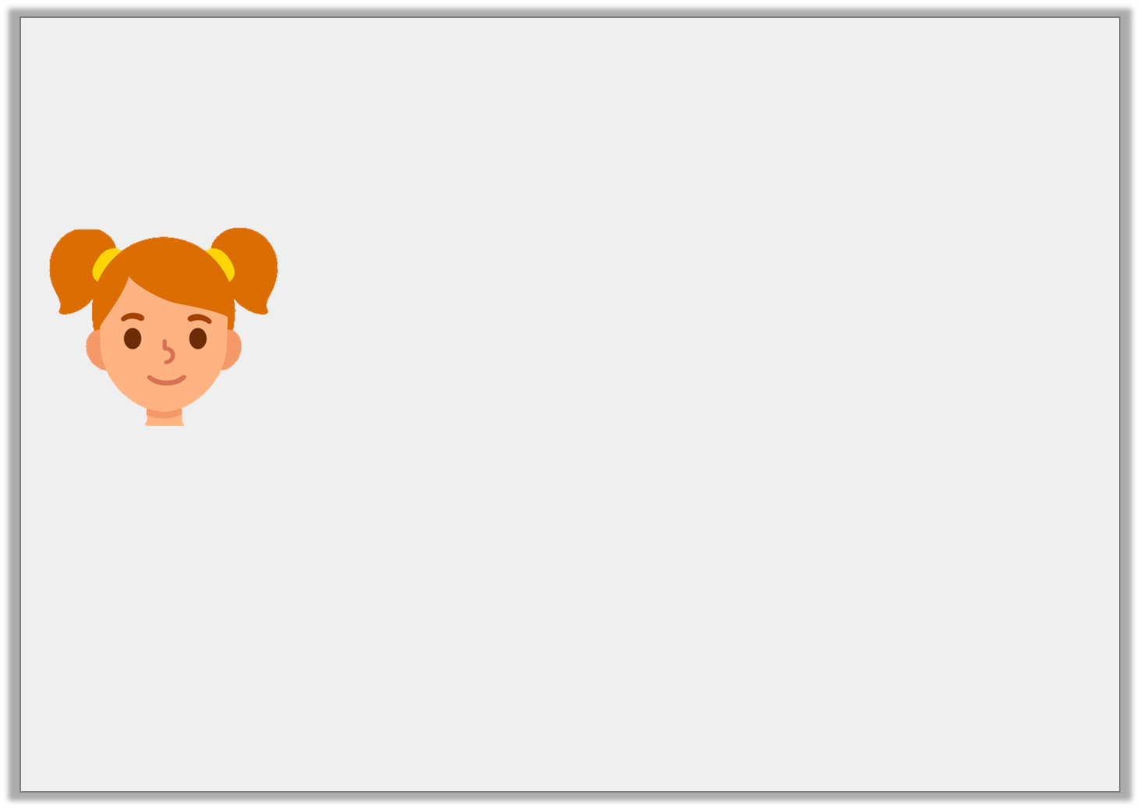
Reasoning 1
True or false?
Convince me.
The word ‘uncaring’ can only be used to describe someone or something in a bad way.
© Classroom Secrets Limited 2019

Slide 18
Reasoning 1
True or false?
Convince me.
False because…
The word ‘uncaring’ can only be used to describe someone or something in a bad way.
© Classroom Secrets Limited 2019

Slide 19
Reasoning 1
True or false?
Convince me.
False because in the sentence ‘She was always a thoughtful girl and was never uncaring towards others’, the girl is described in a positive way.
The word ‘uncaring’ can only be used to describe someone or something in a bad way.
© Classroom Secrets Limited 2019

Slide 20
Reasoning 2
Both of these words with the prefix ‘un-’ can be used to complete the sentence below.
Nico and Emilia bought another pet, but it ended up
being ______________ just like the last few.
Do you agree?
Explain your answer.
wanted
loved
© Classroom Secrets Limited 2019

Slide 21
Reasoning 2
Both of these words with the prefix ‘un-’ can be used to complete the sentence below.
Nico and Emilia bought another pet, but it ended up
being ______________ just like the last few.
Do you agree?
Explain your answer.
I agree because adding the prefix ‘un’ will…
wanted
loved
© Classroom Secrets Limited 2019

Slide 22
Reasoning 2
Both of these words with the prefix ‘un-’ can be used to complete the sentence below.
Nico and Emilia bought another pet, but it ended up
being ______________ just like the last few.
Do you agree?
Explain your answer.
I agree because adding the prefix ‘un’ will change the words into ‘unwanted’ and ‘unloved’. Things can be unwanted or unloved so the sentence makes sense.
wanted
loved
© Classroom Secrets Limited 2019

