Slide 1
Year 4 – Spring Block 4 – Suffixes – Word Families
About This Resource:
This PowerPoint has been designed to support your teaching of this small step. It includes a starter activity and an example of each question from the Varied Fluency and Application and Reasoning resources also provided in this pack. You can choose to work through all examples provided or a selection of them depending on the needs of your class.
National Curriculum Objectives:
English Year 4: (3G6.4) Word families based on common words, showing how words are related in form and meaning [for example, solve, solution, solver, dissolve, insoluble]
More resources from our Grammar, Punctuation and Spelling scheme of work.
Did you like this resource? Don’t forget to review it on our website.
© Classroom Secrets Limited 2019

Slide 2
Year 4 – Spring Block 4 – Suffixes – Word Families
Notes and Guidance:
Word families are common words which share the same root word and are related in form and meaning.
Most children should be familiar with word families from Year 3, and be able to recognise known suffixes and identify the root word.
Children should also be able to use root words and definitions of known suffixes to help them work out the meaning of words within word families.
In this step, children will revisit how to identify root words, in addition to recognising and using word families.
Focused Questions:
Identify the root word in each of the word families below.
Explain the meaning of the root word when a particular prefix or suffix is added.
© Classroom Secrets Limited 2019

Slide 3
Year 4 – Spring Block 4 – Suffixes
Step 1: Word Families
© Classroom Secrets Limited 2019

Slide 4
Introduction
Look at the words below.
Which root word do they all contain?
helpful
helped
helpless
helping
helps
helper
© Classroom Secrets Limited 2019

Slide 5
Introduction
Look at the words below.
Which root word do they all contain?
The root word is help.
helpful
helped
helpless
helping
helps
helper
© Classroom Secrets Limited 2019

Slide 6
Varied Fluency 1
Use the words below to complete the following sentences.
There was _____________________ of time to browse the books in the school library.
Turtles and tortoises are _____________________ on the coast.
plentiful
plenty
© Classroom Secrets Limited 2019

Slide 7
Varied Fluency 1
Use the words below to complete the following sentences.
There was _____________________ of time to browse the books in the school library.
Turtles and tortoises are _____________________ on the coast.
plenty
plentiful
plentiful
plenty
© Classroom Secrets Limited 2019

Slide 8
Varied Fluency 2
True or false?
Agree, agreement and agreeing belong to the same word family.
© Classroom Secrets Limited 2019

Slide 9
Varied Fluency 2
True or false?
Agree, agreement and agreeing belong to the same word family.
True
© Classroom Secrets Limited 2019

Slide 10
Varied Fluency 3
What does the root word dance mean in the word family below?
 | dancing |  | dancer |  | danced
sing
move
spin
© Classroom Secrets Limited 2019

Slide 11
Varied Fluency 3
What does the root word dance mean in the word family below?
 | dancing |  | dancer |  | danced
sing
move | ✓
spin
© Classroom Secrets Limited 2019

Slide 12
Varied Fluency 4
Tick the suffixes that can be used with the root words below to make a new word.
root word | -ful | -er
delight
supply
duty
happy
© Classroom Secrets Limited 2019

Slide 13
Varied Fluency 4
Tick the suffixes that can be used with the root words below to make a new word.
root word | -ful | -er
delight | ✓
supply |  | ✓
duty | ✓
happy |  | ✓
© Classroom Secrets Limited 2019

Slide 14
Reasoning 1
Jacob has written two sentences below.
Your donations will go to a worthy cause.
The old bank notes were worthless as they had been taken out of circulation.
Explain how the suffix has changed the meaning of the root word in each sentence.
© Classroom Secrets Limited 2019

Slide 15
Reasoning 1
Jacob has written two sentences below.
Your donations will go to a worthy cause.
The old bank notes were worthless as they had been taken out of circulation.
Explain how the suffix has changed the meaning of the root word in each sentence.
‘Worthy’ is an adjective which means …
‘Worthless’ is adjective which means…
© Classroom Secrets Limited 2019

Slide 16
Reasoning 1
Jacob has written two sentences below.
Your donations will go to a worthy cause.
The old bank notes were worthless as they had been taken out of circulation.
Explain how the suffix has changed the meaning of the root word in each sentence.
‘Worthy’ is an adjective which means having the qualities that deserve regard.
‘Worthless’ is adjective which means of no value.
© Classroom Secrets Limited 2019

Slide 17
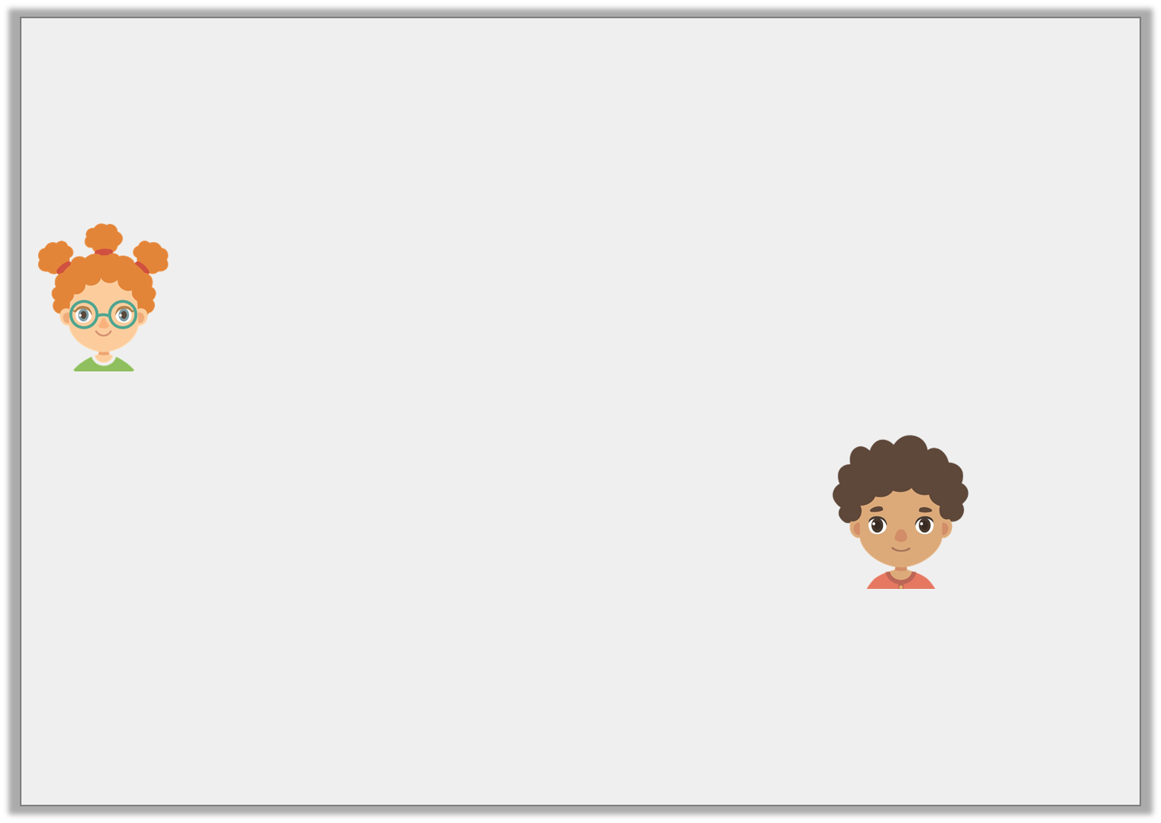
Reasoning 2
Philippa and Joel are talking about the word ‘hope’.
Philippa says,
Joel says,
Who is correct? Explain your answer.
You can add the suffixes ‘-ment’ and ‘-ly’ to this root word.
You can add the suffixes ‘-less’ and ‘-ful’ to this root word.
© Classroom Secrets Limited 2019

Slide 18
Reasoning 2
Philippa and Joel are talking about the word ‘hope’.
Philippa says,
Joel says,
Who is correct? Explain your answer.
Joel is correct because…
You can add the suffixes ‘-ment’ and ‘-ly’ to this root word.
You can add the suffixes ‘-less’ and ‘-ful’ to this root word.
© Classroom Secrets Limited 2019

Slide 19
Reasoning 2
Philippa and Joel are talking about the word ‘hope’.
Philippa says,
Joel says,
Who is correct? Explain your answer.
Joel is correct because ‘-less’ and ‘-ful’ can be added to the ‘hope’ family to form hopeless and hopeful.
You can add the suffixes ‘-ment’ and ‘-ly’ to this root word.
You can add the suffixes ‘-less’ and ‘-ful’ to this root word.
© Classroom Secrets Limited 2019

Slide 20
Application 1
Using the suggested suffixes below, create 3 new words for each root word by adding different suffixes.
manage
cheer
-ment
-less
-ing
-ful
-er
-y
© Classroom Secrets Limited 2019

Slide 21
Application 1
Using the suggested suffixes below, create 3 new words for each root word by adding different suffixes.
manage – management, manager and managing
cheer – cheerful, cheery, cheerless, cheering
manage
cheer
-ment
-less
-ing
-ful
-er
-y
© Classroom Secrets Limited 2019

