Slide 1
We have started a #LIFEworkbalance campaign and we need your help to complete our LIFE/work balance survey.
We hope to publish the results soon, so please give 15 minutes of your time to help us get a true picture of school life.
Want to be a part of this campaign? Take the survey on our website and share it with your colleagues!
© Classroom Secrets Limited 2019

Slide 2
Year 4 – Summer Block 1 – Standard English – ‘Were’ or ‘Was’ and ‘Did’ or ‘Done’
About This Resource:
This PowerPoint has been designed to support your teaching of this small step. It includes a starter activity and an example of each question from the Varied Fluency and Application and Reasoning resources also provided in this pack. You can choose to work through all examples provided or a selection of them depending on the needs of your class.
National Curriculum Objectives:
English Year 4: (4G7.1) Standard English forms for verb inflections instead of local spoken forms [for example, we were instead of we was, or I did instead of I done]
More resources from our Grammar, Punctuation and Spelling scheme of work.
Did you like this resource? Don’t forget to review it on our website.
© Classroom Secrets Limited 2019

Slide 3
Year 4 – Summer Block 1 – Standard English – ‘Were’ or ‘Was’ and ‘Did’ or ‘Done’
Notes and Guidance:
Standard English is the form of the English language that is nationally accepted as the usual correct form and does not use any slang. There is, however, some grammatical variation according to regional dialects.
In this step, comparisons will be made between the use of the words were and was, and did or done.
Were and was are the two simple past forms of the verb ‘to be’. Was is used for singular (I/he/she/it was), and were is used for plural (we/you/they were). The second person singular is an exception which uses were.
Did is the simple past form of the verb ‘to do’ (for example, I did my homework), whereas done is the past participle of the verb ‘to do’ which is used to create the perfect form of tenses (for example, I have done my homework in the present perfect tense).
Children will identify when these words have been used correctly, in addition to recognising the difference between standard and non-standard English.
Children will be able to write sentences using the appropriate words in different standard English sentences.
Focused Questions
Which word is correct in the sentence below, were or was/did or done?
Is this sentence written in standard English? How do you know?
Add the correct word to the sentence so that it becomes standard English.
Insert the correct word in the standard English sentence below.
© Classroom Secrets Limited 2019

Slide 4
Year 4 – Summer Block 1 – Standard English
Step 1: ‘Were’ or ‘Was’ and ‘Did’ or ‘Done’
© Classroom Secrets Limited 2019

Slide 5
Introduction
Tick the sentences below that make sense.
Stanley forgot his pencil case so I borrowed him my ruler.
Jessica goes horse-riding every Saturday morning.
Sharnia is going swimming later, unless she forget her kit.
Ethan wants a new bike for his birthday in April.
© Classroom Secrets Limited 2019

Slide 6
Introduction
Tick the sentences below that make sense.
Stanley forgot his pencil case so I borrowed him my ruler.
Jessica goes horse-riding every Saturday morning.
Sharnia is going swimming later, unless she forget her kit.
Ethan wants a new bike for his birthday in April.
✓
✓
© Classroom Secrets Limited 2019

Slide 7
Varied Fluency 1
Underline the correct form of the verbs in the passage below.
The children who did/done want to make a fruit salad watched carefully to see how it were/was made.
© Classroom Secrets Limited 2019

Slide 8
Varied Fluency 1
Underline the correct form of the verbs in the passage below.
The children who did/done want to make a fruit salad watched carefully to see how it were/was made.
The children who did want to make a fruit salad watched carefully to see how it was made.
© Classroom Secrets Limited 2019

Slide 9
Varied Fluency 2
True or false? The sentence below is written in Standard English.
The medicine were horrible. It tasted like rotten bananas in a bottle.
© Classroom Secrets Limited 2019

Slide 10
Varied Fluency 2
True or false? The sentence below is written in Standard English.
The medicine were horrible. It tasted like rotten bananas in a bottle.
False. The medicine was horrible.
© Classroom Secrets Limited 2019

Slide 11
Varied Fluency 3
Complete the sentence below with the correct past tense forms of the verbs ‘to be’ or ‘to do’.
I promised that I had ________ my exercises before I watched television, but I __________ made to do them again anyway.
© Classroom Secrets Limited 2019

Slide 12
Varied Fluency 3
Complete the sentence below with the correct past tense forms of the verbs ‘to be’ or ‘to do’.
I promised that I had done my exercises before I watched television, but I was made to do them again anyway.
© Classroom Secrets Limited 2019

Slide 13
Varied Fluency 4
Sort the sentences below into the correct columns.
The town library was very busy.
Frank told me the job were done.
I can’t image how you done it!
They had did what they were told.
Can I mention what I did next?
Standard English | Non-standard English
© Classroom Secrets Limited 2019

Slide 14
Varied Fluency 4
Sort the sentences below into the correct columns.
The town library was very busy.
Frank told me the job were done.
I can’t image how you done it!
They had did what they were told.
Can I mention what I did next?
Standard English | Non-standard English
A, E | B, C, D
© Classroom Secrets Limited 2019

Slide 15
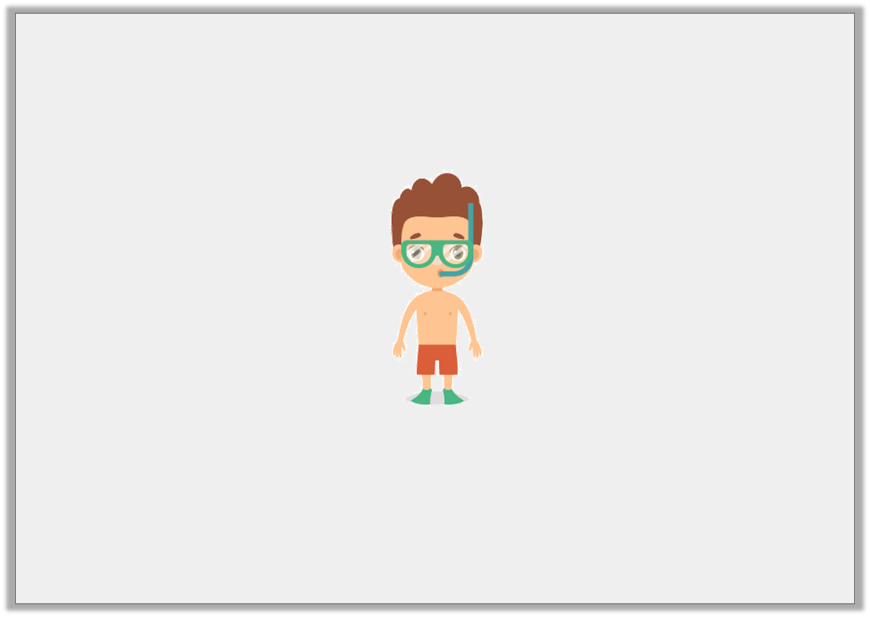
Application 1
Steve is going snorkelling. Write a sentence to describe the picture below using the correct past tense form of the verb ‘to be’.
Your sentence must include a fronted adverbial.
© Classroom Secrets Limited 2019

Slide 16
Application 1
Steve is going snorkelling. Write a sentence to describe the picture below using the correct past tense form of the verb ‘to be’.
Your sentence must include a fronted adverbial.
Various possible answers, for example:
All day long, Steve’s group were snorkelling around the whole island watching the sea creatures.
© Classroom Secrets Limited 2019

Slide 17
Reasoning 1
Min has written a sentence below.
Has she used Standard English? Explain how you know.
 | I were making a birthday card for my favourite
 | friend using glitter and feathers. It was very messy!
© Classroom Secrets Limited 2019

Slide 18
Reasoning 1
Min has written a sentence below.
Has she used Standard English? Explain how you know.
Min has not used Standard English because…
 | I were making a birthday card for my favourite
 | friend using glitter and feathers. It was very messy!
© Classroom Secrets Limited 2019

Slide 19
Reasoning 1
Min has written a sentence below.
Has she used Standard English? Explain how you know.
Min has not used Standard English because she is talking about herself using ‘I’ so she should have used ‘was’.
 | I were making a birthday card for my favourite
 | friend using glitter and feathers. It was very messy!
© Classroom Secrets Limited 2019

Slide 20
Application 2
Frank has written a story but he has made some errors.
It were late at night when the sleek black cat crept out of the house and set off on its regular walk. He slinked along the wall, same as he done every night, and made his way to down to the fishing boats.
Rewrite the text so that it is written in Standard English.
© Classroom Secrets Limited 2019

Slide 21
Application 2
Frank has written a story but he has made some errors.
It were late at night when the sleek black cat crept out of the house and set off on its regular walk. He slinked along the wall, same as he done every night, and made his way to down to the fishing boats.
Rewrite the text so that it is written in Standard English.
It was late at night when the sleek black cat crept out of the house and set off on its regular walk. He slinked along the wall, same as he did every night, and made his way to down to the fishing boats.
© Classroom Secrets Limited 2019

