Slide 1
Year 5 – Spring Block 1 – Parenthesis – Recognising Parenthesis
About This Resource:
This PowerPoint has been designed to support your teaching of this small step. It includes a starter activity and an example of each question from the Varied Fluency and Application and Reasoning resources also provided in this pack. You can choose to work through all examples provided or a selection of them depending on the needs of your class.
National Curriculum Objectives:
English Year 5: (5G5.9) Using brackets, dashes or commas to indicate parenthesis​
Terminology for pupils:​
English Year 5: (5G5.9) parenthesis​
English Year 5: (5G5.9) bracket​
English Year 5: (5G5.9) dash​
More resources from our Grammar, Punctuation and Spelling scheme of work.
Did you like this resource? Don’t forget to review it on our website.
© Classroom Secrets Limited 2018

Slide 2
Year 5 – Spring Block 1 – Parenthesis – Recognising Parenthesis
Notes and Guidance
This step introduces the term parenthesis. Children may have seen examples of parenthesis within texts already covered in class, but may not know the grammatical term for this.
Parenthesis can be demarcated using brackets, dashes or commas and can be positioned mid-sentence or at the end of a sentence as an afterthought. It is used to add non-essential, extra information into a sentence which is otherwise grammatically correct.
Parenthesis which is positioned mid-sentence can be punctuated with a pair of brackets, a pair of dashes or a pair of commas.
Parenthesis which is positioned at the end of a sentence can be punctuated by a pair of brackets, or a single dash or comma.
If brackets are used at the end of a sentence, the punctuation mark to end the sentence must come after the closing bracket.
Examples of parenthesis being used include: Millie – my friend – is coming over for dinner. Jack, who is my neighbour, has a dog. On Tuesday, I will be going to football (unless I get detention).
Focused Questions
Highlight parenthesis in this sentence.
What punctuation can be used to demarcate parenthesis?
Where in the sentence can parenthesis be positioned?
© Classroom Secrets Limited 2018

Slide 3
Year 5 – Spring Block 1 – Parenthesis
Step 1: Recognising Parenthesis
© Classroom Secrets Limited 2018

Slide 4
Introduction
Which sentence below has used parenthesis correctly?
My grandad, who is eighty-four years old enjoys playing chess with his friends each Wednesday and likes to play golf at the weekend.
My grandad (who is eighty-four years old) enjoys playing chess with his friends each Wednesday and likes to play golf at the weekend.
© Classroom Secrets Limited 2018

Slide 5
Introduction
Which sentence below has used parenthesis correctly?
My grandad, who is eighty-four years old enjoys playing chess with his friends each Wednesday and likes to play golf at the weekend.
My grandad (who is eighty-four years old) enjoys playing chess with his friends each Wednesday and likes to play golf at the weekend.
© Classroom Secrets Limited 2018

Slide 6
Varied Fluency 1
Name the punctuation used for parenthesis in the following sentences.
My brother, who is older than me, will be eleven tomorrow and is having a bowling party.
My best friend – who I met at primary school – has just moved house as it was too far from her son’s school.
© Classroom Secrets Limited 2018

Slide 7
Varied Fluency 1
Name the punctuation used for parenthesis in the following sentences.
My brother, who is older than me, will be eleven tomorrow and is having a bowling party.
My best friend – who I met at primary school – has just moved house as it was too far from her son’s school.
A uses a pair of commas.
B uses a pair of dashes.
© Classroom Secrets Limited 2018

Slide 8
Varied Fluency 2
Circle the punctuation used for parenthesis in the sentence below.
My next-door neighbour, whose house is attached to ours, has a large tree in his back garden and his children love to climb it!
© Classroom Secrets Limited 2018

Slide 9
Varied Fluency 2
Circle the punctuation used for parenthesis in the sentence below.
My next-door neighbour, whose house is attached to ours, has a large tree in his back garden and his children love to climb it!
© Classroom Secrets Limited 2018

Slide 10
Varied Fluency 3
Underline the parenthesis in the sentence below.
On my birthday – 1st June – the weather is always sunny so we usually go to the park for a picnic.
© Classroom Secrets Limited 2018

Slide 11
Varied Fluency 3
Underline the parenthesis in the sentence below.
On my birthday – 1st June – the weather is always sunny so we usually go to the park for a picnic.
© Classroom Secrets Limited 2018

Slide 12
Varied Fluency 4
True or false? Commas are used correctly for parenthesis in the sentences below.
 | T | F
A. Although it was still dark, I went to the shop to buy some milk and bread for our breakfast.
B. My mum, who needed milk and bread, asked me to go to the shop because I was going to town anyway.
© Classroom Secrets Limited 2018

Slide 13
Varied Fluency 4
True or false? Commas are used correctly for parenthesis in the sentences below.
 | T | F
A. Although it was still dark, I went to the shop to buy some milk and bread for our breakfast. |  | ✓
B. My mum, who needed milk and bread, asked me to go to the shop because I was going to town anyway. | ✓
© Classroom Secrets Limited 2018

Slide 14
Application 1
Which of the following sentences use correct punctuation to show parenthesis?
A. There are three bookshelves at the back of our classroom and they are used for our home-school reading books.
B. There are three large bookshelves at the back of our classroom for us to take home to read – mystery books are our favourites.
C. The bookshelves (which are at the back of the classroom) are full of books since we all love reading.
© Classroom Secrets Limited 2018

Slide 15
Application 1
Which of the following sentences use correct punctuation to show parenthesis?
A. There are three bookshelves at the back of our classroom and they are used for our home-school reading books.
B. There are three large bookshelves at the back of our classroom for us to take home to read – mystery books are our favourites.
C. The bookshelves (which are at the back of the classroom) are full of books since we all love reading.
© Classroom Secrets Limited 2018

Slide 16
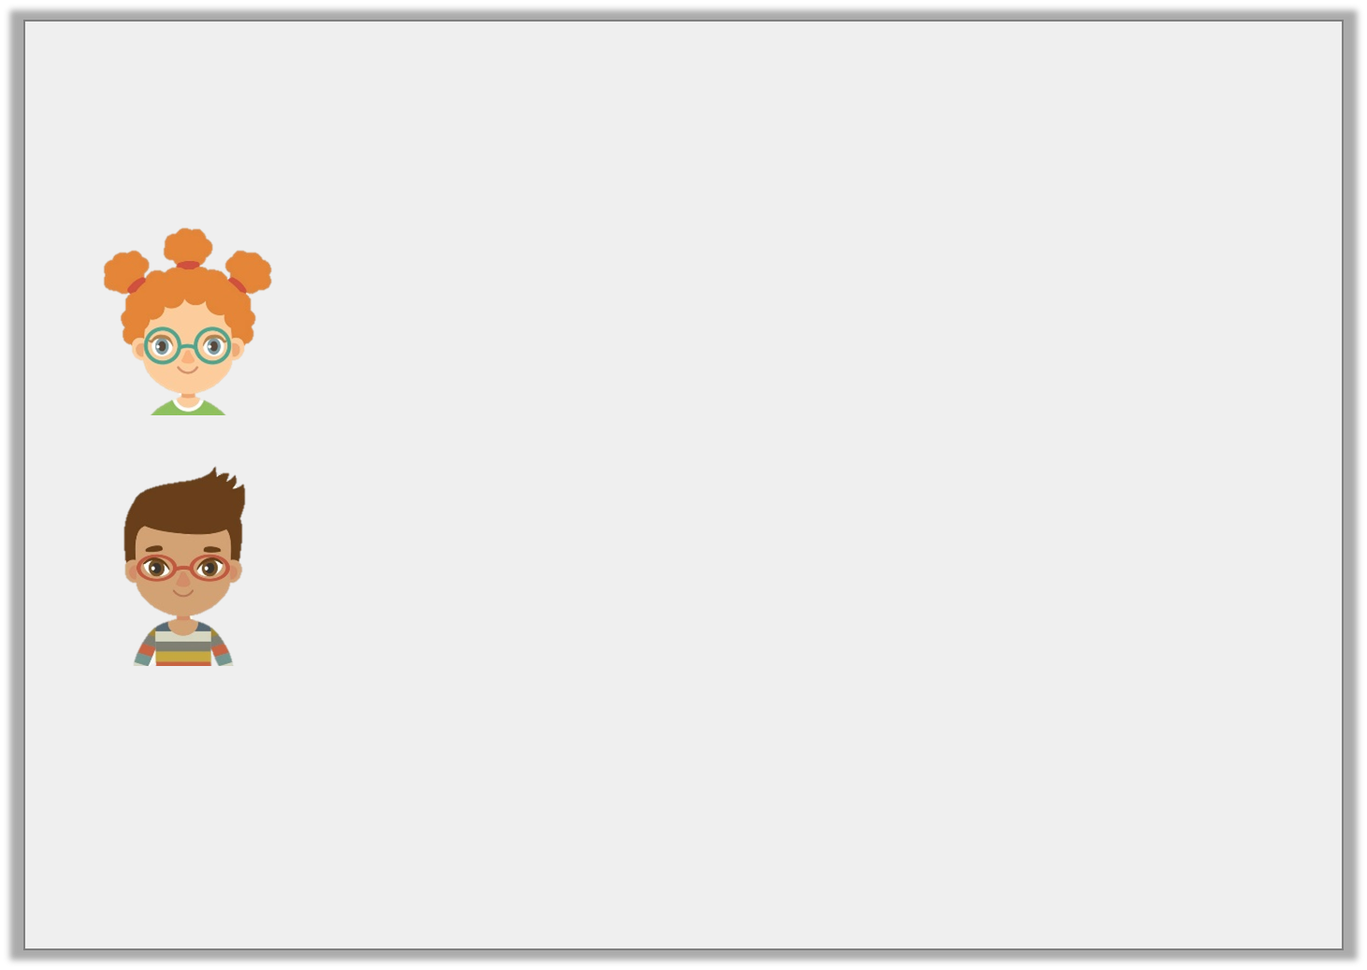
Reasoning 1
Sinead and Josh are using dashes to show parenthesis. Who has used punctuation correctly? Explain how you know.
She set off on her journey and headed towards the Caves of Doom – probably the most dangerous caves in the world!
Sinead
She set off – on her journey – towards the Caves of Doom which are probably the most dangerous caves in the world.
Josh
© Classroom Secrets Limited 2018

Slide 17
Reasoning 1
Sinead and Josh are using dashes to show parenthesis. Who has used punctuation correctly? Explain how you know.
Sinead has used punctuation to show parenthesis correctly because …
She set off on her journey and headed towards the Caves of Doom – probably the most dangerous caves in the world!
Sinead
She set off – on her journey – towards the Caves of Doom which are probably the most dangerous caves in the world.
Josh
© Classroom Secrets Limited 2018

Slide 18
Reasoning 1
Sinead and Josh are using dashes to show parenthesis. Who has used punctuation correctly? Explain how you know.
Sinead has used punctuation to show parenthesis correctly because she has used a single dash to mark the extra information. Josh has used a pair of dashes incorrectly because he has marked information that is needed as part of the main clause.
She set off on her journey and headed towards the Caves of Doom – probably the most dangerous caves in the world!
Sinead
She set off – on her journey – towards the Caves of Doom which are probably the most dangerous caves in the world.
Josh
© Classroom Secrets Limited 2018

Slide 19
Reasoning 2
Which sentence does not use punctuation for parenthesis? Tick one.
Explain how you know.
A. We went to the park yesterday, and then went to the café for our lunch.
B. We went to the park yesterday and also went to the café, where we had lunch.
© Classroom Secrets Limited 2018

Slide 20
Reasoning 2
Which sentence does not use punctuation for parenthesis? Tick one.
Explain how you know.
A does not use punctuation for parenthesis because …
A. We went to the park yesterday, and then went to the café for our lunch.
B. We went to the park yesterday and also went to the café, where we had lunch.
© Classroom Secrets Limited 2018

Slide 21
Reasoning 2
Which sentence does not use punctuation for parenthesis? Tick one.
Explain how you know.
A does not use punctuation for parenthesis because the comma is used to separate the clauses of the sentence.
A. We went to the park yesterday, and then went to the café for our lunch. | ✓
B. We went to the park yesterday and also went to the café, where we had lunch.
© Classroom Secrets Limited 2018

