Slide 1
LIFE/work balance
We have started a #LIFEworkbalance campaign and we need your help to complete our LIFE/work balance survey.
We hope to publish the results soon, so please give 15 minutes of your time to help us get a true picture of school life.
Want to be a part of this campaign? Take the survey on our website and share it with your colleagues!
© Classroom Secrets Limited 2019

Slide 2
Year 6 – Summer Block 2 – Consolidation – Consolidating Relative Clauses
About This Resource:
This PowerPoint has been designed to support your teaching of this small step. It includes a starter activity and an example of each question from the Varied Fluency and Application and Reasoning resources also provided in this pack. You can choose to work through all examples provided or a selection of them depending on the needs of your class.
National Curriculum Objectives:
English Year 5: (5G3.1a) Using relative clauses beginning with who, which, where, when, whose, that or with an implied (ie omitted) relative pronoun
Terminology for pupils:
(5G1.5b) relative pronoun
(5G3.1a) relative clause
More resources from our Grammar, Punctuation and Spelling scheme of work.
Did you like this resource? Don’t forget to review it on our website.
© Classroom Secrets Limited 2019

Slide 3
Year 6 – Summer Block 2 – Consolidation – Consolidating Relative Clauses
Notes and Guidance:
As this is a consolidation block, it provides a more general overview of previous detailed learning covered in Key Stage 2.
This step consolidates recognising, understanding and using relative pronouns such as who, which, where, when and that, as well as knowing the difference between relative, personal and possessive pronouns.
This step will also consolidate how relative pronouns introduce a relative clause linking one part of a sentence back to another noun or pronoun that has been mentioned previously.
Children should be reminded how to use implied/omitted relative pronouns, where a relative clause has no relative pronoun at the start. For example; ‘I went to the park which is around the corner from my house’ can still make sense without the relative pronoun which or the verb is.
Children should recognise which noun or pronoun a relative clause is referring to and be able to create their own relative clauses, choosing an appropriate relative pronoun in a relative clause to link back to a noun or pronoun in the main clause.
Focused Questions:
Identify the relative pronoun and relative clause in this sentence.
Write a relative clause relating to the noun / pronoun in the following sentence.
Can the relative pronoun be omitted from this sentence? Explain your answer.
© Classroom Secrets Limited 2019

Slide 4
Year 6 – Summer Block 2 – Consolidation
Step 1: Consolidating Relative Clauses
© Classroom Secrets Limited 2019

Slide 5
Introduction
Which of these statements describes a relative clause?
Always adds essential information to a sentence.
Part of the sentence which makes sense on its own.
Part of the sentence which does not make sense on its own.
© Classroom Secrets Limited 2019

Slide 6
Introduction
Which of these statements describes a relative clause?
Always adds essential information to a sentence.
Part of the sentence which makes sense on its own.
Part of the sentence which does not make sense on its own. The relative clause: ‘which lives next door’ does not make sense without any other information. A relative clause is a type of subordinate clause.
© Classroom Secrets Limited 2019

Slide 7
Varied Fluency 1
Circle all the relative pronouns in the table below.
mine | hers | whose
who | us | we
© Classroom Secrets Limited 2019

Slide 8
Varied Fluency 1
Circle all the relative pronouns in the table below.
mine | hers | whose
who | us | we
© Classroom Secrets Limited 2019

Slide 9
Varied Fluency 2
Use the relative clause below embedded in a sentence.
…which was overgrown with nettles…
© Classroom Secrets Limited 2019

Slide 10
Varied Fluency 2
Use the relative clause below embedded in a sentence.
The next door neighbours garden, which was overgrown with nettles, was an absolute eyesore.
© Classroom Secrets Limited 2019

Slide 11
Varied Fluency 3
Underline the sentence that uses a relative clause.
As the sun set, people relaxed lazily underneath the shade of the trees in the park.
The people, who were all becoming quite agitated, marched down the road towards the houses of parliament.
© Classroom Secrets Limited 2019

Slide 12
Varied Fluency 3
Underline the sentence that uses a relative clause.
As the sun set, people relaxed lazily underneath the shade of the trees in the park.
The people, who were all becoming quite agitated, marched down the road towards the houses of parliament.
© Classroom Secrets Limited 2019

Slide 13
Varied Fluency 4
Circle the one relative pronoun that can be used to complete both relative clauses below.
The superhero, ____________ had muscles the size of footballs, leapt from the tower block, crushing the car that was being chased by the police.
At the seaside, Joe and Jack, ____________ were best friends, searched the rock pools for crabs, shrimp and periwinkles.
which |  | who |  | whose
© Classroom Secrets Limited 2019

Slide 14
Varied Fluency 4
Circle the one relative pronoun that can be used to complete both relative clauses below.
The superhero, ____________ had muscles the size of footballs, leapt from the tower block, crushing the car that was being chased by the police.
At the seaside, Joe and Jack, ____________ were best friends, searched the rock pools for crabs, shrimp and periwinkles.
which |  | who |  | whose
© Classroom Secrets Limited 2019

Slide 15
Reasoning 1
Has the correct relative pronoun been used in the sentence below?
When the mouse, who was tiny, ran under my chair, I leapt on to the table and screamed.
Explain your answer.
© Classroom Secrets Limited 2019

Slide 16
Reasoning 1
Has the correct relative pronoun been used in the sentence below?
When the mouse, who was tiny, ran under my chair, I leapt on to the table and screamed.
Explain your answer.
No because…
© Classroom Secrets Limited 2019

Slide 17
Reasoning 1
Has the correct relative pronoun been used in the sentence below?
When the mouse, who was tiny, ran under my chair, I leapt on to the table and screamed.
Explain your answer.
No because ‘which’ should replace ‘who’ because it is referring to an animal, not a person.
© Classroom Secrets Limited 2019

Slide 18
Application 1
Complete the sentence below by adding an embedded relative clause. Use one of the following relative pronouns:
The new singer, ______________________ , is going to perform live at the church hall in our village.
who |  | whose
© Classroom Secrets Limited 2019

Slide 19
Application 1
Complete the sentence below by adding an embedded relative clause. Use one of the following relative pronouns:
Example answer:
The new singer, whose music I love, is going to perform live at the church hall in our village.
who |  | whose
© Classroom Secrets Limited 2019

Slide 20
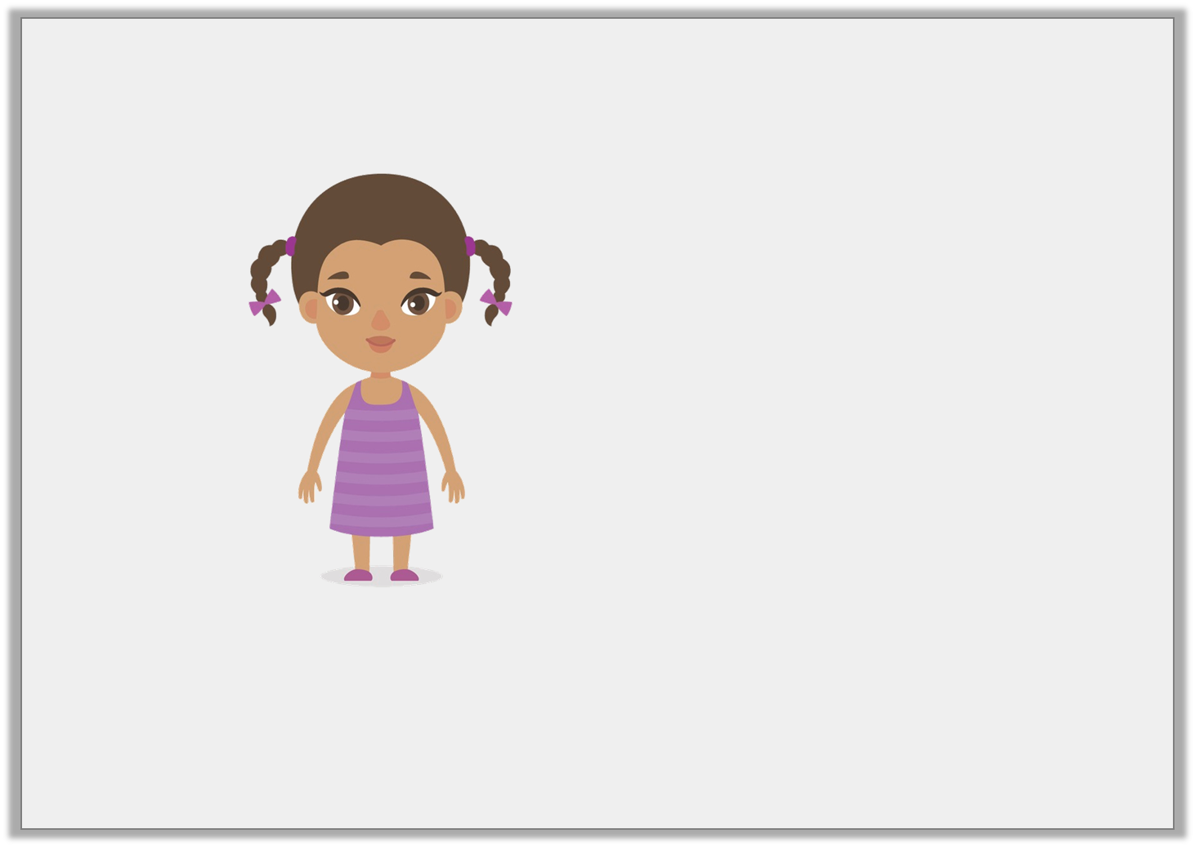
Reasoning 2
Thalia says,
Is she correct? Explain your answer.
A relative clause never makes sense on its own.
© Classroom Secrets Limited 2019

Slide 21
Reasoning 2
Thalia says,
Is she correct? Explain your answer.
Thalia is correct because…
A relative clause never makes sense on its own.
© Classroom Secrets Limited 2019

Slide 22
Reasoning 2
Thalia says,
Is she correct? Explain your answer.
Thalia is correct because a relative clause is a type of subordinate clause which uses a relative pronoun to provide additional information.
A relative clause never makes sense on its own.
© Classroom Secrets Limited 2019

