Slide 1
Pride
KS1 Assembly

Slide 2
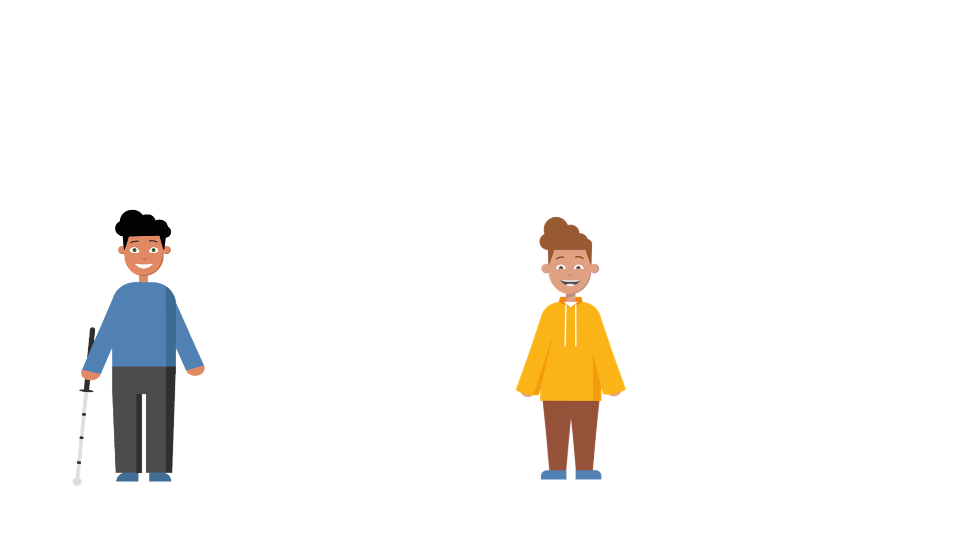
Families and Relationships
Communities are made up of different types of families and relationships.
I live with my mum and step-dad during the week and my dad and step-mum at the weekend.
I live with my mum and my dad. We have a pet dog, and his name is Chip.
Lucas
George

Slide 3
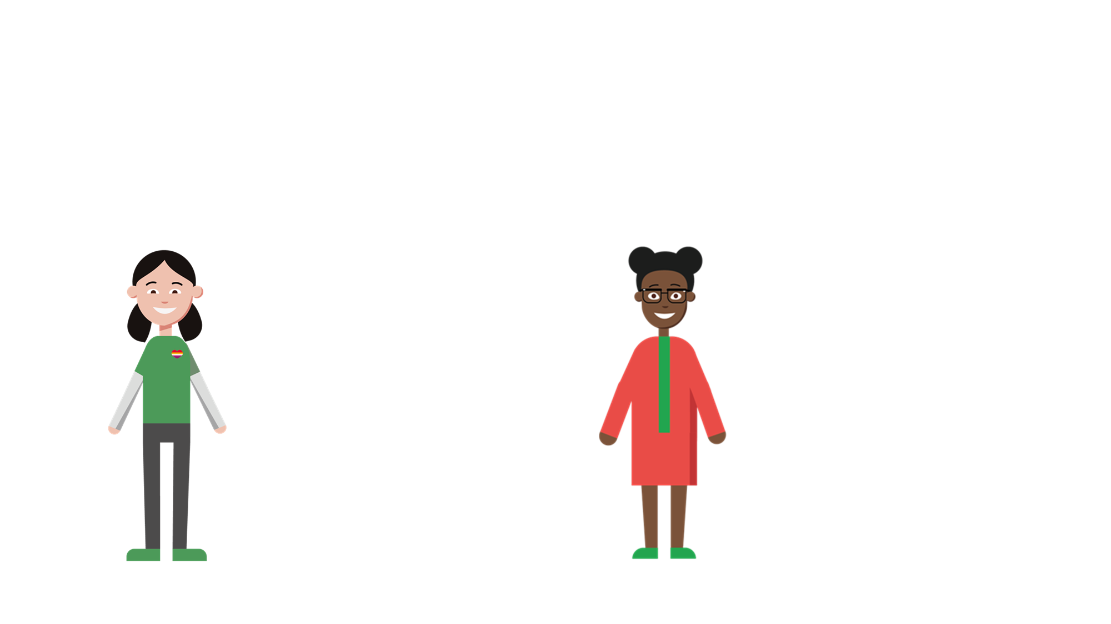
Families and Relationships
Communities are made up of different types of families and relationships.
I live with my two mums. We have a pet cat, and his name is Oscar
I live with my mum, my dad and my younger sister, Cora.
Emi
Star

Slide 4
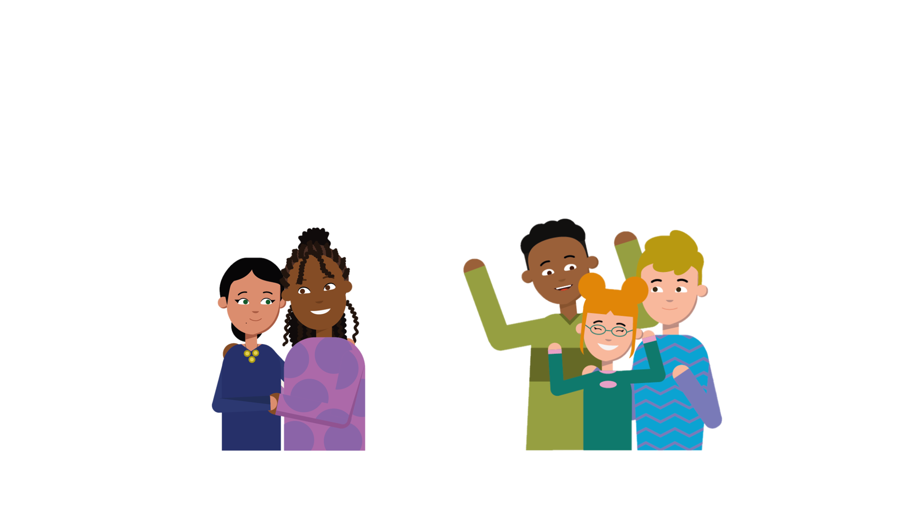
Families and Relationships
No matter who we are or who we love, it is important to show respect and kindness to everyone.

Slide 5
What is Pride month?
Throughout the year, but particularly during the month of June, a variety of events are held to celebrate diversity and inclusivity.
Pride month is all about focusing on being proud of who you are, regardless of who you love. It’s a time to celebrate the work of the LGBTQ+ community.
You may recognise this traditional Pride flag. The colours are designed to reflect the diversity of the LGBTQ+ community.

Slide 6
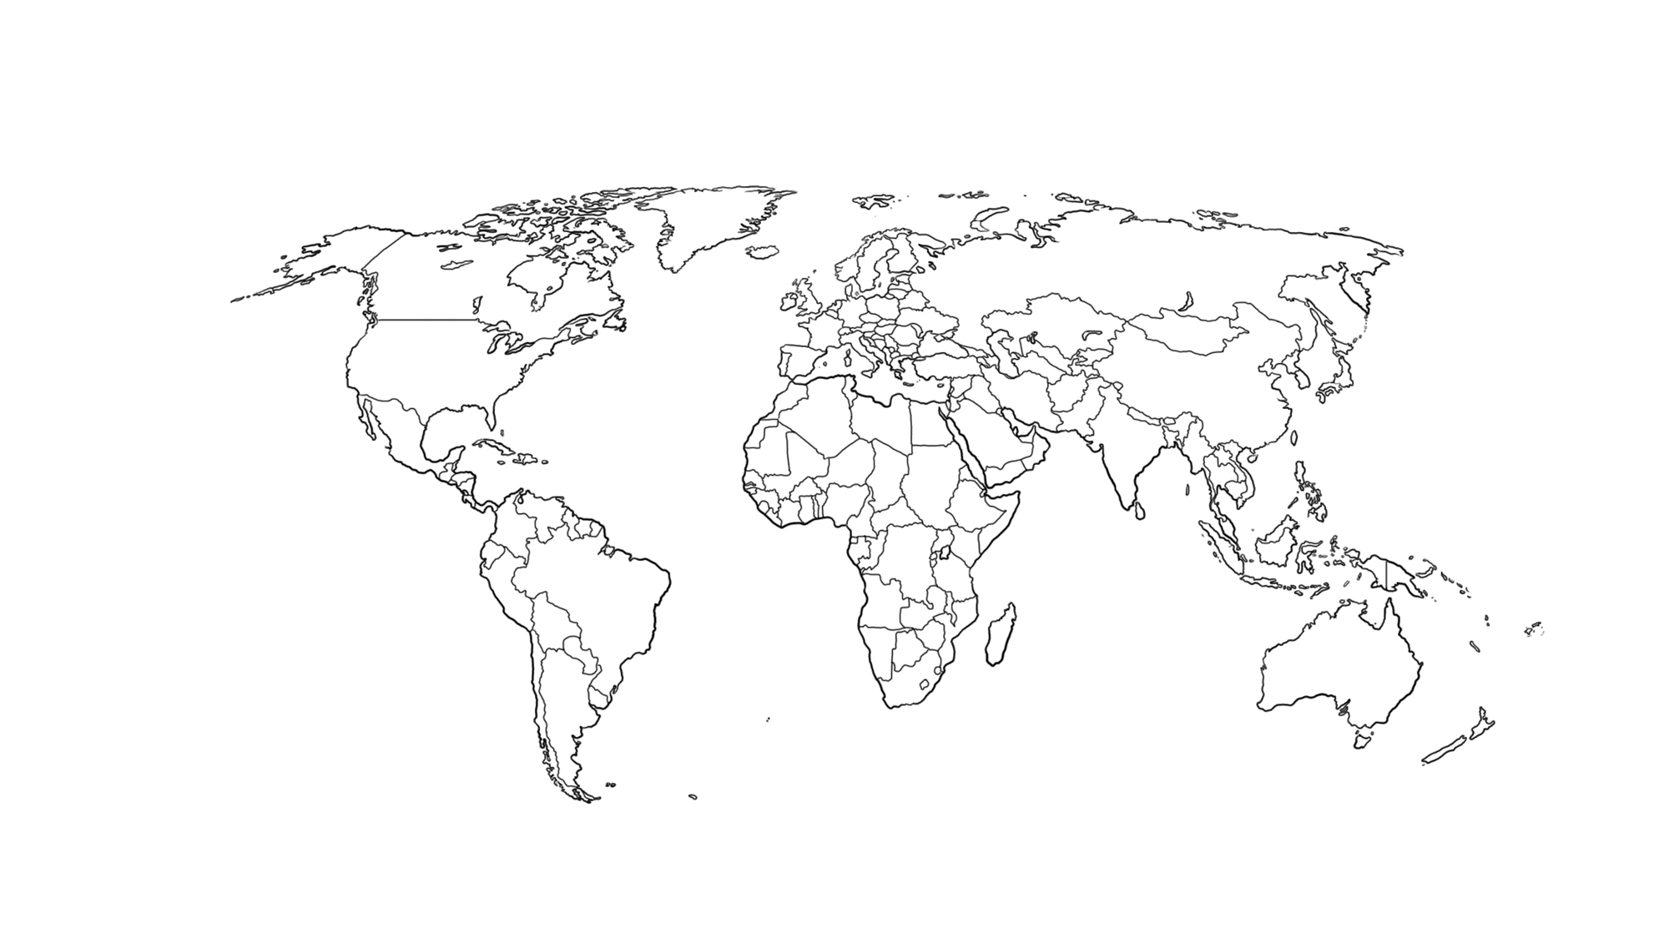
Where do Pride celebrations take place?
Pride celebrations take place across the whole world!

Slide 7
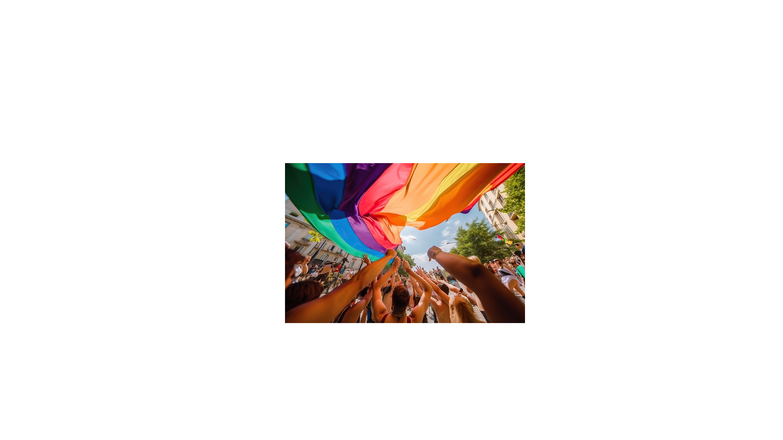
What happens during Pride celebrations?
Communities come together to take part in events such as parades, picnics, concerts and parties.
People wear brightly-coloured clothing to reflect the Pride flag, and sometimes they paint their faces in glitter. Loud music and whistles can often be heard during the celebrations.

Slide 8
Key Vocabulary
LGBTQ+ stands for lesbian, gay, bisexual, transgender and queer.
A lesbian is a female attracted to other females.
Gay means people, usually males, who are attracted to the same gender.
A bisexual person is attracted to both males and females.
A transgender person feels different to the gender they were registered with at birth.
Queer means ‘different’. This is a term used within the LGBTQ+ community to describe themselves.
+ includes all identities.

