Slide 1
Pride
KS2 Assembly

Slide 2
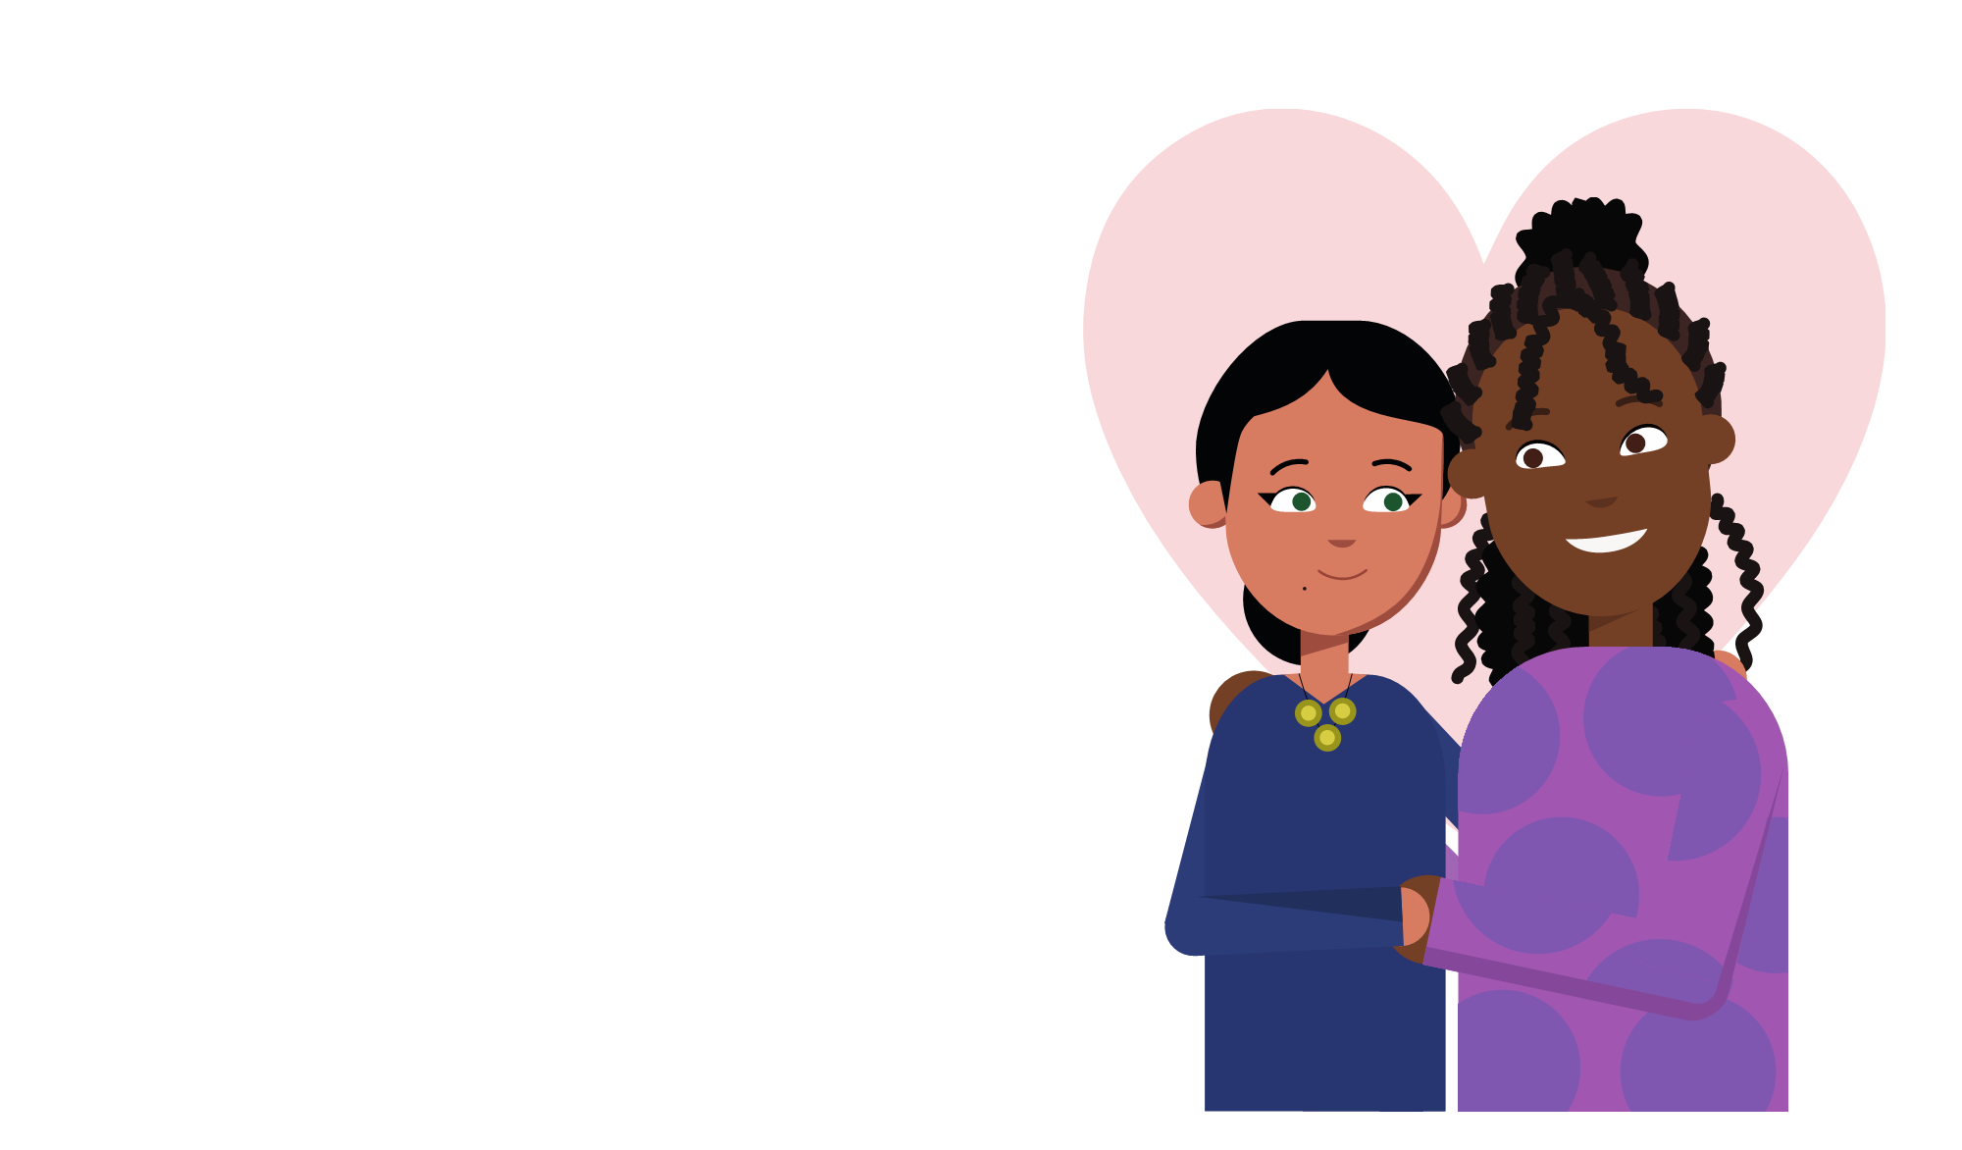
What is Pride Month?
Pride month is an opportunity to celebrate the work and identities of LGBTQ+ people. Pride celebrates diversity and highlights the importance of equality and acceptance.
Pride isn’t limited to just one month and is celebrated throughout the year too!

Slide 3
What is Pride Month?
During the month of June, people around the world come together and take part in parties, parades, concerts and picnics. People often wear face paint and brightly coloured clothing to reflect the colours of the Pride flag.
Loud music and whistles can often be heard during the celebrations.
Here we can see some of the places that Pride is celebrated throughout the world where the LGBTQ+ community have rights.

Slide 4
Vocabulary
LGBTQ+ stands for lesbian, gay, bisexual, transgender and queer.
Straight: A male who is attracted to females or a female who is attracted to males.
Lesbian: Females who are attracted to other females.
Queer: A term for people who are not straight
Gay means people, usually males, who are attracted to the same gender.
+ includes all identities.
Bisexual: A person who is attracted to more than one gender.

Slide 5
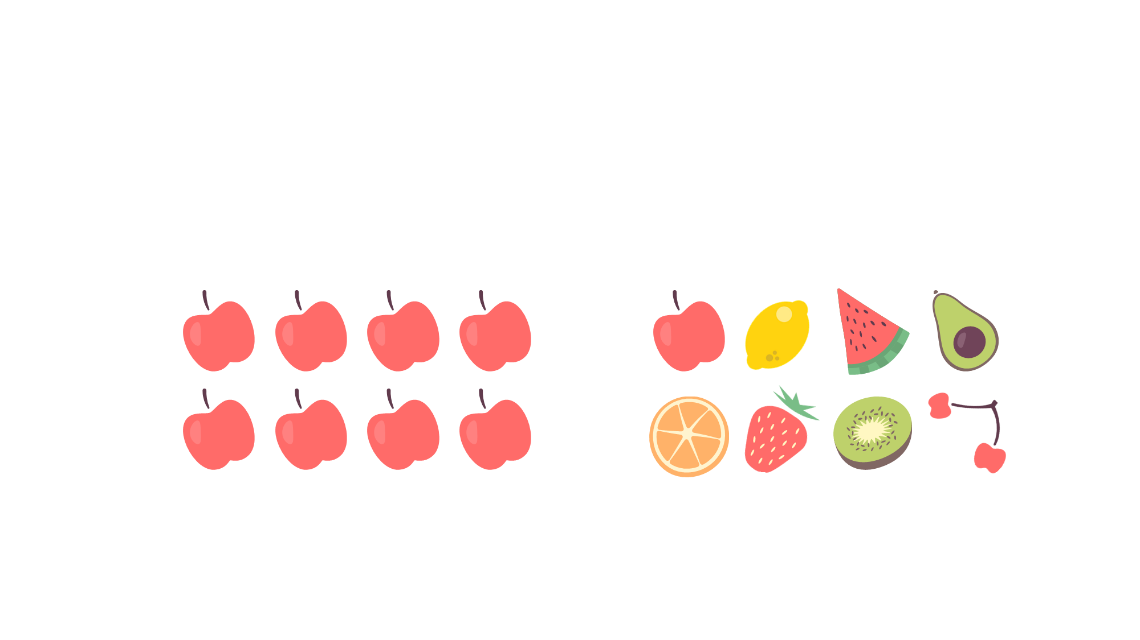
What is diversity?
Not diverse
Diverse

Slide 6
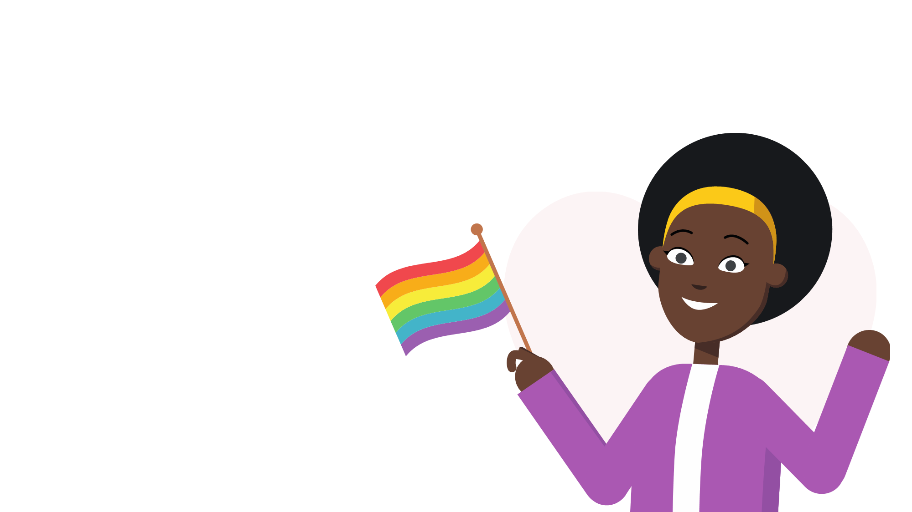
Meaning of the rainbow flag
The colours of the traditional pride flag are designed to reflect the diversity of the LGBTQ+ community.
Red: Life
Orange: Healing
Yellow: Sunlight
Green: Nature
Blue: Harmony
Violet: Spirit

Slide 7
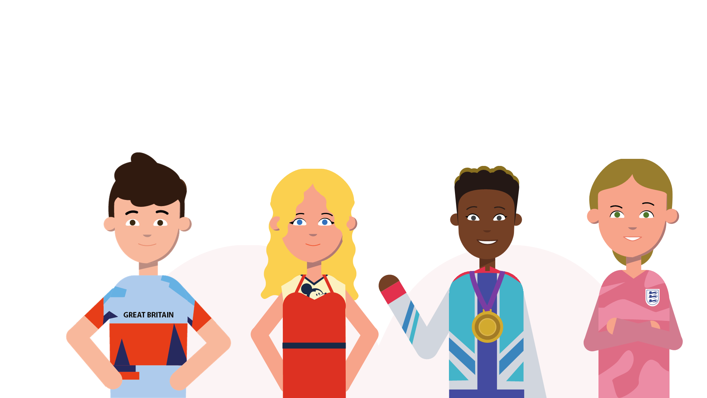
People you might know who are LGBTQ+
Tom Daley
Miley Cyrus
Nicola Adams
Mary Earps

Slide 8
LGBTQ+ A History
Equal rights for the LGBTQ+ community have come a long way during the last one hundred years; however, it is important to recognise the struggles that these groups have overcome.
From incurring the death penalty to the legalisation of same-sex marriage, the following timeline shows some of the most crucial points within the history of the LGBTQ+ community.
Alan Turing

Slide 9
Important dates in LGBTQ+ history
After the Civil Partnership Act came into force in 2005, full marriage rights were granted to same-sex couples when the Marriage Act was passed in 2013.
To mark the first anniversary of the Stonewall riots, the first gay pride march took place across North America in 1970.
The 2004 Gender Recognition Act is established, allowing people to change their legal gender.
In 1861 the death penalty was replaced with a
10-year prison sentence.
In 1965 Labour MP Leo Abse and the Earl of Arran sought to decriminalise same-sex relations.
1500
Today
In 1533 an act which saw same-sex relationships incur the death penalty.
In 1885 it became illegal for men but not women to engage in same-sex relationships.
1969 saw the Stonewall riots and the beginning of a series of protests by the LGBTQ+ community. These were in response to a police raid on a gay bar, called the Stonewall Inn, in New York City.
The original rainbow flag was created in 1978 by artist Gilbert Baker. The flag’s colours represent the diversity of the LGBTQ+ community.
The 2010 Equality Act is introduced, legally protecting people from discrimination in the workplace and wider society.

Slide 10
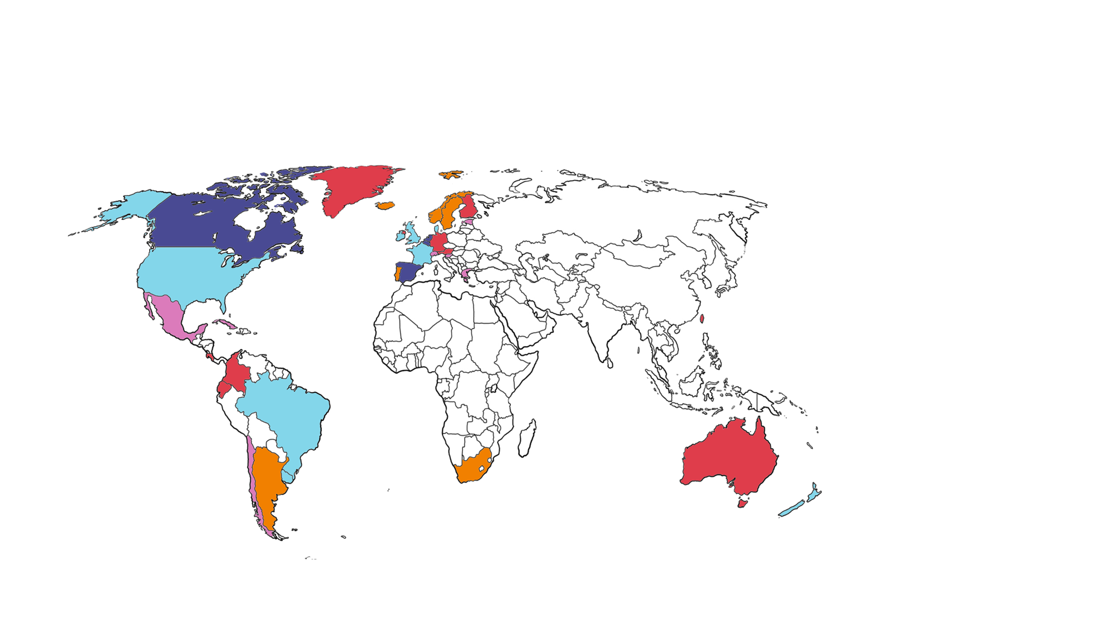
The legalisation of same-sex marriage
2000 – 2005
Netherlands
Belgium
Canada
Spain
2016 – 2020
Finland
Columbia
Greenland
Australia
Malta
Germany
Austria
Costa Rica
Ecuador
Taiwan
Northern Ireland
2006 – 2010
South Africa
Norway
Sweden
Argentina
Iceland
Portugal
2021 – 2024
Switzerland
Chile
Cuba
Mexico
Slovenia
Andorra
Estonia
Greece
2011 – 2015
Denmark
Brazil
England/ Wales
France
New Zealand
Uruguay
Luxembourg
Scotland
Ireland
USA

Slide 11
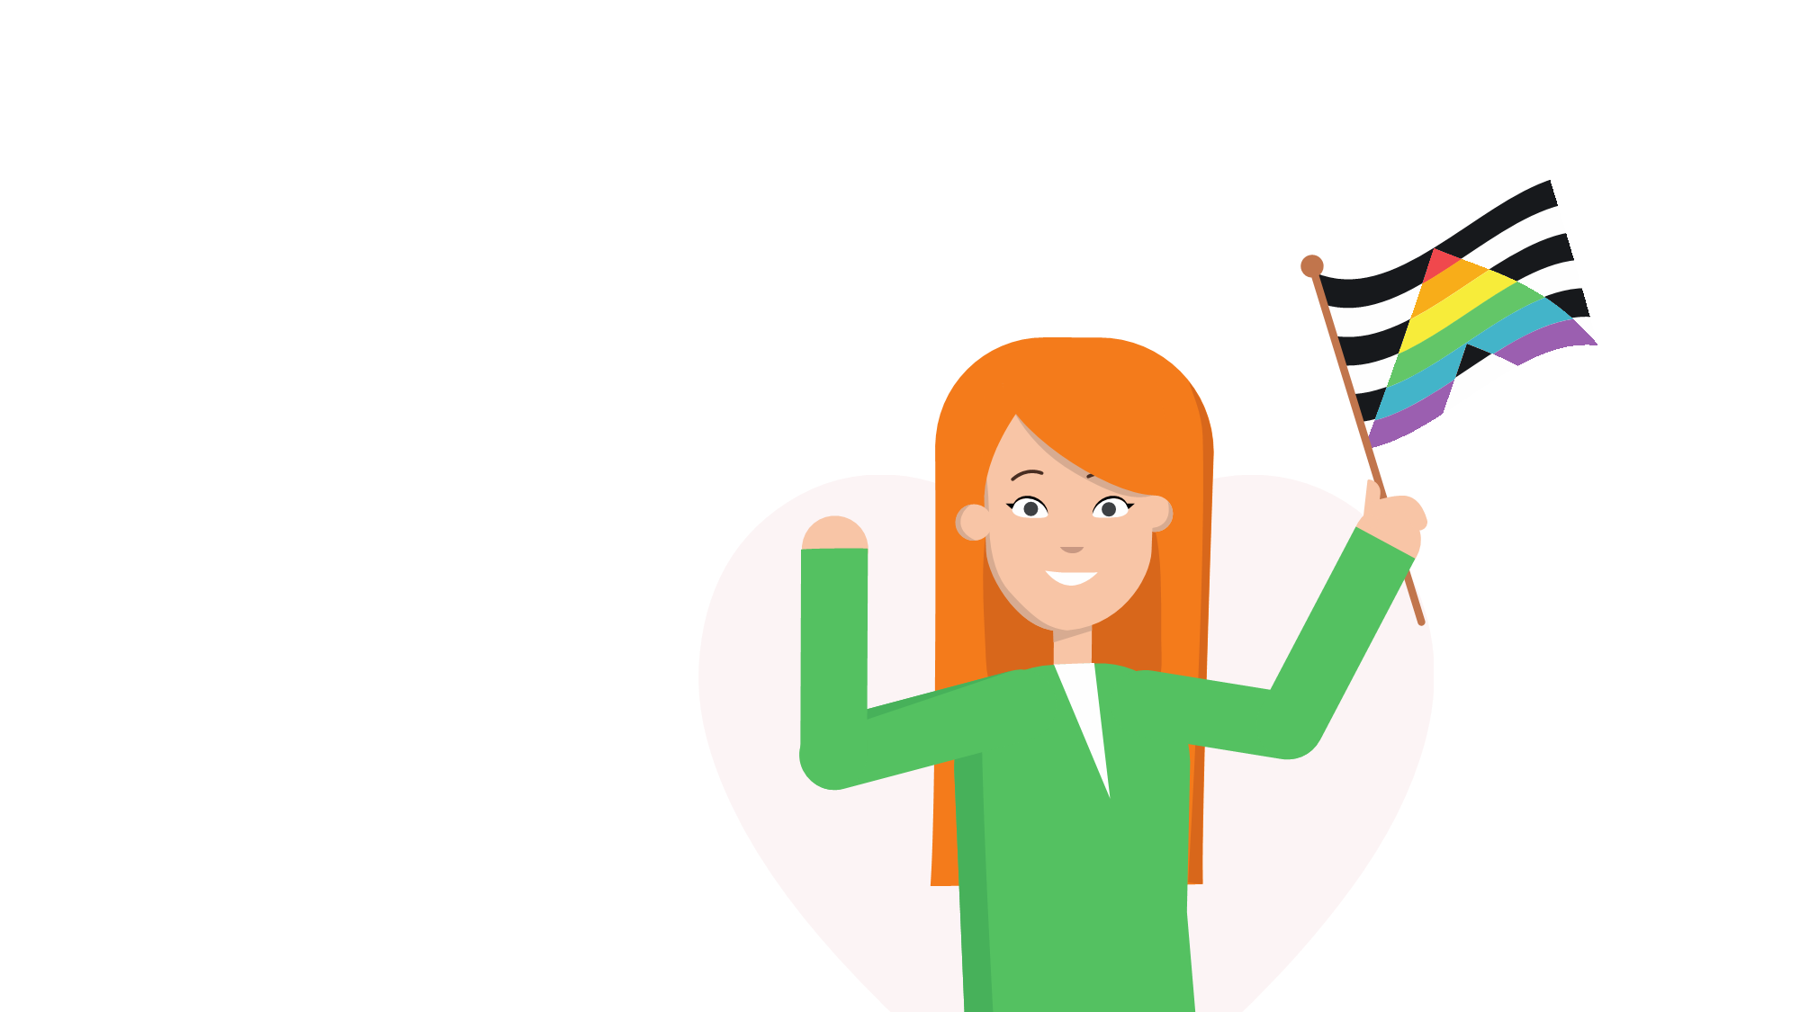
What is an ally?
A person who supports LGBTQ+ people.
Ally flag

Slide 12
How to be a good ally
Harry Styles
1
Listen to other people’s experiences.
2
Learn about different people.
3
Support people who need your help.
4
Stand up to bullying and discrimination.

