Slide 1
Y1
FRENCH
Unit 1 - Culture

Slide 2
Introducing French Vocabulary
Introducing French Vocabulary
Sam and Sophia are going to help us learn some words in French.
First, Sam will say the words in English, then Sophia will say the words in French.
Have a go at copying what Sophia says.
Sam
Sophia

Slide 3
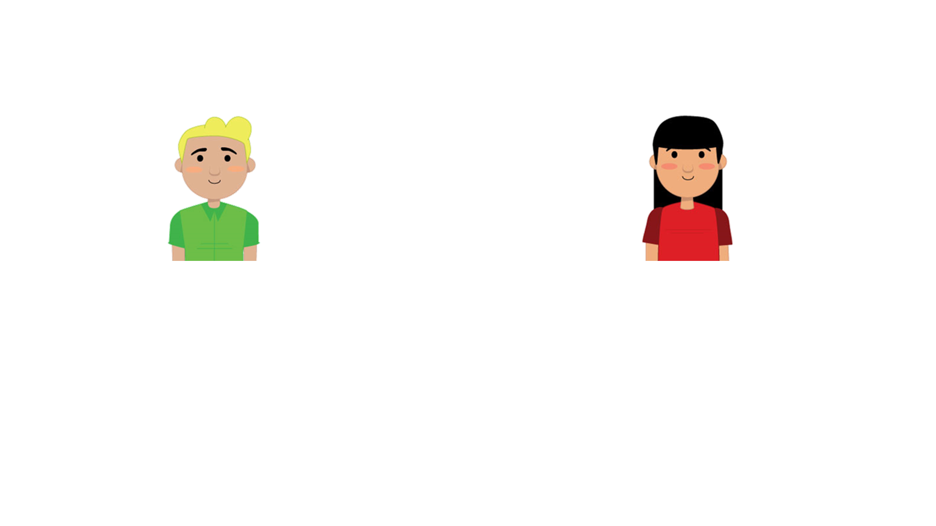
Introducing French Vocabulary
Hello! My name is Sam. I am British and I live in London.
Hello! My name is Sophia. I am French and I live in Paris.

Slide 4
Introducing French Vocabulary
Hello!
Bonjour!
You have a go after Sophia.
Well done!

Slide 5
Introducing French Vocabulary
Yes
Oui
Copy what Sophia says.
Brilliant!

Slide 6
Introducing French Vocabulary
No
Non
Now it’s your turn.
Well done!

Slide 7
Introducing French Vocabulary
Thank you!
Merci!
Now it’s your turn again.
You’re doing really well.

Slide 8
Introducing French Vocabulary
Goodbye!
Au revoir!
You have a go.
Fantastic!

Slide 9
Introducing French Vocabulary
Match these French words to their meaning.
au revoir
thank you
merci
no
oui
goodbye
bonjour
yes
non
hello

Slide 10
Introducing French Vocabulary
Match these French words to their meaning.
au revoir
thank you
merci
no
oui
goodbye
bonjour
yes
non
hello

Slide 11
Introducing French Vocabulary
Order this conversation.
Bonjour, Sophia!
Au revoir, Sophia!
Au revoir, Sam!
Bonjour, Sam!

Slide 12
Introducing French Vocabulary
Order this conversation.
Bonjour, Sophia!
Bonjour, Sam!
Au revoir, Sophia!
Au revoir, Sam!
Try having your own French conversation with a friend.

Slide 13
Introducing French Vocabulary
You have learnt a lot of French words today. Well done!
Goodbye!
Au revoir!
See you next time.

