Slide 1
Y2
FRENCH
Unit 1 - Culture

Slide 2
Introducing French Vocabulary
Introducing French Vocabulary
Sam and Sophia are going to help us learn some French words.
First, Sam will say the words in English; then, Sophia will say the words in French.
You can have a go at copying what Sophia says.
Sam
Sophia

Slide 3
Introducing French Vocabulary
I am Sam. I am English and I live in London.
I am Sophia. I am French and I live in Paris.

Slide 4
Introducing French Vocabulary
The children are saying hello.
Have a go at copying what Sophia said.
Good job!
Hello!
Bonjour!

Slide 5
Introducing French Vocabulary
Now let’s learn another French word.
Now it is your turn.
Great!
Yes
Oui

Slide 6
Introducing French Vocabulary
Here is another one.
Repeat what Sophia said.
Well done!
No
Non

Slide 7
Introducing French Vocabulary
The children are asked if they have black hair. What is Sophia’s reply?
No

Slide 8
Introducing French Vocabulary
The children are asked if they have black hair. What is Sophia’s reply?
No
Oui

Slide 9
Introducing French Vocabulary
Now we can learn some more words.
Your turn.
Amazing!
Thank you
Merci

Slide 10
Introducing French Vocabulary
Now your go.
Very good!
Pardon?
Pardon?

Slide 11
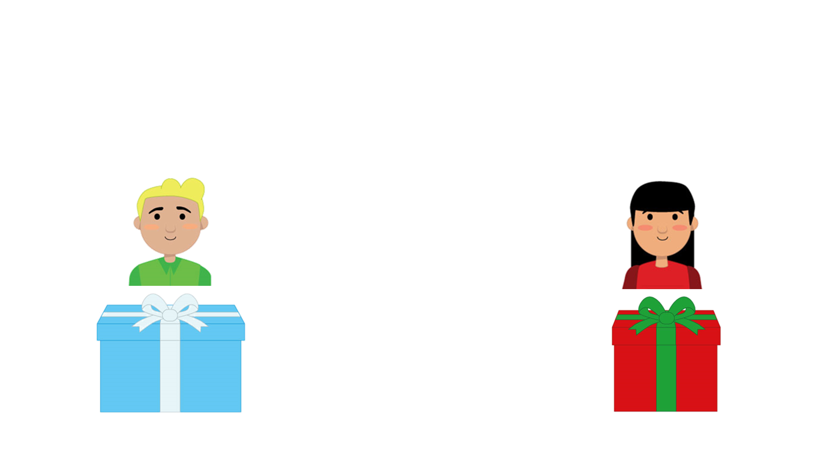
Introducing French Vocabulary
The children are given a present. What does Sophia say?
Thank you!

Slide 12
Introducing French Vocabulary
The children are given a present. What does Sophia say?
Thank you!
Merci!

Slide 13
Introducing French Vocabulary
It’s nearly time to go now.
Copy Sophia.
Fantastic!
Goodbye
Au revoir!

Slide 14
Introducing French Vocabulary
Here are some more things you might say.
Your turn.
Excellent!
See you soon.
À bientôt.

Slide 15
Introducing French Vocabulary
Now, your turn.
Great!
Have a good day.
Bonne journée.

Slide 16
Introducing French Vocabulary
Now you have a go.
Good job!
Have a good evening.
Bonne soirée.

Slide 17
Introducing French Vocabulary
Order this conversation.
Bonjour, Sophia!
Bonjour, Sam!
À bientôt, Sam!
Au revoir, Sophia!

Slide 18
Introducing French Vocabulary
Order this conversation.
Bonjour, Sophia!
Bonjour Sam!
Au revoir, Sophia!
À bientôt, Sam!

Slide 19
Introducing French Vocabulary
You have learnt a lot of French words today. Well done!
See you next time.
Au revoir.
À bientôt.

