Slide 1
Y2
FRENCH
Unit 1 - Culture

Slide 2
Simple Foods
Simple Foods
Olivia and Karim are going to help us learn some French words for different foods and drinks.
First, Olivia will say the words in English; then, Karim will say the words in French.
Have a go at copying what Karim says.
Olivia
Karim

Slide 3
Simple Foods
My name is Olivia. I am British and I live in London.
My name is Karim. I am French and I live in Paris.

Slide 4
Simple Foods
You have a go at saying the French words after Karim.
the apple
la pomme
Well done!

Slide 5
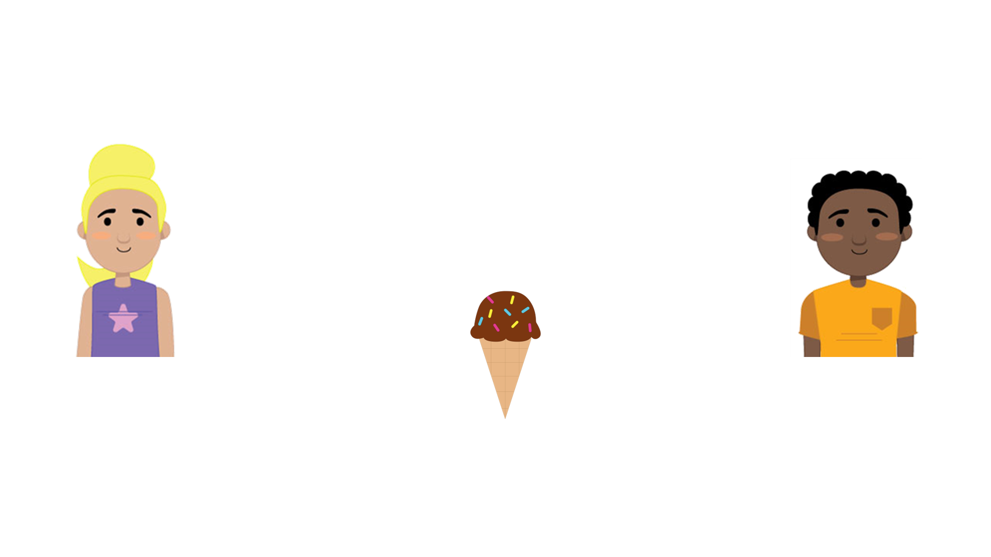
Simple Foods
the ice cream
la glace
Now it’s your turn.
Brilliant!

Slide 6
Simple Foods
the cheese
le fromage
Now you have a go.
Well done!

Slide 7
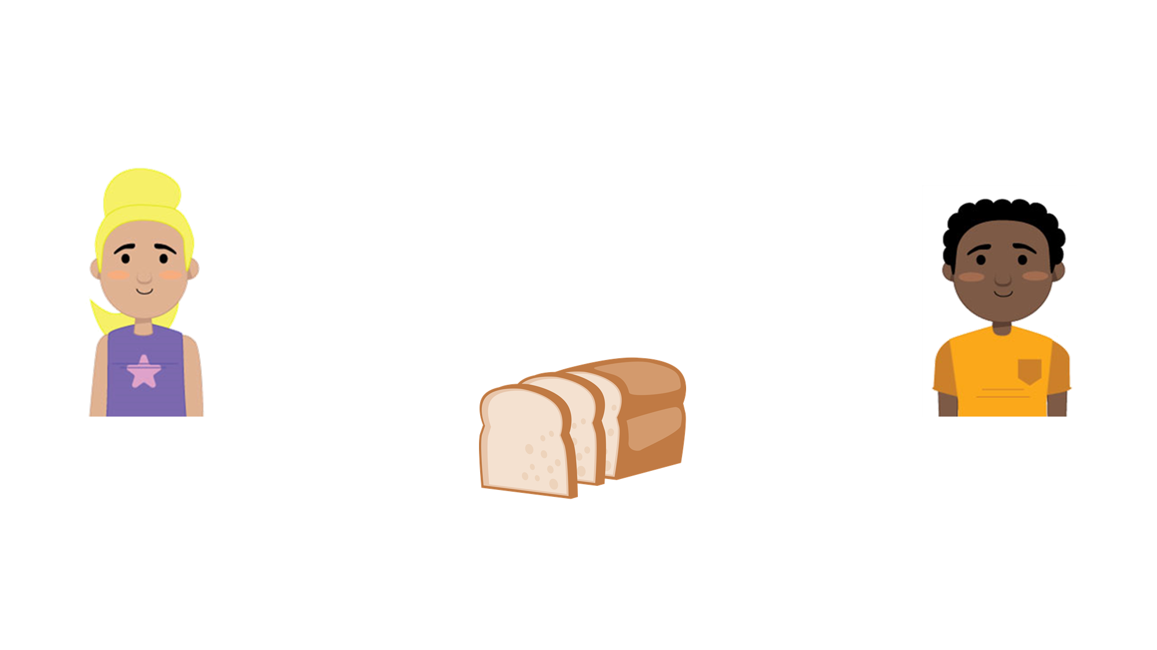
Simple Foods
the bread
le pain
Now it’s your turn again.
You’re doing really well.

Slide 8
Simple Foods
the chips
les frites
You have a go.
Fantastic!

Slide 9
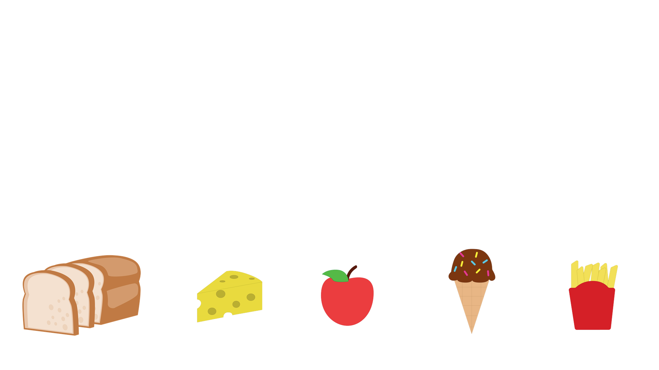
Simple Foods
Match these French words to their image.
le fromage
les frites
la pomme
la glace
le pain

Slide 10
Simple Foods
Match these French words to their image.
le fromage
les frites
la pomme
la glace
le pain

Slide 11
Simple Foods
Let’s learn some more French words.
the water
l’eau
You have a go.
Super!

Slide 12
Simple Foods
the milk
le lait
Now it’s your turn.
Fantastic!

Slide 13
Simple Foods
I like
J’aime
Your turn again.
Well done!

Slide 14
Simple Foods
You’re doing really well. Let’s learn a whole sentence now.
What would you like to eat?
Qu’est-ce que tu aimes manger?
You have a go.
Brilliant!

Slide 15
Simple Foods
Here’s another sentence to learn.
What do you like to drink?
Qu’est-ce que tu aimes boire?
Your turn.
Amazing!

Slide 16
Simple Foods
Which of the French words could complete Karim’s sentence?
Qu’est-ce que tu aimes boire?
J’aime boire de
les frites
l’eau
la pomme
le pain

Slide 17
Simple Foods
Which of the French words could complete Karim’s sentence?
Qu’est-ce que tu aimes boire?
J’aime boire de l’eau.
les frites
l’eau
la pomme
le pain
Olivia is asking Karim what he would like to drink. L’eau is the only drink given. All the other words are French foods. Karim likes to drink water.

Slide 18
Simple Foods
Well done! You have learnt lots of French words today.
Goodbye!
Au revoir!
See you next time.

