Slide 1
LIFE/work balance
We have started a #LIFEworkbalance campaign and we need your help to complete our LIFE/work balance survey.
We hope to publish the results soon, so please give 15 minutes of your time to help us get a true picture of school life.
Want to be a part of this campaign? Take the survey on our website and share it with your colleagues!
© Classroom Secrets Limited 2019

Slide 2
Year 1 – Spring Block 1 – Addition and Subtraction – Add by Counting On
About This Resource:
This PowerPoint has been designed to support your teaching of this small step. It includes a starter activity and an example of each question from the Varied Fluency and Reasoning and Problem Solving resources also provided in this pack. You can choose to work through all examples provided or a selection of them depending on the needs of your class.
National Curriculum Objectives:
Mathematics Year 1: (1C2a) Add and subtract one-digit and two-digit numbers to 20, including zero
Mathematics Year 1: (1C4) Solve one-step problems that involve addition and subtraction, using concrete objects and pictorial representations, and missing number problems such as 7 = – 9
More Year 1 Addition and Subtraction resources.
Did you like this resource? Don’t forget to review it on our website.
© Classroom Secrets Limited 2018

Slide 3
Year 1 – Spring Block 1 – Addition and Subtraction
Step 1: Add by Counting On
© Classroom Secrets Limited 2018

Slide 4
Introduction
The rabbit is jumping to get the carrots.
He has done 7 jumps so far.
How many more jumps does the rabbit need to do?
0 | 1 | 2 | 3 | 4 | 5 | 6 | 7 | 8 | 9 | 10 | 11 | 12 | 13 | 14 | 15
© Classroom Secrets Limited 2018

Slide 5
Introduction
The rabbit is jumping to get the carrots.
He has done 7 jumps so far.
How many more jumps does the rabbit need to do?
4
0 | 1 | 2 | 3 | 4 | 5 | 6 | 7 | 8 | 9 | 10 | 11 | 12 | 13 | 14 | 15
© Classroom Secrets Limited 2018

Slide 6
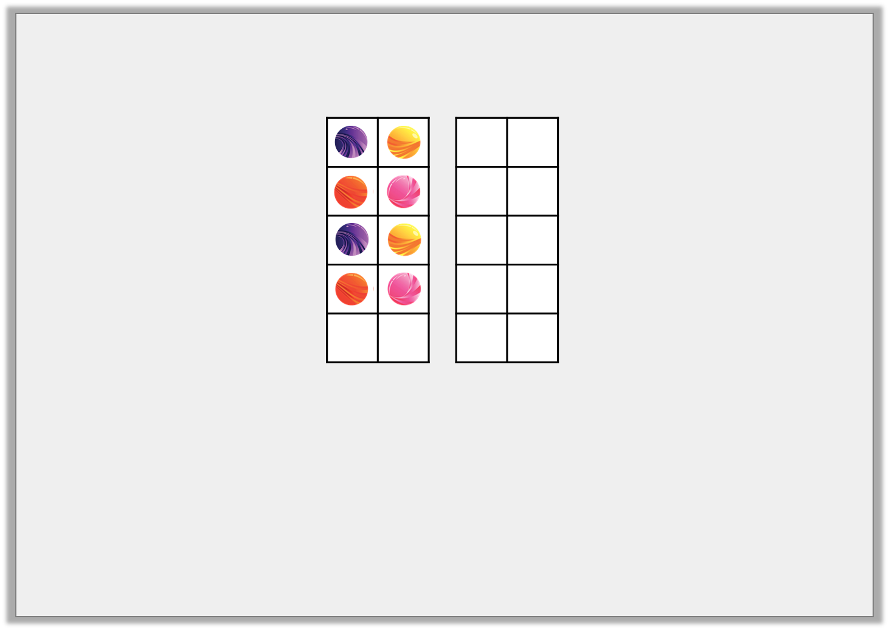
Varied Fluency 1
True or false?
Ted has 8 marbles. He wins 6 more. Now he has 14 marbles.
© Classroom Secrets Limited 2018

Slide 7
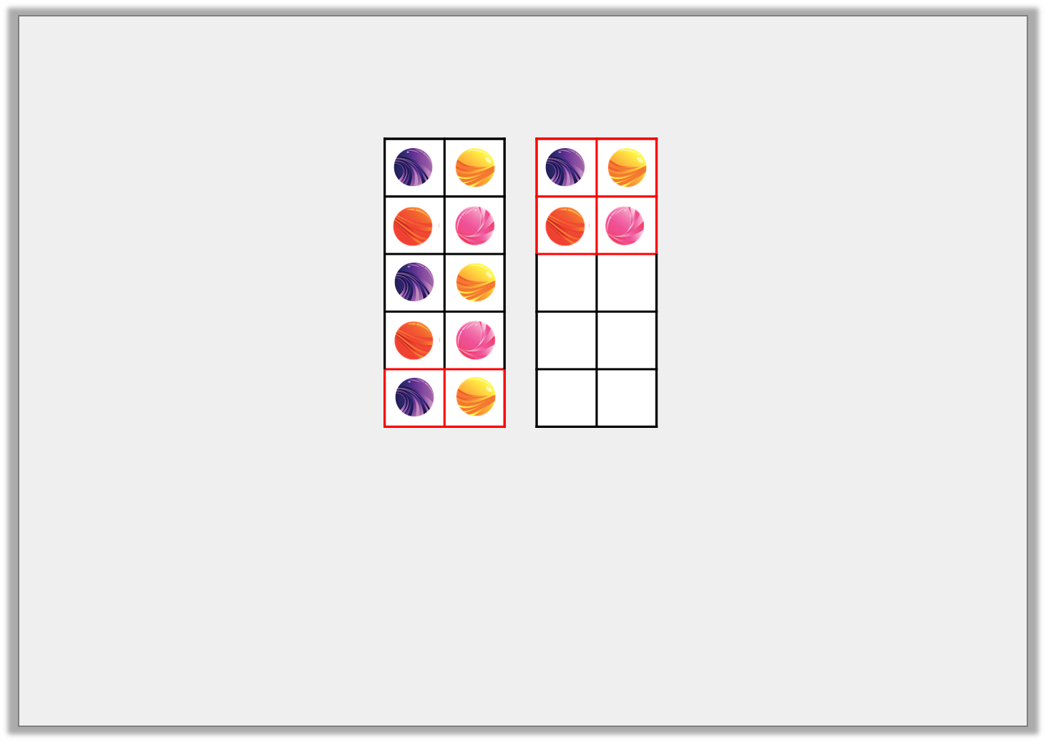
Varied Fluency 1
True or false?
True
Ted has 8 marbles. He wins 6 more. Now he has 14 marbles.
© Classroom Secrets Limited 2018

Slide 8
Varied Fluency 2
Use the number line to complete the number sentence.
15 | + | 4 | =
10 | 11 | 12 | 13 | 14 | 15 | 16 | 17 | 18 | 19 | 20
© Classroom Secrets Limited 2018

Slide 9
Varied Fluency 2
Use the number line to complete the number sentence.
15 | + | 4 | = | 19
10 | 11 | 12 | 13 | 14 | 15 | 16 | 17 | 18 | 19 | 20
© Classroom Secrets Limited 2018

Slide 10
Varied Fluency 3
Complete the bar model by counting on.
13 | 5
13 | 1 | 1 | 1 | 1 | 1
© Classroom Secrets Limited 2018

Slide 11
Varied Fluency 3
Complete the bar model by counting on.
18
13 | 5
13 | 1 | 1 | 1 | 1 | 1
© Classroom Secrets Limited 2018

Slide 12
Varied Fluency 4
Circle the number sentence shown on the number line and complete the answer.
0 | 1 | 2 | 3 | 4 | 5 | 6 | 7 | 8 | 9 | 10 | 11 | 12 | 13 | 14 | 15 | 16 | 17 | 18 | 19 | 20
7 + 4 = |  | 7 + 5 =
11 + 7 = |  | 0 + 7 =
© Classroom Secrets Limited 2018

Slide 13
Varied Fluency 4
Circle the number sentence shown on the number line and complete the answer.
0 | 1 | 2 | 3 | 4 | 5 | 6 | 7 | 8 | 9 | 10 | 11 | 12 | 13 | 14 | 15 | 16 | 17 | 18 | 19 | 20
12
7 + 4 = |  | 7 + 5 =
11 + 7 = |  | 0 + 7 =
© Classroom Secrets Limited 2018

Slide 14
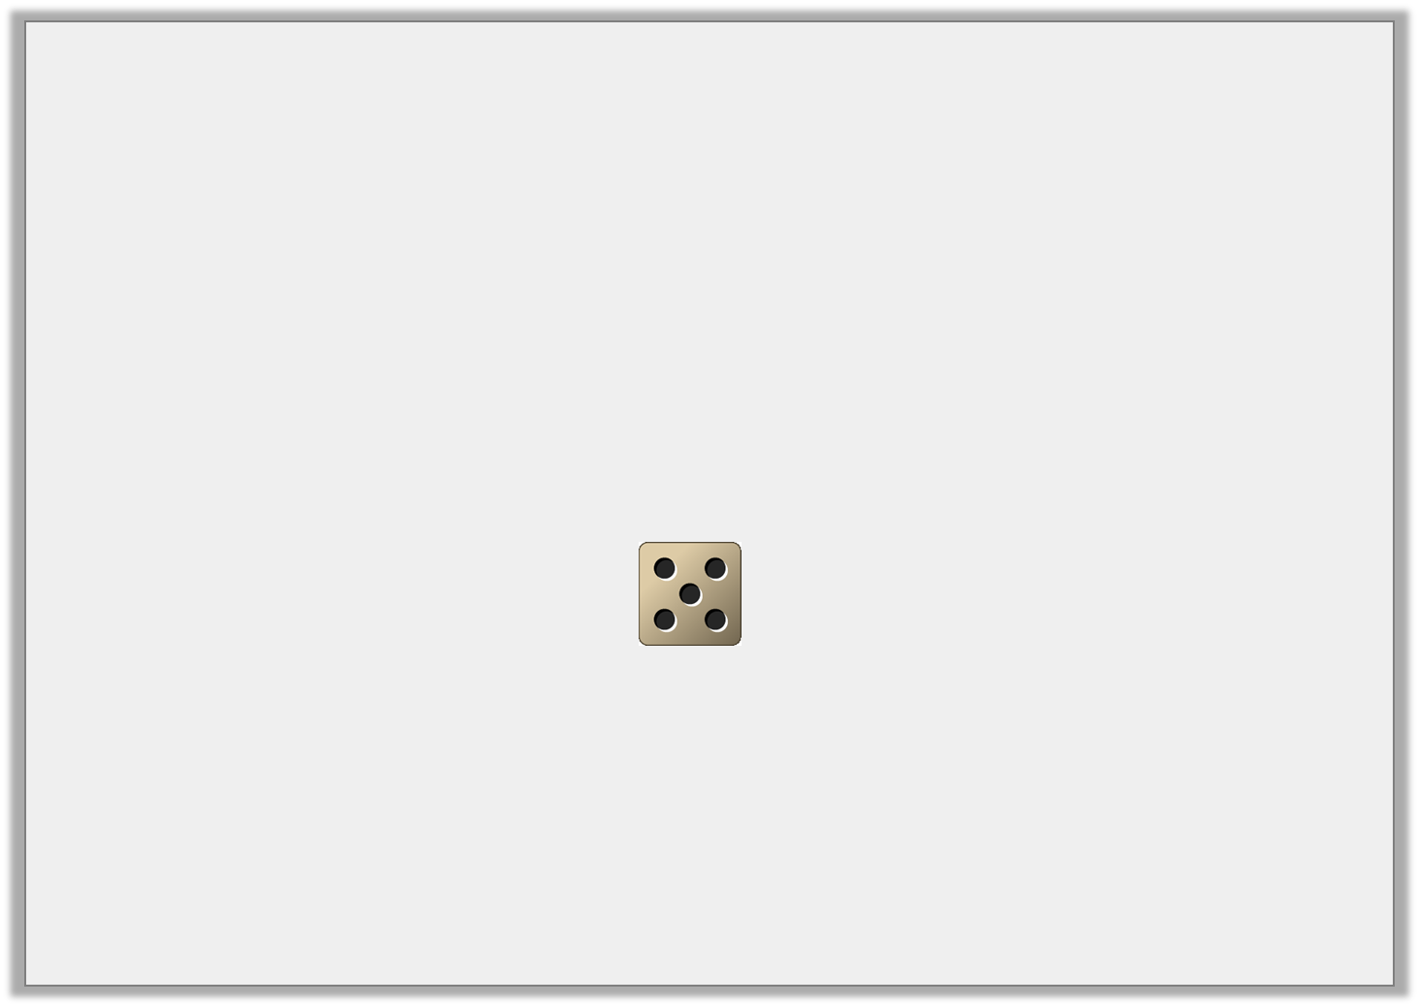
Problem Solving 1
Freddy chooses a number card.
Then he rolls a dice and counts on the number he rolls.
What could his score be? Find all the possible answers.
5
7
6
© Classroom Secrets Limited 2018

Slide 15
Problem Solving 1
Freddy chooses a number card.
Then he rolls a dice and counts on the number he rolls.
What could his score be? Find all the possible answers.
5 + 5 = 10 7 + 5 = 12 6 + 5 = 11
5
7
6
© Classroom Secrets Limited 2018

Slide 16
Reasoning 1
Count on to find the odd one out.
Explain your answer.
A. | ?
 | 7
B. | ?
 | 8
C. | ?
 |  | 11
© Classroom Secrets Limited 2018

Slide 17
Reasoning 1
Count on to find the odd one out.
Explain your answer.
C is the odd one out because…
A. | ?
 | 7
B. | ?
 | 8
C. | ?
 |  | 11
© Classroom Secrets Limited 2018

Slide 18
Reasoning 1
Count on to find the odd one out.
Explain your answer.
C is the odd one out because A and B equal 12 but C equals 14.
A. | 12
 | 7
B. | 12
 | 8
C. | 14
 |  | 11
© Classroom Secrets Limited 2018

Slide 19
Problem Solving 2
Count on 4 from each number.
If the answer is more than 15 colour the box.
8 |  | 15
 | 9
10 |  | 11
© Classroom Secrets Limited 2018

Slide 20
Problem Solving 2
Count on 4 from each number.
If the answer is more than 15 colour the box.
8 |  | 15
 | 9
10 |  | 11
© Classroom Secrets Limited 2018

