Slide 1
LIFE/work balance
We have started a #LIFEworkbalance campaign and we need your help to complete our LIFE/work balance survey.
We hope to publish the results soon, so please give 15 minutes of your time to help us get a true picture of school life.
Want to be a part of this campaign? Take the survey on our website and share it with your colleagues!
© Classroom Secrets Limited 2019

Slide 2
Year 1 – Summer Block 1 – Multiplication and Division – Count in 10s
About this Resource:
This PowerPoint has been designed to support your teaching of this small step. It includes a starter activity and an example of each question from the Varied Fluency and Reasoning and Problem Solving resources also provided in this pack. You can choose to work through all examples provided or a selection of them depending on the needs of your class.
National Curriculum Objectives:
Mathematics Year 1: (1N1b) Count in multiples of twos, fives and tens
Mathematics Year 1: (1C8) Solve one-step problems involving multiplication and division, by calculating the answer using concrete objects, pictorial representations and arrays with the support of the teacher
More Year 1 Multiplication and Division resources.
Did you like this resource? Don’t forget to review it on our website.
© Classroom Secrets Limited 2018

Slide 3
Year 1 – Summer Block 1 – Multiplication and Division
Step 1: Count in 10s
© Classroom Secrets Limited 2018

Slide 4
Introduction
Complete the missing numbers on the hundred square.
1 | 2 | 3 | 4 | 5 | 6 | 7 | 8 | 9
11 | 12 | 13 | 14 | 15 | 16 | 17 | 18 | 19
21 | 22 | 23 | 24 | 25 | 26 | 27 | 28 | 29
31 | 32 | 33 | 34 | 35 | 36 | 37 | 38 | 39
41 | 42 | 43 | 44 | 45 | 46 | 47 | 48 | 49
51 | 52 | 53 | 54 | 55 | 56 | 57 | 58 | 59
61 | 62 | 63 | 64 | 65 | 66 | 67 | 68 | 69
71 | 72 | 73 | 74 | 75 | 76 | 77 | 78 | 79
81 | 82 | 83 | 84 | 85 | 86 | 87 | 88 | 89
91 | 92 | 93 | 94 | 95 | 96 | 97 | 98 | 99
© Classroom Secrets Limited 2018

Slide 5
Introduction
Complete the missing numbers on the hundred square.
1 | 2 | 3 | 4 | 5 | 6 | 7 | 8 | 9 | 10
11 | 12 | 13 | 14 | 15 | 16 | 17 | 18 | 19 | 20
21 | 22 | 23 | 24 | 25 | 26 | 27 | 28 | 29 | 30
31 | 32 | 33 | 34 | 35 | 36 | 37 | 38 | 39 | 40
41 | 42 | 43 | 44 | 45 | 46 | 47 | 48 | 49 | 50
51 | 52 | 53 | 54 | 55 | 56 | 57 | 58 | 59 | 60
61 | 62 | 63 | 64 | 65 | 66 | 67 | 68 | 69 | 70
71 | 72 | 73 | 74 | 75 | 76 | 77 | 78 | 79 | 80
81 | 82 | 83 | 84 | 85 | 86 | 87 | 88 | 89 | 90
91 | 92 | 93 | 94 | 95 | 96 | 97 | 98 | 99 | 100
© Classroom Secrets Limited 2018

Slide 6
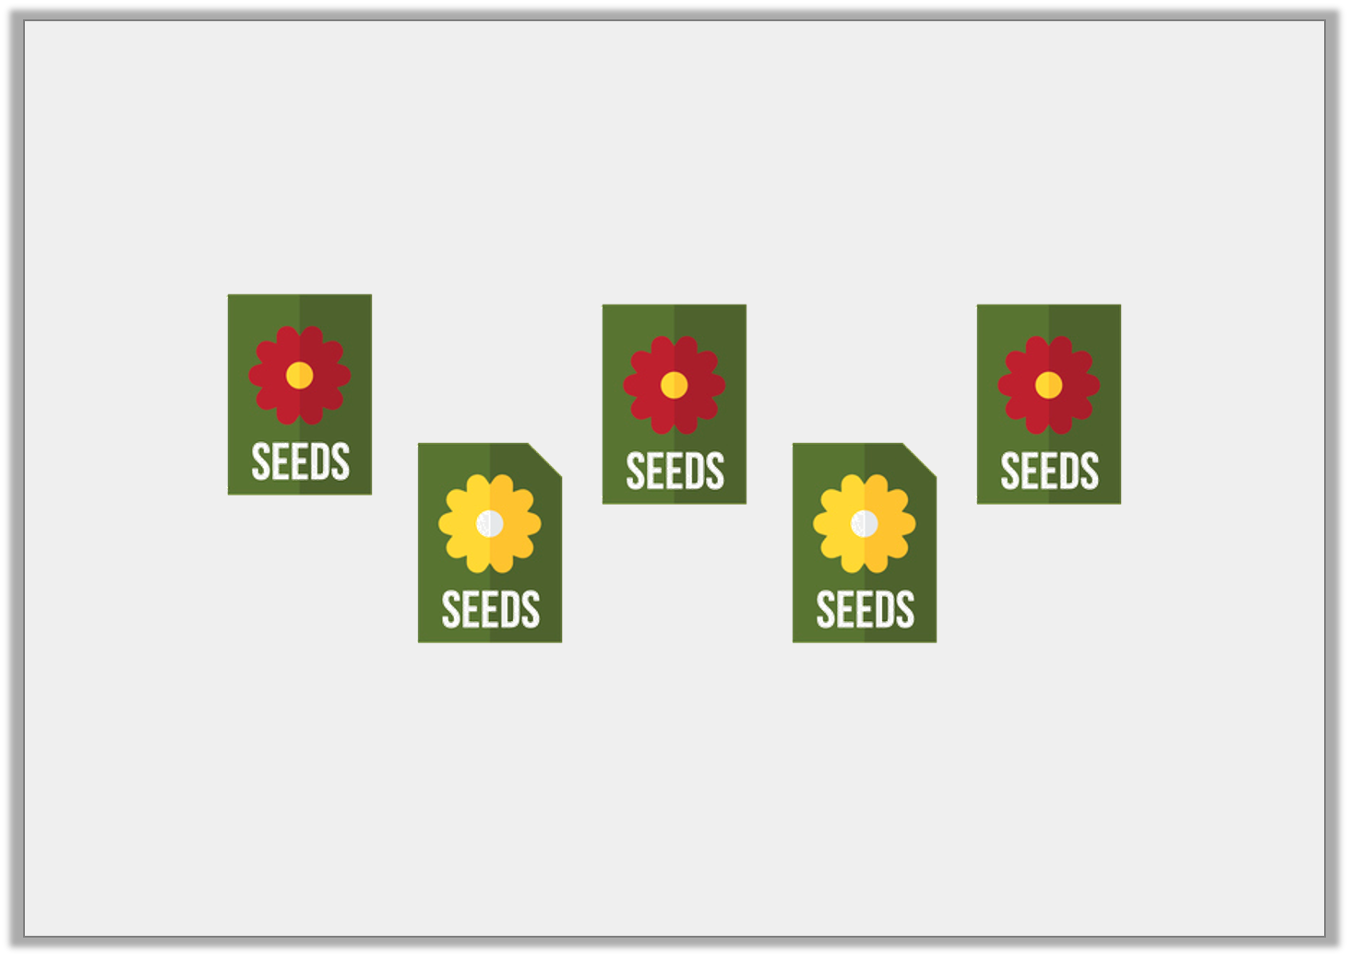
Varied Fluency 1
If one packet of seeds has 10 seeds, how many seeds do 5 packets of seeds have?
© Classroom Secrets Limited 2018

Slide 7
Varied Fluency 1
If one packet of seeds has 10 seeds, how many seeds do 5 packets of seeds have?
5 packets of seeds will have 50 seeds altogether.
© Classroom Secrets Limited 2018

Slide 8
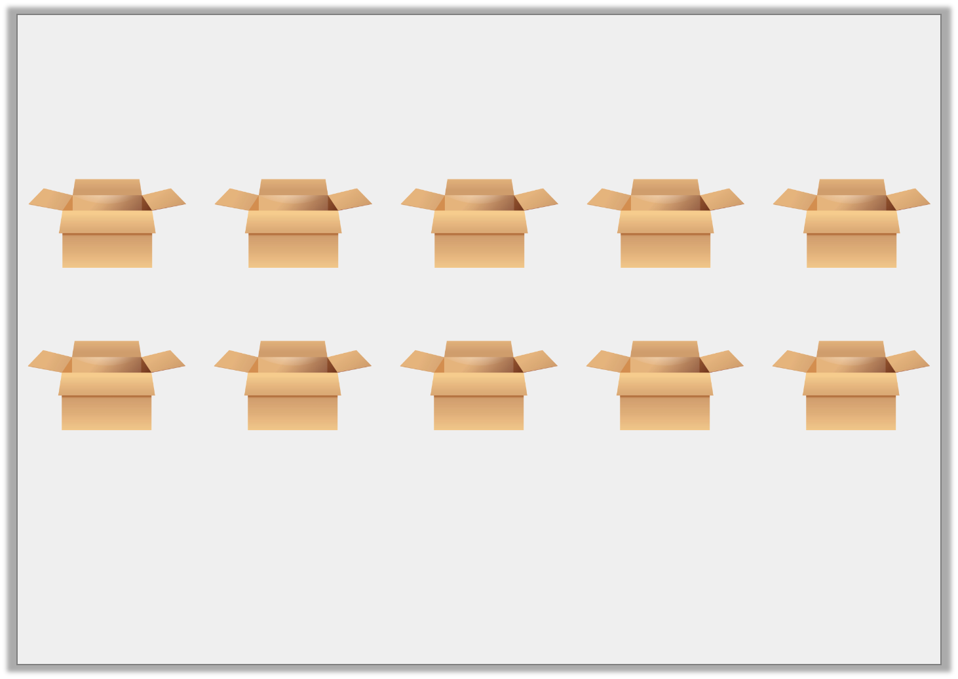
Varied Fluency 2
If one box holds 10 toys, circle the boxes you need to hold 60 toys.
© Classroom Secrets Limited 2018

Slide 9
Varied Fluency 2
If one box holds 10 toys, circle the boxes you need to hold 60 toys.
You will need 6 boxes.
© Classroom Secrets Limited 2018

Slide 10
Varied Fluency 3
Complete the sequence to find the missing numbers.
50 , | 60 , | 70 , |  | ,
© Classroom Secrets Limited 2018

Slide 11
Varied Fluency 3
Complete the sequence to find the missing numbers.
50 , | 60 , | 70 , | 80 | , | 90
© Classroom Secrets Limited 2018

Slide 12
Varied Fluency 4
Label the missing numbers on the number line.
30 |  | 40 |  | 50 |  |  |  |  |  | 80 |  | 90
© Classroom Secrets Limited 2018

Slide 13
Varied Fluency 4
Label the missing numbers on the number line.
30 |  | 40 |  | 50 |  | 60 |  | 70 |  | 80 |  | 90
© Classroom Secrets Limited 2018

Slide 14
Reasoning 1
Lea is counting in 10s starting from 10.
She thinks she will land on the number 44.
Is she correct? Explain your answer.
1 | 2 | 3 | 4 | 5 | 6 | 7 | 8 | 9 | 10
11 | 12 | 13 | 14 | 15 | 16 | 17 | 18 | 19 | 20
21 | 22 | 23 | 24 | 25 | 26 | 27 | 28 | 29 | 30
31 | 32 | 33 | 34 | 35 | 36 | 37 | 38 | 39 | 40
41 | 42 | 43 | 44 | 45 | 46 | 47 | 48 | 49 | 50
51 | 52 | 53 | 54 | 55 | 56 | 57 | 58 | 59 | 60
61 | 62 | 63 | 64 | 65 | 66 | 67 | 68 | 69 | 70
71 | 72 | 73 | 74 | 75 | 76 | 77 | 78 | 79 | 80
81 | 82 | 83 | 84 | 85 | 86 | 87 | 88 | 89 | 90
91 | 92 | 93 | 94 | 95 | 96 | 97 | 98 | 99 | 100
© Classroom Secrets Limited 2018

Slide 15
Reasoning 1
Lea is counting in 10s starting from 10.
She thinks she will land on the number 44.
Is she correct? Explain your answer.
Lea is not correct because…
1 | 2 | 3 | 4 | 5 | 6 | 7 | 8 | 9 | 10
11 | 12 | 13 | 14 | 15 | 16 | 17 | 18 | 19 | 20
21 | 22 | 23 | 24 | 25 | 26 | 27 | 28 | 29 | 30
31 | 32 | 33 | 34 | 35 | 36 | 37 | 38 | 39 | 40
41 | 42 | 43 | 44 | 45 | 46 | 47 | 48 | 49 | 50
51 | 52 | 53 | 54 | 55 | 56 | 57 | 58 | 59 | 60
61 | 62 | 63 | 64 | 65 | 66 | 67 | 68 | 69 | 70
71 | 72 | 73 | 74 | 75 | 76 | 77 | 78 | 79 | 80
81 | 82 | 83 | 84 | 85 | 86 | 87 | 88 | 89 | 90
91 | 92 | 93 | 94 | 95 | 96 | 97 | 98 | 99 | 100
© Classroom Secrets Limited 2018

Slide 16
Reasoning 1
Lea is counting in 10s starting from 10.
She thinks she will land on the number 44.
Is she correct? Explain your answer.
Lea is not correct because all the numbers she lands on end in ‘0’.
1 | 2 | 3 | 4 | 5 | 6 | 7 | 8 | 9 | 10
11 | 12 | 13 | 14 | 15 | 16 | 17 | 18 | 19 | 20
21 | 22 | 23 | 24 | 25 | 26 | 27 | 28 | 29 | 30
31 | 32 | 33 | 34 | 35 | 36 | 37 | 38 | 39 | 40
41 | 42 | 43 | 44 | 45 | 46 | 47 | 48 | 49 | 50
51 | 52 | 53 | 54 | 55 | 56 | 57 | 58 | 59 | 60
61 | 62 | 63 | 64 | 65 | 66 | 67 | 68 | 69 | 70
71 | 72 | 73 | 74 | 75 | 76 | 77 | 78 | 79 | 80
81 | 82 | 83 | 84 | 85 | 86 | 87 | 88 | 89 | 90
91 | 92 | 93 | 94 | 95 | 96 | 97 | 98 | 99 | 100
© Classroom Secrets Limited 2018

Slide 17
Problem Solving 1
Each flower has 10 petals.
One bee can rest on each petal.
Are there enough petals for 50 bees to rest on?
© Classroom Secrets Limited 2018

Slide 18
Problem Solving 1
Each flower has 10 petals.
One bee can rest on each petal.
Are there enough petals for 50 bees to rest on?
There are enough petals because there are 5 groups of 10 petals, so there are 50 petals altogether.
© Classroom Secrets Limited 2018

Slide 19
Reasoning 2
Suki thinks the arrow is pointing to 40.
Is she correct? Explain how you know.
30 |  |  |  |  |  |  |  |  |  |  |  | 90
© Classroom Secrets Limited 2018

Slide 20
Reasoning 2
Suki thinks the arrow is pointing to 40.
Is she correct? Explain how you know.
Suki is not correct because…
30 |  |  |  |  |  |  |  |  |  |  |  | 90
© Classroom Secrets Limited 2018

Slide 21
Reasoning 2
Suki thinks the arrow is pointing to 40.
Is she correct? Explain how you know.
Suki is not correct because the arrow is pointing to the number 70.
30 |  | 40 |  | 50 |  | 60 |  | 70 |  | 80 |  | 90
© Classroom Secrets Limited 2018

