Slide 1
LIFE/work balance
We have started a #LIFEworkbalance campaign and we need your help to complete our LIFE/work balance survey.
We hope to publish the results soon, so please give 15 minutes of your time to help us get a true picture of school life.
Want to be a part of this campaign? Take the survey on our website and share it with your colleagues!
© Classroom Secrets Limited 2019

Slide 2
Year 1 – Summer Block 3 – Position and Direction – Describe Turns
About This Resource:
This PowerPoint has been designed to support your teaching of this small step. It includes a starter activity and an example of each question from the Varied Fluency and Reasoning and Problem Solving resources also provided in this pack. You can choose to work through all examples provided or a selection of them depending on the needs of your class.
National Curriculum Objectives:
Mathematics Year 1: (1P2) Describe position, direction and movement, including whole, half, quarter and three-quarter turns
More Year 1 Position and Direction resources.
Did you like this resource? Don’t forget to review it on our website.
© Classroom Secrets Limited 2019

Slide 3
Year 1 – Summer Block 3 – Position and Direction
Step 1: Describe Turns
© Classroom Secrets Limited 2019

Slide 4
Introduction
Stand up and face the front of the classroom. Follow these instructions. Which ones make one full turn?
 | Instructions | Full turn?
1 | Make a quarter turn. Make a half turn in the same direction. Make another half turn in the same direction.
2 | Make a half turn. Make a quarter turn in the same direction. Make another quarter turn in the same direction.
3 | Make a three quarter turn. Make a half turn in the same direction.
© Classroom Secrets Limited 2019

Slide 5
Introduction
Stand up and face the front of the classroom. Follow these instructions. Which ones make one full turn?
 | Instructions | Full turn?
1 | Make a quarter turn. Make a half turn in the same direction. Make another half turn in the same direction. | X
2 | Make a half turn. Make a quarter turn in the same direction. Make another quarter turn in the same direction. | ✓
3 | Make a three quarter turn. Make a half turn in the same direction. | X
© Classroom Secrets Limited 2019

Slide 6
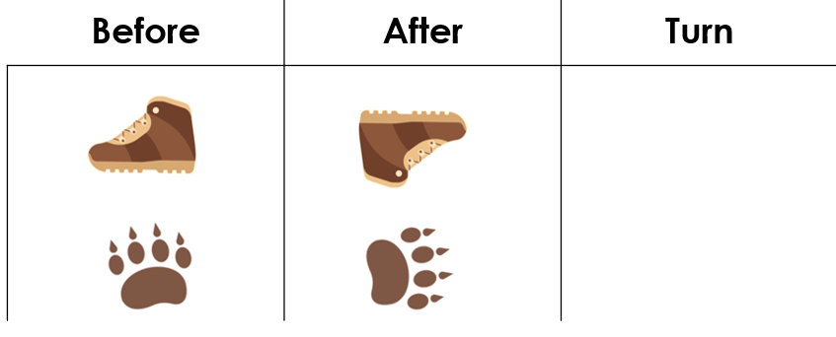
Varied Fluency 1
Look at the objects below. How have they moved?
Write the correct turn for each object.
© Classroom Secrets Limited 2019

Slide 7
Varied Fluency 1
Look at the objects below. How have they moved?
The paw print may also make a three quarter turn to the left.
Half turn
Quarter
turn
© Classroom Secrets Limited 2019

Slide 8
Varied Fluency 2
How will this shape look after a quarter turn. Circle your answer.
a
b
© Classroom Secrets Limited 2019

Slide 9
Varied Fluency 2
How will this shape look after a quarter turn. Circle your answer.
a
b
© Classroom Secrets Limited 2019

Slide 10
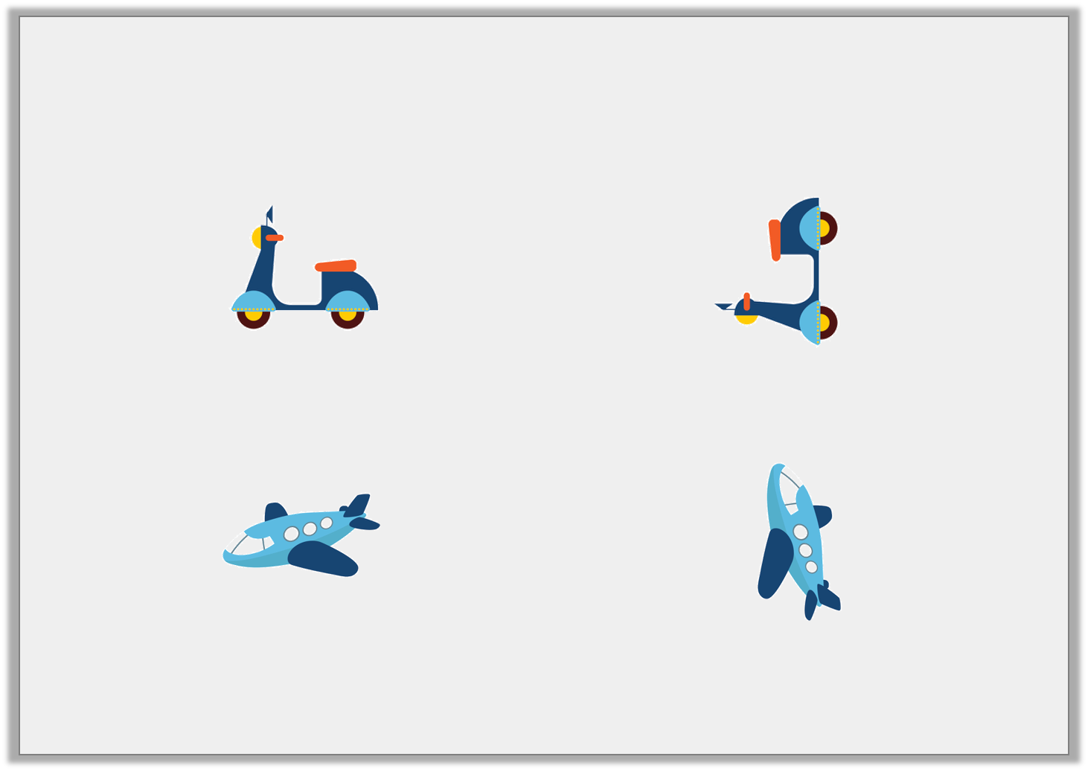
Varied Fluency 3
Draw an arrow in the box to show
the direction each object has turned.
Describe the turn each object has made.
z
© Classroom Secrets Limited 2019

Slide 11
Varied Fluency 3
Draw an arrow in the box to show
the direction each object has turned.
A quarter turn
A quarter turn
Describe the turn each object has made.
© Classroom Secrets Limited 2019

Slide 12
Varied Fluency 4
Circle the shapes which have made a 3 quarter turn.
© Classroom Secrets Limited 2019

Slide 13
Varied Fluency 4
Circle the shapes which have made a 3 quarter turn.
Think about which way the shapes could turn.
© Classroom Secrets Limited 2019

Slide 14
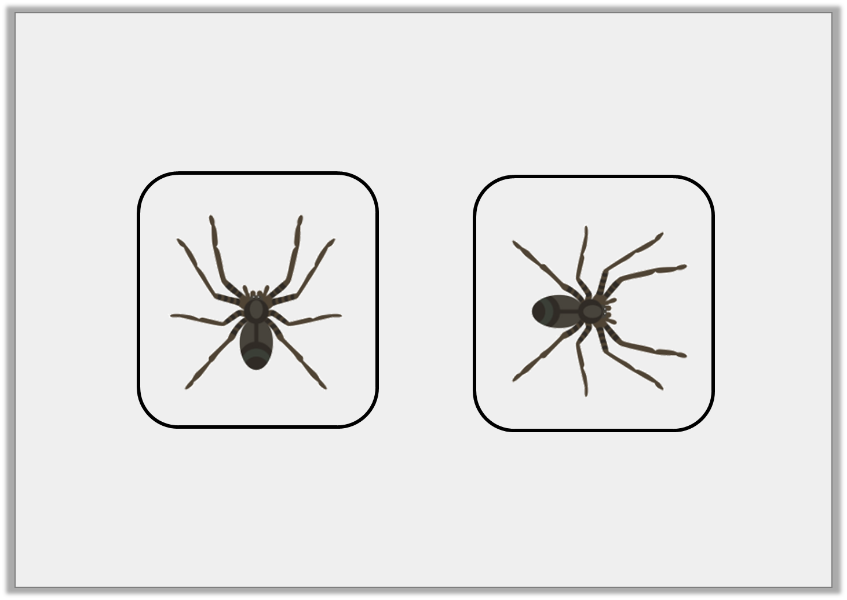
Problem Solving 1
Joseph has turned his game piece twice, in the same direction.
Which two turns could leave him facing this way?
Start
Now
© Classroom Secrets Limited 2019

Slide 15
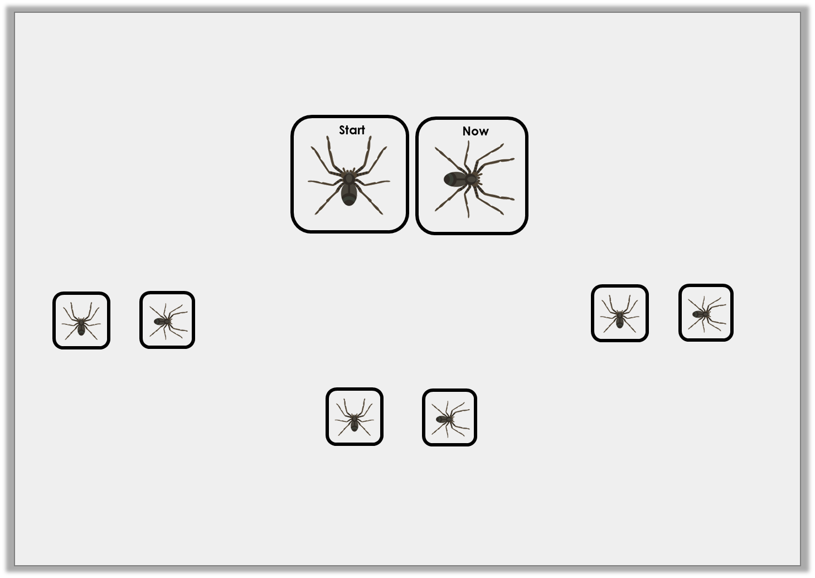
Problem Solving 1
Joseph has turned his game piece twice, in the same direction.
Which two turns could leave him facing this way?
One full turn and one quarter turn
One half turn and one quarter turn
One three quarter turn and one half turn
© Classroom Secrets Limited 2019

Slide 16
Problem Solving 2
The jigsaw pieces need to turn to fit their space.
How should they each turn?
© Classroom Secrets Limited 2019

Slide 17
Problem Solving 2
The jigsaw pieces need to turn to fit their space.
How should they each turn?
a quarter turn
a half turn
a quarter turn
© Classroom Secrets Limited 2019

Slide 18
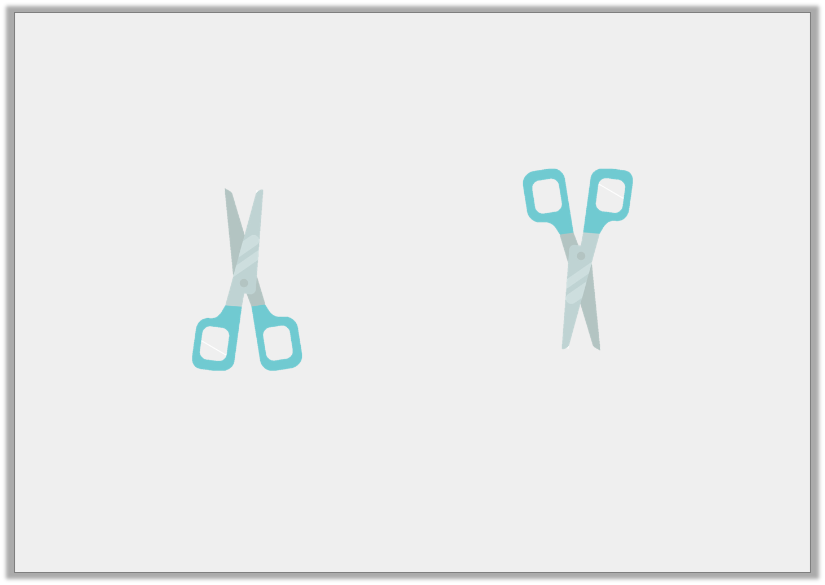
Reasoning 1
Emily was asked to turn the scissors one quarter turn and one half turn.
Did she follow the instructions? Explain and correct any mistakes you find.
© Classroom Secrets Limited 2019

Slide 19
Reasoning 1
Emily was asked to turn the scissors one quarter turn and one half turn.
Did she follow the instructions? Explain and correct any mistakes you find.
Emily has not followed the instructions...
© Classroom Secrets Limited 2019

Slide 20
Reasoning 1
Emily was asked to turn the scissors one quarter turn and one half turn.
Did she follow the instructions? Explain and correct any mistakes you find.
Emily has not followed the instructions. She turned the scissors one half turn. She needs to turn them one quarter turn more.
© Classroom Secrets Limited 2019

