Slide 1
LIFE/work balance
We have started a #LIFEworkbalance campaign and we need your help to complete our LIFE/work balance survey.
We hope to publish the results soon, so please give 15 minutes of your time to help us get a true picture of school life.
Want to be a part of this campaign? Take the survey on our website and share it with your colleagues!
R
R
PS
PS
© Classroom Secrets Limited 2019

Slide 2
Year 1 – Summer Block 4 – Place Value – Counting to 100
About This Resource:
This PowerPoint has been designed to support your teaching of this small step. It includes a starter activity and an example of each question from the Varied Fluency and Reasoning and Problem Solving resources also provided in this pack. You can choose to work through all examples provided or a selection of them depending on the needs of your class.
National Curriculum Objectives:
Mathematics Year 1: (1N1a) Count to and across 100, forwards and backwards, beginning with 0 or 1, or from any given number
More Year 1 Place Value resources.
Did you like this resource? Don’t forget to review it on our website.
© Classroom Secrets Limited 2019

Slide 3
Year 1 – Summer Block 4 – Place Value
Step 1: Counting to 100
© Classroom Secrets Limited 2019

Slide 4
Introduction
Start at 27. Count forwards 11 Count backwards 6 Count forwards 22 Count backwards 4 Count forwards 34 What is the answer?
1 | 2 | 3 | 4 | 5 | 6 | 7 | 8 | 9 | 10
11 | 12 | 13 | 14 | 15 | 16 | 17 | 18 | 19 | 20
21 | 22 | 23 | 24 | 25 | 26 | 27 | 28 | 29 | 30
31 | 32 | 33 | 34 | 35 | 36 | 37 | 38 | 39 | 40
41 | 42 | 43 | 44 | 45 | 46 | 47 | 48 | 49 | 50
51 | 52 | 53 | 54 | 55 | 56 | 57 | 58 | 59 | 60
61 | 62 | 63 | 64 | 65 | 66 | 67 | 68 | 69 | 70
71 | 72 | 73 | 74 | 75 | 76 | 77 | 78 | 79 | 80
81 | 82 | 83 | 84 | 85 | 86 | 87 | 88 | 89 | 90
91 | 92 | 93 | 94 | 95 | 96 | 97 | 98 | 99 | 100
© Classroom Secrets Limited 2019

Slide 5
Introduction
Start at 27. Count forwards 11 (38) Count backwards 6 (32) Count forwards 22 (54) Count backwards 4 (50) Count forwards 34 (84) What is the answer?
The answer is 84
1 | 2 | 3 | 4 | 5 | 6 | 7 | 8 | 9 | 10
11 | 12 | 13 | 14 | 15 | 16 | 17 | 18 | 19 | 20
21 | 22 | 23 | 24 | 25 | 26 | 27 | 28 | 29 | 30
31 | 32 | 33 | 34 | 35 | 36 | 37 | 38 | 39 | 40
41 | 42 | 43 | 44 | 45 | 46 | 47 | 48 | 49 | 50
51 | 52 | 53 | 54 | 55 | 56 | 57 | 58 | 59 | 60
61 | 62 | 63 | 64 | 65 | 66 | 67 | 68 | 69 | 70
71 | 72 | 73 | 74 | 75 | 76 | 77 | 78 | 79 | 80
81 | 82 | 83 | 84 | 85 | 86 | 87 | 88 | 89 | 90
91 | 92 | 93 | 94 | 95 | 96 | 97 | 98 | 99 | 100
© Classroom Secrets Limited 2019

Slide 6
Varied Fluency 1
Circle the number that comes before 80
81 | 69 | 79
© Classroom Secrets Limited 2019

Slide 7
Varied Fluency 1
Circle the number that comes before 80
81 | 69 | 79
© Classroom Secrets Limited 2019

Slide 8
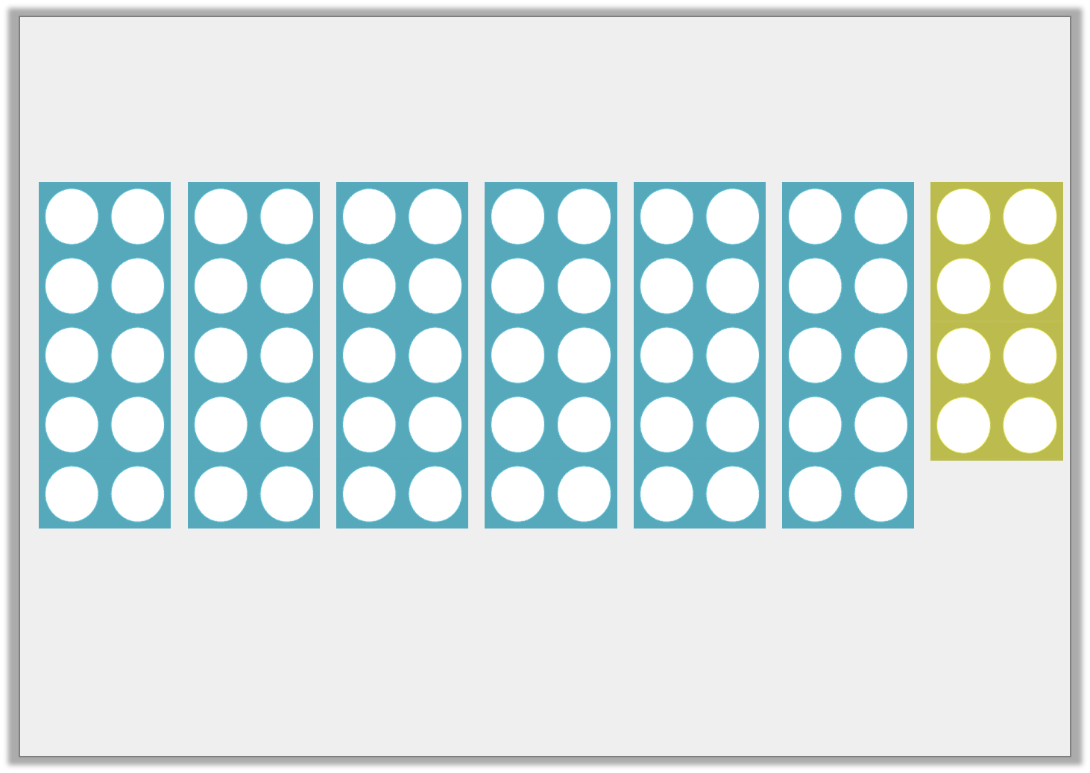
Varied Fluency 2
What is the number shown?
© Classroom Secrets Limited 2019

Slide 9
Varied Fluency 2
What is the number shown?
68
© Classroom Secrets Limited 2019

Slide 10
Varied Fluency 3
Fill in the missing cards.
56 | fifty-seven | 58
© Classroom Secrets Limited 2019

Slide 11
Varied Fluency 3
Fill in the missing cards.
56 | fifty-seven | 58 | 59 |  | 60
© Classroom Secrets Limited 2019

Slide 12
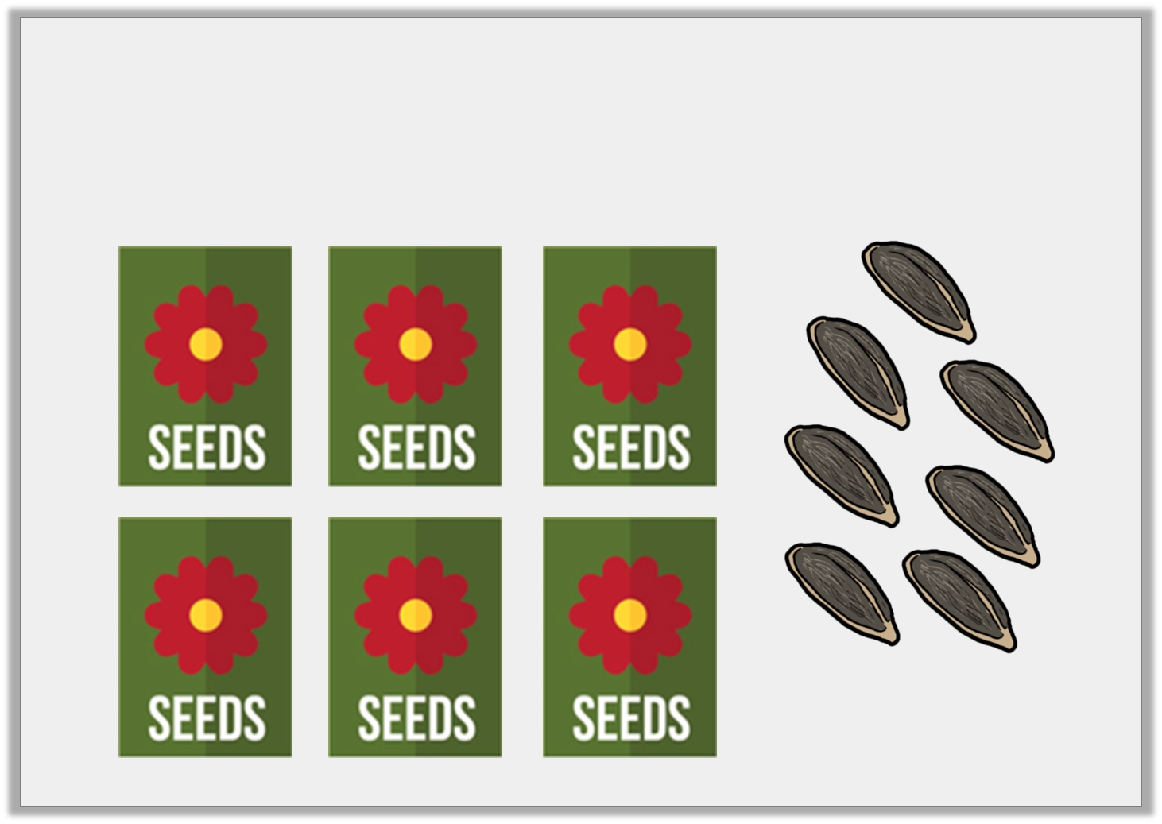
Varied Fluency 4
There are 10 seeds in each packet.
How many seeds are there altogether?
© Classroom Secrets Limited 2019

Slide 13
Varied Fluency 4
There are 10 seeds in each packet.
How many seeds are there altogether?
67
© Classroom Secrets Limited 2019

Slide 14
Problem Solving 1
Here is part of a hundred square.
Fill in the missing squares.
 |  | 63
 | 72 | 73
 |  | 83
© Classroom Secrets Limited 2019

Slide 15
Problem Solving 1
Here is part of a hundred square.
Fill in the missing squares.
61 | 62 | 63
 | 72 | 73 | 74 | 75
 |  | 83 | 84 | 85
© Classroom Secrets Limited 2019

Slide 16
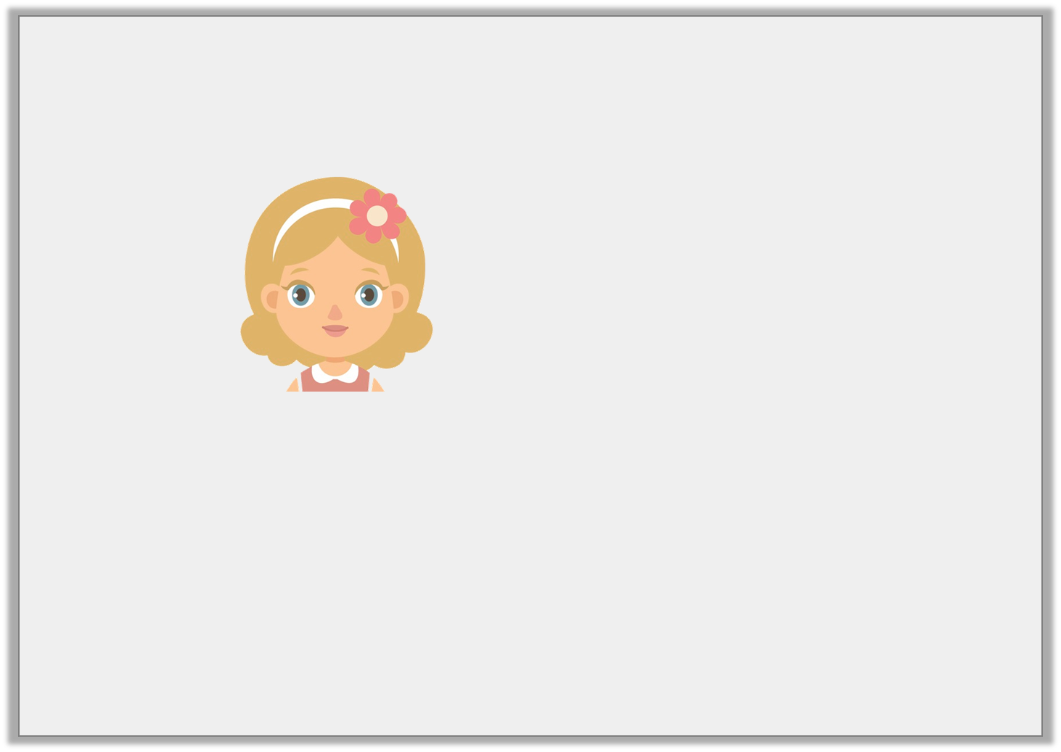
Reasoning 1
Jill says:
Will she say the number 88?
Explain your reasoning.
I am going to count to 95. I will start at 83 and count forwards.
© Classroom Secrets Limited 2019

Slide 17
Reasoning 1
Jill says:
Will she say the number 88?
Explain your reasoning.
Jill will say the number 88 because...
I am going to count to 95. I will start at 83 and count forwards.
© Classroom Secrets Limited 2019

Slide 18
Reasoning 1
Jill says:
Will she say the number 88?
Explain your reasoning.
Jill will say the number 88 because it comes after 83 and before 95.
I am going to count to 95. I will start at 83 and count forwards.
© Classroom Secrets Limited 2019

Slide 19
Reasoning 2
Callum has counted the biscuits in the cupboard. Some of the biscuits are in packets of 10 biscuits.
He thinks there are 70 biscuits.
Explain his mistake.
© Classroom Secrets Limited 2019

Slide 20
Reasoning 2
Callum has counted the biscuits in the cupboard. Some of the biscuits are in packets of 10 biscuits.
He thinks there are 70 biscuits.
Explain his mistake.
Callum has counted the single biscuits as 10 biscuits. There are 43 biscuits.
© Classroom Secrets Limited 2019

