Slide 1
LIFE/work balance
We have started a #LIFEworkbalance campaign and we need your help to complete our LIFE/work balance survey.
We hope to publish the results soon, so please give 15 minutes of your time to help us get a true picture of school life.
Want to be a part of this campaign? Take the survey on our website and share it with your colleagues!
© Classroom Secrets Limited 2018

Slide 2
Year 1 – Summer Block 5 – Money – Recognising Coins
Teaching Note:
We recommend using real coins to support this step.
About This Resource:
This PowerPoint has been designed to support your teaching of this small step. It includes a starter activity and an example of each question from the Varied Fluency and Reasoning and Problem Solving resources also provided in this pack. You can choose to work through all examples provided or a selection of them depending on the needs of your class.
National Curriculum Objectives:
Mathematics Year 1: (1M3) Recognise and know the value of different denominations of coins and notes
More Year 1 Money resources.
Did you like this resource? Don’t forget to review it on our website.
© Classroom Secrets Limited 2018

Slide 3
Year 1 – Summer Block 5 – Money
Step 1: Recognising Coins
© Classroom Secrets Limited 2018

Slide 4
Introduction
Help Zoe count in steps of 2, 5 and 10.
32 |  | 36 |  | 40 |  | 44
 | 90 |  | 70 |  | 50
50 |  | 40 |  | 30 |  | 20
© Classroom Secrets Limited 2018

Slide 5
Introduction
Help Zoe count in steps of 2, 5 and 10.
32 | 34 | 36 | 38 | 40 | 42 | 44
90 | 80 | 70 | 60 | 50 | 40 | 30
50 | 45 | 40 | 35 | 30 | 25 | 20
© Classroom Secrets Limited 2018

Slide 6
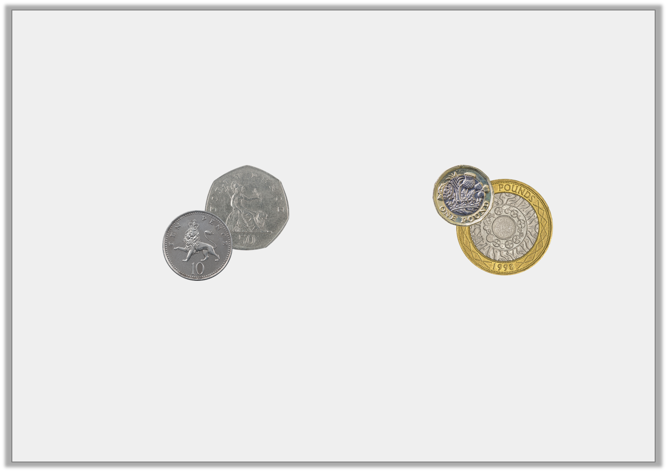
Varied Fluency 1
What is the value of each set?
© Classroom Secrets Limited 2018

Slide 7
Varied Fluency 1
What is the value of each set?
60p | £3
© Classroom Secrets Limited 2018

Slide 8
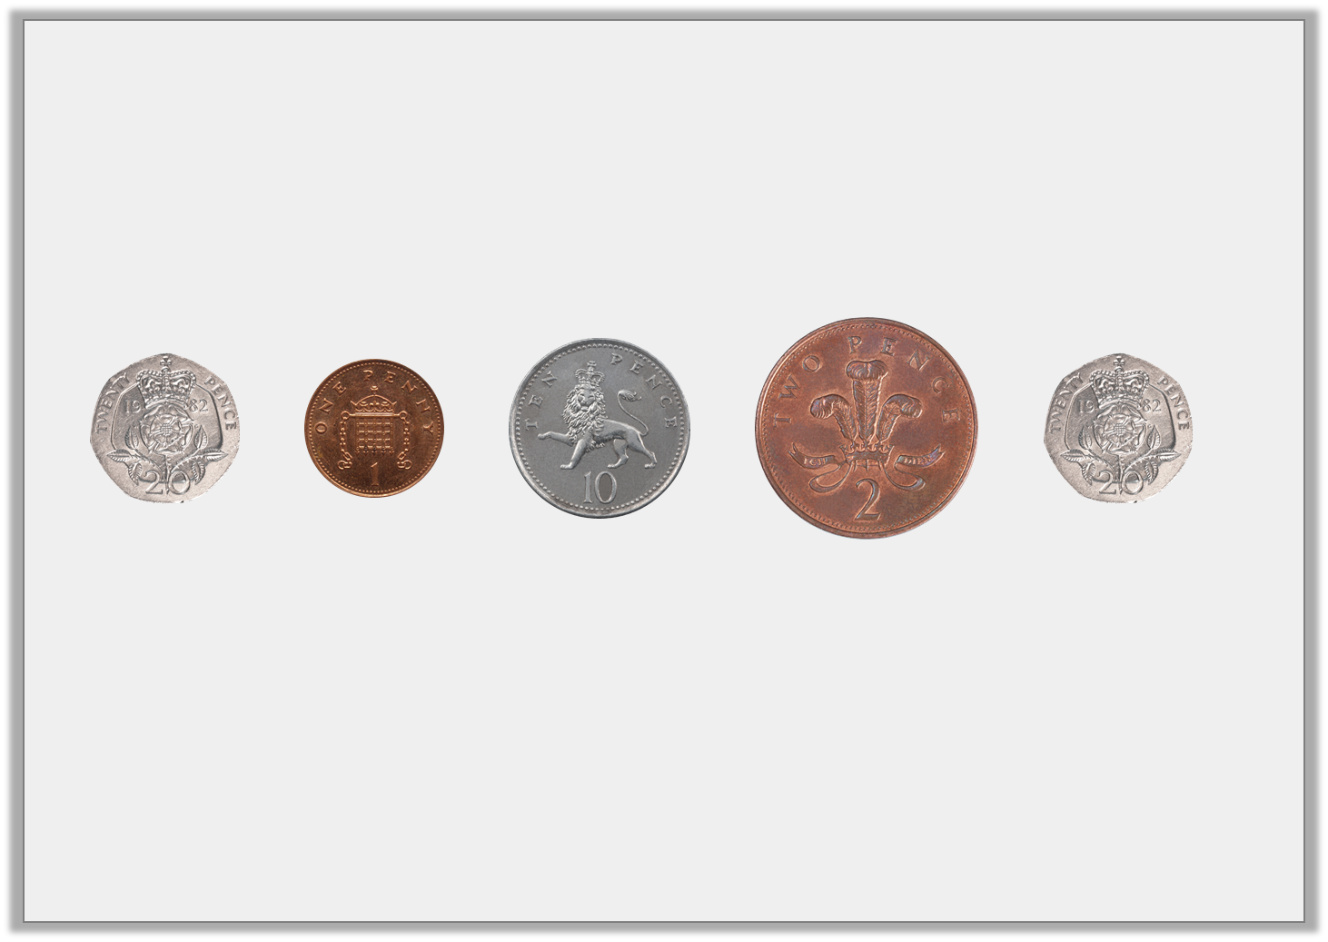
Varied Fluency 2
Circle the coins that total 40p.
© Classroom Secrets Limited 2018

Slide 9
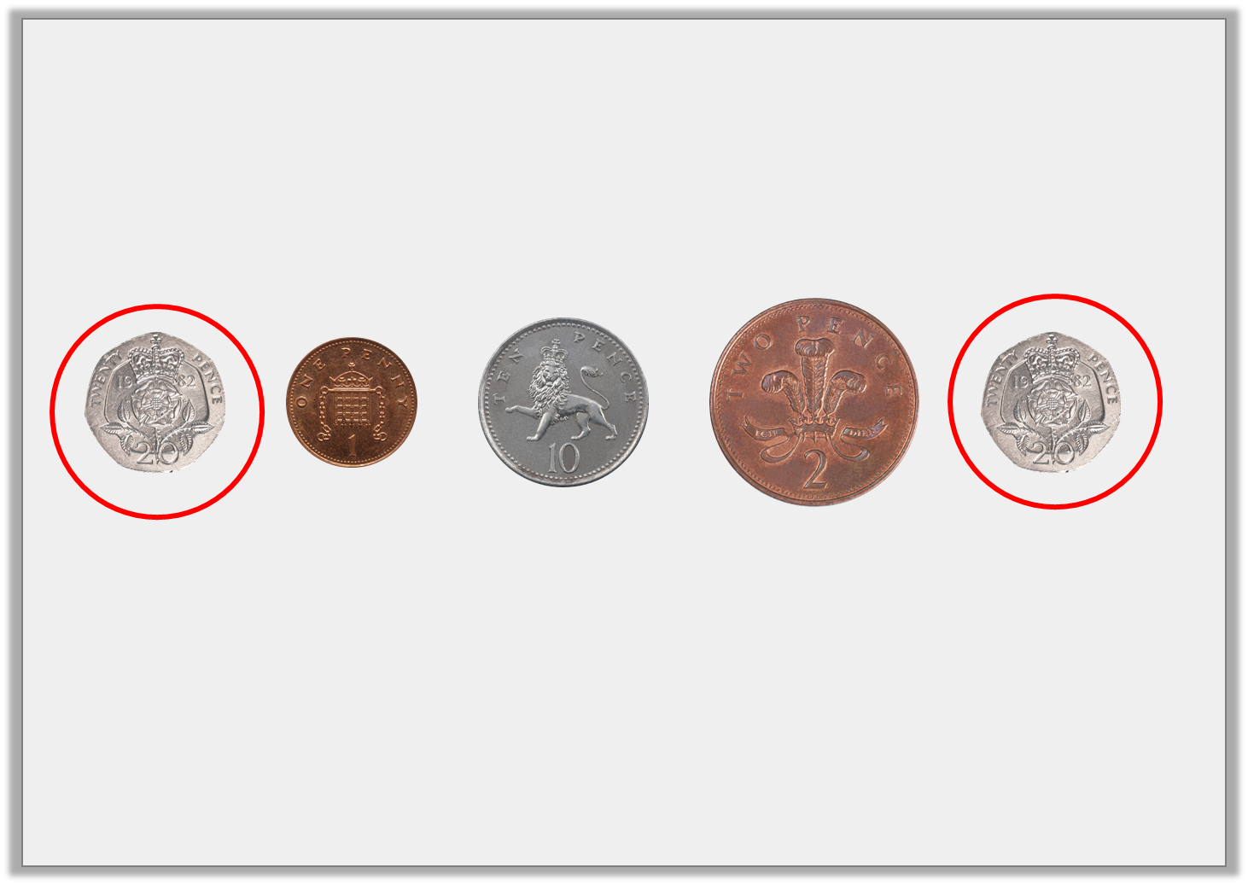
Varied Fluency 2
Circle the coins that total 40p.
20p + 20p = 40p
© Classroom Secrets Limited 2018

Slide 10
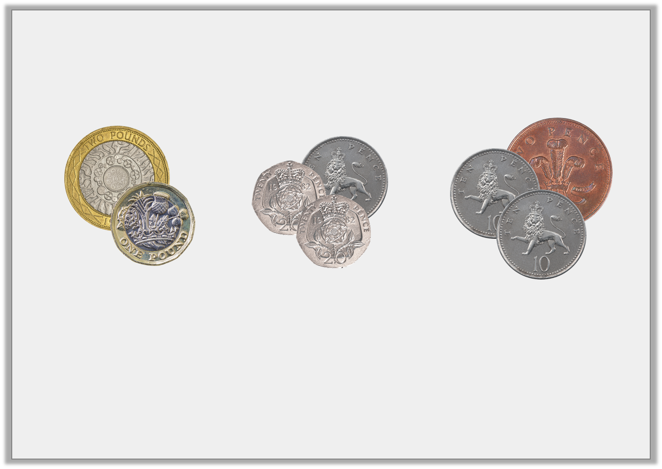
Varied Fluency 3
Circle the set with the most value.
© Classroom Secrets Limited 2018

Slide 11
Varied Fluency 3
Circle the set with the most value.
£3 | 50p | 22p
© Classroom Secrets Limited 2018

Slide 12
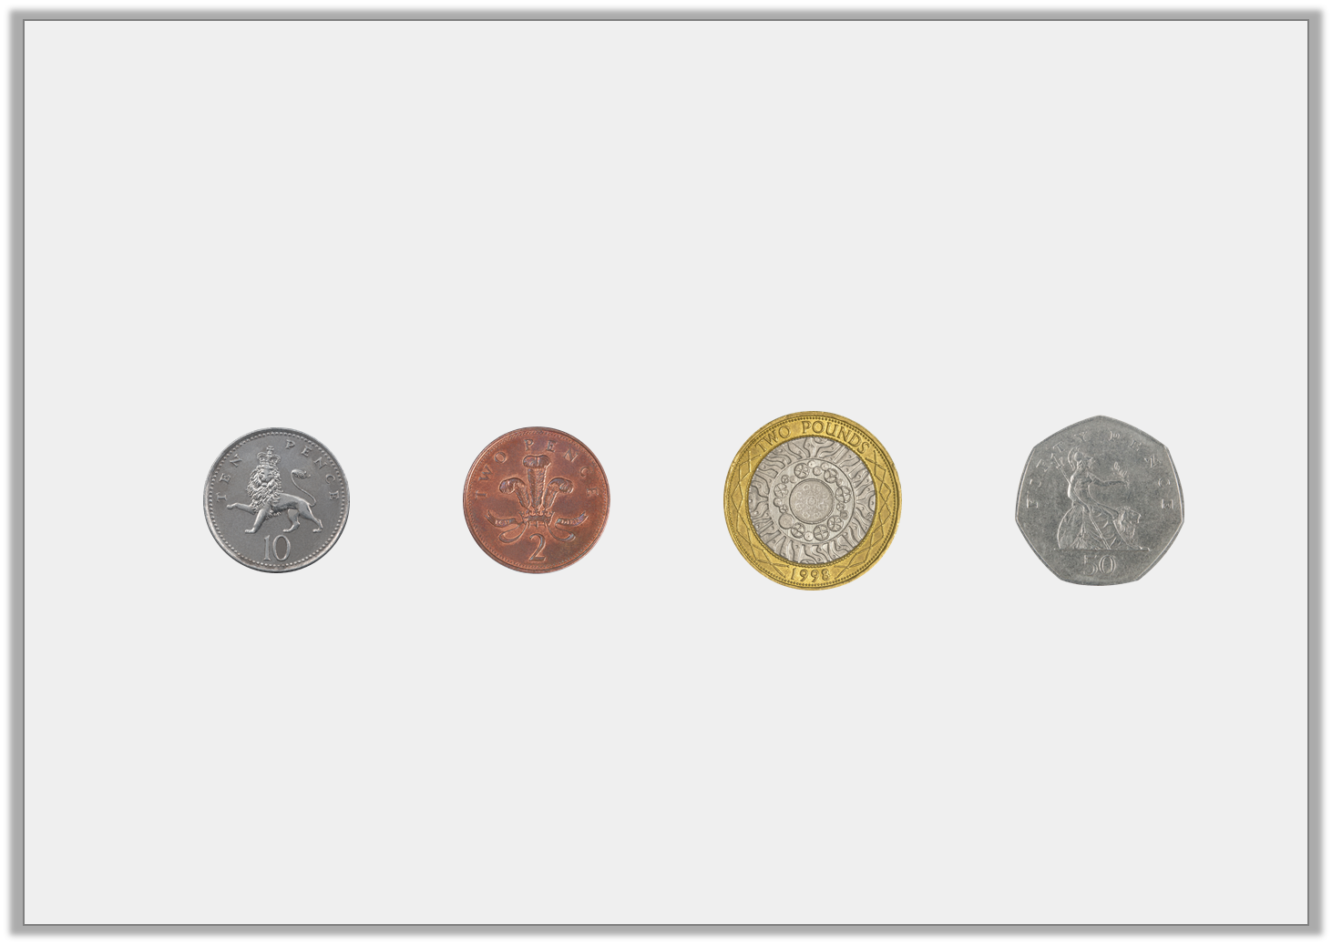
Varied Fluency 4
Order the coins from least to most value.
© Classroom Secrets Limited 2018

Slide 13
Varied Fluency 4
Order the coins from least to most value.
least
most
© Classroom Secrets Limited 2018

Slide 14
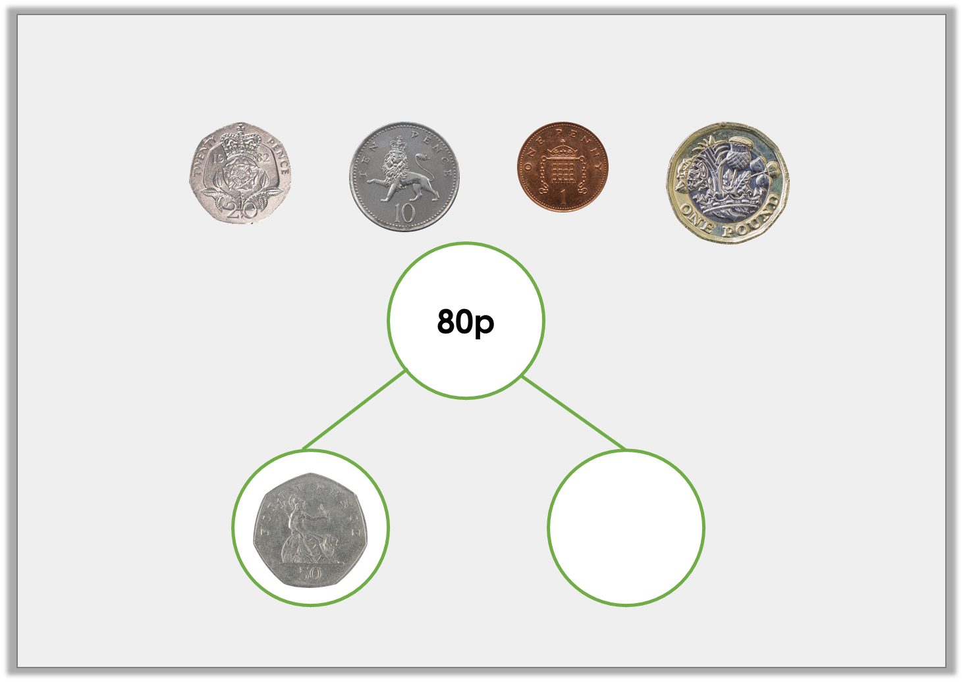
Varied Fluency 5
Use two of these coins to complete the part whole model.
© Classroom Secrets Limited 2018

Slide 15
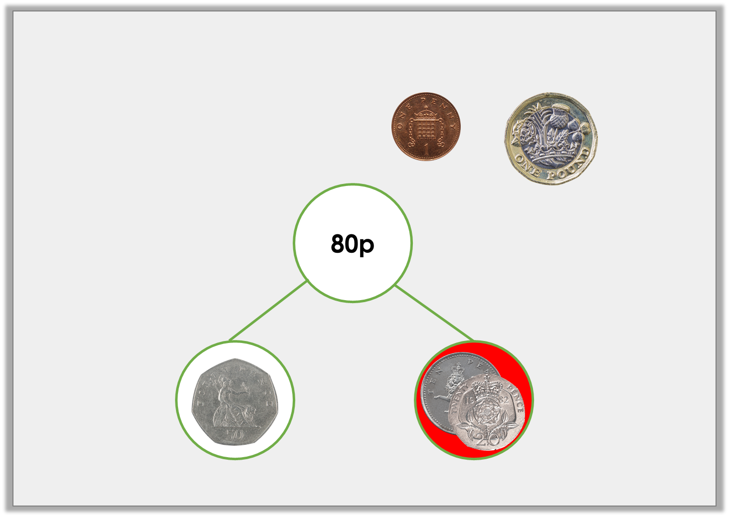
Varied Fluency 5
Use two of these coins to complete the part whole model.
© Classroom Secrets Limited 2018

Slide 16
Reasoning 1
Sara has two coins in her pocket. They total 55p.
Her friend Hafsah says,
Is she correct? Explain your answer.
© Classroom Secrets Limited 2018

Slide 17
Reasoning 1
Sara has two coins in her pocket. They total 55p.
Her friend Hafsah says,
Is she correct? Explain your answer.
She is incorrect…
© Classroom Secrets Limited 2018

Slide 18
Reasoning 1
Sara has two coins in her pocket. They total 55p.
Her friend Hafsah says,
Is she correct? Explain your answer.
She is incorrect because 5p and 5p total 10p not 55p. Sara must have a 50p and a 5p coin.
© Classroom Secrets Limited 2018

Slide 19
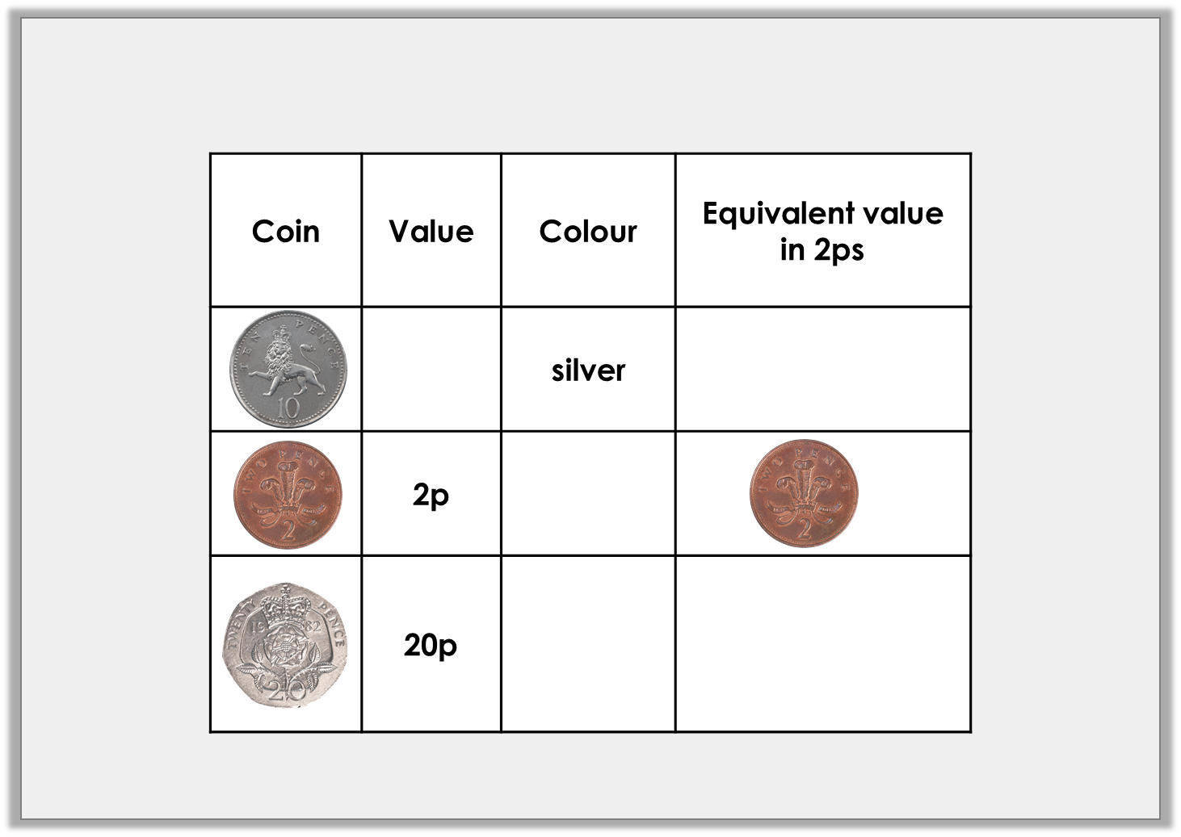
Problem Solving 1
Complete the table.
© Classroom Secrets Limited 2018

Slide 20
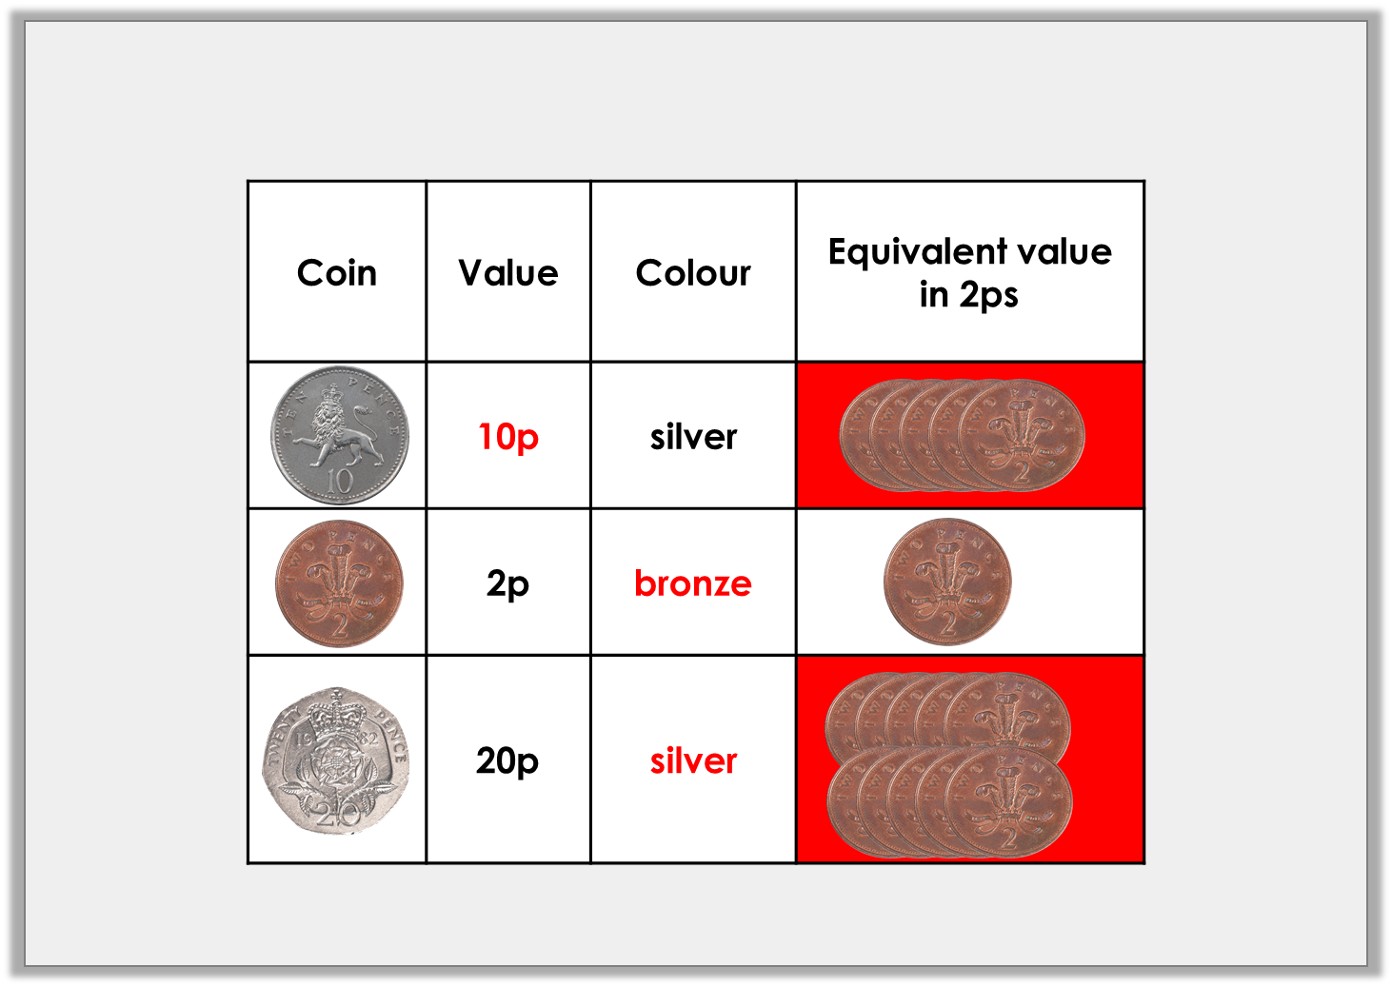
Problem Solving 1
Complete the table.
© Classroom Secrets Limited 2018

Slide 21
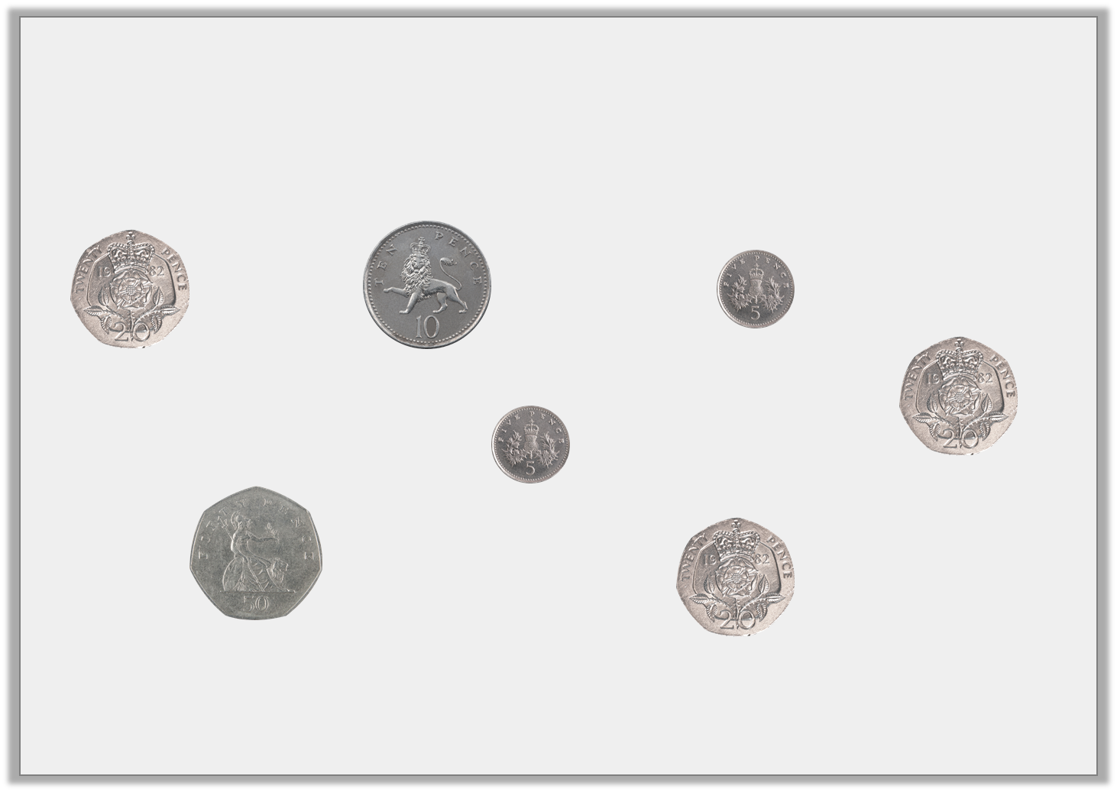
Problem Solving 2
Make 60p in as many different ways as you can using these coins. Use three coins or less.
© Classroom Secrets Limited 2018

Slide 22
Problem Solving 2
Make 60p in as many different ways as you can using these coins. Use three coins or less.
50p + 10p; 50p + 5p + 5p; 20p + 20p + 20p
© Classroom Secrets Limited 2018

