Slide 1
LIFE/work balance
We have started a #LIFEworkbalance campaign and we need your help to complete our LIFE/work balance survey.
We hope to publish the results soon, so please give 15 minutes of your time to help us get a true picture of school life.
Want to be a part of this campaign? Take the survey on our website and share it with your colleagues!
© Classroom Secrets Limited 2019

Slide 2
Year 2 – Autumn Block 3 – Money – Count Money – Pence
About This Resource:
This PowerPoint has been designed to support your teaching of this small step. It includes a starter activity and an example of each question from the Varied Fluency and Reasoning and Problem Solving resources also provided in this pack. You can choose to work through all examples provided or a selection of them depending on the needs of your class.
National Curriculum Objectives:
Mathematics Year 2: (2M3a) Recognise and use symbols for pounds (£) and pence (p); combine amounts to make a particular value
More Year 2 Money resources.
Did you like this resource? Don’t forget to review it on our website.
© Classroom Secrets Limited 2018

Slide 3
Year 2 – Autumn Block 3 – Money
Step 1: Count Money – Pence
© Classroom Secrets Limited 2018

Slide 4
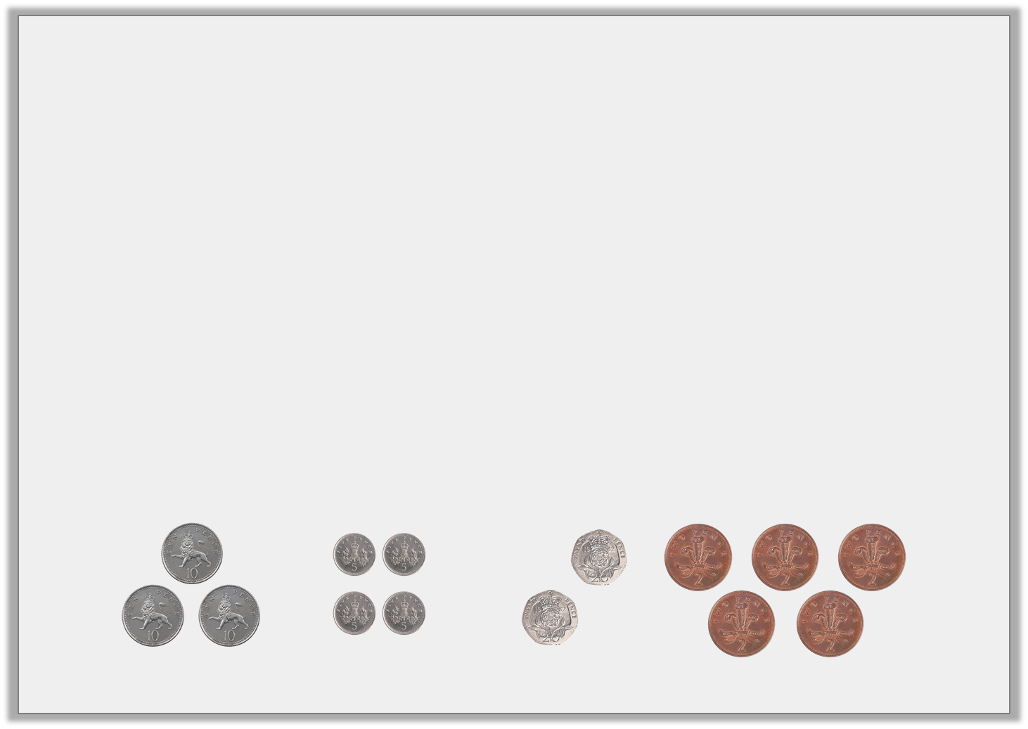
Introduction
Sort the coins into the table to make the correct total.
10p | 20p | 30p | 40p
© Classroom Secrets Limited 2018

Slide 5
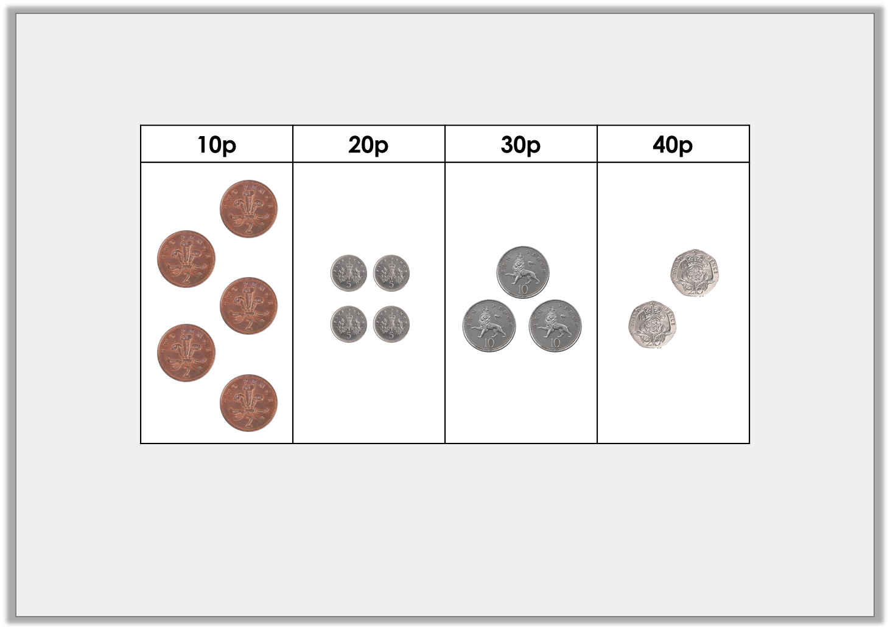
Introduction
Sort the coins into the table to make the correct total.
Example answer
© Classroom Secrets Limited 2018

Slide 6
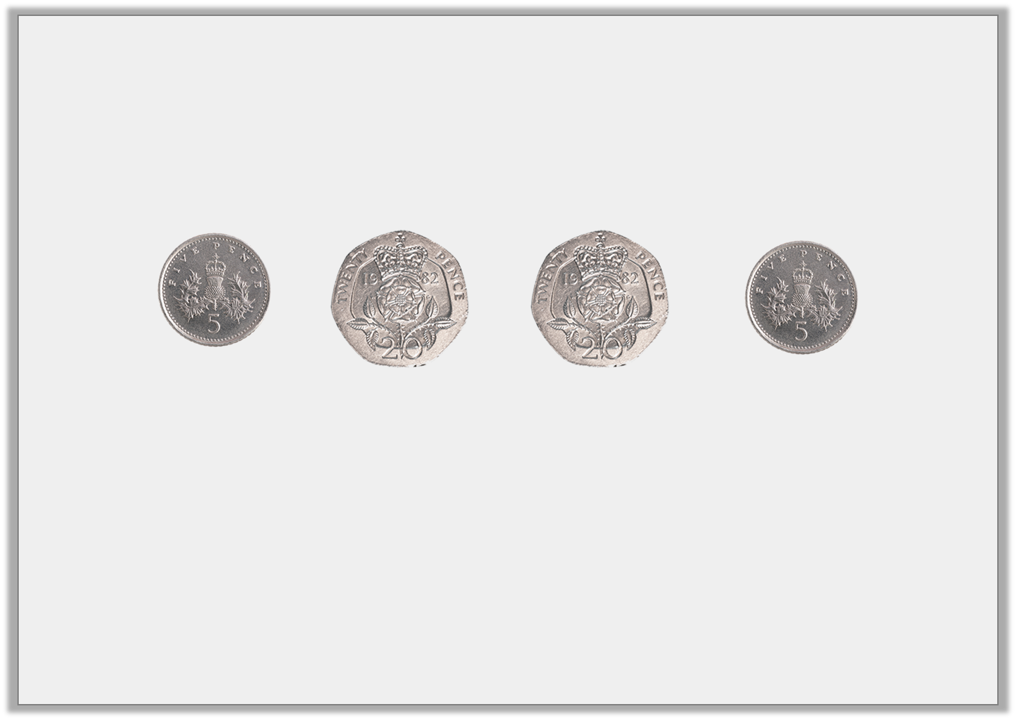
Varied Fluency 1
Circle the correct total for the coins shown.
50p | 40p | 60p
© Classroom Secrets Limited 2018

Slide 7
Varied Fluency 1
Circle the correct total for the coins shown.
50p | 40p | 60p
© Classroom Secrets Limited 2018

Slide 8
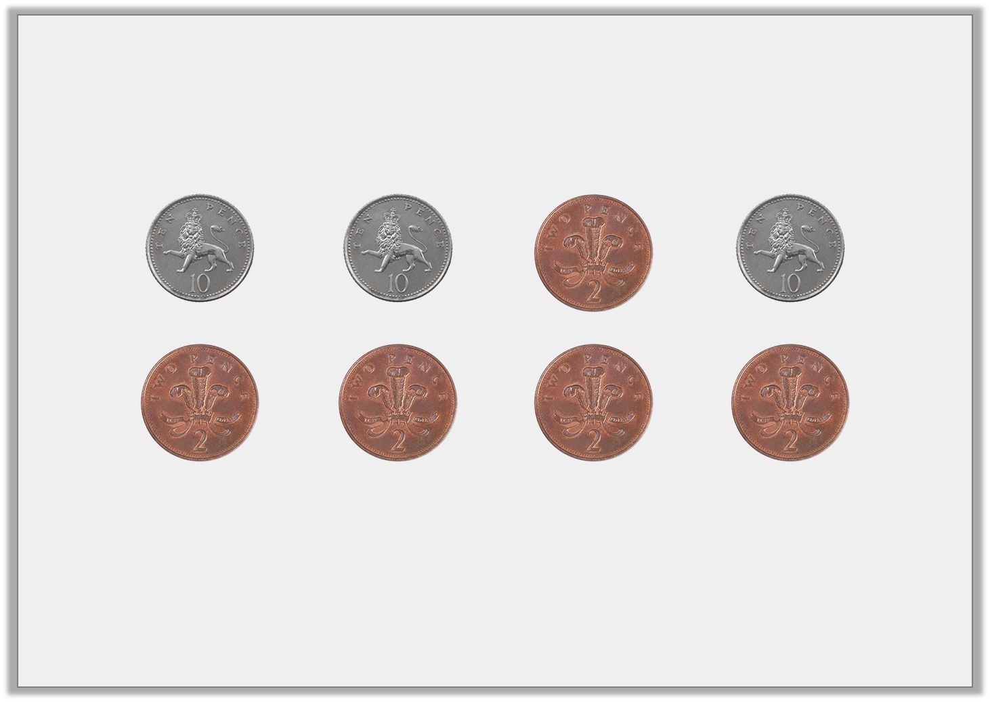
Varied Fluency 2
What is the total of the coins below?
© Classroom Secrets Limited 2018

Slide 9
Varied Fluency 2
What is the total of the coins below?
40p
© Classroom Secrets Limited 2018

Slide 10
Varied Fluency 3
True or false?
I have 60p.
© Classroom Secrets Limited 2018

Slide 11
Varied Fluency 3
True or false?
False, he has 70p.
I have 60p.
© Classroom Secrets Limited 2018

Slide 12
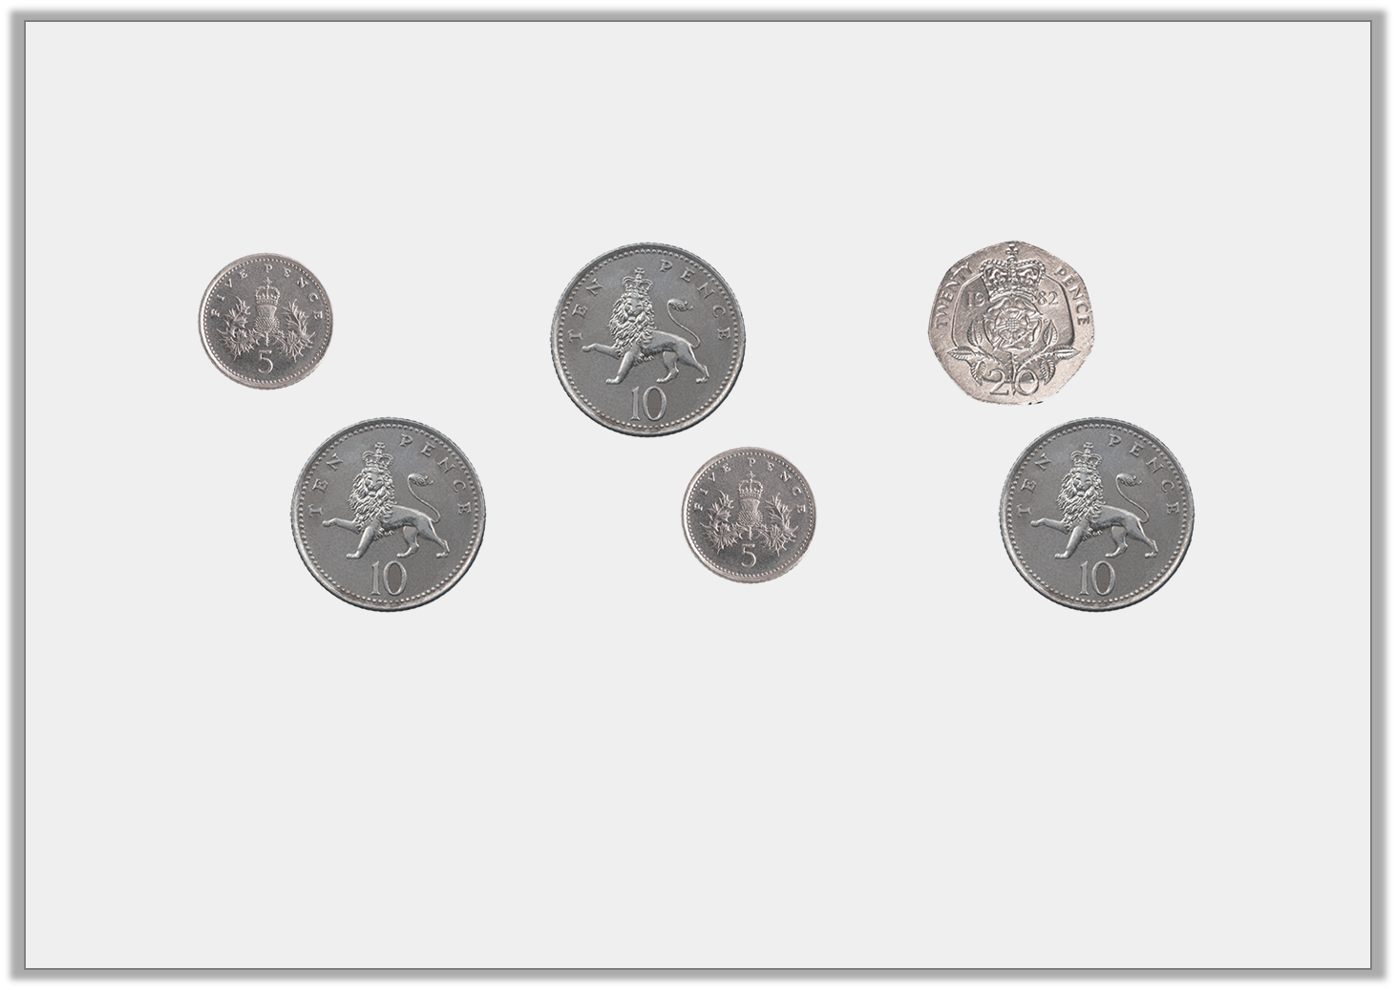
Varied Fluency 4
Circle the coin/s to make 50p.
© Classroom Secrets Limited 2018

Slide 13
Varied Fluency 4
Circle the coin/s to make 50p.
20p + 10p + 10p + 10p or
20p + 10p + 10p + 5p + 5p
© Classroom Secrets Limited 2018

Slide 14
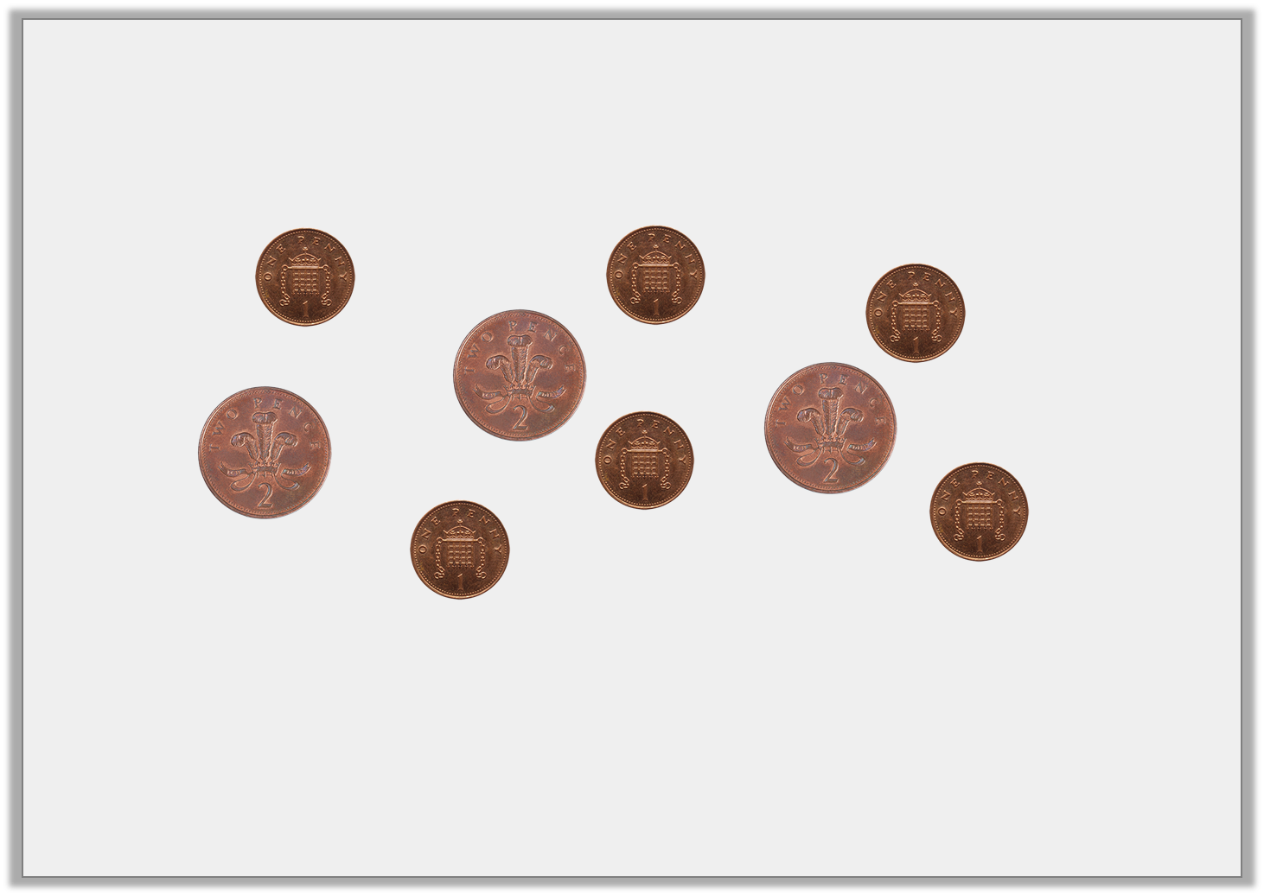
Problem Solving 1
Arrange the coins below into two groups of 6p.
© Classroom Secrets Limited 2018

Slide 15
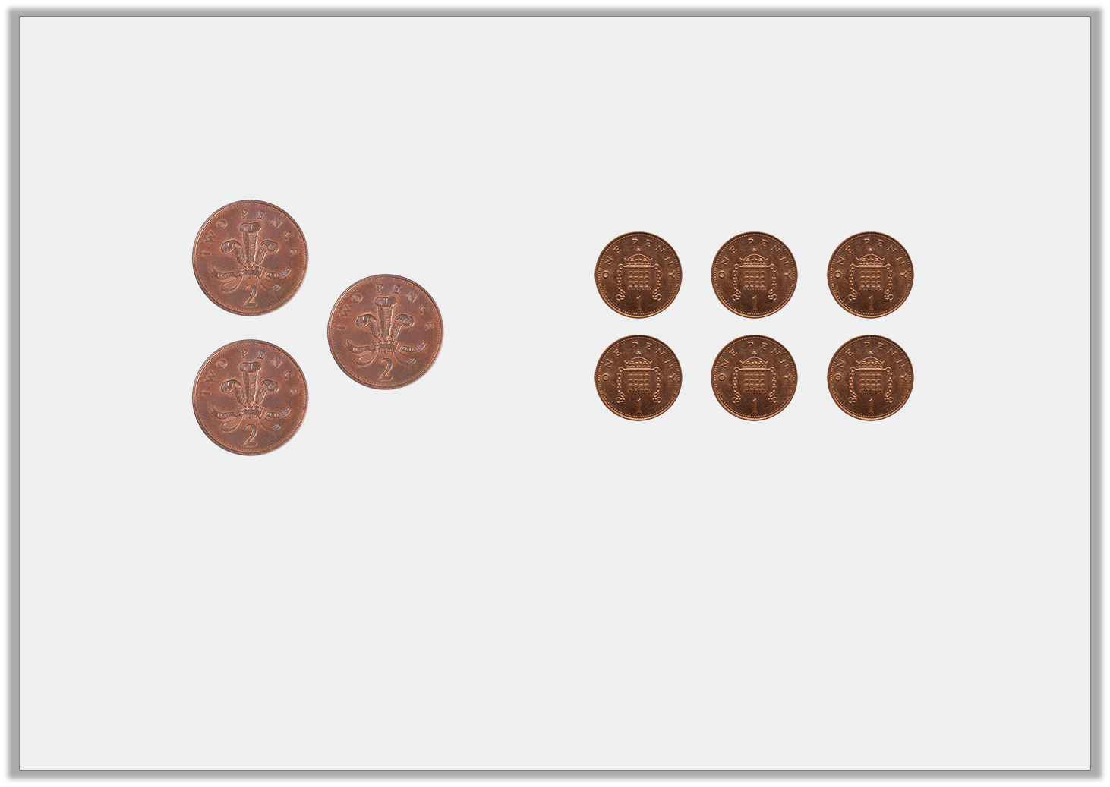
Problem Solving 1
Arrange the coins below into two groups of 6p.
Various answers, for example:
2p + 2p + 2p
© Classroom Secrets Limited 2018

Slide 16
Problem Solving 2
Abilene says,
Which coins could Abilene have?
What is the lowest number of coins she could have?
I have two different types of coins. I have 20p.
© Classroom Secrets Limited 2018

Slide 17
Problem Solving 2
Abilene says,
Which coins could Abilene have?
Various answers, for example: 10p + 5p + 5p.
What is the lowest number of coins she could have?
3
I have two different types of coins. I have 20p.
© Classroom Secrets Limited 2018

Slide 18
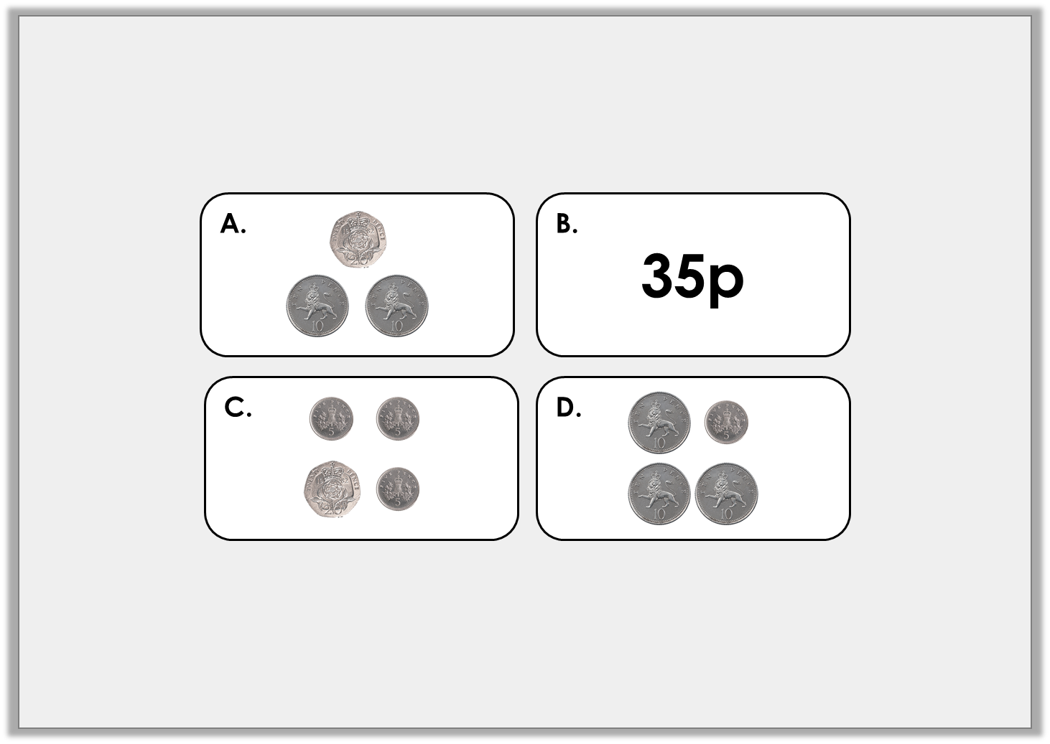
Reasoning 1
Which is the odd one out?
Explain your answer.
© Classroom Secrets Limited 2018

Slide 19
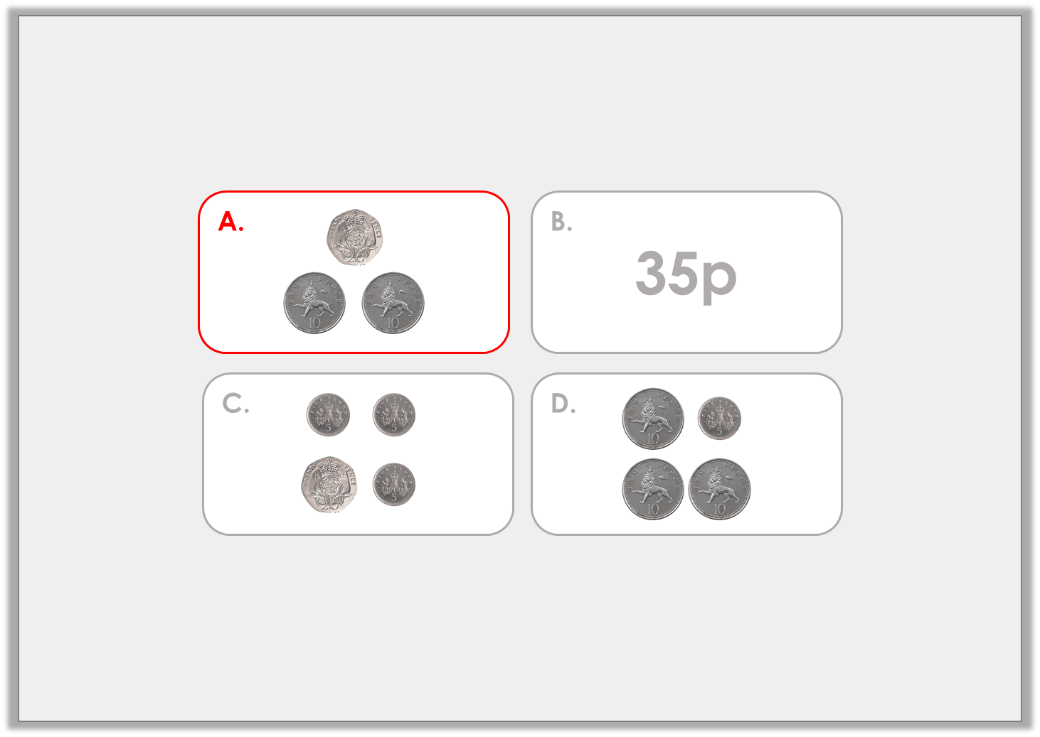
Reasoning 1
Which is the odd one out?
Explain your answer.
A as it shows.... B, C and D show…
© Classroom Secrets Limited 2018

Slide 20
Reasoning 1
Which is the odd one out?
Explain your answer.
A as it shows 40p. B, C and D show 35p.
© Classroom Secrets Limited 2018

