Slide 1
LIFE/work balance
We have started a #LIFEworkbalance campaign and we need your help to complete our LIFE/work balance survey.
We hope to publish the results soon, so please give 15 minutes of your time to help us get a true picture of school life.
Want to be a part of this campaign? Take the survey on our website and share it with your colleagues!
© Classroom Secrets Limited 2019

Slide 2
Year 2 – Spring Block 1 – Multiplication and Division – Making Equal Groups – Sharing
About This Resource:
This PowerPoint has been designed to support your teaching of this small step. It includes a starter activity and an example of each question from the Varied Fluency and Reasoning and Problem Solving resources also provided in this pack. You can choose to work through all examples provided or a selection of them depending on the needs of your class. We recommend using concrete manipulatives to support children’s understanding of sharing into groups.
National Curriculum Objectives:
Mathematics Year 2: (2C6) Recall and use multiplication and division facts for the 2, 5 and 10 multiplication tables, including recognising odd and even numbers
Mathematics Year 2: (2C7) Calculate mathematical statements for multiplication and division within the multiplication tables and write them using the multiplication (×), division (÷) and equals (=) signs
Mathematics Year 2: (2C8) Solve problems involving multiplication and division, using materials, arrays, repeated addition, mental methods, and multiplication and division facts, including problems in contexts
More Year 2 Multiplication and Division resources.
Did you like this resource? Don’t forget to review it on our website.
© Classroom Secrets Limited 2018

Slide 3
Year 2 – Spring Block 1 – Multiplication and Division
Step 1: Make Equal Groups – Sharing
© Classroom Secrets Limited 2018

Slide 4
Introduction
Complete the number sentences.
2 | x | 8 | =
5 | x | 9 | =
2 | x | 7 | =
5 | x | 7 | =
© Classroom Secrets Limited 2018

Slide 5
Introduction
Complete the number sentences.
2 | x | 8 | = | 16
5 | x | 9 | = | 45
2 | x | 7 | = | 14
5 | x | 7 | = | 35
© Classroom Secrets Limited 2018

Slide 6
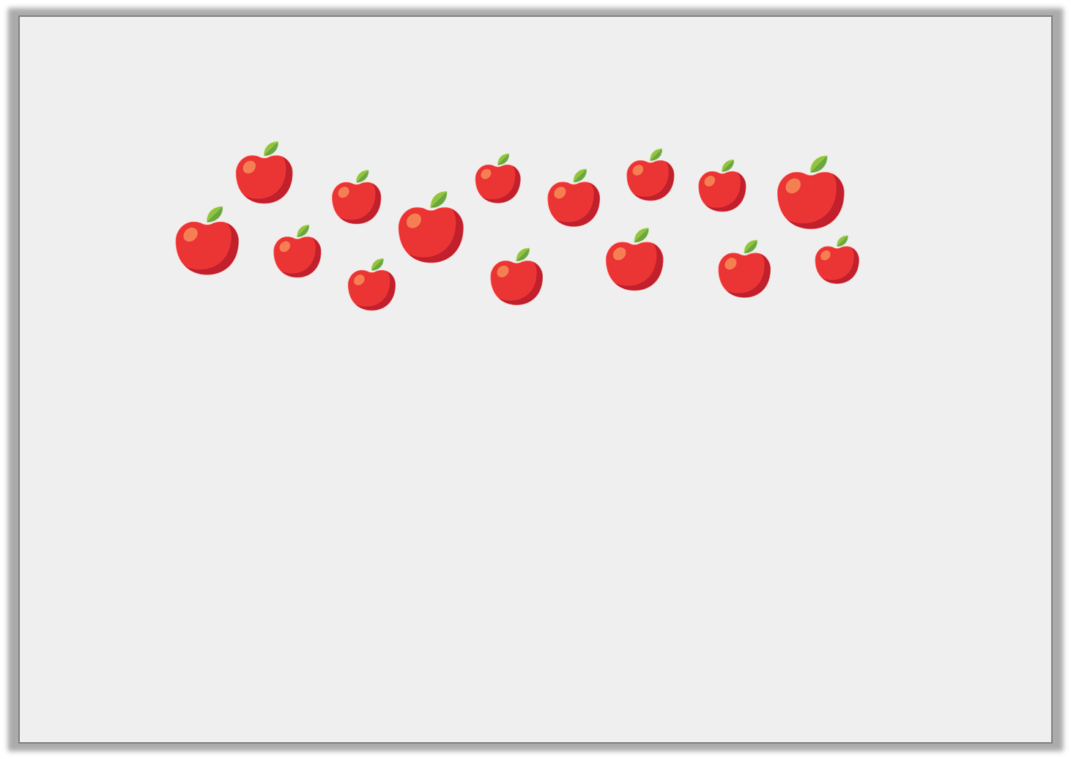
Varied Fluency 1
Share the apples into equal groups. Complete the stem sentence.
 | is shared into |  | groups of
© Classroom Secrets Limited 2018

Slide 7
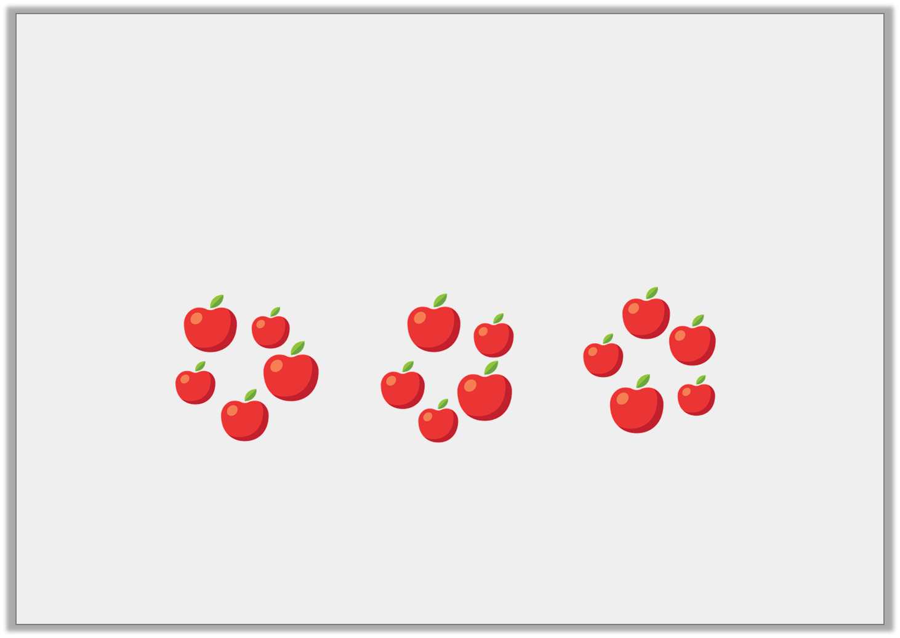
Varied Fluency 1
Share the apples into equal groups. Complete the stem sentence.
15 | is shared into | 3 | groups of | 5
© Classroom Secrets Limited 2018

Slide 8
Varied Fluency 2
True or false? 17 can be shared equally between 6 groups.
© Classroom Secrets Limited 2018

Slide 9
Varied Fluency 2
True or false? 17 can be shared equally between 6 groups.
False. The groups are unequal.
© Classroom Secrets Limited 2018

Slide 10
Varied Fluency 3
Use the pictures to complete the number sentence..
12 | ÷ |  | =
© Classroom Secrets Limited 2018

Slide 11
Varied Fluency 3
Use the pictures to complete the number sentence..
12 | ÷ | 4 | = | 3
© Classroom Secrets Limited 2018

Slide 12
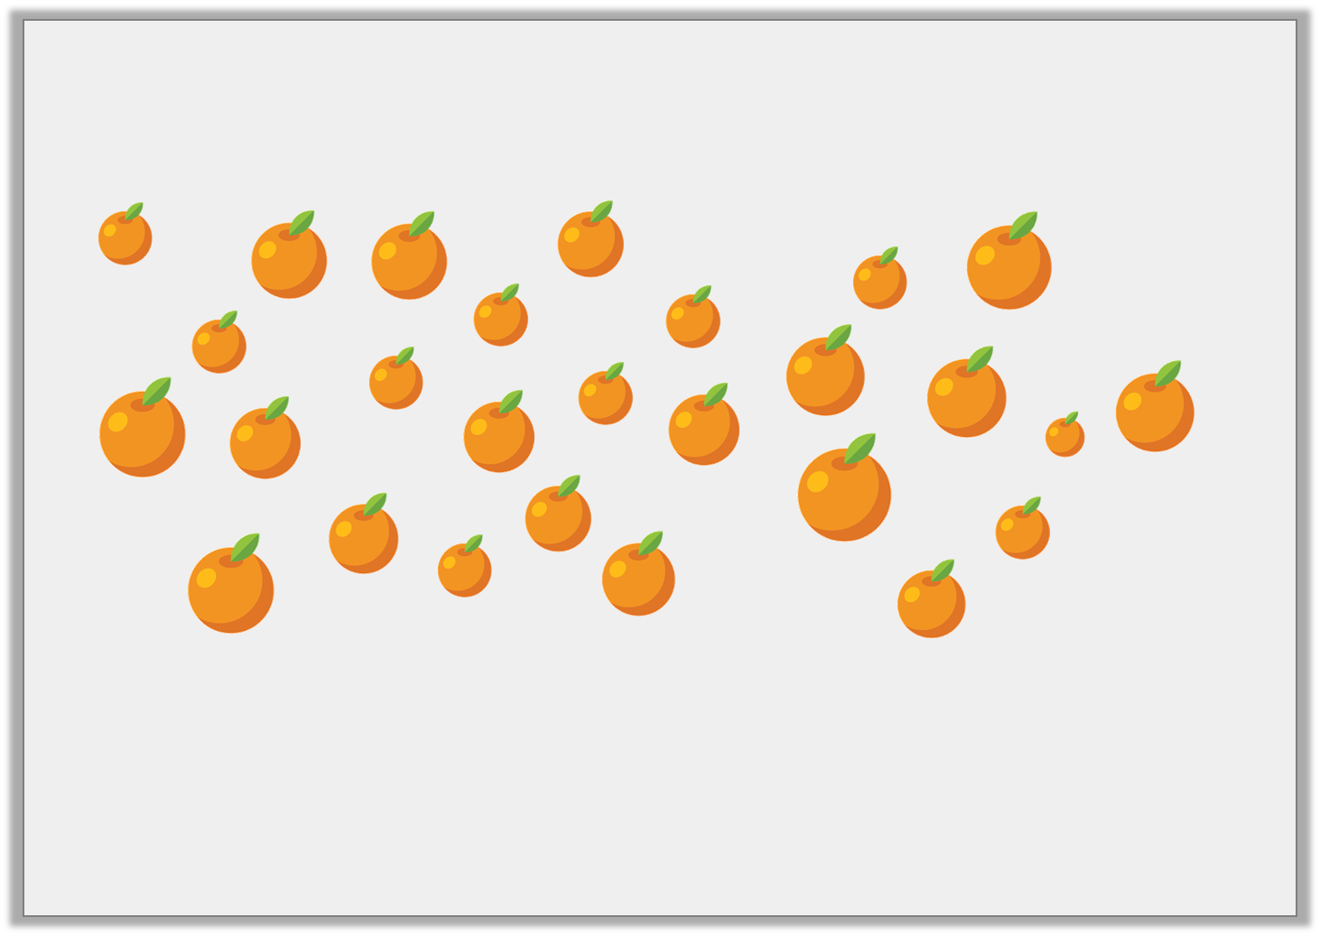
Varied Fluency 4
Solve the calculation below.
27 | ÷ | 3 | =
© Classroom Secrets Limited 2018

Slide 13
Varied Fluency 4
Solve the calculation below.
27 | ÷ | 3 | = | 9
© Classroom Secrets Limited 2018

Slide 14
Problem Solving 1
Mark has 18 colouring pencils. When he shares them into pencil pots, he has none left over.
How many pencil pots can he fairly share the pencils into so that every pencil pot has the same amount?
Find 3 different amounts of pencil pots.
© Classroom Secrets Limited 2018

Slide 15
Problem Solving 1
Mark has 18 colouring pencils. When he shares them into pencil pots, he has none left over.
How many pencil pots can he fairly share the pencils into so that every pencil pot has the same amount?
Find 3 different amounts of pencil pots.
Various answers, for example: 2 pots with 9 pencils in each; 3 pots with 6 in each; 9 pots with 2 in each.
© Classroom Secrets Limited 2018

Slide 16
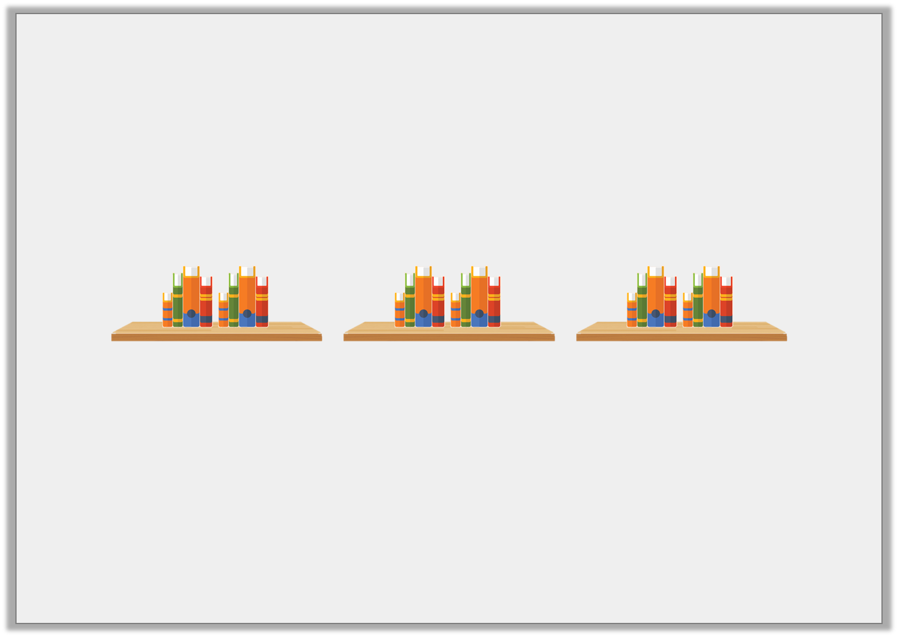
Problem Solving 2
Harriet shares her books between 3 shelves. Each shelf has 8 books.
How many books does Harriet have altogether?
She loses 3 books. Then 1 shelf breaks.
Can she re-share the books equally between the remaining shelves?
© Classroom Secrets Limited 2018

Slide 17
Problem Solving 2
Harriet shares her books between 3 shelves. Each shelf has 8 books.
How many books does Harriet have altogether? 24
She loses 3 books. Then 1 shelf breaks.
Can she re-share the books equally between the remaining shelves?
Harriet cannot re-share the remaining books as 21 cannot be shared equally between 2 groups.
© Classroom Secrets Limited 2018

Slide 18
Reasoning 1
Which of these numbers can create 3 equal groups?
Explain your choices.
15
21
11
© Classroom Secrets Limited 2018

Slide 19
Reasoning 1
Which of these numbers can create 3 equal groups?
Explain your choices.
15 and 21 because…
15
21
11
© Classroom Secrets Limited 2018

Slide 20
Reasoning 1
Which of these numbers can create 3 equal groups?
Explain your choices.
15 and 21 because 15 ÷ 3 = 5 and 21 ÷ 3 = 7. 11 would create unequal groups when shared between 3.
15
21
11
© Classroom Secrets Limited 2018

