Slide 1
LIFE/work balance
We have started a #LIFEworkbalance campaign and we need your help to complete our LIFE/work balance survey.
We hope to publish the results soon, so please give 15 minutes of your time to help us get a true picture of school life.
Want to be a part of this campaign? Take the survey on our website and share it with your colleagues!
© Classroom Secrets Limited 2020

Slide 2
Year 2 – Spring Block 4 – Fractions – Make Equal Parts
About This Resource:
This PowerPoint has been designed to support your teaching of this small step. It includes a starter activity and an example of each question from the Varied Fluency and Reasoning and Problem Solving resources also provided in this pack. You can choose to work through all examples provided or a selection of them depending on the needs of your class.
National Curriculum Objectives:
Mathematics Year 2: (2F1a) Recognise, find, name and write fractions 1/3 , 1/4 , 2/4 and 3/4 of a length, shape, set of objects or quantity
More Year 2 Fractions resources.
Did you like this resource? Don’t forget to review it on our website.
© Classroom Secrets Limited 2019

Slide 3
Year 2 – Spring Block 4 – Fractions
Step 1: Make Equal Parts
© Classroom Secrets Limited 2019

Slide 4
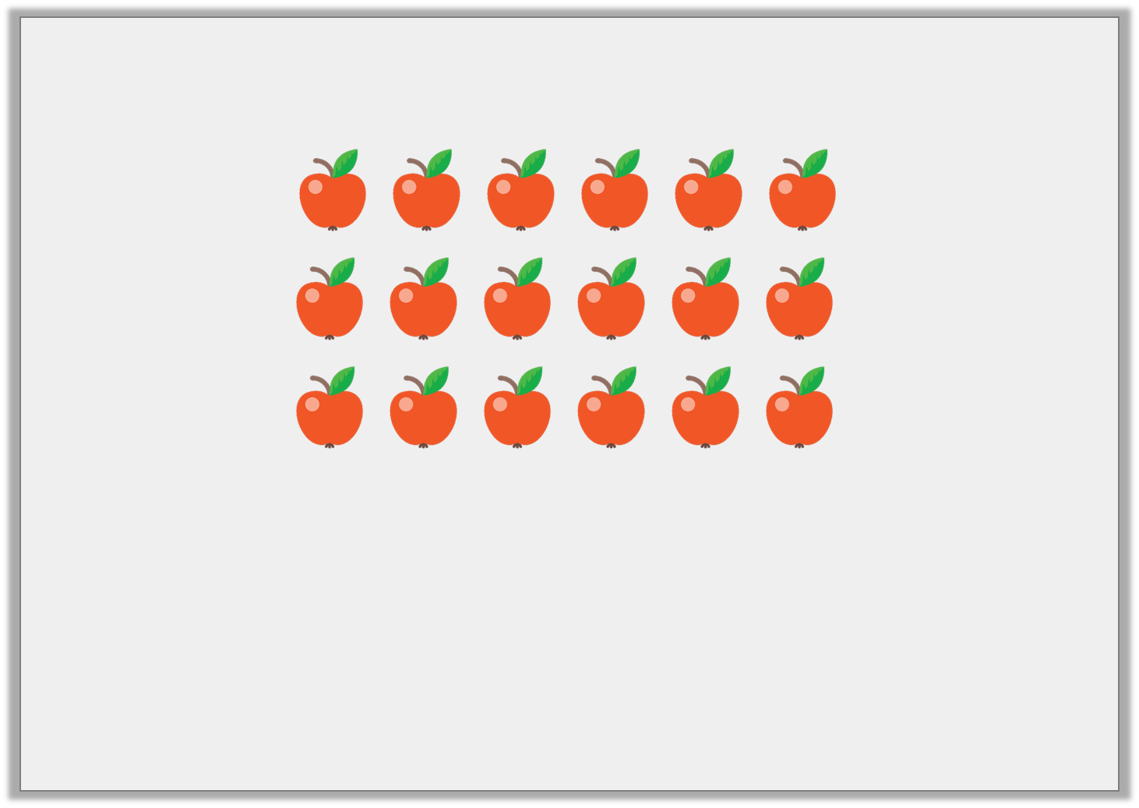
Introduction
Complete the questions below.
A) How many apples are there altogether?
B) If the apples were divided into 2 equal parts, how many would be in each part?
C) If the apples were divided into 3 equal parts, how many would be in each part?
© Classroom Secrets Limited 2019

Slide 5
Introduction
Complete the questions below.
A) How many apples are there altogether? 18
B) If the apples were divided into 2 equal parts, how many would be in each part? 9
C) If the apples were divided into 3 equal parts, how many would be in each part? 6
© Classroom Secrets Limited 2019

Slide 6
Varied Fluency 1
Tick the shapes below that are divided into equal parts.
A. |  | B. |  | C.
© Classroom Secrets Limited 2019

Slide 7
Varied Fluency 1
Tick the shapes below that are divided into equal parts.
Shape A
A. |  | B. |  | C.
✓
© Classroom Secrets Limited 2019

Slide 8
Varied Fluency 2
How many equal groups are the marbles split into?
© Classroom Secrets Limited 2019

Slide 9
Varied Fluency 2
How many equal groups are the marbles split into?
3 equal parts
© Classroom Secrets Limited 2019

Slide 10
Varied Fluency 3
Are the shapes split into equal or unequal parts?
 | Equal |  |  | Unequal
A.
B.
C.
© Classroom Secrets Limited 2019

Slide 11
Varied Fluency 3
Are the shapes split into equal or unequal parts?
 | Equal |  |  | Unequal
A. |  | ✓
B. |  | ✓
C. |  |  |  |  | ✓
© Classroom Secrets Limited 2019

Slide 12
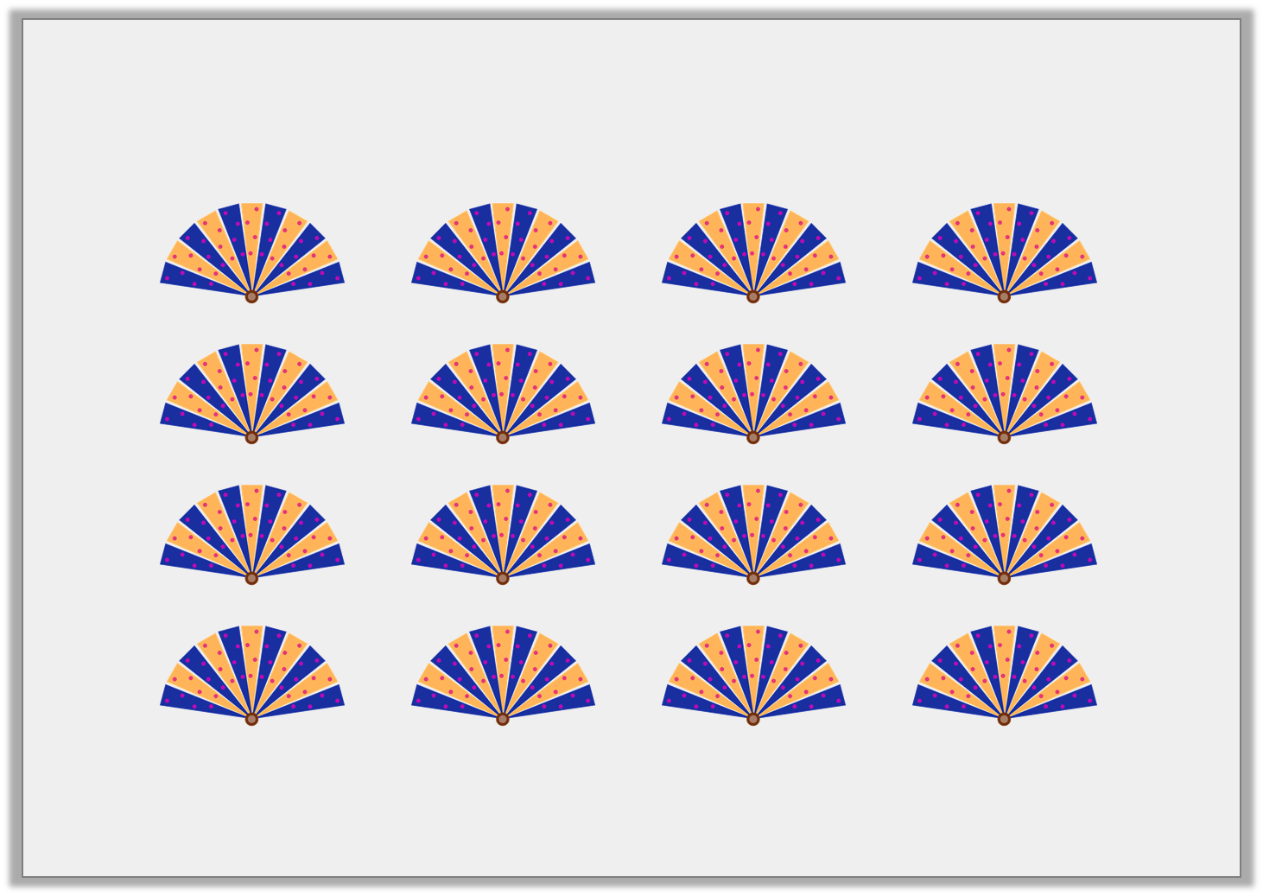
Varied Fluency 4
Divide the fans into 4 equal groups by circling each group.
© Classroom Secrets Limited 2019

Slide 13
Varied Fluency 4
Divide the fans into 4 equal groups by circling each group.
The fans could be split vertically (as shown above) or horizontally.
© Classroom Secrets Limited 2019

Slide 14
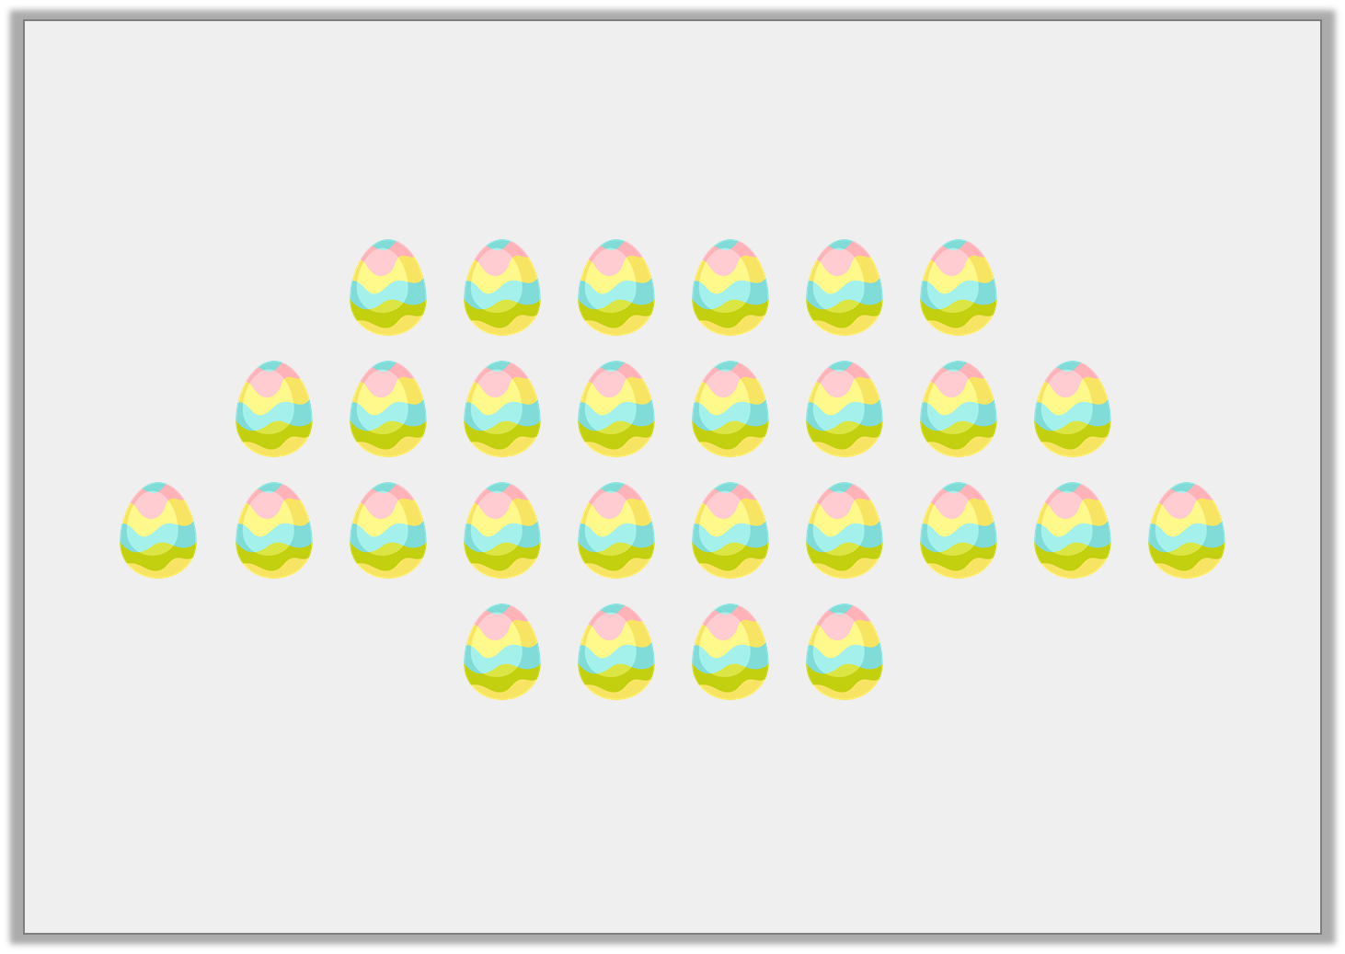
Reasoning 1
Evie thinks that if she divides the eggs into 4 equal groups,
there will be 7 in each group.
Is Evie correct? Explain why.
© Classroom Secrets Limited 2019

Slide 15
Reasoning 1
Evie thinks that if she divides the eggs into 4 equal groups,
there will be 7 in each group.
Is Evie correct? Explain why.
Evie is correct because...
© Classroom Secrets Limited 2019

Slide 16
Reasoning 1
Evie thinks that if she divides the eggs into 4 equal groups,
there will be 7 in each group.
Is Evie correct? Explain why.
Evie is correct because 28 eggs shared into 4 equal groups is 7.
© Classroom Secrets Limited 2019

Slide 17
Problem Solving 1
Divide the shapes below into 3 unequal parts.
© Classroom Secrets Limited 2019

Slide 18
Problem Solving 1
Divide the shapes below into 3 unequal parts.
Various answers. One example is shown above.
© Classroom Secrets Limited 2019

Slide 19
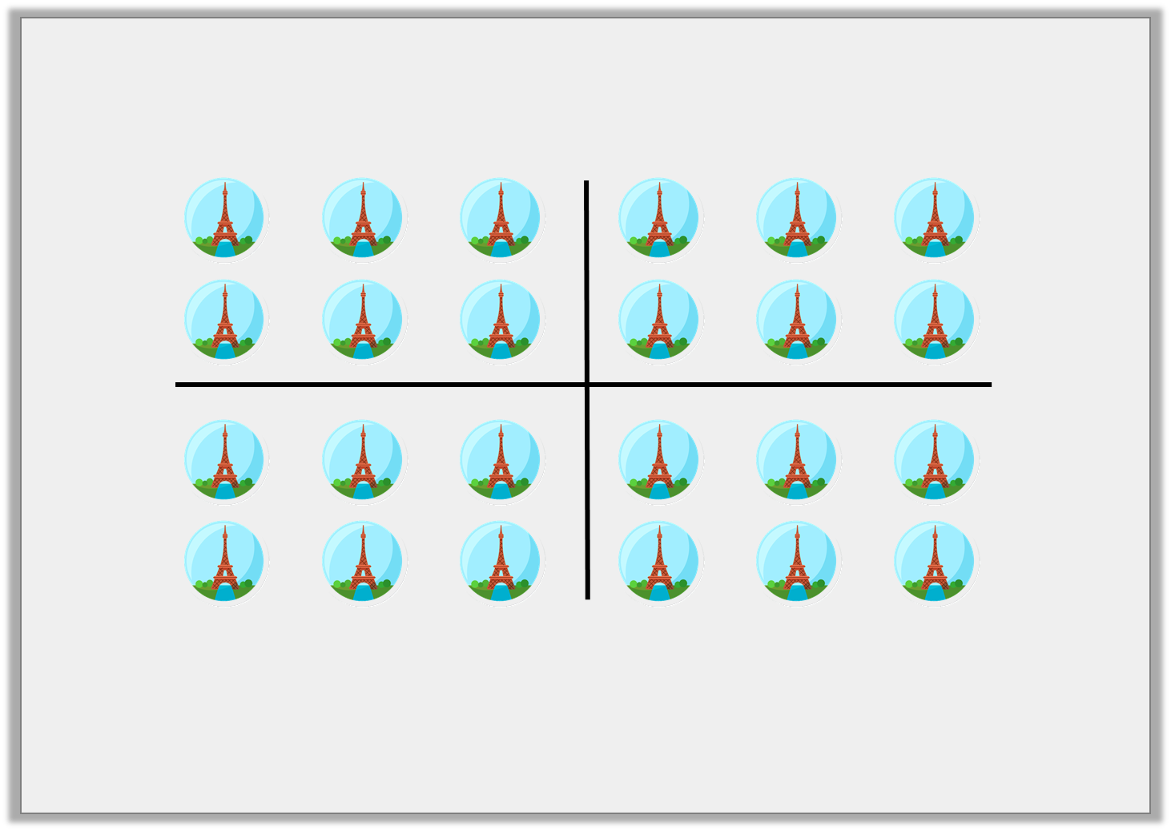
Reasoning 2
True or false? All the groups are equal.
Prove it.
© Classroom Secrets Limited 2019

Slide 20
Reasoning 2
True or false? All the groups are equal.
Prove it.
True because…
© Classroom Secrets Limited 2019

Slide 21
Reasoning 2
True or false? All the groups are equal.
Prove it.
True because there are 6 fridge magnets in each group.
© Classroom Secrets Limited 2019

