Slide 1
LIFE/work balance
We have started a #LIFEworkbalance campaign and we need your help to complete our LIFE/work balance survey.
We hope to publish the results soon, so please give 15 minutes of your time to help us get a true picture of school life.
Want to be a part of this campaign? Take the survey on our website and share it with your colleagues!
© Classroom Secrets Limited 2019

Slide 2
Year 3 – Autumn Block 1 – Place Value – Hundreds
About This Resource:
This PowerPoint has been designed to support your teaching of this small step. It includes a starter activity and an example of each question from the Varied Fluency and Reasoning and Problem Solving resources also provided in this pack. You can choose to work through all examples provided or a selection of them depending on the needs of your class.
National Curriculum Objectives:
Mathematics Year 3: (3N1b) Count from 0 in multiples of 4, 8, 50 and 100; find 10 or 100 more or less than a given number
Mathematics Year 3: (3N4) Identify, represent and estimate numbers using different representations
More Year 3 Place Value resources.
Did you like this resource? Don’t forget to review it on our website.
© Classroom Secrets Limited 2018

Slide 3
Year 3 – Autumn Block 1 – Place Value
Step 1: Hundreds
© Classroom Secrets Limited 2018

Slide 4
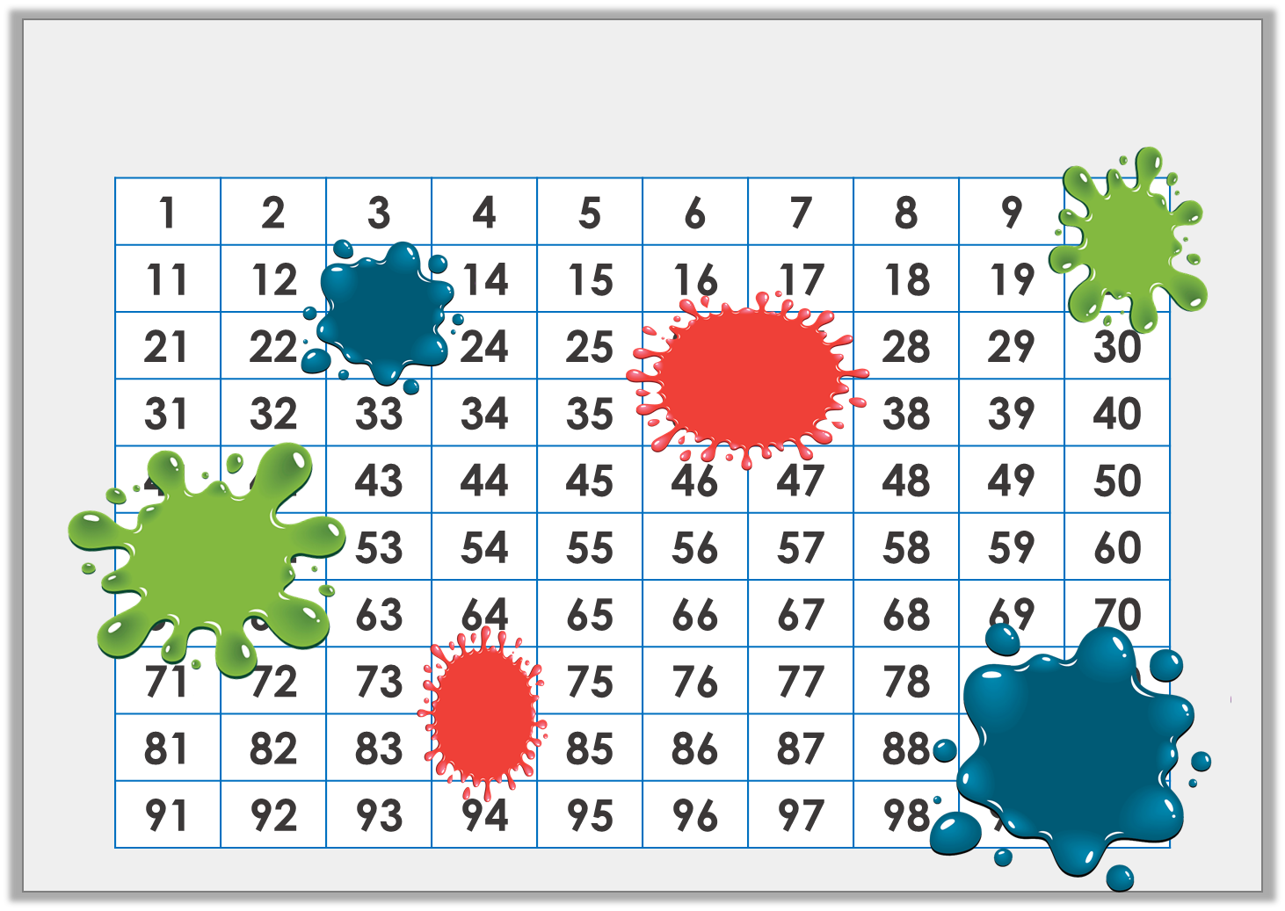
Introduction
Identify the numbers hidden by the splats of paint.
© Classroom Secrets Limited 2018

Slide 5
Introduction
Identify the numbers hidden by the splats of paint.
1 | 2 | 3 | 4 | 5 | 6 | 7 | 8 | 9 | 10
11 | 12 | 13 | 14 | 15 | 16 | 17 | 18 | 19 | 20
21 | 22 | 23 | 24 | 25 | 26 | 27 | 28 | 29 | 30
31 | 32 | 33 | 34 | 35 | 36 | 37 | 38 | 39 | 40
41 | 42 | 43 | 44 | 45 | 46 | 47 | 48 | 49 | 50
51 | 52 | 53 | 54 | 55 | 56 | 57 | 58 | 59 | 60
61 | 62 | 63 | 64 | 65 | 66 | 67 | 68 | 69 | 70
71 | 72 | 73 | 74 | 75 | 76 | 77 | 78 | 79 | 80
81 | 82 | 83 | 84 | 85 | 86 | 87 | 88 | 89 | 90
91 | 92 | 93 | 94 | 95 | 96 | 97 | 98 | 99 | 100
© Classroom Secrets Limited 2018

Slide 6
Varied Fluency 1
Write the number represented by each image.
H | T | O
100
100
100
100
100
100
© Classroom Secrets Limited 2018

Slide 7
Varied Fluency 1
Write the number represented by each image.
H | T | O
200
100
100
100
100
600
100
100
© Classroom Secrets Limited 2018

Slide 8
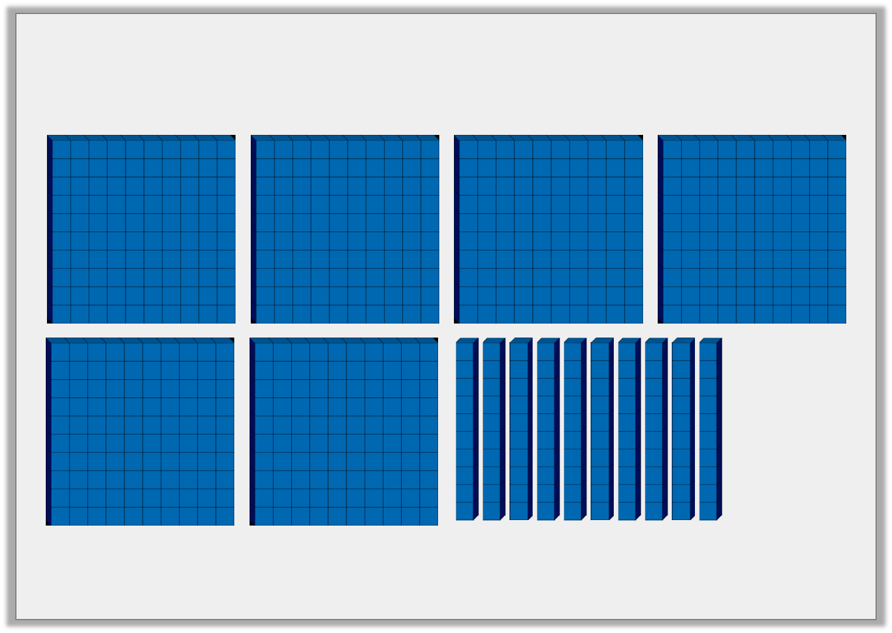
Varied Fluency 2
True or false? The image below represents 700.
© Classroom Secrets Limited 2018

Slide 9
Varied Fluency 2
True or false? The image below represents 700.
True
© Classroom Secrets Limited 2018

Slide 10
Varied Fluency 3
If you count backwards in hundreds, what number will you say after the one represented in the image below?
H | T | O
© Classroom Secrets Limited 2018

Slide 11
Varied Fluency 3
If you count backwards in hundreds, what number will you say after the one represented in the image below?
600
H | T | O
© Classroom Secrets Limited 2018

Slide 12
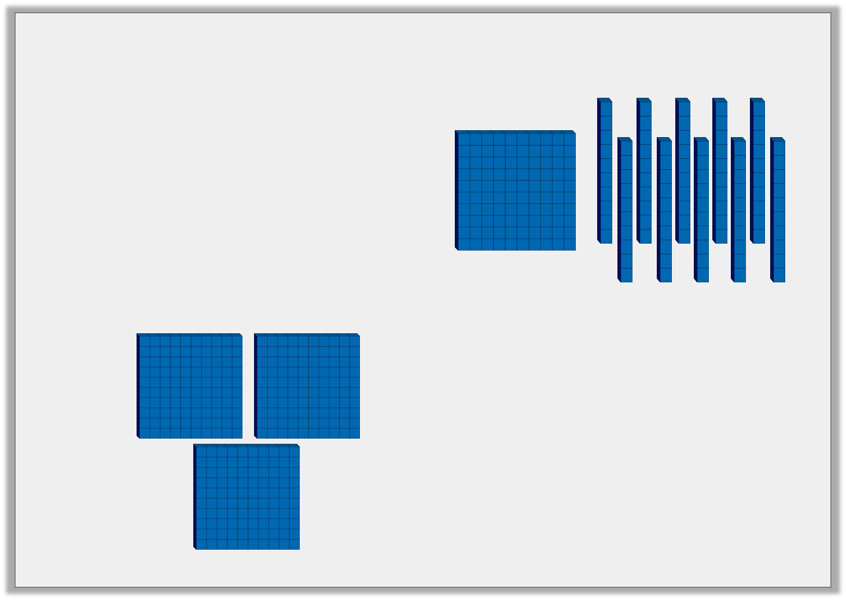
Varied Fluency 4
Circle the correct statement below.
100
100
100
=
H | T | O
>
© Classroom Secrets Limited 2018

Slide 13
Varied Fluency 4
Circle the correct statement below.
100
100
100
=
H | T | O
>
© Classroom Secrets Limited 2018

Slide 14
Reasoning 1
Which image is the odd one out?
Explain your answer.
A.
10
10
100
10
10
100
10
10
10
10
10
10
B.
H | T | O
C.
© Classroom Secrets Limited 2018

Slide 15
Reasoning 1
Which image is the odd one out?
Explain your answer.
B is the odd one out because…
A.
10
10
100
10
10
100
10
10
10
10
10
10
B.
H | T | O
C.
© Classroom Secrets Limited 2018

Slide 16
Reasoning 1
Which image is the odd one out?
Explain your answer.
B is the odd one out because A and C are 300, but B is 400.
A.
10
10
100
10
10
100
10
10
10
10
10
10
B.
H | T | O
C.
© Classroom Secrets Limited 2018

Slide 17
Problem Solving 1
Use the cards below to complete the inequality statements.
100
100
H | T | O
100
100
100
100
 |  | <
 |  | >
© Classroom Secrets Limited 2018

Slide 18
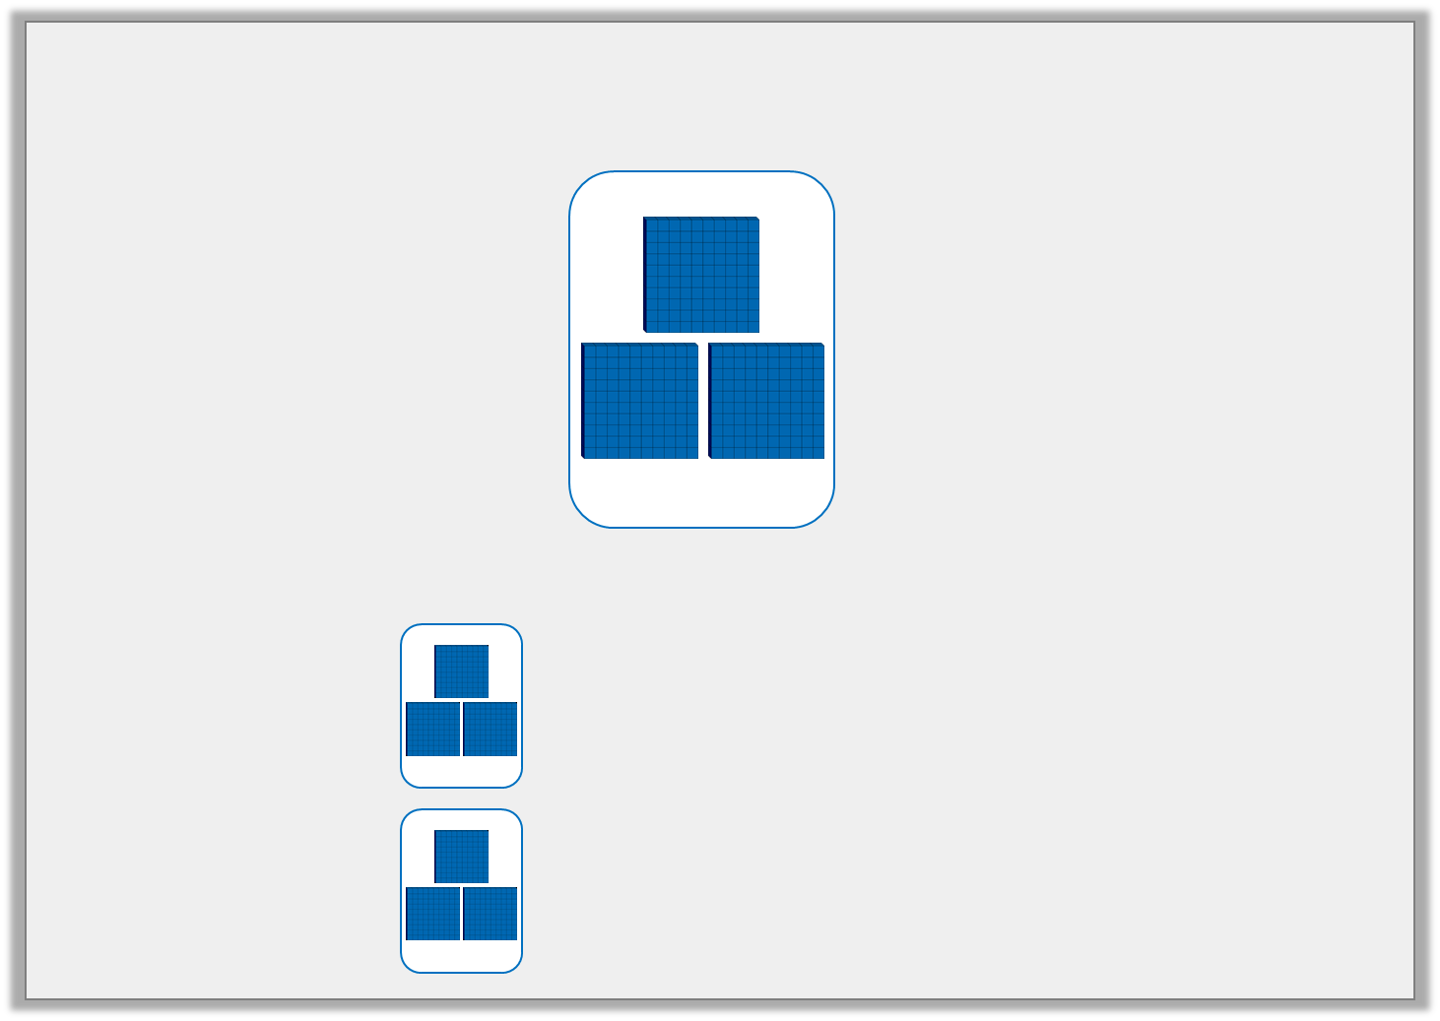
Problem Solving 1
Use the cards below to complete the inequality statements.
Various answers, for example:
100
100
H | T | O
100
100
100
100
100
100
 |  | <
 |  | >
100
100
100
100
H | T | O
© Classroom Secrets Limited 2018

Slide 19
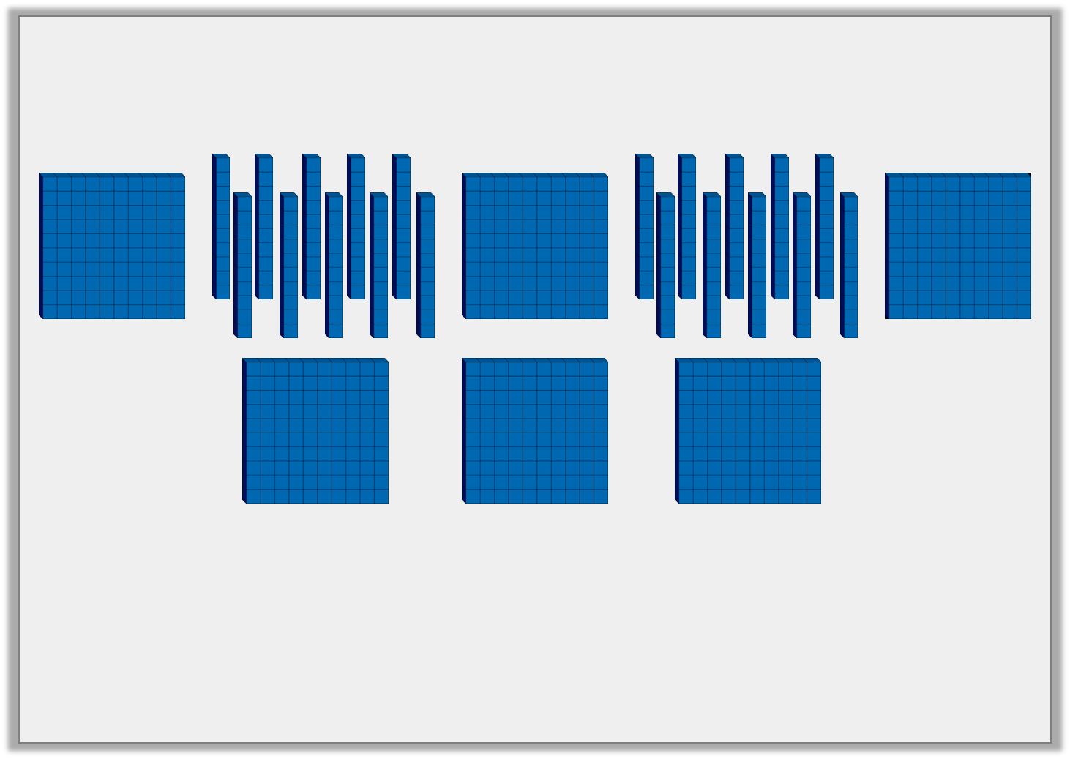
Reasoning 2
Janie has written a statement about the image below. Do you agree?
This number is 900.
Explain your answer.
© Classroom Secrets Limited 2018

Slide 20
Reasoning 2
Janie has written a statement about the image below. Do you agree?
This number is 900.
Explain your answer.
No, because…
© Classroom Secrets Limited 2018

Slide 21
Reasoning 2
Janie has written a statement about the image below. Do you agree?
This number is 900.
Explain your answer.
No, because there are 8 hundreds represented by the image.
© Classroom Secrets Limited 2018

