Slide 1
LIFE/work balance
We have started a #LIFEworkbalance campaign and we need your help to complete our LIFE/work balance survey.
We hope to publish the results soon, so please give 15 minutes of your time to help us get a true picture of school life.
Want to be a part of this campaign? Take the survey on our website and share it with your colleagues!
© Classroom Secrets Limited 2020

Slide 2
Year 3 – Spring Block 2 – Money – Pounds and Pence
About This Resource:
This PowerPoint has been designed to support your teaching of this small step. It includes a starter activity and an example of each question from the Varied Fluency and Reasoning and Problem Solving resources also provided in this pack. You can choose to work through all examples provided or a selection of them depending on the needs of your class.
National Curriculum Objectives:
Mathematics Year 3: (3M9a) Add and subtract amounts of money to give change, using both £ and p in practical contexts
More Year 3 Money resources.
Did you like this resource? Don’t forget to review it on our website.
© Classroom Secrets Limited 2018

Slide 3
Year 3 – Spring Block 2 – Money
Step 1: Pounds and Pence
© Classroom Secrets Limited 2018

Slide 4
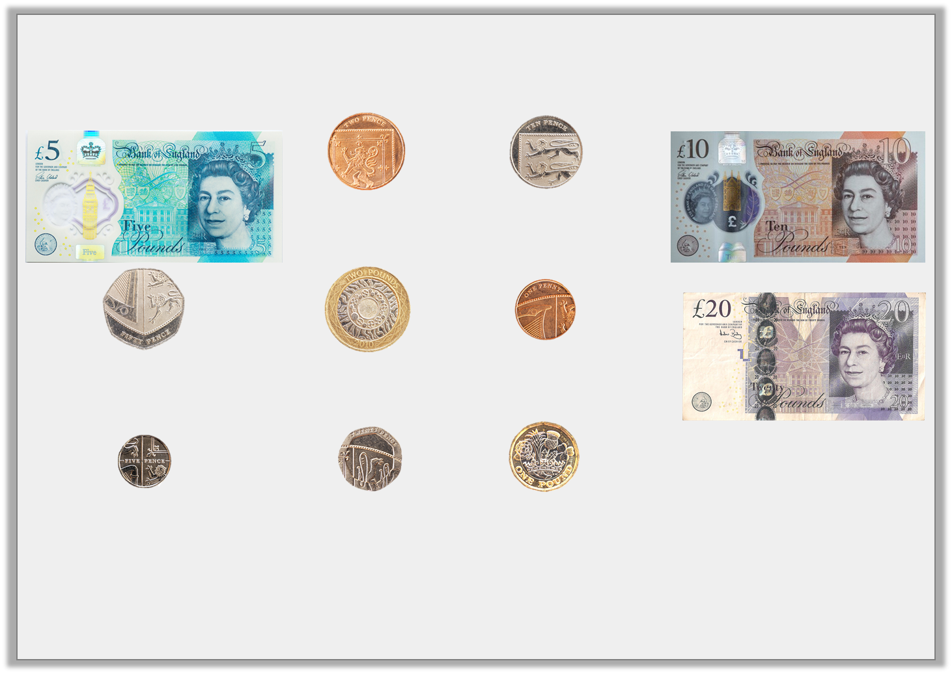
Introduction
Match the coins or notes to their values.
20p
£20
£5
5p
2p
1p
10p
£10
50p
£2
£1
© Classroom Secrets Limited 2018

Slide 5
Introduction
Match the coins or notes to their values.
Now place them in value order, largest at the top left.
£5
2p
10p
£10
50p
£2
1p
£20
5p
20p
£1
© Classroom Secrets Limited 2018

Slide 6
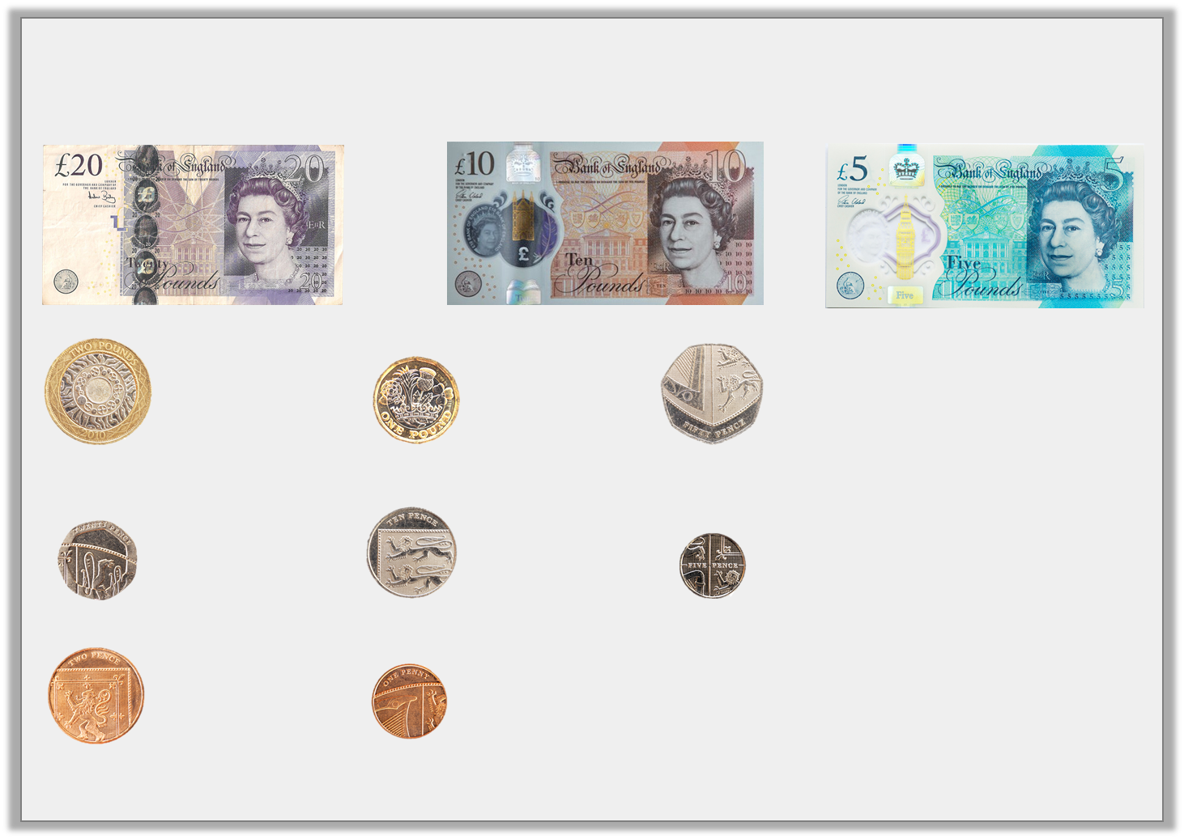
Introduction
Match the coins or notes to their values.
Now place them in value order, largest at the top left.
£20
£10
£5
£2
£1
50p
20p
10p
5p
2p
1p
© Classroom Secrets Limited 2018

Slide 7
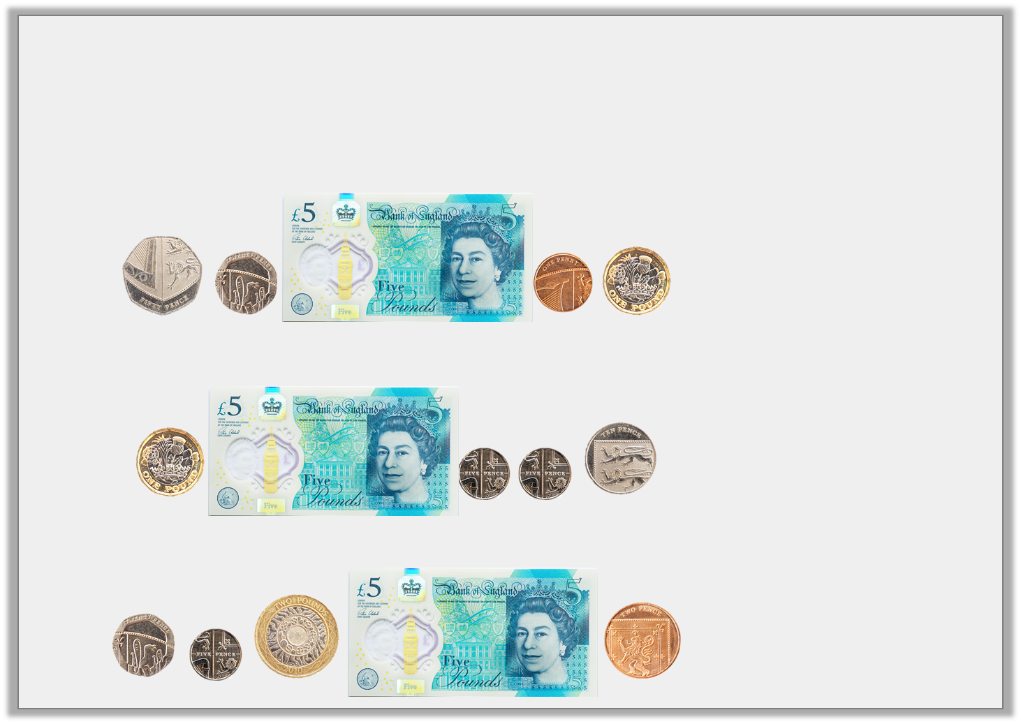
Varied Fluency 1
Match the notes and coins to the correct amounts.
A.
B.
C.
£6 and 20p
£6 and 71p
£7 and 27p
© Classroom Secrets Limited 2018

Slide 8
Varied Fluency 1
Match the notes and coins to the correct amounts.
A.
B.
C.
£6 and 20p
£6 and 71p
£7 and 27p
© Classroom Secrets Limited 2018

Slide 9
Varied Fluency 2
Identify the total of the coins below.
© Classroom Secrets Limited 2018

Slide 10
Varied Fluency 2
Identify the total of the coins below.
£2 and 51p
© Classroom Secrets Limited 2018

Slide 11
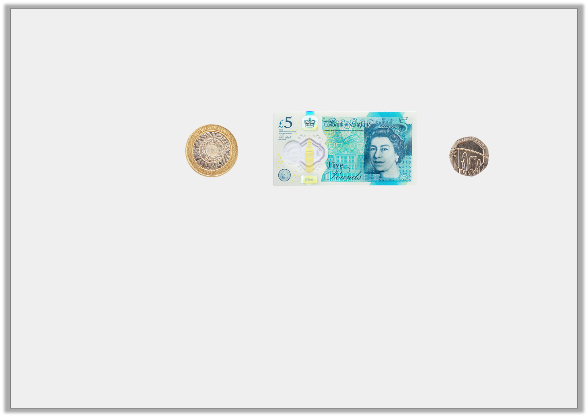
Varied Fluency 3
Which has the greatest value?
A.
B. | £7 and 40p
C. | £8 and 20p
© Classroom Secrets Limited 2018

Slide 12
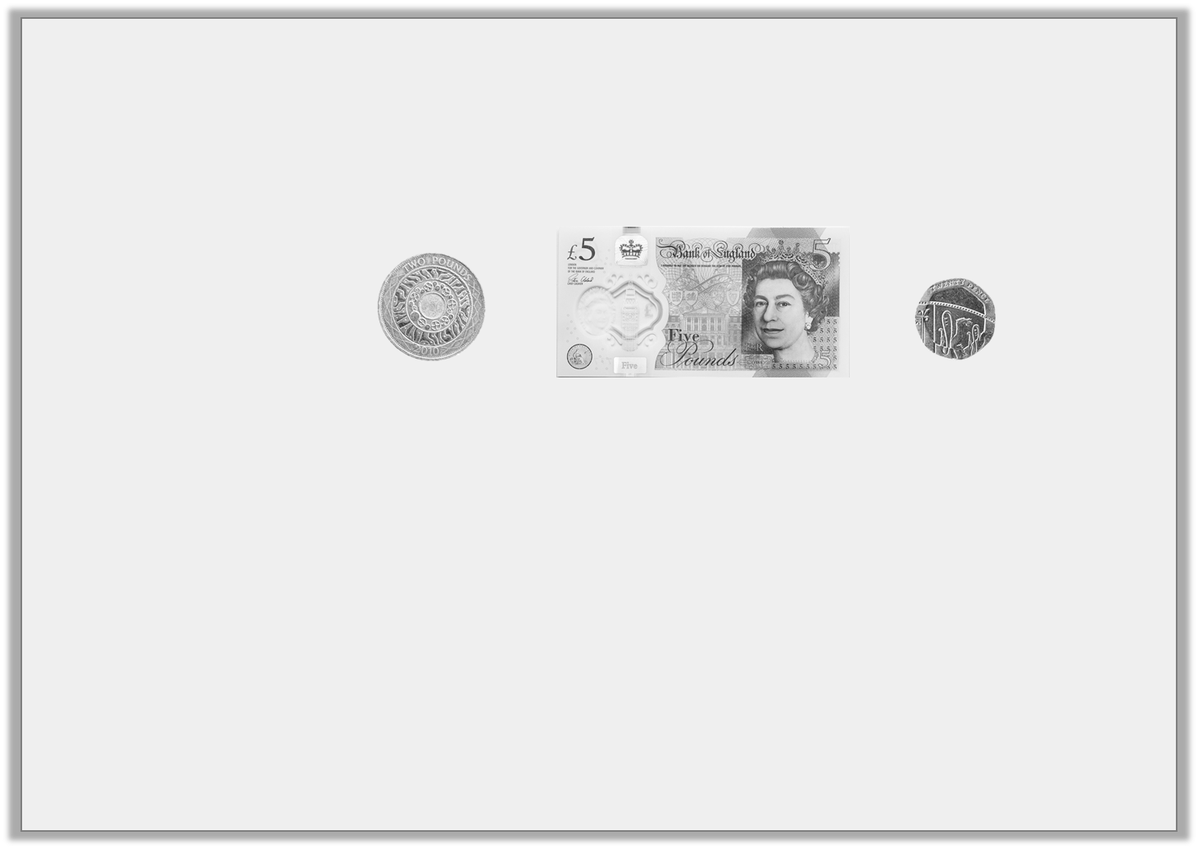
Varied Fluency 3
Which has the greatest value?
A.
B. | £7 and 40p
C. | £8 and 20p
© Classroom Secrets Limited 2018

Slide 13
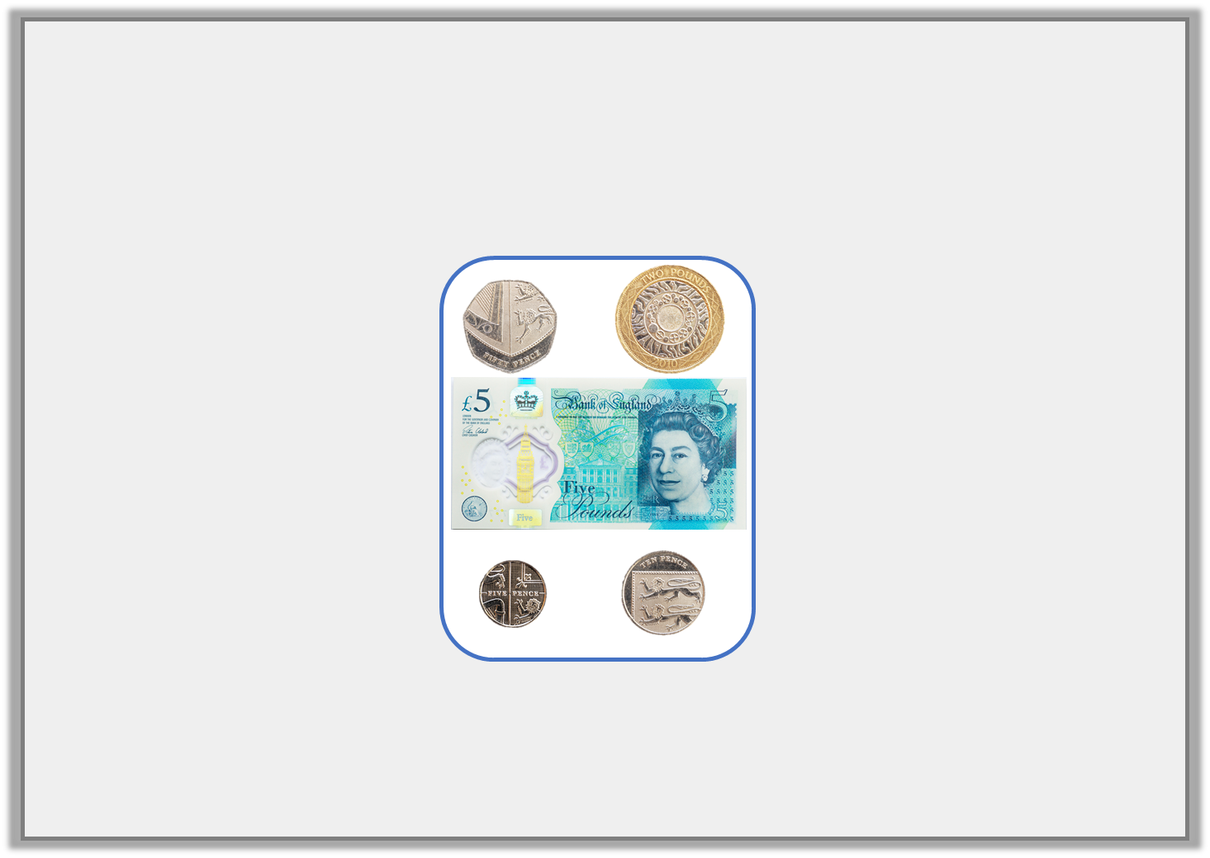
Varied Fluency 4
Tick the odd one out.
A. | B. | C.
£6 and 56p
£7 and 65p
© Classroom Secrets Limited 2018

Slide 14
Varied Fluency 4
Tick the odd one out.
A. | B. | C.
£6 and 56p
£7 and 65p
✓
© Classroom Secrets Limited 2018

Slide 15
Problem Solving 1
Look at the pricelist below.
Frank uses 5 coins to buy some flip flops and 1 note and 6 coins to buy some goggles.
Find three possible combinations of notes and coins for each item which total less than £10 for each item.
Flip Flops | £____ and 40p
Goggles | £8 and _____ p
© Classroom Secrets Limited 2018

Slide 16
Problem Solving 1
Look at the pricelist below.
Frank uses 5 coins to buy some flip flops and 1 note and 6 coins to buy some goggles.
Find three possible combinations of notes and coins for each item which total less than £10 for each item.
Various answers, for example: To buy some flip flops he could use one £2 coin, two £1 coins, two 20p coins (£4 and 40p);
To buy some goggles he could use one £5 note, one £2 coin, one £1 coin, one 50p coin, two 10p coins and one 5p coin (£8 and 75p).
Three different combinations given for each.
Flip Flops | £____ and 40p
Goggles | £8 and _____ p
© Classroom Secrets Limited 2018

Slide 17
Problem Solving 2
Draw £9 and 10p in the purse, using one note and up to five coins.
Find one more combination.
© Classroom Secrets Limited 2018

Slide 18
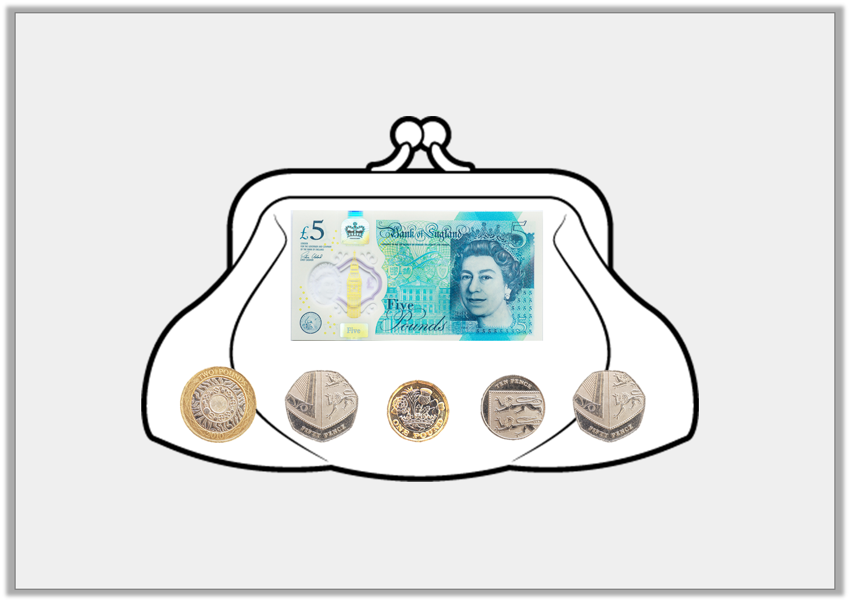
Problem Solving 2
Draw £9 and 10p in the purse, using one note and up to five coins.
Find one more combination.
One £5 note, two £2 coins and two 5p coins.
© Classroom Secrets Limited 2018

Slide 19
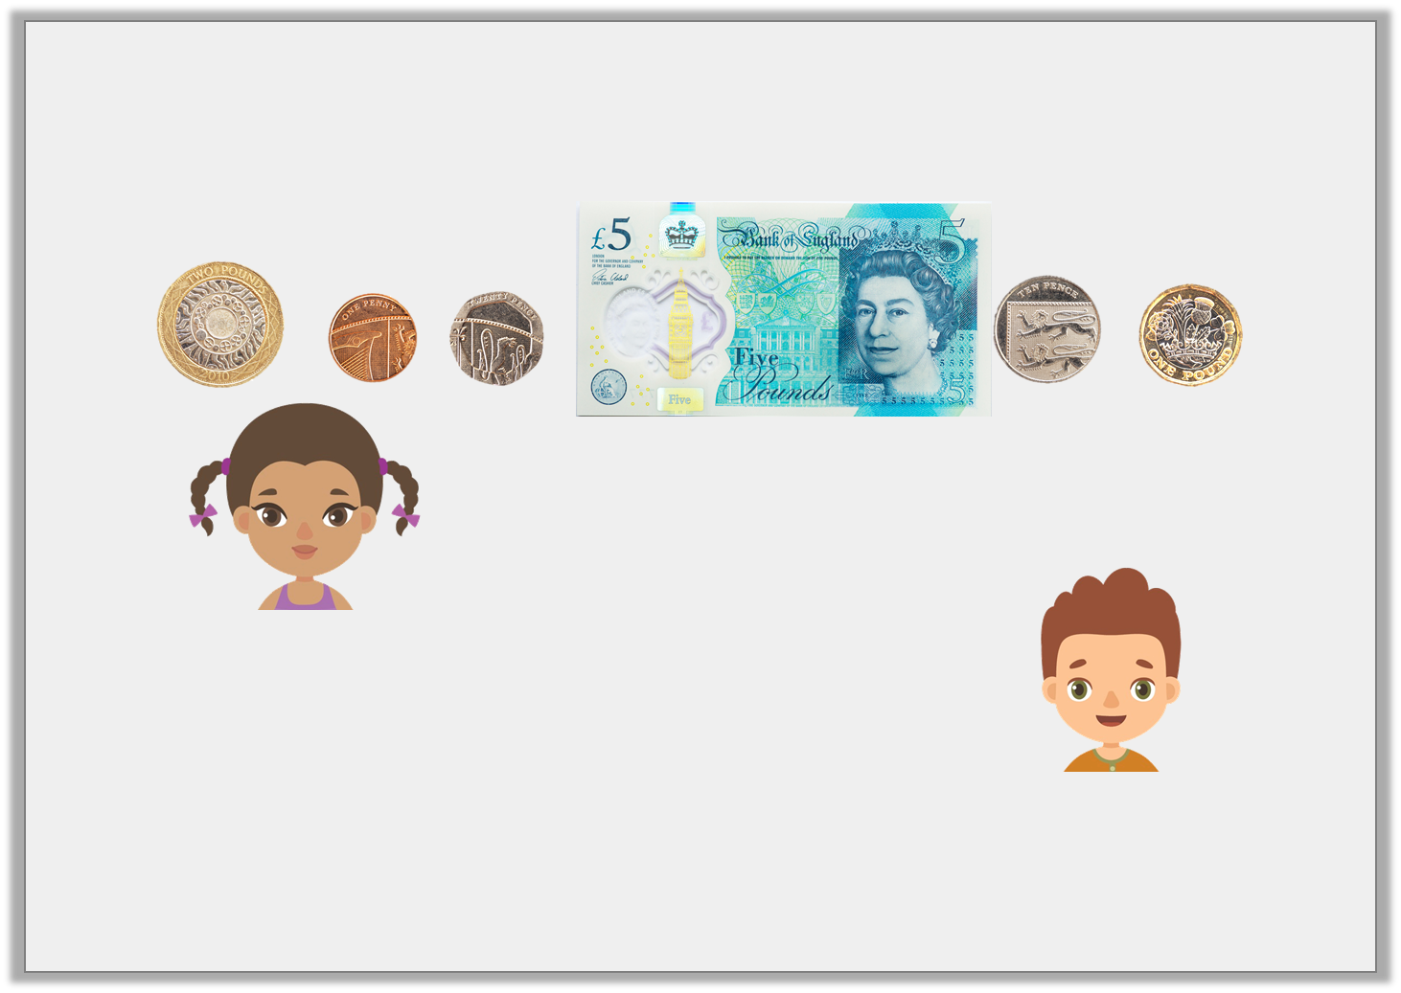
Reasoning 1
Freya and Niles are finding the total of the coins below.
Who is correct? Explain why.
I think the total is £8 and 26p.
Freya
I think the total is £8 and 31p.
Niles
© Classroom Secrets Limited 2018

Slide 20
Reasoning 1
Freya and Niles are finding the total of the coins below.
Who is correct? Explain why.
Niles is correct because...
I think the total is £8 and 26p.
Freya
I think the total is £8 and 31p.
Niles
© Classroom Secrets Limited 2018

Slide 21
Reasoning 1
Freya and Niles are finding the total of the coins below.
Who is correct? Explain why.
Niles is correct because one £5 note + one £2 coin + one 20p coin + one 10p coin + one 1p coin = £8 and 31p.
I think the total is £8 and 26p.
Freya
I think the total is £8 and 31p.
Niles
© Classroom Secrets Limited 2018

