Slide 1
LIFE/work balance
We have started a #LIFEworkbalance campaign and we need your help to complete our LIFE/work balance survey.
We hope to publish the results soon, so please give 15 minutes of your time to help us get a true picture of school life.
Want to be a part of this campaign? Take the survey on our website and share it with your colleagues!
© Classroom Secrets Limited 2020

Slide 2
Year 3 – Spring Block 4 – Length and Perimeter – Measure Length
About This Resource:
This PowerPoint has been designed to support your teaching of this small step. It includes a starter activity and an example of each question from the Varied Fluency and Reasoning and Problem Solving resources also provided in this pack. You can choose to work through all examples provided or a selection of them depending on the needs of your class.
National Curriculum Objectives:
Mathematics Year 3: (3M2a) Measure lengths (m/cm/mm)
More Year 3 Length and Perimeter resources.
Did you like this resource? Don’t forget to review it on our website.
© Classroom Secrets Limited 2019

Slide 3
Year 3 – Spring Block 4 – Length and Perimeter
Step 1: Measure Length
© Classroom Secrets Limited 2019

Slide 4
Introduction
Put these measurements in order of length, shortest to longest.
15 metres
60 centimetres
100 millimetres
3 metres
© Classroom Secrets Limited 2019

Slide 5
Introduction
Put these measurements in order of length, shortest to longest.
100 millimetres
60 centimetres
3 metres
15 metres
© Classroom Secrets Limited 2019

Slide 6
Varied Fluency 1
Measure each line.
A.
B.
C.
D.
© Classroom Secrets Limited 2019

Slide 7
Varied Fluency 1
Measure each line.
A.
B.
Answers will vary depending on equipment used.
C.
D.
© Classroom Secrets Limited 2019

Slide 8
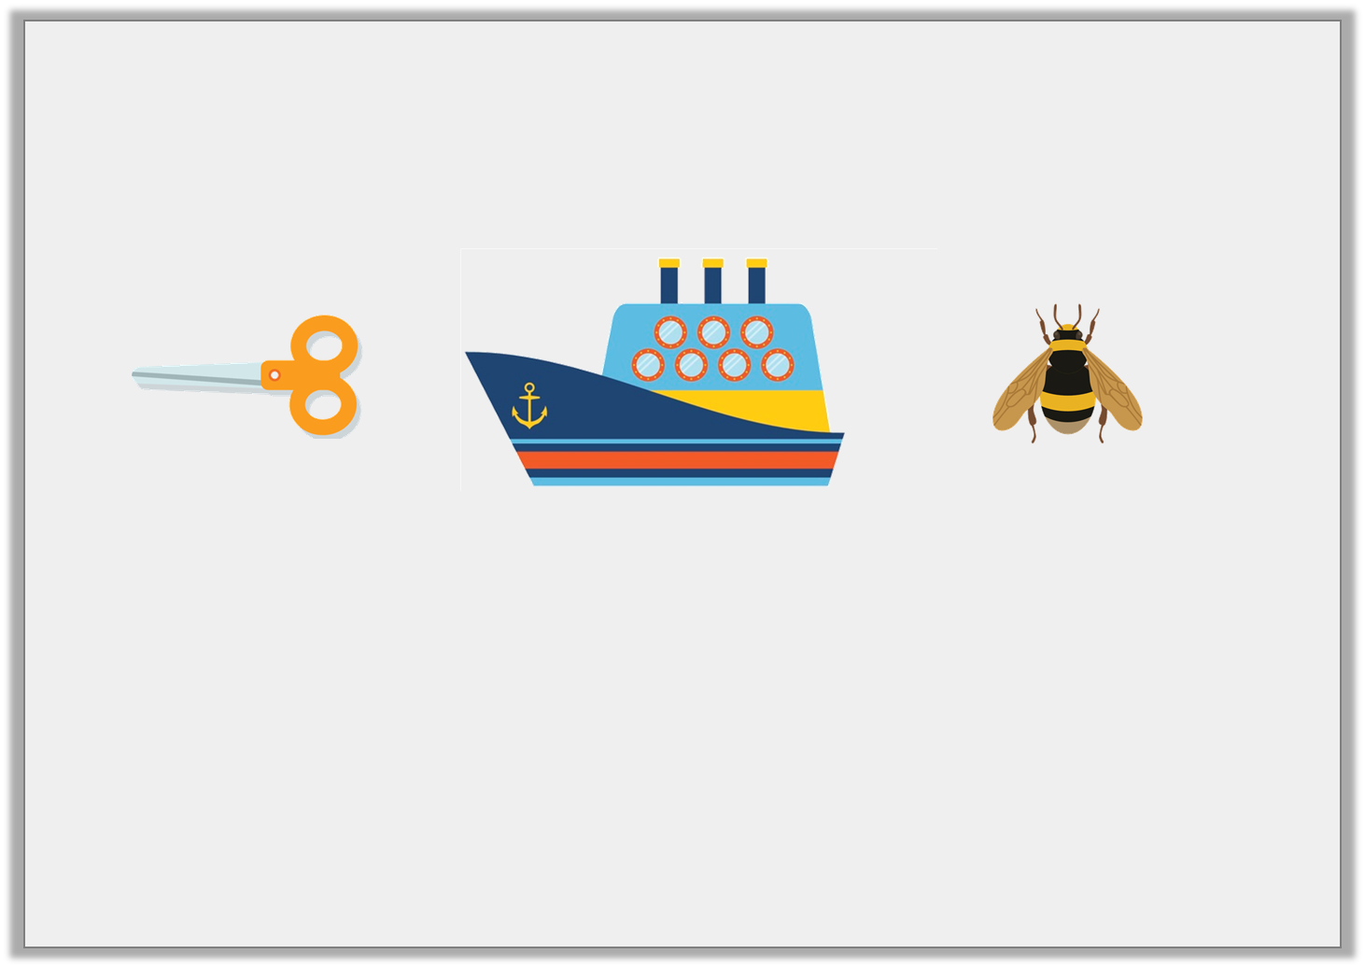
Varied Fluency 2
Imagine these objects are their usual size and match them to the most suitable length measurement.
scissors
cruise ship
bee
15cm
9mm
250m
© Classroom Secrets Limited 2019

Slide 9
Varied Fluency 2
Imagine these objects are their usual size and match them to the most suitable length measurement.
scissors
cruise ship
bee
15cm
9mm
250m
© Classroom Secrets Limited 2019

Slide 10
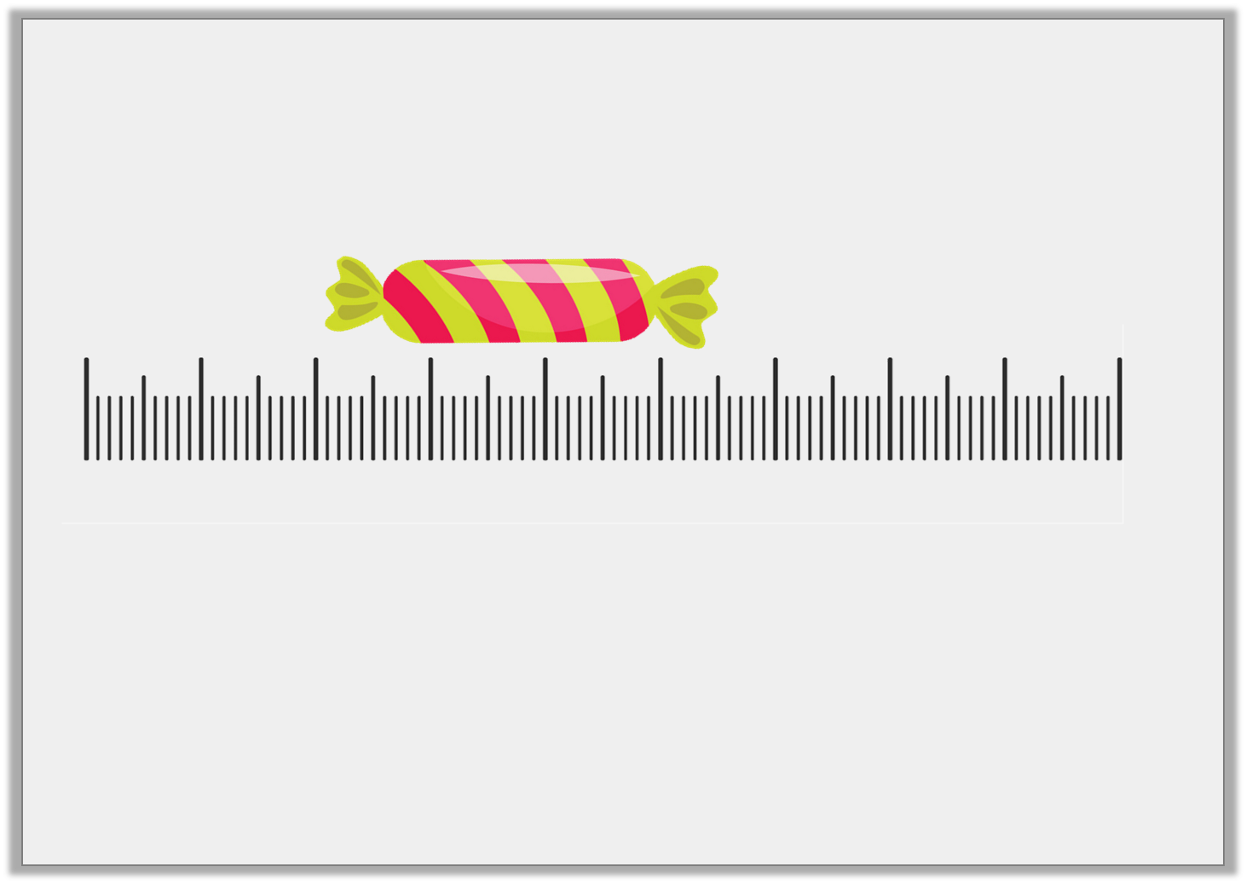
Varied Fluency 3
Tick the length of the sweet.
Not drawn to scale
5 | 6 | 7 | 8 | 9 | 10 | 11 | 12 | 13 | 14
3cm and 5mm |  |  | 5cm
© Classroom Secrets Limited 2019

Slide 11
Varied Fluency 3
Tick the length of the sweet.
Not drawn to scale
5 | 6 | 7 | 8 | 9 | 10 | 11 | 12 | 13 | 14
3cm and 5mm | ✓ |  | 5cm
© Classroom Secrets Limited 2019

Slide 12
Varied Fluency 4
Complete the sentence below.
The line is |  | cm and |  | mm long.
© Classroom Secrets Limited 2019

Slide 13
Varied Fluency 4
Complete the sentence below.
Answers will vary depending on equipment used.
The line is |  | cm and |  | mm long.
© Classroom Secrets Limited 2019

Slide 14
Problem Solving 1
This bag is 20cm and 5mm long.
Find 3 objects in your classroom that are shorter than the bag.
Write the measurements of the objects carefully in cm and the nearest 5mm.
Not drawn to scale
© Classroom Secrets Limited 2019

Slide 15
Problem Solving 1
This bag is 20cm and 5mm long.
Find 3 objects in your classroom that are shorter than the bag.
Write the measurements of the objects carefully in cm and the nearest 5mm.
Various answers, for example: Pen; pencil; scissors. Ensure measurements are recorded accurately.
Not drawn to scale
© Classroom Secrets Limited 2019

Slide 16
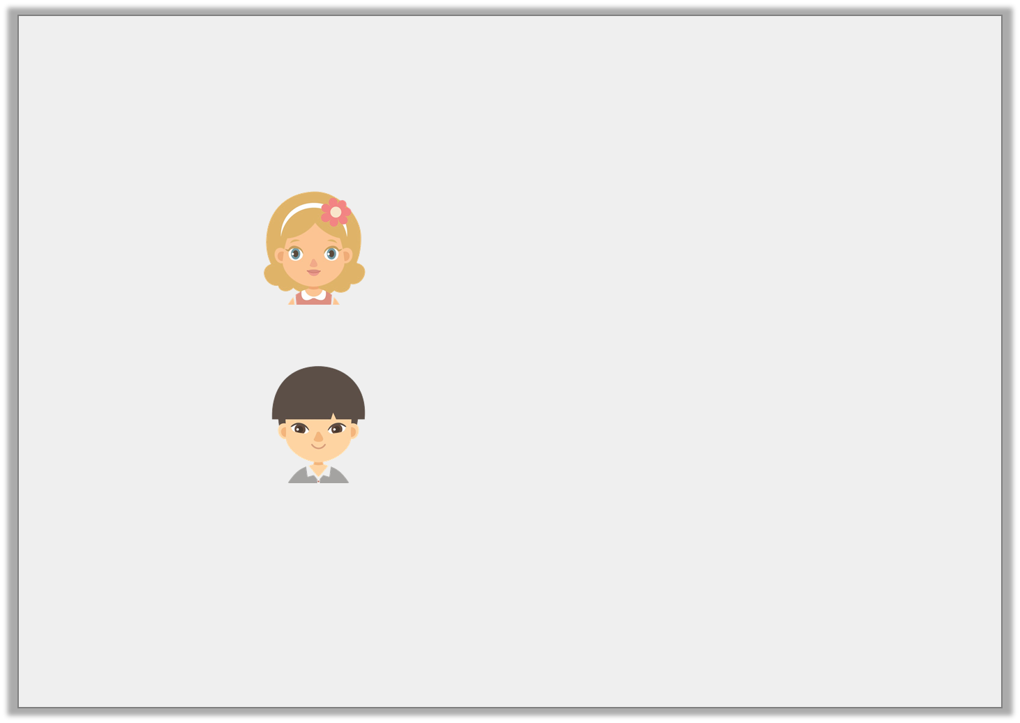
Reasoning 1
Stephanie and Danny are discussing the measurement of a tree.
Who do you agree with? Explain why.
I think a tree would measure 4m.
Stephanie
I think a tree would measure 38cm.
Danny
© Classroom Secrets Limited 2019

Slide 17
Reasoning 1
Stephanie and Danny are discussing the measurement of a tree.
Who do you agree with? Explain why.
I would agree with Stephanie because…
I think a tree would measure 4m.
Stephanie
I think a tree would measure 38cm.
Danny
© Classroom Secrets Limited 2019

Slide 18
Reasoning 1
Stephanie and Danny are discussing the measurement of a tree.
Who do you agree with? Explain why.
I would agree with Stephanie because a tree would most likely measure 4m not 38cm.
I think a tree would measure 4m.
Stephanie
I think a tree would measure 38cm.
Danny
© Classroom Secrets Limited 2019

Slide 19
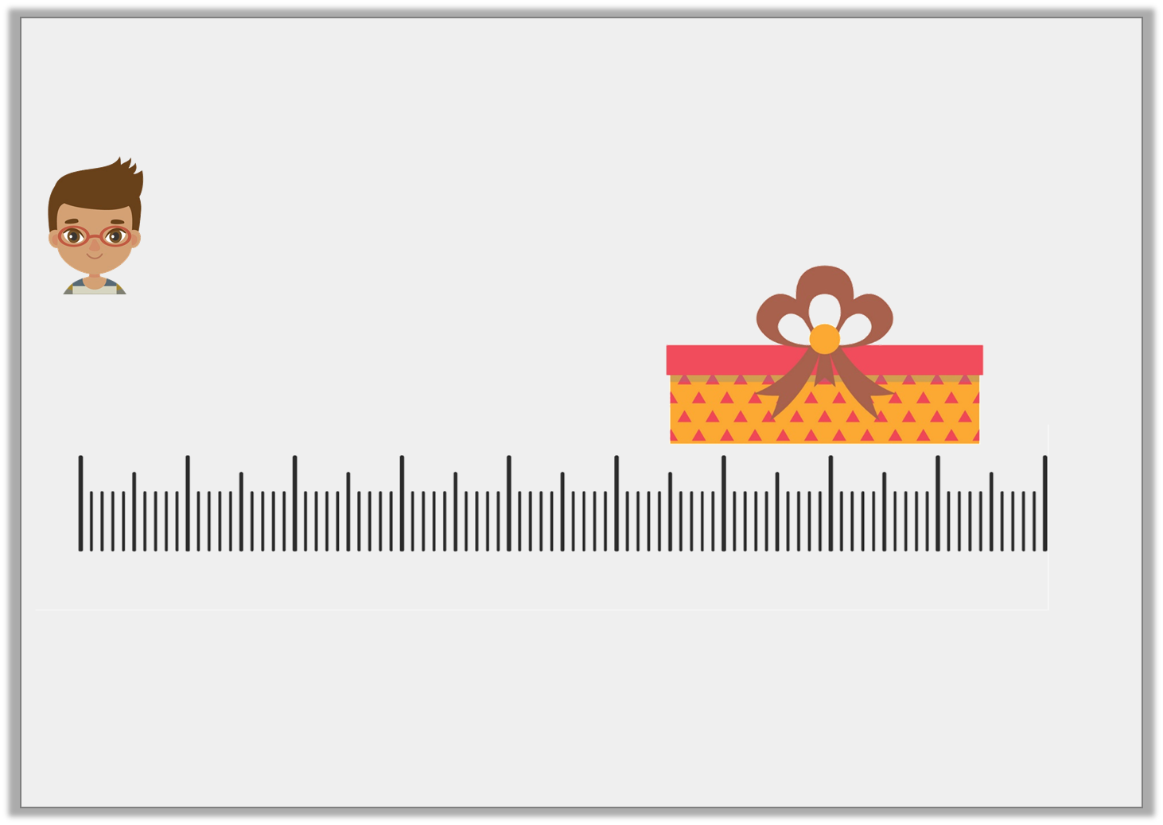
Reasoning 2
Rahil has measured the gift box.
Not drawn to scale
Is he correct? Convince me.
I think the gift box is 3cm and 2mm long.
3 | 4 | 5 | 6 | 7 | 8 | 9 | 10 | 11 | 12
© Classroom Secrets Limited 2019

Slide 20
Reasoning 2
Rahil has measured the gift box.
Not drawn to scale
Is he correct? Convince me.
No, Rahil is incorrect because…
I think the gift box is 3cm and 2mm long.
3 | 4 | 5 | 6 | 7 | 8 | 9 | 10 | 11 | 12
© Classroom Secrets Limited 2019

Slide 21
Reasoning 2
Rahil has measured the gift box.
Not drawn to scale
Is he correct? Convince me.
No, Rahil is incorrect because the gift box measures approximately 2cm and 9mm or 29mm.
I think the gift box is 3cm and 2mm long.
3 | 4 | 5 | 6 | 7 | 8 | 9 | 10 | 11 | 12
© Classroom Secrets Limited 2019

