Slide 1
LIFE/work balance
We have started a #LIFEworkbalance campaign and we need your help to complete our LIFE/work balance survey.
We hope to publish the results soon, so please give 15 minutes of your time to help us get a true picture of school life.
Want to be a part of this campaign? Take the survey on our website and share it with your colleagues!
© Classroom Secrets Limited 2018

Slide 2
Year 3 – Summer Block 1 – Fractions – Equivalent Fractions 1
About This Resource:
This PowerPoint has been designed to support your teaching of this small step. It includes a starter activity and an example of each question from the Varied Fluency and Reasoning and Problem Solving resources also provided in this pack. You can choose to work through all examples provided or a selection of them depending on the needs of your class.
National Curriculum Objectives:
Mathematics Year 3: (3F2) Recognise and show, using diagrams, equivalent fractions with small denominators
More Year 3 Fractions resources.
Did you like this resource? Don’t forget to review it on our website.
© Classroom Secrets Limited 2018

Slide 3
Year 3 – Summer Block 1 – Fractions
Step 1:
Equivalent Fractions 1
© Classroom Secrets Limited 2018

Slide 4
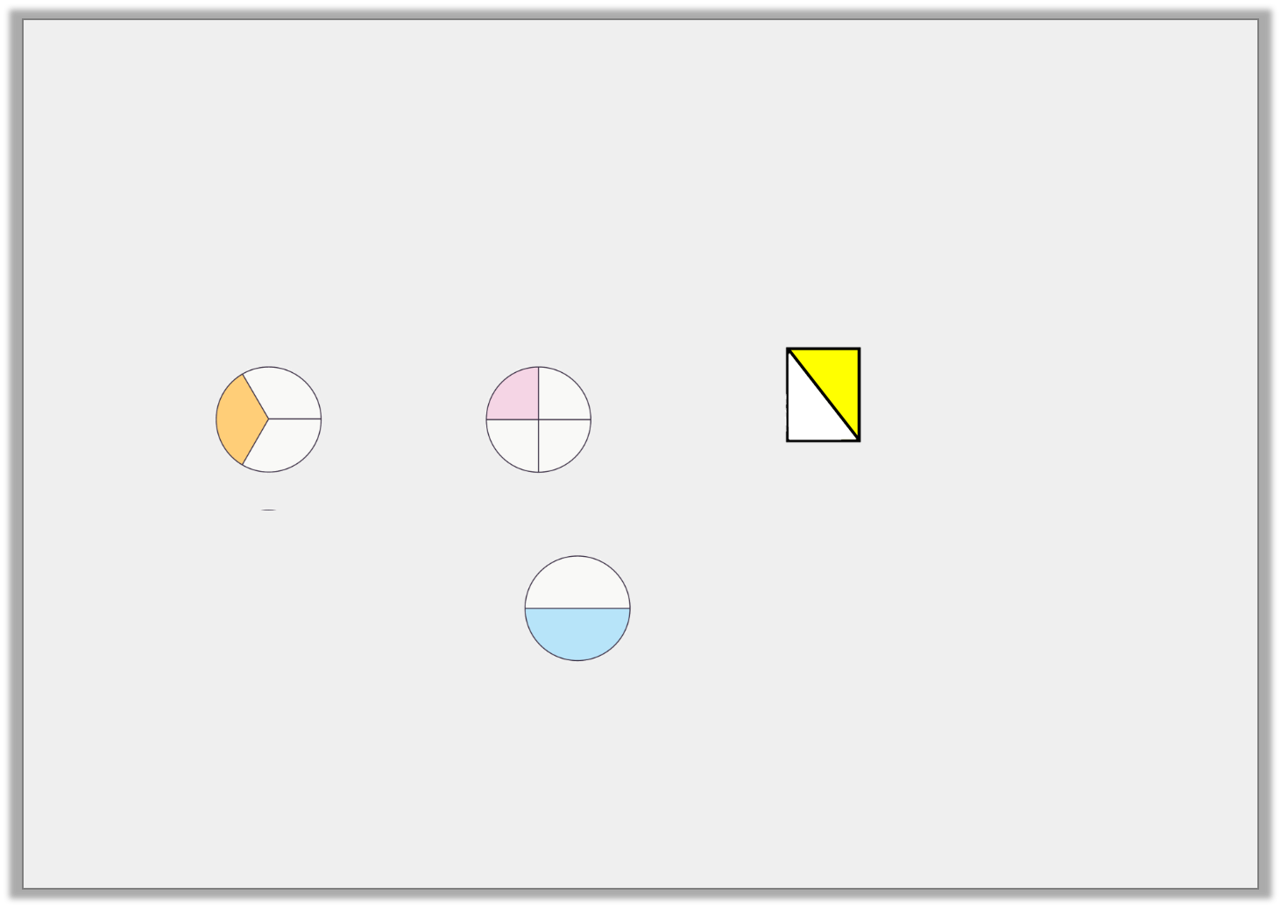
Introduction
Match the images to these fractions:
Do they all match up? Explain why.
1
2
1
4
1
3
© Classroom Secrets Limited 2018

Slide 5
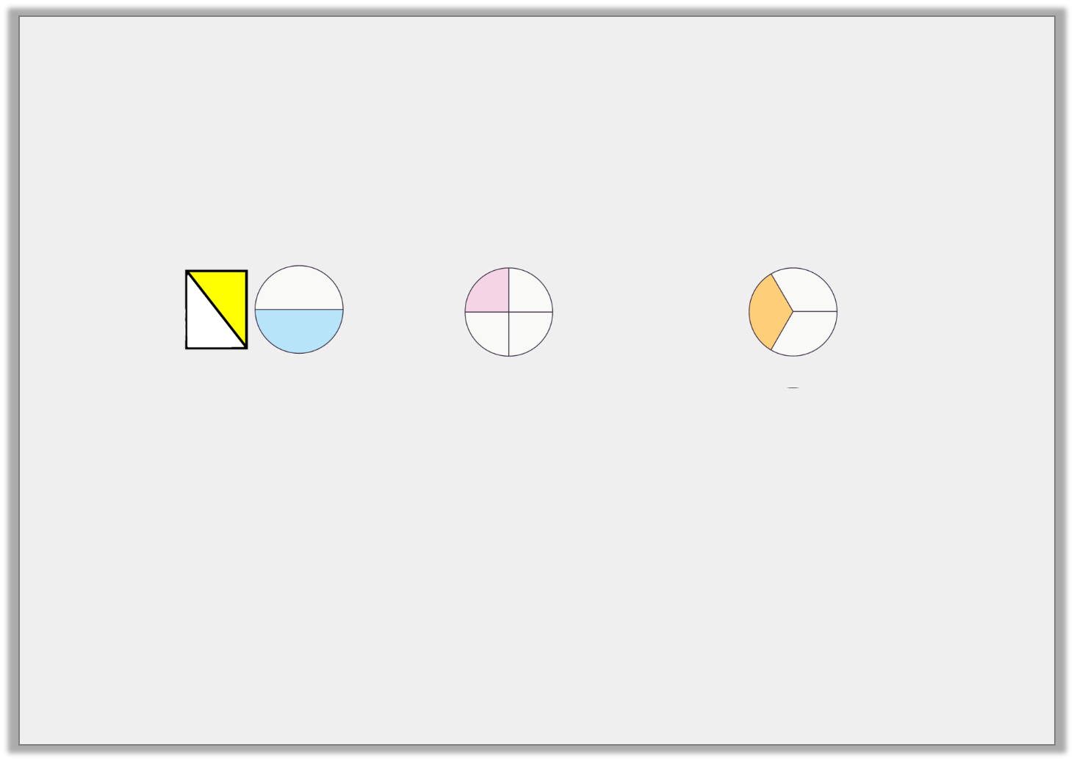
Introduction
Match the images to these fractions:
Do they all match up? Explain why/why not.
This shape does not match as it has not been split into 2 equal parts.
1
2
1
4
1
3
© Classroom Secrets Limited 2018

Slide 6
Varied Fluency 1
Complete the statement to match the image.
 | = |  | =
© Classroom Secrets Limited 2018

Slide 7
Varied Fluency 1
Complete the statement to match the image.
1 | = | 2 | = | 3
3 |  | 6 |  | 9
© Classroom Secrets Limited 2018

Slide 8
Varied Fluency 2
Which shapes show equivalent fifths?
Shape A
Shape B
Shape C
© Classroom Secrets Limited 2018

Slide 9
Varied Fluency 2
Which shapes show equivalent fifths?
Shape A
Shape B
Shape C
© Classroom Secrets Limited 2018

Slide 10
Varied Fluency 3
Circle the pair of equivalent fractions.
1 |  | 1 |  | 3 |  | 2
5 |  | 8 |  | 15 |  | 4
© Classroom Secrets Limited 2018

Slide 11
Varied Fluency 3
Circle the pair of equivalent fractions.
1 |  | 1 |  | 3 |  | 2
5 |  | 8 |  | 15 |  | 4
© Classroom Secrets Limited 2018

Slide 12
Varied Fluency 4
Complete the statements.
1 | =
6 |  | 24
1 | =
10 |  | 30
© Classroom Secrets Limited 2018

Slide 13
Varied Fluency 4
Complete the statements.
1 | = | 4
6 |  | 24
1 | = | 3
10 |  | 30
© Classroom Secrets Limited 2018

Slide 14
Problem Solving 1
Find 3 different ways to colour in half of the same shape.
Complete this statement:
1 | =
2 |  | 12
© Classroom Secrets Limited 2018

Slide 15
Problem Solving 1
Find 3 different ways to colour in half of the same shape.
Complete this statement:
Any 6 squares need to be coloured in each shape.
1 | = | 6
2 |  | 12
© Classroom Secrets Limited 2018

Slide 16
Problem Solving 2
Sort the fractions into the correct circle. Are there any fractions that don’t fit in the circles?
Equivalent to a quarter
Equivalent to a third
2
6
2
8
4
8
3
12
5
20
5
15
© Classroom Secrets Limited 2018

Slide 17
Problem Solving 2
Sort the fractions into the correct circle. Are there any fractions that don’t fit in the circles?
Equivalent to a quarter
Equivalent to a third
3
12
5
20
2
6
5
15
2
8
4
8
© Classroom Secrets Limited 2018

Slide 18
Reasoning 1
Rose says,
Is she correct? Explain why.
I think that is
equivalent to .
1
6
3
12
© Classroom Secrets Limited 2018

Slide 19
Reasoning 1
Rose says,
Is she correct? Explain why.
Rose is not correct as I know that…
I think that is
equivalent to .
1
6
3
12
© Classroom Secrets Limited 2018

Slide 20
Reasoning 1
Rose says,
Is she correct? Explain why.
Rose is not correct as I know that one sixth is equivalent to two twelfths, not three twelfths.
I think that is
equivalent to .
1
6
3
12
© Classroom Secrets Limited 2018

