Slide 1
Year 3 – Summer Block 2 – Time – Months and Years
About This Resource:
This PowerPoint has been designed to support your teaching of this small step. It includes a starter activity and an example of each question from the Varied Fluency and Reasoning and Problem Solving resources also provided in this pack. You can choose to work through all examples provided or a selection of them depending on the needs of your class.
National Curriculum Objectives:
Mathematics Year 3: (3M4e) Know the number of seconds in a minute and the number of days in each month, year and leap year
More Year 3 Time resources.
Did you like this resource? Don’t forget to review it on our website.
© Classroom Secrets Limited 2018

Slide 2
Year 3 – Summer Block 2 – Time
Step 1: Months and Years
© Classroom Secrets Limited 2018

Slide 3
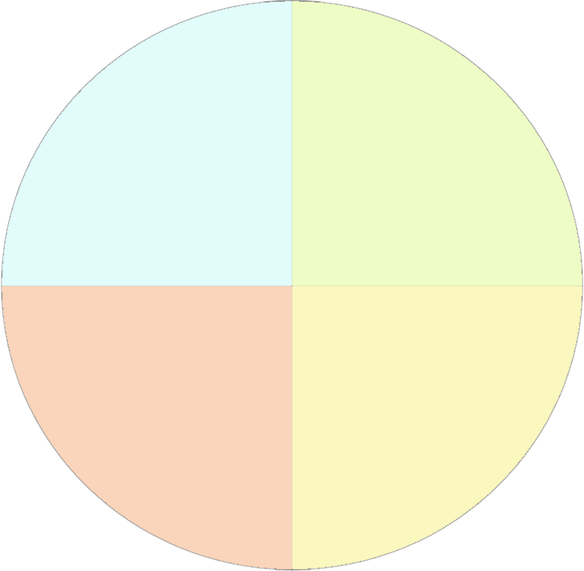
Introduction
Decide which month should go in which season and place them in the correct order.
July
Winter
Spring
November
September
March
October
December
June
Autumn
Summer
April
May
August
February
January
© Classroom Secrets Limited 2018

Slide 4
Introduction
Decide which month should go in which season and place them in the correct order.
July
Winter
Spring
November
September
December
March
March
January
April
February
May
October
December
June
Autumn
Summer
April
September
June
May
October
July
August
November
August
February
January
© Classroom Secrets Limited 2018

Slide 5
Varied Fluency 1
Circle the month or months that do not have 30 days in total.
The eighth month of the year | April | The month before March
© Classroom Secrets Limited 2018

Slide 6
Varied Fluency 1
Circle the month or months that do not have 30 days in total.
The eighth month of the year | April | The month before March
© Classroom Secrets Limited 2018

Slide 7
Varied Fluency 2
Write the date a week later.
28th February (non-leap year)
30th December
© Classroom Secrets Limited 2018

Slide 8
Varied Fluency 2
Write the date a week later.
28th February (non-leap year) | 7th March
30th December | 6th January
© Classroom Secrets Limited 2018

Slide 9
Varied Fluency 3
Complete the table.
Number of days in the fifth month of the year
Number of days in 2019
Number of days in February in a _________ year | 29
© Classroom Secrets Limited 2018

Slide 10
Varied Fluency 3
Complete the table.
Number of days in the fifth month of the year | 31
Number of days in 2019 | 365
Number of days in February in a leap year | 29
© Classroom Secrets Limited 2018

Slide 11
Varied Fluency 4
Draw lines to match the statements to the missing parts.
There are ________ days in the 10th month of the year |  | 8
August is the ________ th month of the year |  | 31
The month after March has ________ days |  | 30
© Classroom Secrets Limited 2018

Slide 12
Varied Fluency 4
Draw lines to match the statements to the missing parts.
There are ________ days in the 10th month of the year |  | 8
August is the ________ th month of the year |  | 31
The month after March has ________ days |  | 30
© Classroom Secrets Limited 2018

Slide 13
Reasoning 1
Are the following statements always true, sometimes true or never true?
March has fewer days than September
A year has 366 days
January is the first month of the year
2020 will be a leap year
Explain your reasoning.
A.
B.
C.
D.
© Classroom Secrets Limited 2018

Slide 14
Reasoning 1
Are the following statements always true, sometimes true or never true?
March has fewer days than September
Never true because March has 31 days and September has 30 days.
B. A year has 366 days
Sometimes true because a leap year has 366 days but a non-leap year has 365 days.
C. January is the first month of the year
Always true.
D. 2020 will be a leap year
Always true because leap years happen every four years, and the last one was 2016.
© Classroom Secrets Limited 2018

Slide 15
Reasoning 2
Which card is the odd out one?
Explain your reasoning.
June
The month before September
The first month of the year
© Classroom Secrets Limited 2018

Slide 16
Reasoning 2
Which card is the odd out one?
Explain your reasoning.
June is the odd one out because…
June
The month before September
The first month of the year
© Classroom Secrets Limited 2018

Slide 17
Reasoning 2
Which card is the odd out one?
Explain your reasoning.
June is the odd one out because June has 30 days whereas August (the month before September) and January (the first month of the year) both have 31 days.
June
The month before September
The first month of the year
© Classroom Secrets Limited 2018

Slide 18
Problem Solving 1
Complete the table about the siblings’ dates of birth using the information below.
Jaxon’s birthday is two days after Christmas.
Harvey’s birthday is in August.
Harvey’s birthday is on the same day of the month as Jaxon’s.
Delilah’s birthday is in the month before Harvey’s.
 |  | 27 | / | 12 | / | 2012
 |  |  | / |  | / | 2008
Delilah |  | 6 | / |  | / | 2004
© Classroom Secrets Limited 2018

Slide 19
Problem Solving 1
Complete the table about the siblings’ dates of birth using the information below.
Jaxon’s birthday is two days after Christmas.
Harvey’s birthday is in August.
Harvey’s birthday is on the same day of the month as Jaxon’s.
Delilah’s birthday is in the month before Harvey’s.
Jaxon |  | 27 | / | 12 | / | 2012
Harvey |  | 27 | / | 8 | / | 2008
Delilah |  | 6 | / | 7 | / | 2004
© Classroom Secrets Limited 2018

