Slide 1
LIFE/work balance
We have started a #LIFEworkbalance campaign and we need your help to complete our LIFE/work balance survey.
We hope to publish the results soon, so please give 15 minutes of your time to help us get a true picture of school life.
Want to be a part of this campaign? Take the survey on our website and share it with your colleagues!
© Classroom Secrets Limited 2019

Slide 2
Year 3 – Summer Block 3 – Properties of Shape – Turns and Angles
About This Resource:
This PowerPoint has been designed to support your teaching of this small step. It includes a starter activity and an example of each question from the Varied Fluency and Reasoning and Problem Solving resources also provided in this pack. You can choose to work through all examples provided or a selection of them depending on the needs of your class.
National Curriculum Objectives:
Mathematics Year 3: (3G4a) Recognise that angles are a property of a shape or a description of a turn
Mathematics Year 3: (3G4b) Identify right angles, recognise that two right angles make a half turn, three make three quarters of a turn and four a complete turn; identify whether angles are greater than or less than a right angle
More Year 3 Properties of Shape resources.
Did you like this resource? Don’t forget to review it on our website.
© Classroom Secrets Limited 2019

Slide 3
Year 3 – Summer Block 3 – Properties of Shape
Step 1: Turns and Angles
© Classroom Secrets Limited 2019

Slide 4
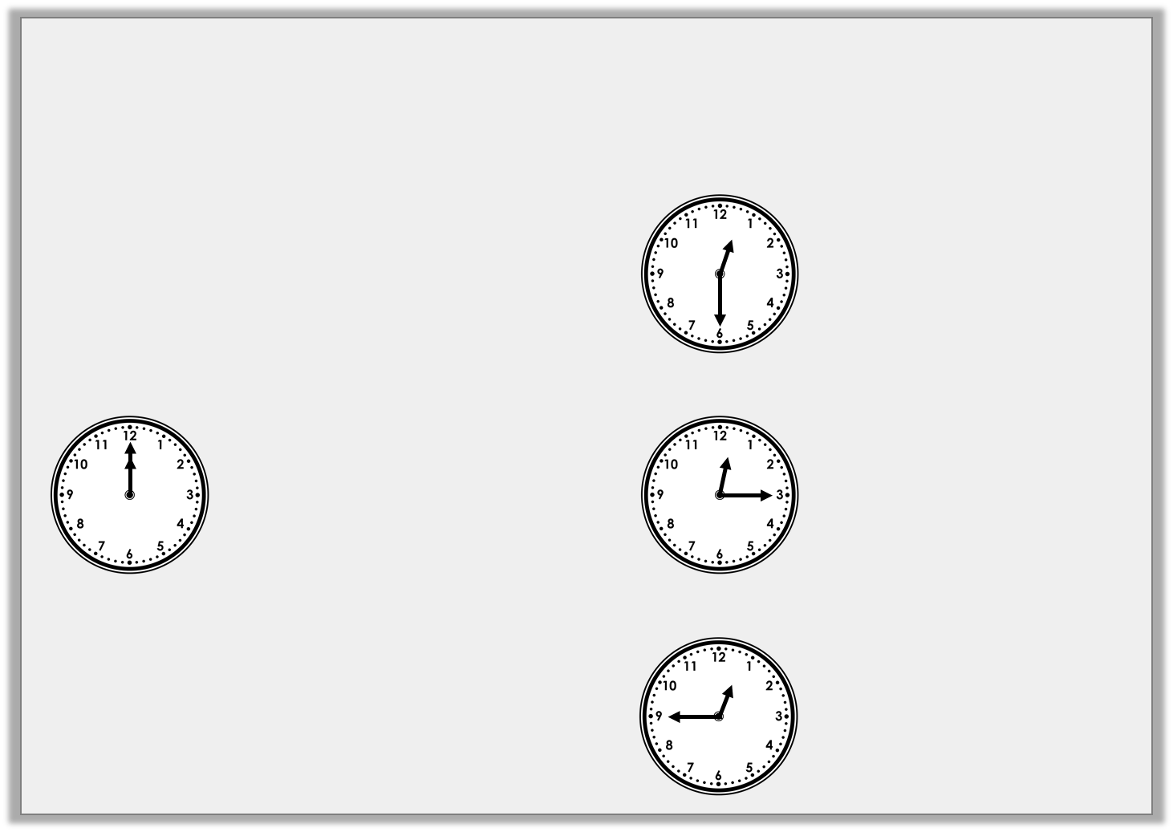
Introduction
Match the starting clock to the durations and the turns
that the minute hand has made.
Half turn clockwise
+ 30 mins
Start
Quarter turn clockwise
+ 45 mins
Three- quarter turn clockwise
+ 15 mins
© Classroom Secrets Limited 2019

Slide 5
Introduction
Match the starting clock to the durations and the turns
that the minute hand has made.
Half turn clockwise
+ 30 mins
Start
Quarter turn clockwise
+ 45 mins
Three- quarter turn clockwise
+ 15 mins
© Classroom Secrets Limited 2019

Slide 6
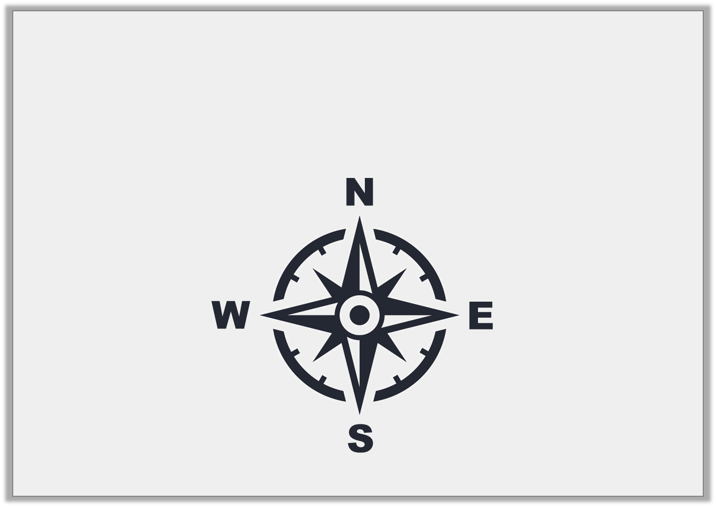
Varied Fluency 1
Start at east.
Turn three quarters clockwise.
Which direction are you now facing?
© Classroom Secrets Limited 2019

Slide 7
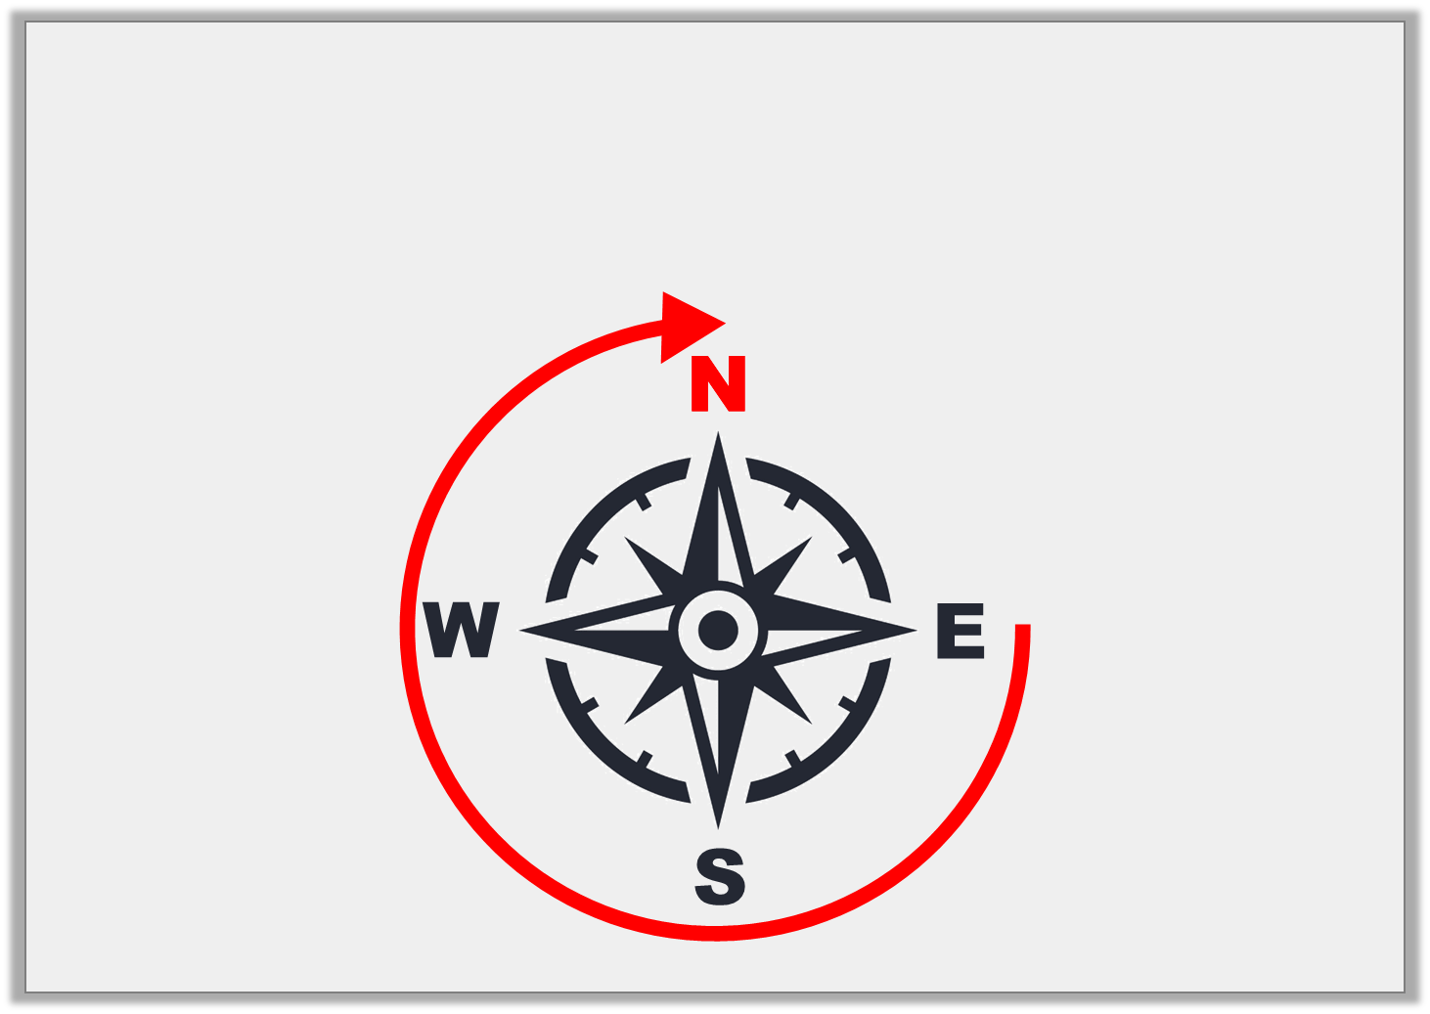
Varied Fluency 1
Start at east.
Turn three quarters clockwise.
Which direction are you now facing?
© Classroom Secrets Limited 2019

Slide 8
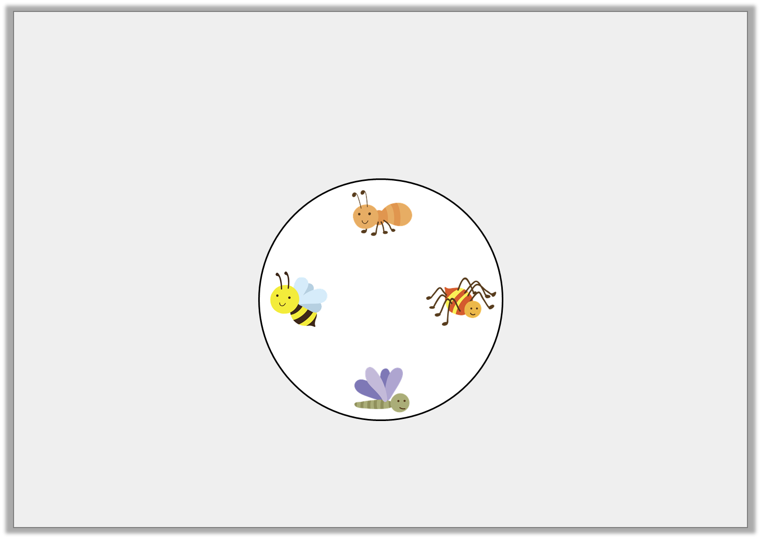
Varied Fluency 2
What turn does the spinner need to make to get
from the dragonfly to the spider?
© Classroom Secrets Limited 2019

Slide 9
Varied Fluency 2
What turn does the spinner need to make to get
from the dragonfly to the spider?
A quarter turn anti-clockwise or a three-quarter turn clockwise.
© Classroom Secrets Limited 2019

Slide 10
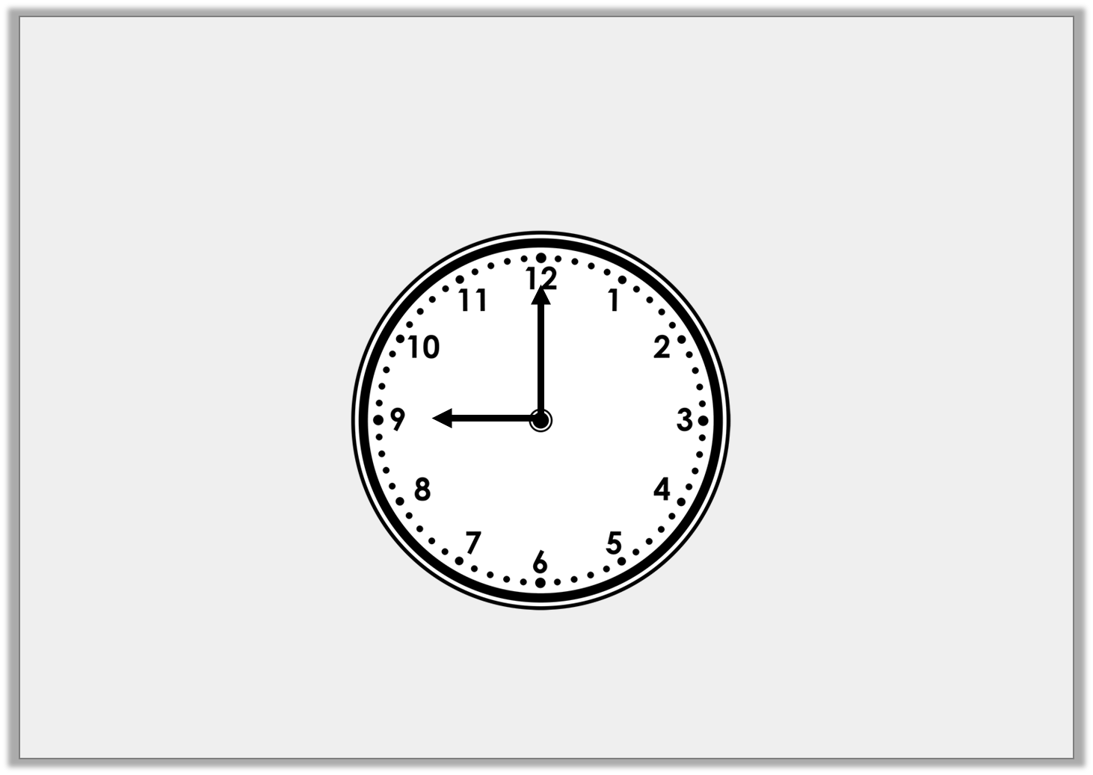
Varied Fluency 3
If the hour hand is turned a turn, what time will it be?
1
4
© Classroom Secrets Limited 2019

Slide 11
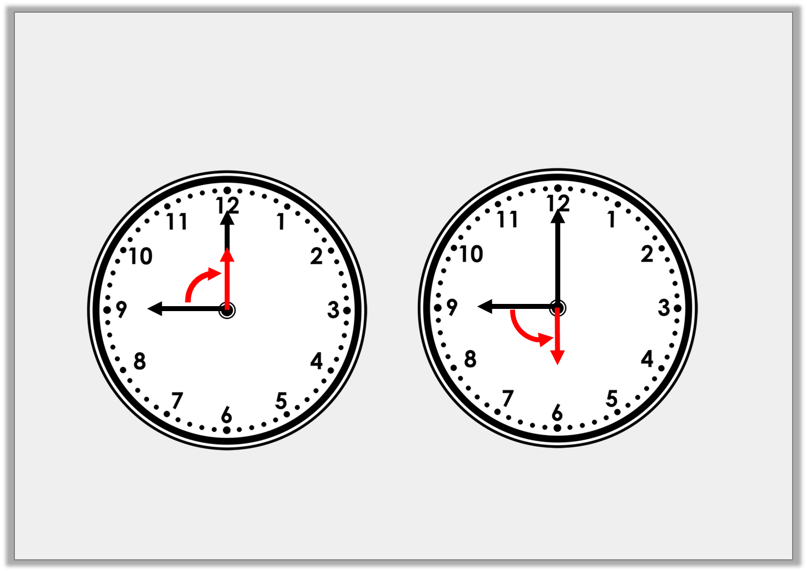
Varied Fluency 3
If the hour hand is turned a turn, what time will it be?
1
4
12 o’clock
6 o’clock
© Classroom Secrets Limited 2019

Slide 12
Varied Fluency 4
Sort these images into the table.
All lines make angles | Not all lines make angles
© Classroom Secrets Limited 2019

Slide 13
Varied Fluency 4
Sort these images into the table.
All lines make angles | Not all lines make angles
© Classroom Secrets Limited 2019

Slide 14
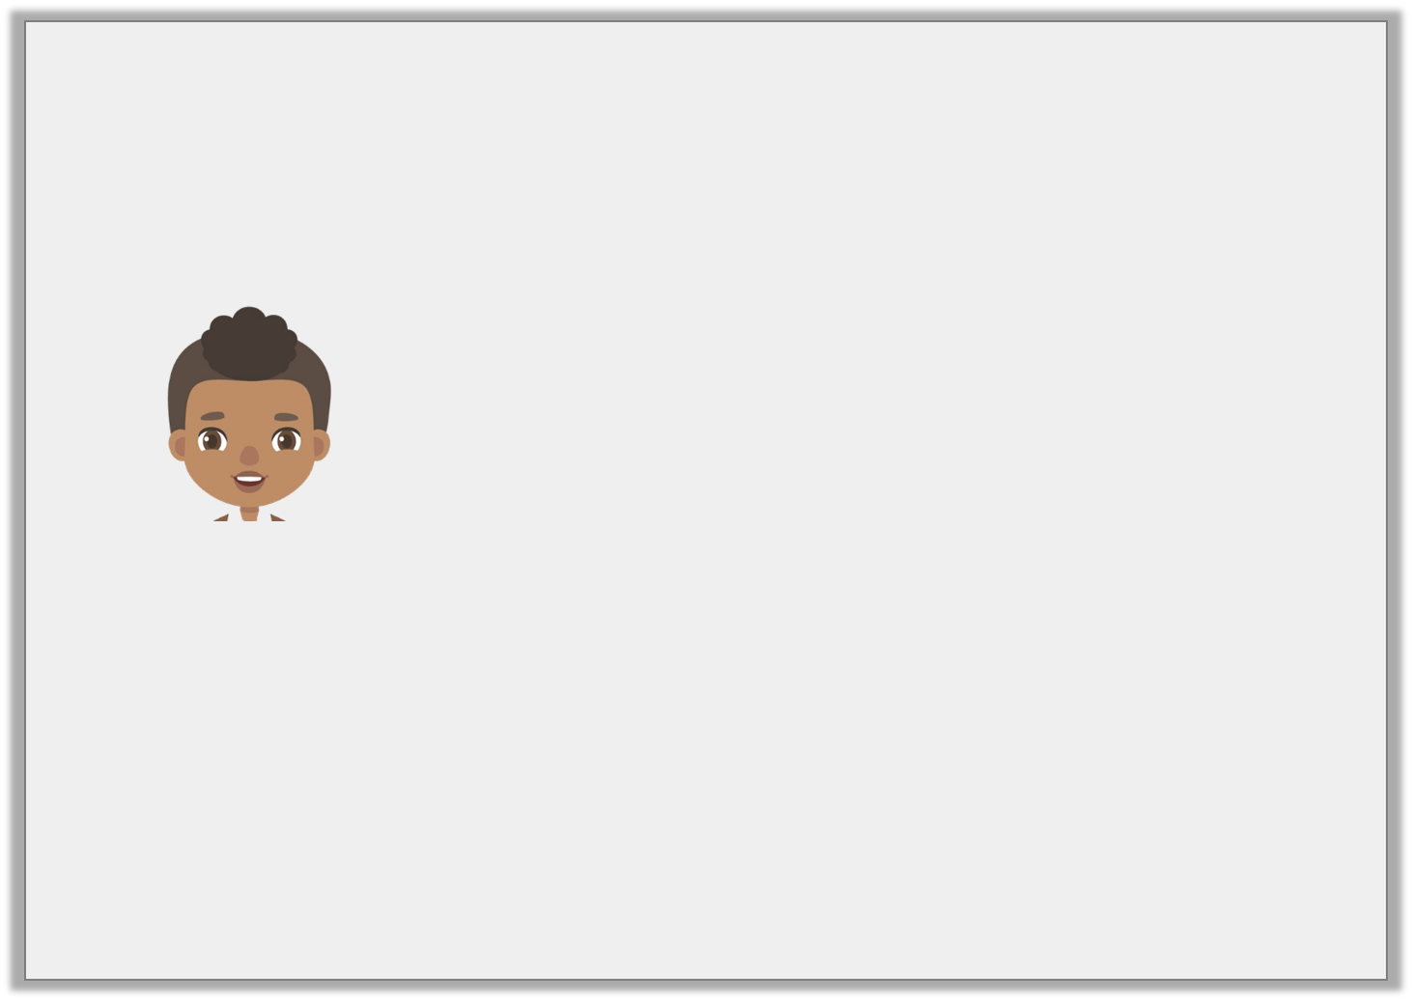
Problem Solving 1
Iqbal is thinking of a shape.
He says,
Draw the shape that he is thinking of.
The shape has 6 angles that are the same size.
© Classroom Secrets Limited 2019

Slide 15
Problem Solving 1
Iqbal is thinking of a shape.
He says,
Draw the shape that he is thinking of.
The shape has 6 angles that are the same size.
© Classroom Secrets Limited 2019

Slide 16
Problem Solving 2
After a three quarter turn anti-clockwise, you are now facing the zebra. Which animal were you facing when you started?
© Classroom Secrets Limited 2019

Slide 17
Problem Solving 2
After a three quarter turn anti-clockwise, you are now facing the zebra. Which animal were you facing when you started?
Leopard
© Classroom Secrets Limited 2019

Slide 18
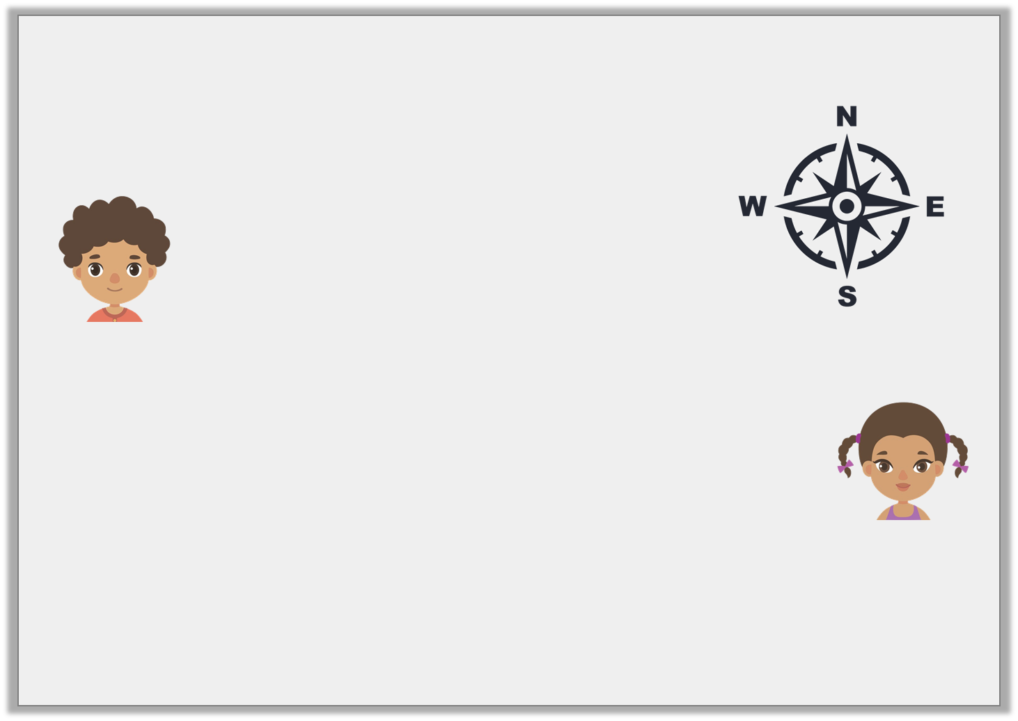
Reasoning 1
A compass needle has moved from south to north.
Jon says,
Fiona says,
Who is correct? Explain how you know.
It has moved a half turn clockwise.
It has moved a half turn anti-clockwise.
© Classroom Secrets Limited 2019

Slide 19
Reasoning 1
A compass needle has moved from south to north.
Jon says,
Fiona says,
Who is correct? Explain how you know.
Both Jon and Fiona could be correct because…
It has moved a half turn clockwise.
It has moved a half turn anti-clockwise.
© Classroom Secrets Limited 2019

Slide 20
Reasoning 1
A compass needle has moved from south to north.
Jon says,
Fiona says,
Who is correct? Explain how you know.
Both Jon and Fiona could be correct because a half turn in either direction from the same starting point will end up at north.
It has moved a half turn clockwise.
It has moved a half turn anti-clockwise.
© Classroom Secrets Limited 2019

