Slide 1
Y3
FRENCH
Where is France?
Unit 1 - Culture

Slide 2
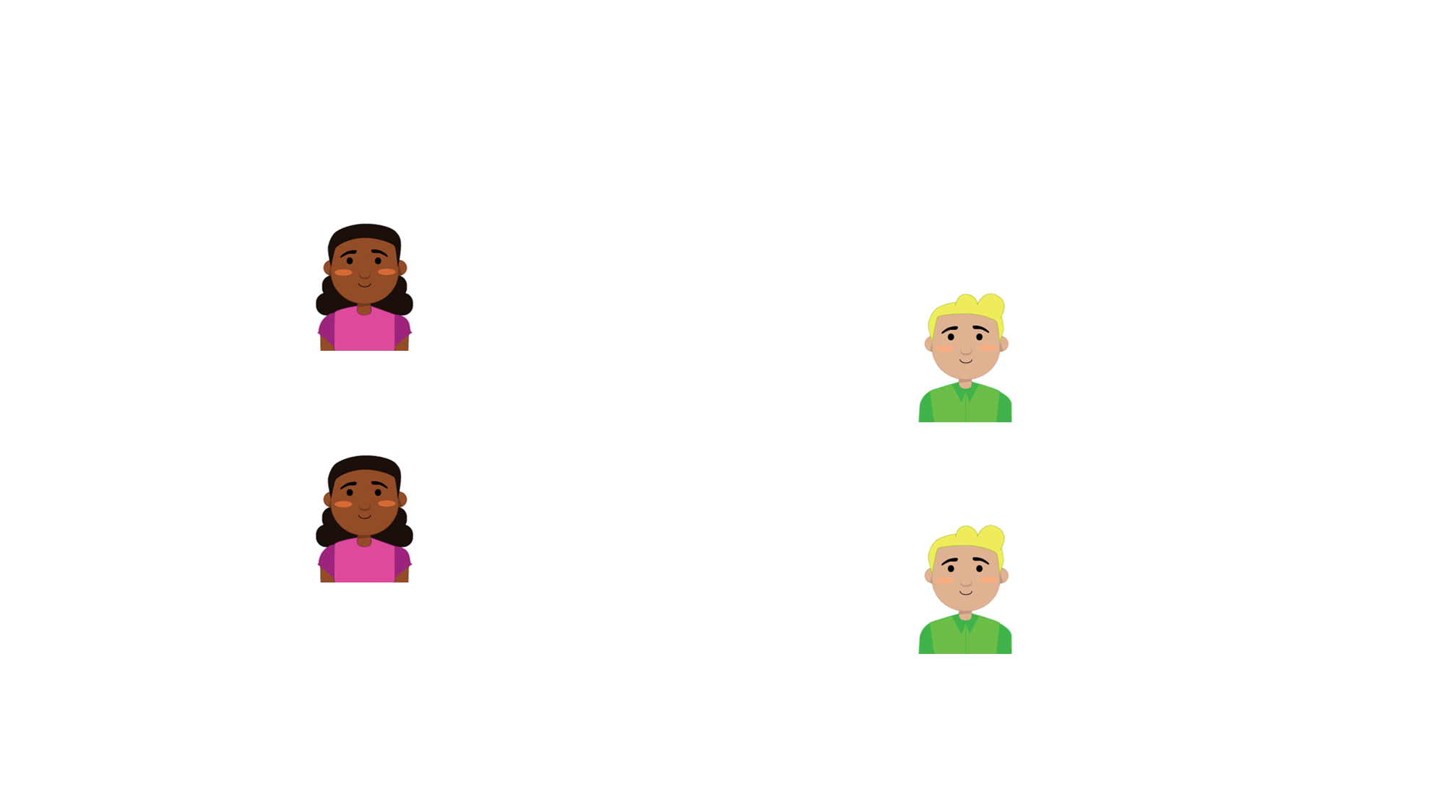
Where is France?
Let’s start with a question about greetings in French. Select the correct phrase to respond to Manon.
Bonjour Sam !
Manon
Bonjour Manon !
Sam
À bientôt.
Manon
Sam
Bonjour !
Au revoir.
Merci.

Slide 3
Where is France?
Let’s start with a question about greetings in French. Select the correct phrase to respond to Manon.
Bonjour Sam !
Manon
Bonjour Manon !
Sam
À bientôt.
Manon
Au revoir.
Sam
Bonjour !
Au revoir.
Merci.

Slide 4
Where is France?
Before we look at the geographical features, let’s find out some fun facts about France.
Fact
Fact
The official language of France is French. French is one of the most spoken languages in the world.
In France, they use euros and cents, unlike the British pound and pence.
Fact
France is located on the mainland of Europe. This means it shares land borders with other countries.
Fact
The coastline around the north of France is called the English Channel and the Mediterranean Sea is on the south coast.
Fact
France has five overseas departments around the world.

Slide 5
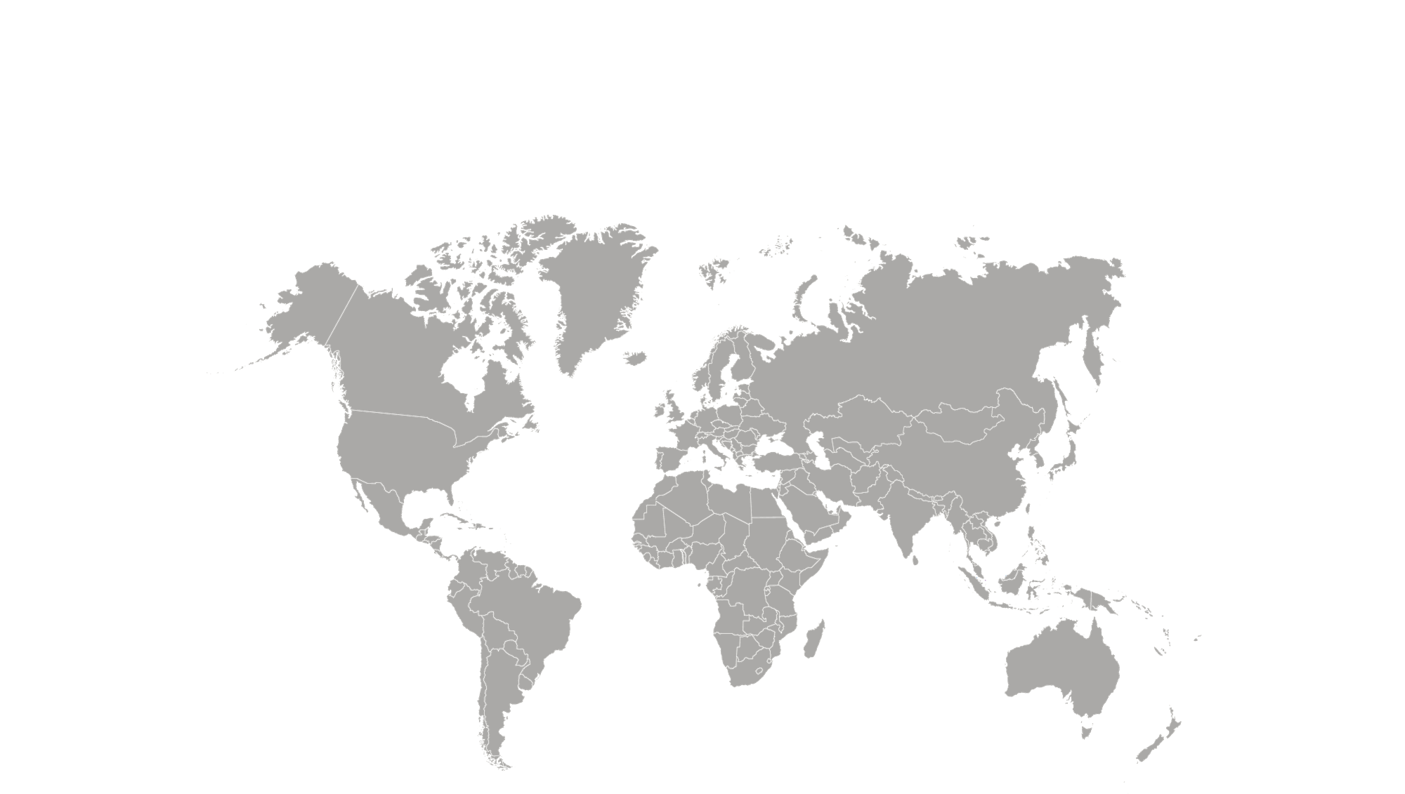
Where is France?
Now that we are ready to move on, we can learn about where France is in the world.

Slide 6
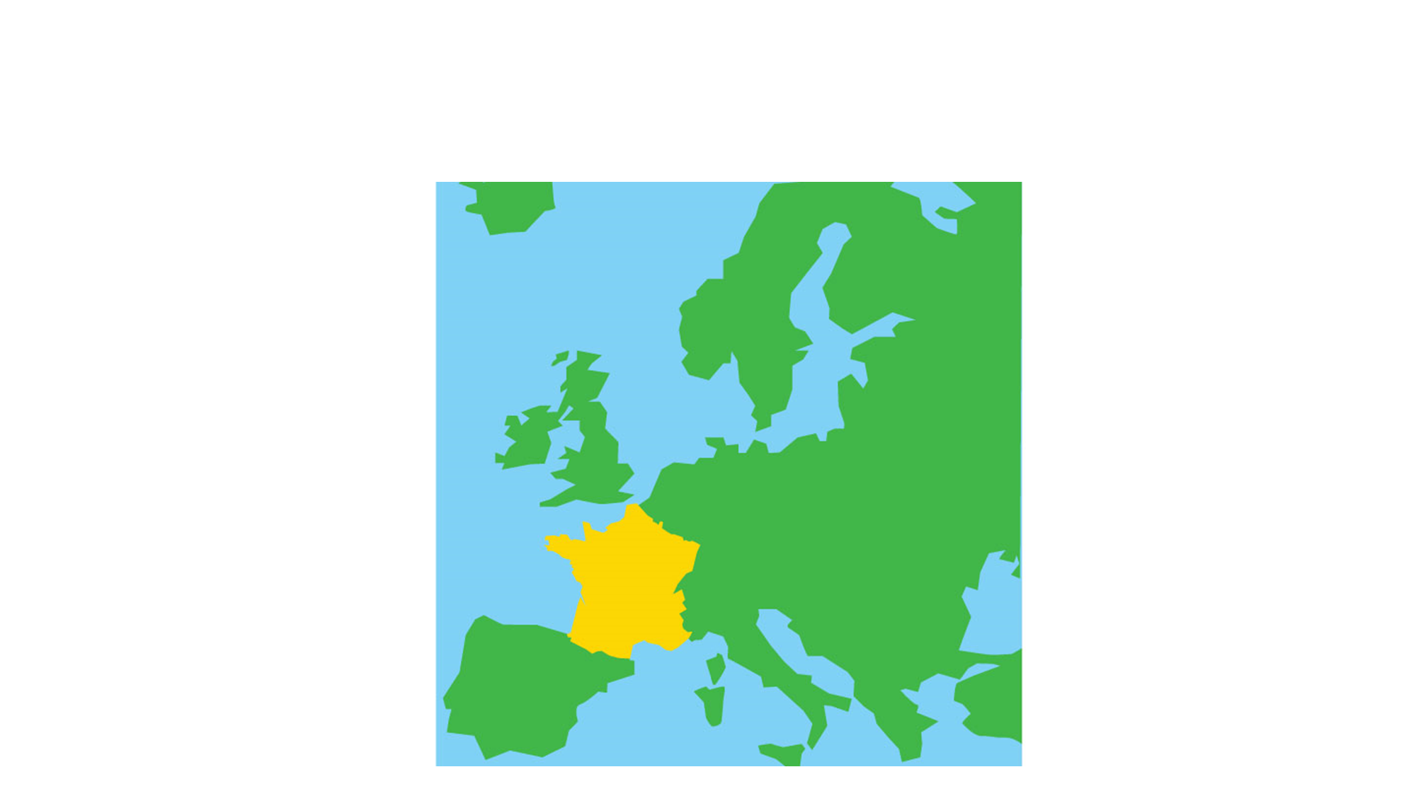
Where is France?
France is a country on the continent Europe, just like the United Kingdom.
United Kingdom
France

Slide 7
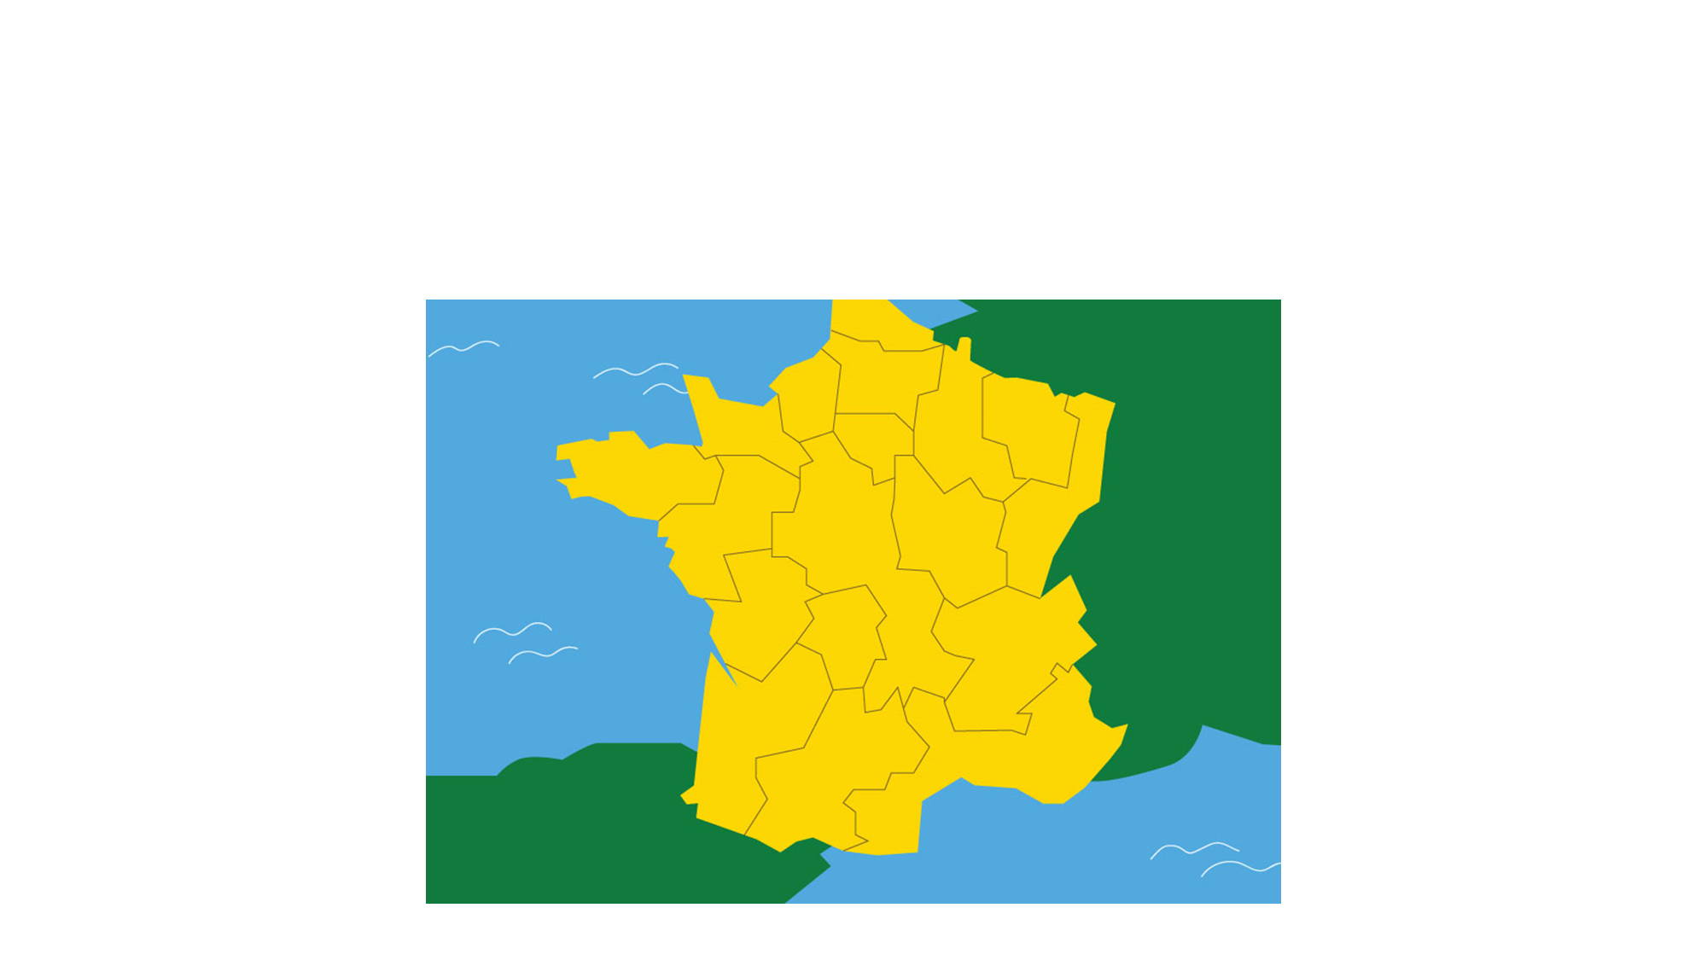
Where is France?
France is made up of 101 different regions, similar to our counties. In French, these are known as départements.

Slide 8
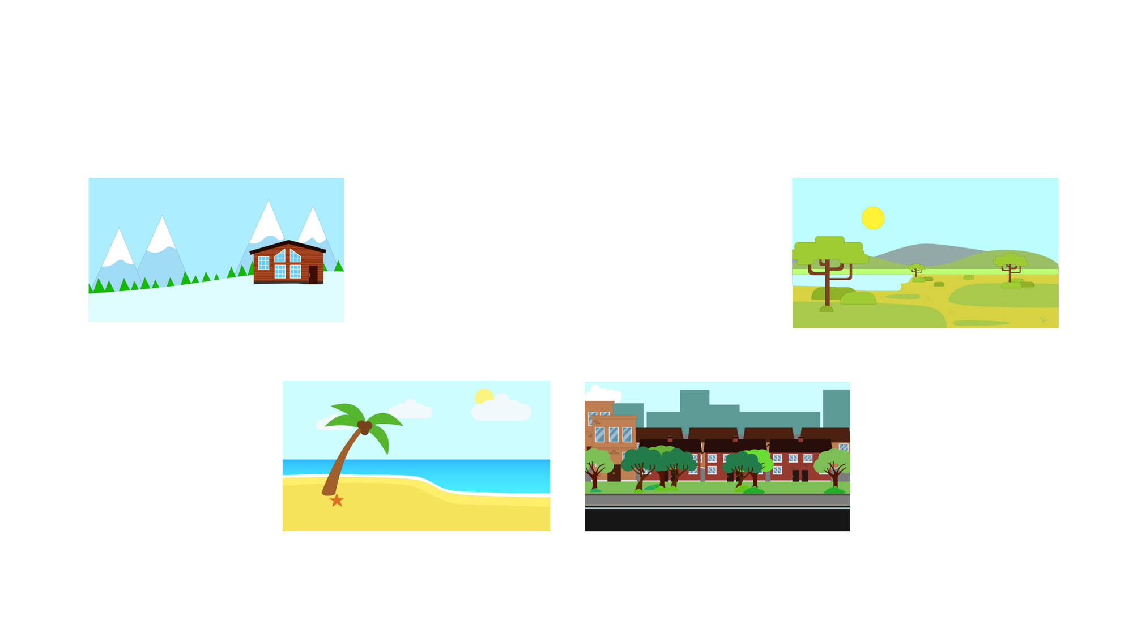
Where is France?
People visit the regions of France for many different reasons:
la montagne
la campagne
the mountain
the countryside
la plage
une ville
the beach
a town
Let’s take a closer look at the towns and cities in France.

Slide 9
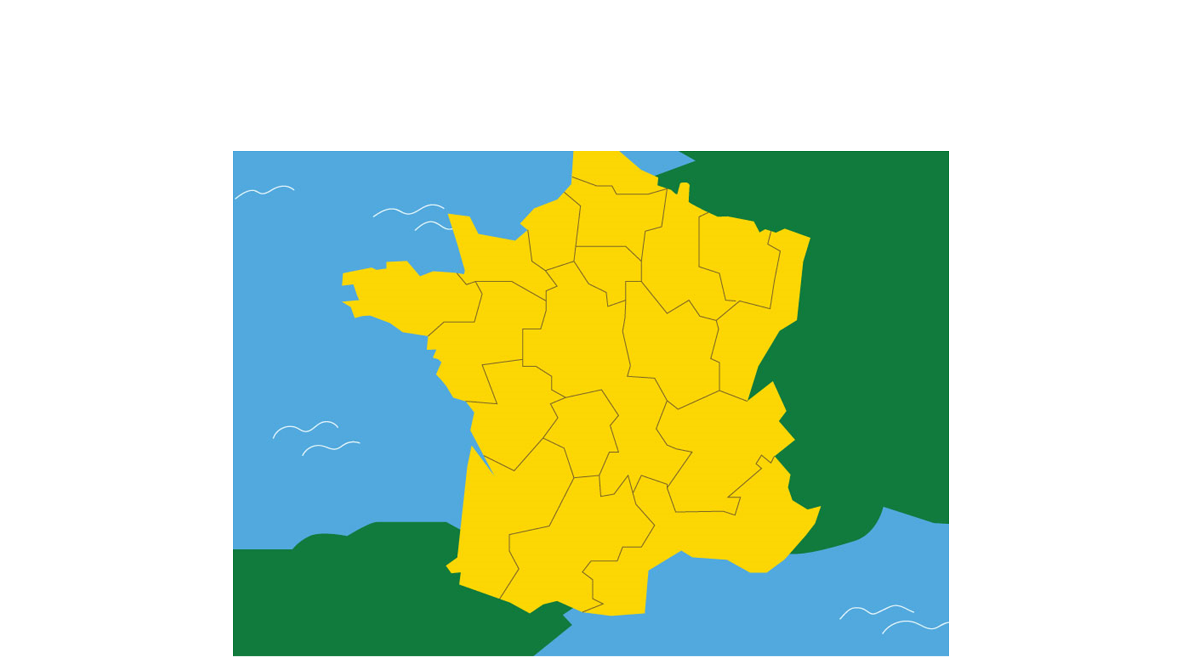
Where is France?
Like the UK, France has popular towns and cities that people like to visit.
Paris
Remember
Paris is the capital city, just like London is the capital city in England.
La Rochelle
Lyon
Bordeaux
Nice

Slide 10
Where is France?
Select the statements that are true.
Lyon is the capital city of France.
The French use euros and cents.
Nice, Bordeaux and la Rochelle are all on the coast.
The French word for the mountains is les montagnes.

Slide 11
Where is France?
Select the statements that are true.
Paris is the capital city.
Lyon is the capital city of France.
The French use euros and cents not pounds and pence.
Nice, Bordeaux and la Rochelle are all on the coast.
The French word for the mountains is les montagnes.

Slide 12
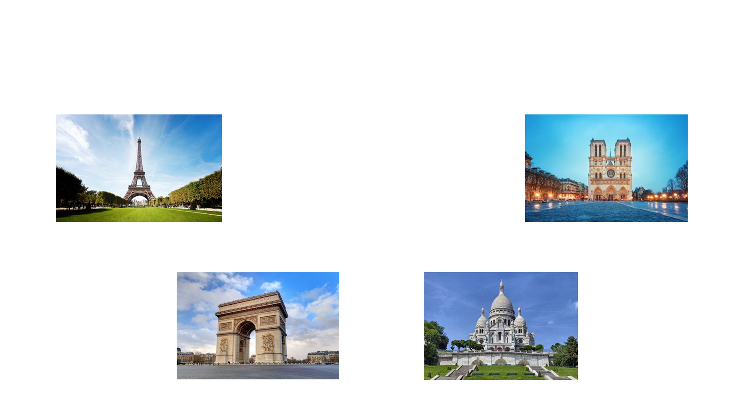
Where is France?
In Paris, there are many famous landmarks for people to visit.
la tour Eiffel
Notre-Dame
the Eiffel Tower
Notre Dame cathedral
L’Arc de Triomphe
Le Sacré-Cœur
the arch of triumph
the Basilica of the Sacred Heart

Slide 13
Where is France?
Paris is famous for other reasons.
Fact
Fact
Paris can be found in the north of the country and has the largest population of all French cities.
People have settled in Paris since Roman times. Its name comes from a tribe called the Parisii.
Fact
People travel around Paris on the underground. This is called the métro.
Fact
Fact
Many artist and writer, such as Pablo Picasso and Vincent van Gogh, have been attracted to Paris over the years. Its nickname is the City of Lights.
A river runs through Paris. It is called la Seine in French. In English we call it the Seine. It is spelt the same in English like Paris but we pronounce it differently.

