Slide 1
LIFE/work balance
We have started a #LIFEworkbalance campaign and we need your help to complete our LIFE/work balance survey.
We hope to publish the results soon, so please give 15 minutes of your time to help us get a true picture of school life.
Want to be a part of this campaign? Take the survey on our website and share it with your colleagues!
© Classroom Secrets Limited 2018

Slide 2
Year 4 – Spring Block 1 – Multiplication and Division – 11 and 12 Times Table
About This Resource:
This PowerPoint has been designed to support your teaching of this small step. It includes a starter activity and an example of each question from the Varied Fluency and Reasoning and Problem Solving resources also provided in this pack. You can choose to work through all examples provided or a selection of them depending on the needs of your class.
National Curriculum Objectives:
Mathematics Year 4: (4C6a) Recall multiplication and division facts for multiplication tables up to 12 × 12
Mathematics Year 4: (4C7) Multiply two-digit and three-digit numbers by a one-digit number using formal written layout
Mathematics Year 4: (4C8) Solve problems involving multiplying and adding, including using the distributive law to multiply two digit numbers by one digit, integer scaling problems and harder correspondence problems such as n objects are connected to m objects
More Year 4 Multiplication and Division resources.
Did you like this resource? Don’t forget to review it on our website.
© Classroom Secrets Limited 2018

Slide 3
Year 4 – Spring Block 1 – Multiplication and Division
Step 1: 11 and 12 Times Table
© Classroom Secrets Limited 2018

Slide 4
Introduction
Circle the incorrect multiplications below.
1 | x | 9 | = | 9
10 | x | 9 | = | 9
2 | x | 2 | = | 4
3 | x | 9 | = | 26
10 | x | 6 | = | 66
2 | x | 9 | = | 18
7 | x | 9 | = | 63
10 | x | 5 | = | 50
2 | x | 7 | = | 15
10 | x | 9 | = | 99
10 | x | 3 | = | 30
2 | x | 11 | = | 24
© Classroom Secrets Limited 2018

Slide 5
Introduction
Circle the incorrect multiplications below.
1 | x | 9 | = | 9
10 | x | 9 | = | 9
2 | x | 2 | = | 4
3 | x | 9 | = | 26
10 | x | 6 | = | 66
2 | x | 9 | = | 18
7 | x | 9 | = | 63
10 | x | 5 | = | 50
2 | x | 7 | = | 15
10 | x | 9 | = | 99
10 | x | 3 | = | 30
2 | x | 11 | = | 24
© Classroom Secrets Limited 2018

Slide 6
Varied Fluency 1
Complete 5 x 12, by partitioning it into tens and ones.
10
10
1
1
1
1
1
1
10
10
10
1
1
1
1
10
10
10
10
10
10 ones
 | + |  | =
© Classroom Secrets Limited 2018

Slide 7
Varied Fluency 1
Complete 5 x 12, by partitioning it into tens and ones.
10
10
1
1
1
1
1
1
10
10
10
1
1
1
1
10
10
10
10
10
10 ones
50 | + | 10 | = | 60
© Classroom Secrets Limited 2018

Slide 8
Varied Fluency 2
Fill in the grid to find the answer.
11 x 8 =
x | 10 | 1
8
© Classroom Secrets Limited 2018

Slide 9
Varied Fluency 2
Fill in the grid to find the answer.
11 x 8 =
x | 10 | 1
8 | 80 | 8
88
© Classroom Secrets Limited 2018

Slide 10
Varied Fluency 3
Use >, < or = to make each statement correct.
96 ÷ 12 |  | 88 ÷ 11
5 x 11 |  | 4 x 12
12 x 12 |  | 132 ÷ 11
© Classroom Secrets Limited 2018

Slide 11
Varied Fluency 3
Use >, < or = to make each statement correct.
96 ÷ 12 | = | 88 ÷ 11
5 x 11 | > | 4 x 12
12 x 12 | > | 132 ÷ 11
© Classroom Secrets Limited 2018

Slide 12
Varied Fluency 4
Complete the missing numbers.
A. |  |  | x | 12 | = | 24
B. |  | 11 | x | 9 | =
C. |  | 9 | = |  | ÷ | 11
D. |  |  | ÷ | 12 | = | 2
© Classroom Secrets Limited 2018

Slide 13
Varied Fluency 4
Complete the missing numbers.
A. |  | 2 | x | 12 | = | 24
B. |  | 11 | x | 9 | = | 99
C. |  | 9 | = | 99 | ÷ | 11
D. |  | 24 | ÷ | 12 | = | 2
© Classroom Secrets Limited 2018

Slide 14
Problem Solving 1
Write number sentences to describe five equal groups of the place value counters shown below.
1
10
 | x |  | =
 | x |  | =
 | ÷ |  | =
 | ÷ |  | =
1
10
10
1
1
10
10
1
© Classroom Secrets Limited 2018

Slide 15
Problem Solving 1
Write number sentences to describe five equal groups of the place value counters shown below.
1
10
5 | x | 11 | = | 55
11 | x | 5 | = | 55
55 | ÷ | 5 | = | 11
55 | ÷ | 11 | = | 5
1
10
10
1
1
10
10
1
© Classroom Secrets Limited 2018

Slide 16
Problem Solving 2
Rocco is hosting a dinner party. Part of his sea bass recipe is shown below.
How many artichokes and slices of ham will he need for 12 guests?
 | To serve one person, I need:
 | 10 artichokes
 | 2 handfuls of sun-dried tomatoes
 | 2 slices of bread
 | 3 finely chopped leeks
 | 6 slices of Parma ham
 | 1 large sea bass fillet
© Classroom Secrets Limited 2018

Slide 17
Problem Solving 2
Rocco is hosting a dinner party. Part of his sea bass recipe is shown below.
How many artichokes and slices of ham will he need for 12 guests?
Rocco will need 120 artichokes (10 x 12) and 72 slices of ham
(6 x 12).
 | To serve one person, I need:
 | 10 artichokes
 | 2 handfuls of sun-dried tomatoes
 | 2 slices of bread
 | 3 finely chopped leeks
 | 6 slices of Parma ham
 | 1 large sea bass fillet
© Classroom Secrets Limited 2018

Slide 18
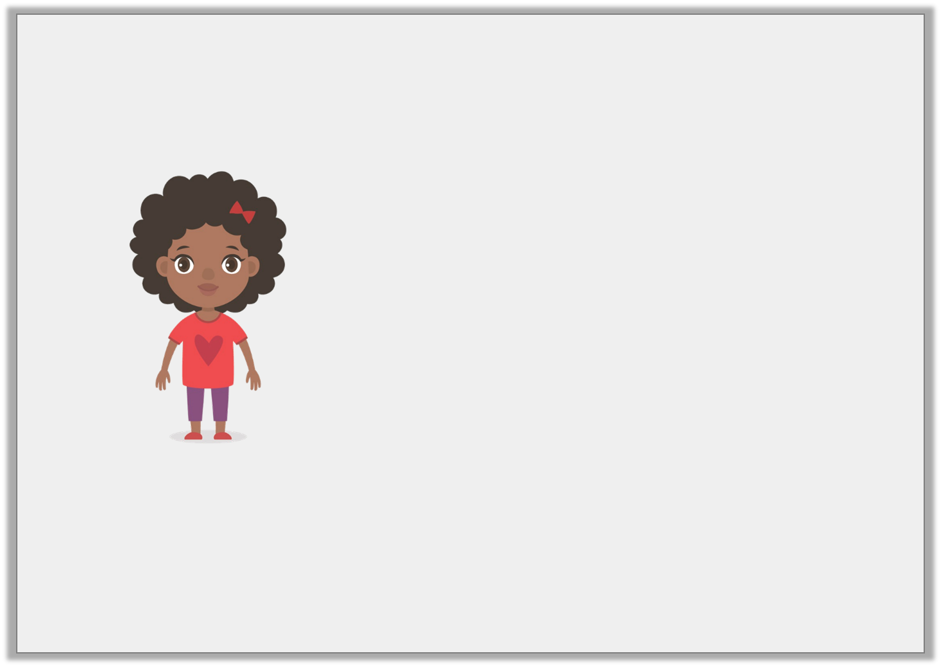
Reasoning 1
Nyla is working out the multiplication 12 x 12.
Is Nyla correct? Explain your answer.
The answer is 144 as
it’s the same as
12 x 10 add 12 x 2.
120 + 24 = 144.
© Classroom Secrets Limited 2018

Slide 19
Reasoning 1
Nyla is working out the multiplication 12 x 12.
Is Nyla correct? Explain your answer.
Yes, Nyla is correct because…
The answer is 144 as
it’s the same as
12 x 10 add 12 x 2.
120 + 24 = 144.
© Classroom Secrets Limited 2018

Slide 20
Reasoning 1
Nyla is working out the multiplication 12 x 12.
Is Nyla correct? Explain your answer.
Yes, Nyla is correct because she has partitioned 12 correctly.
12 x 10 = 120 and 12 x 2 = 24, 120 + 24 = 144.
The answer is 144 as
it’s the same as
12 x 10 add 12 x 2.
120 + 24 = 144.
© Classroom Secrets Limited 2018

