Slide 1
Year 4 – Summer Block 1 – Decimals – Make a Whole
About This Resource:
This PowerPoint has been designed to support your teaching of this small step. It includes a starter activity and an example of each question from the Varied Fluency and Reasoning and Problem Solving resources also provided in this pack. You can choose to work through all examples provided or a selection of them depending on the needs of your class.
National Curriculum Objectives:
Mathematics Year 4: (4F6b) Recognise and write decimal equivalents of any number of tenths or hundredths
Mathematics Year 4: (4F10b) Solve simple measure and money problems involving fractions and decimals to two decimal places
More Year 4 Decimals resources.
Did you like this resource? Don’t forget to review it on our website.
© Classroom Secrets Limited 2018

Slide 2
Year 4 – Summer Block 1 – Decimals
Step 1: Make a Whole
© Classroom Secrets Limited 2018

Slide 3
Introduction
Using any combination of these numbers:
Add, subtract, multiply or divide to make this number:
1
2
4
7
20
75
100
© Classroom Secrets Limited 2018

Slide 4
Introduction
Using any combination of these numbers:
Add, subtract, multiply or divide to make this number:
Various possible answers, for example:
1 + 4 = 5, 5 x 20 = 100
1 + 2 + 4 + 20 + 75 = 100
7 – 2 = 5, 5 + 20 = 25, 25 + 75 = 100
75 + 1 + 4 + 20 = 100
1
2
4
7
20
75
100
© Classroom Secrets Limited 2018

Slide 5
Varied Fluency 1
Find the missing number in each bar model.
0.4
1
0.75
1
0.59
2
© Classroom Secrets Limited 2018

Slide 6
Varied Fluency 1
Find the missing number in each bar model.
0.4 | 0.6
1
0.75 | 0.25
1
0.59 | 1.41
2
© Classroom Secrets Limited 2018

Slide 7
Varied Fluency 2
Write statements to describe the hundred square.
© Classroom Secrets Limited 2018

Slide 8
Varied Fluency 2
Write statements to describe the hundred square.
0.43 + 0.57 = 1
0.57 + 0.43 = 1
1 – 0.43 = 0.57
1 – 0.57 = 0.43
© Classroom Secrets Limited 2018

Slide 9
Varied Fluency 3
You have 2 tenths and 3 hundredths.
Draw a bar model to find how many more hundredths you need to make one whole.
© Classroom Secrets Limited 2018

Slide 10
Varied Fluency 3
You have 2 tenths and 3 hundredths.
Draw a bar model to find how many more hundredths you need to make one whole.
You need 77 more hundredths to make one whole.
0.23 | 0.77
1
© Classroom Secrets Limited 2018

Slide 11
Varied Fluency 4
Each cube is worth one hundredth.
How many more cubes do you need to make one whole?
© Classroom Secrets Limited 2018

Slide 12
Varied Fluency 4
Each cube is worth one hundredth.
How many more cubes do you need to make one whole?
You need 67 more cubes.
© Classroom Secrets Limited 2018

Slide 13
Varied Fluency 5
True or false?
2 tenths and 5 hundredths and 8 tenths and 5 hundredths make one whole.
© Classroom Secrets Limited 2018

Slide 14
Varied Fluency 5
True or false?
2 tenths and 5 hundredths and 8 tenths and 5 hundredths make one whole.
False, it makes one whole and one tenth.
© Classroom Secrets Limited 2018

Slide 15
Problem Solving 1
Complete the calculation below. How many different solutions can you find?
0.3◻ + 0.6◻ = 1
© Classroom Secrets Limited 2018

Slide 16
Problem Solving 1
Complete the calculation below. How many different solutions can you find?
0.3◻ + 0.6◻ = 1
0.31 + 0.69 = 1, 0.32 + 0.68 = 1, 0.33 + 0.67 = 1
0.34 + 0.66 = 1, 0.35 + 0.65 = 1, 0.36 + 0.64 = 1
0.37 + 0.63 = 1, 0.38 + 0.62 = 1, 0.39 + 0.61 = 1
© Classroom Secrets Limited 2018

Slide 17
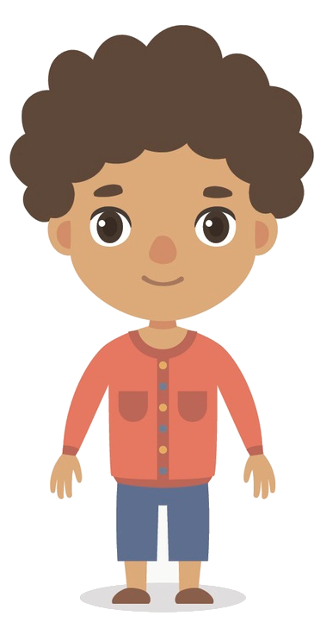
Reasoning 1
Toby says:
Is he correct? Explain why or why not.
If I have 0.24, I need to add on 0.86 to make a whole.
© Classroom Secrets Limited 2018

Slide 18
Reasoning 1
Toby says:
Is he correct? Explain why or why not.
Toby is not correct because…
If I have 0.24, I need to add on 0.86 to make a whole.
© Classroom Secrets Limited 2018

Slide 19
Reasoning 1
Toby says:
Is he correct? Explain why or why not.
Toby is not correct because 0.24 + 0.86 = 1 whole and 1 tenth. He needs to add 0.76 instead.
If I have 0.24, I need to add on 0.86 to make a whole.
© Classroom Secrets Limited 2018

Slide 20
Problem Solving 2
Each flag on the bunting is 0.36m wide at the top.
Will two flags fit on a strip that is 1m long?
How much space will be left over?
© Classroom Secrets Limited 2018

Slide 21
Problem Solving 2
Each flag on the bunting is 0.36m wide at the top.
Will two flags fit on a strip that is 1m long?
How much space will be left over?
Two flags are 0.72m wide so they will fit
on the strip with 0.28m of space left over.
© Classroom Secrets Limited 2018

