Slide 1
Standard English
‘Were’ or ‘Was’ and ‘Did’ or ‘Done’

Slide 2
Key Information
Standard English is the form of the English language that is nationally accepted as the usual correct form and does not use any slang.
Singular is when there is one of whatever is being named. For example: bus
Plural is when there is more than one of whatever is being named. For example: ‘buses’ is the plural form of ‘bus’.
A past participle can be combined with the verb 'to have' to form the perfect tense of a verb, usually by adding the suffix '-ed'. For example: We have boiled the water. It can also be used on its own as an adjective to modify a noun. For example: We drank the boiled water.
The perfect form shows when something has been completed either at a specific point in the past or future or by the present. There is the past perfect form, future perfect form and present perfect form.

Slide 3
Let’s start with a question about the present perfect form, which is linked to the new learning later in this lesson.

Slide 4
The present perfect tense shows an action starting in the past, but that may continue now.
The present perfect tense uses ‘has’ or ‘have’ with the past participle.
The past participle is a verb written in the past tense. For example: walk becomes walked.
I walked to school. simple past tense
I have walked to school. present perfect tense
past participle

Slide 5
Tick to show whether the sentences below are in the simple past tense or the present perfect tense.
simple past tense
present perfect tense
A. I swam a mile for charity.
B. I have forgotten my PE kit.
C. My dad has fixed the fence.
D. I fell off my bike yesterday.

Slide 6
Tick to show whether the sentences below are in the simple past tense or the present perfect tense.
simple past tense
present perfect tense
✓
A. I swam a mile for charity.
B. I have forgotten my PE kit.
C. My dad has fixed the fence.
D. I fell off my bike yesterday.
✓
✓
✓

Slide 7
Now that we are ready to move on, we can learn about ‘were’ or ‘was’ and ‘did’ or ‘done’.

Slide 8
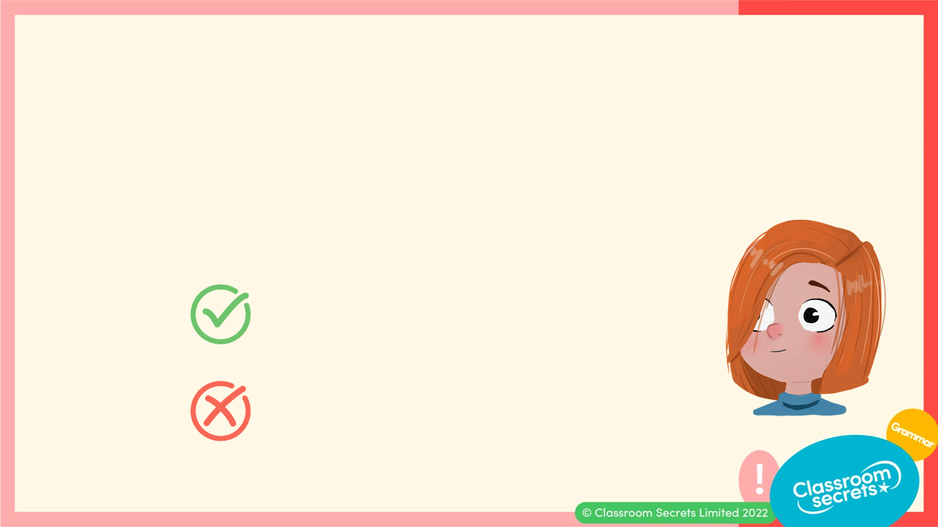
Standard English is the form of the English language that is nationally accepted as the correct form.
There can be some differences according to the area of the country you live in.
Here is an example of standard English.
I played well. Standard English
I played good. Non-standard English

Slide 9
To use standard English, we need to follow certain rules. One of these is for when we use ‘was’ or ‘were’.
‘Was’ and ‘were’ are simple past tense forms of the verb ‘to be’.
‘Was’ is used with singular nouns or pronouns.
For example:
I was running.
He was running.
She was running.
It was running.
George was running.

Slide 10
To use standard English, we need to follow certain rules. One of these is for when we use ‘was’ or ‘were’.
‘Were’ is used with plural nouns or pronouns.
For example:
They were running.
We were running.
Jack and Jill were running.
The boys were running.
The exception to this rule is the pronoun ‘you’. Although ‘you’ can be singular, ‘were’ is still used.
You were running.

Slide 11
Complete the sentences below using ‘was’ or ‘were’.
A. You _______ still playing outside even after I asked you to come in.
B. I _______ hoping for a letter regarding my place at university.
C. Liana _______ singing her favourite song as she drove home in the car.
D. The girls _______ warming up together before their football match.
E. We _______ walking towards the bus stop when the bus drove past us.

Slide 12
Complete the sentences below using ‘was’ or ‘were’.
A. You were still playing outside even after I asked you to come in.
B. I was hoping for a letter regarding my place at university.
C. Liana was singing her favourite song as she drove home in the car.
D. The girls were warming up together before their football match.
E. We were walking towards the bus stop when the bus drove past us.

Slide 13
We also need to follow certain rules when using the verb ‘to do’.
‘Did’ is the simple past tense form of the verb ‘to do’.
For example:
I did this all of the time.
He did the washing up on Sunday.
Gracie did her homework.

Slide 14
We also need to follow certain rules when using the verb ‘to do’.
‘Done’ is the past participle of the verb ‘to do’ and is often used with ‘has’ or ‘have’ when forming the present perfect tense.
For example:
I have done all of my chores.
They have done their homework for tomorrow.
He has done most of the cooking this weekend.
Francis has done her best in her piano exam.

Slide 15
Which sentences have used ‘did’ or ‘done’ correctly?
A. We done the washing up for mum.
B. You did your work very neatly.
C. They have did the marathon for charity.
D. Rhys has done the staff rota for work this week.

Slide 16
Which sentences have used ‘did’ or ‘done’ correctly?
A. We done the washing up for mum.
B. You did your work very neatly.
C. They have did the marathon for charity.
D. Rhys has done the staff rota for work this week.
B and D are correct.
A should use ‘did’ and C should use ‘done’.

Slide 17
Now that we can recognise and use ‘were’ or ‘was’ and ‘did’ or ‘done’ correctly, let’s apply our learning to some application and reasoning questions.

Slide 18
Chloe has completed her homework but she has made some errors.
 | The wives of Henry VIII was either beheaded, divorced or they
 | died except for his last wife who survived. His wives done
 | everything they could to give him a son so that they would not
 | be beheaded. Henry were thought to be a ruthless king which
 | was proved to be true in the things he done.
Rewrite the text so that it is written in standard English.

Slide 19
Chloe has completed her homework but she has made some errors.
 | The wives of Henry VIII was either beheaded, divorced or they
 | died except for his last wife who survived. His wives done
 | everything they could to give him a son so that they would not
 | be beheaded. Henry were thought to be a ruthless king which
 | was proved to be true in the things he done.
Rewrite the text so that it is written in standard English.
The wives of Henry VIII were either beheaded, divorced or they died except for his last wife who survived. His wives did everything they could to give him a son so that they would not be beheaded. Henry was thought to be a ruthless king which was proved to be true in the things he did.

Slide 20
Tyler is looking at the sentence below.
The children _____ ___ cleaning up after they had _____ ___ their artwork.
He says,
Is he correct? Explain your answer.
The first missing word is ‘was’ and the second missing word is ‘done’.

Slide 21
Tyler is looking at the sentence below.
The children _____ ___ cleaning up after they had _____ ___ their artwork.
He says,
Is he correct? Explain your answer.
Tyler is incorrect for the first missing word. As ‘children’ is plural, ‘were’ is needed. Tyler is correct for the second missing word because of the use of ‘had’.
The first missing word is ‘was’ and the second missing word is ‘done’.

Slide 22
You’re ready to progress!
Now apply your learning by trying some questions.

Slide 23
Underline the correct form of the verbs in the passage below.
The children who did/done want to make a fruit salad watched carefully to see how it were/was made.
Varied Fluency 1

Slide 24
Underline the correct form of the verbs in the passage below.
The children who did/done want to make a fruit salad watched carefully to see how it were/was made.
The children who did want to make a fruit salad watched carefully to see how it was made.
Varied Fluency 1

Slide 25
True or false? The sentence below is written in Standard English.
The medicine were horrible. It tasted like rotten bananas in a bottle.
Varied Fluency 2

Slide 26
True or false? The sentence below is written in Standard English.
The medicine were horrible. It tasted like rotten bananas in a bottle.
False. The medicine was horrible.
Varied Fluency 2

Slide 27
Complete the sentence below with the correct past tense forms of the verbs ‘to be’ or ‘to do’.
I promised that I had ________ my exercises before I watched television, but I __________ made to do them again anyway.
Varied Fluency 3

Slide 28
Complete the sentence below with the correct past tense forms of the verbs ‘to be’ or ‘to do’.
I promised that I had done my exercises before I watched television, but I was made to do them again anyway.
Varied Fluency 3

Slide 29
Sort the sentences into the correct columns.
The town library was very busy.
Frank told me the job were done.
I can’t image how you done it!
They had did what they were told.
Can I mention what I did next?
Standard English | Non-standard English
Varied Fluency 4

Slide 30
Sort the sentences into the correct columns.
The town library was very busy.
Frank told me the job were done.
I can’t image how you done it!
They had did what they were told.
Can I mention what I did next?
Standard English | Non-standard English
A, E | B, C, D
Varied Fluency 4

Slide 31
Steve is going snorkelling. Write a sentence to describe the picture below using the correct past tense form of the verb ‘to be’.
Your sentence must include a fronted adverbial.
Application 1

Slide 32
Steve is going snorkelling. Write a sentence to describe the picture below using the correct past tense form of the verb ‘to be’.
Your sentence must include a fronted adverbial.
Various possible answers, for example:
All day long, Steve’s group were snorkelling around the whole island watching the sea creatures.
Application 1

Slide 33
Min has written a sentence below.
Has she used Standard English? Explain how you know.
Min has not used Standard English because she is talking about herself using ‘I’ so she should have used ‘was’.
 | I were making a birthday card for my
 | favourite friend using glitter and feathers. It
 | was very messy!
Reasoning 1

Slide 34
Min has written a sentence below.
Has she used Standard English? Explain how you know.
 | I were making a birthday card for my
 | favourite friend using glitter and feathers. It
 | was very messy!
Reasoning 1

Slide 35
Min has written a sentence below.
Has she used Standard English? Explain how you know.
Min has not used Standard English because she is talking about herself using ‘I’ so she should have used ‘was’.
 | I were making a birthday card for my
 | favourite friend using glitter and feathers. It
 | was very messy!
Reasoning 1

Slide 36
Frank has written a story but he has made some errors.
It were late at night when the sleek black cat crept out of the house and set off on its regular walk. He slinked along the wall, same as he done every night, and made his way to down to the fishing boats.
Rewrite the text so that it is written in Standard English.
Application 2

Slide 37
Frank has written a story but he has made some errors.
It were late at night when the sleek black cat crept out of the house and set off on its regular walk. He slinked along the wall, same as he done every night, and made his way to down to the fishing boats.
Rewrite the text so that it is written in Standard English.
It was late at night when the sleek black cat crept out of the house and set off on its regular walk. He slinked along the wall, same as he did every night, and made his way to down to the fishing boats.
Application 2

