Slide 1
Y4
FRENCH
Where in the World Speaks French?
Unit 1 - Culture

Slide 2
Where in the World Speaks French?
Match the statement to the correct answer.
The capital of France
La tour Eiffel
A mountain range in France
L’Espagne
A famous landmark in France
Paris
A country France shares a border with
Les Alpes

Slide 3
Where in the World Speaks French?
Match the statement to the correct answer.
The capital of France
La tour Eiffel
A mountain range in France
L’Espagne
A famous landmark in France
Paris
A country France shares a border with
Les Alpes

Slide 4
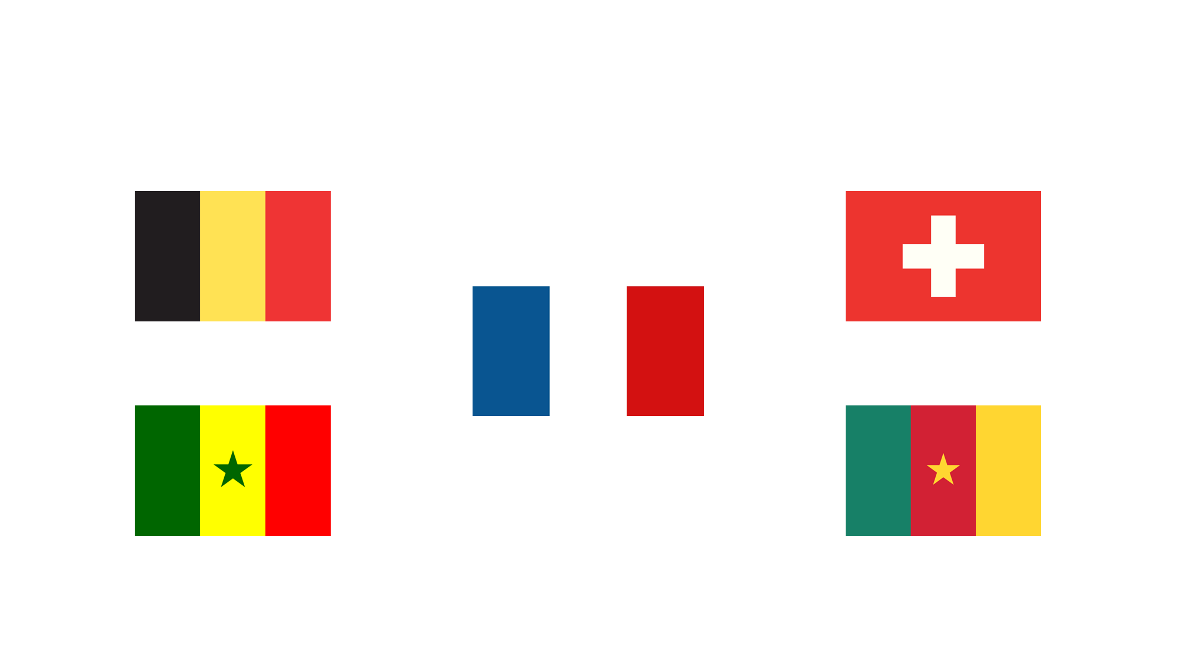
Where in the World Speaks French?
Below are the flags of some of the countries that speak French.
Do you know any of them?

Slide 5
Where in the World Speaks French?
France is not the only country in the world where the language of French is spoken.
In fact, there are 29 countries where French is the official language.
This makes it the second most used language in the world!
Follow up question
Do you know any other countries that speak French?

Slide 6
Where in the World Speaks French?
Here are some of the countries around the world that speak French.
English name French name
Belgium la Belgique
Cameroon le Cameroun
Canada le Canada
The Ivory Coast la Côte d'Ivoire
Haiti Haïti
Luxembourg le Luxembourg
Madagascar Madagascar
Monaco Monaco
Niger le Niger
Senegal le Sénégal
Seychelles les Seychelles
Switzerland la Suisse

Slide 7
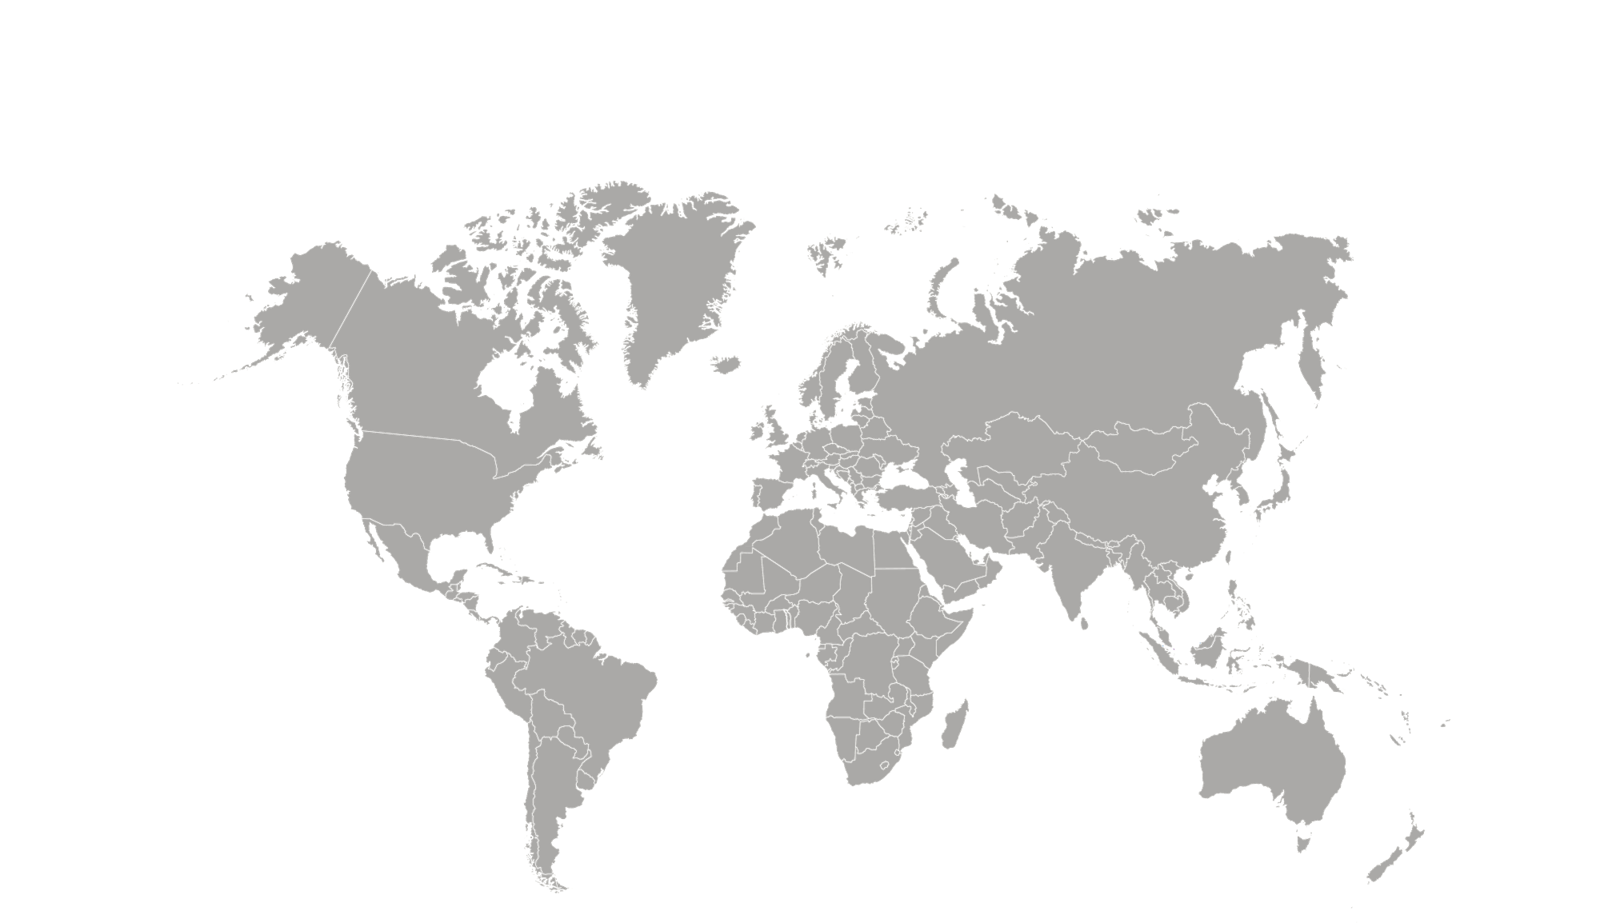
Where in the World Speaks French?
Here are some of the countries located on a world map.
Canada
Belgium
France
Switzerland
Monaco
Senegal
Niger
The Ivory Coast
Madagascar
Cameroon

Slide 8
Where in the World Speaks French?
Unscramble the letters to find the French speaking countries.
GELBQUIE
CONAMO
REGIN
DANACA
ROCAMUEN
SCHELLEEYS
SESIUS
GLANÉSÉ

Slide 9
Where in the World Speaks French?
Unscramble the letters to find the French speaking countries.
BELGIQUE
MONACO
NIGER
CANADA
CAMEROUN
SEYCHELLES
SUISSE
SÉNÉGAL

Slide 10
Where in the World Speaks French?
Follow up question
Why do you think there are other countries apart from France where French is spoken?

Slide 11
Where in the World Speaks French?
Some countries were part of the French empire and so the people of those countries had to learn to speak French.
They were colonies of France, captured by the Kingdom of France through wars during the 16th and 17th centuries.
Many of the early colonies of France gained their independence during the frequent wars during the 18th and 19th century and most gained their independence following World War I.
However, many former colonies still have French as their main language.
Other reasons for French being spoken in other countries is due to French explorers and travellers who journeyed around the world and taught people their language.

