Slide 1
Y5
FRENCH
French festivals
Unit 1

Slide 2
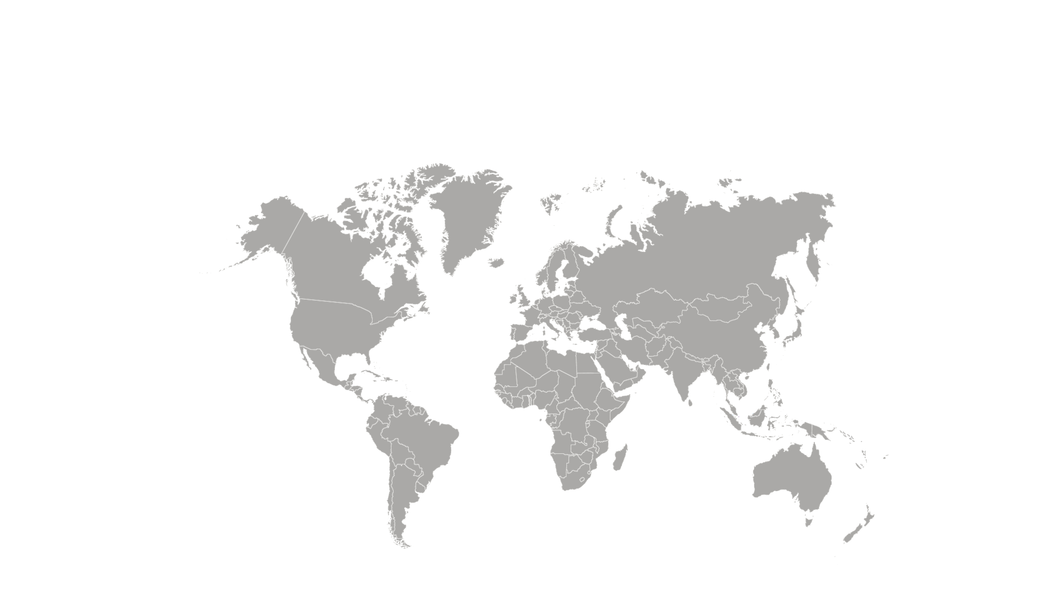
French Festivals
Let’s start with a question about France and where it is located in the world.

Slide 3
French Festivals
Let’s start with a question about France and where it is located in the world.
France

Slide 4
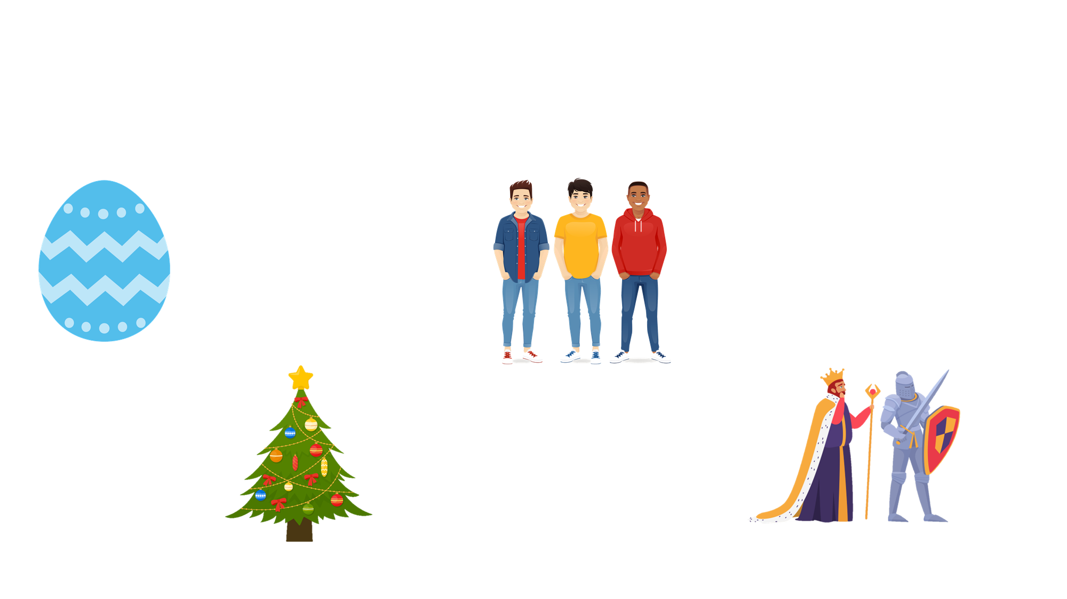
French Festivals
Now that we are ready to move on, we can learn about some of the different festivals celebrated in France.
Pâques
la Fête des Voisins
Noël
le 14 juillet

Slide 5
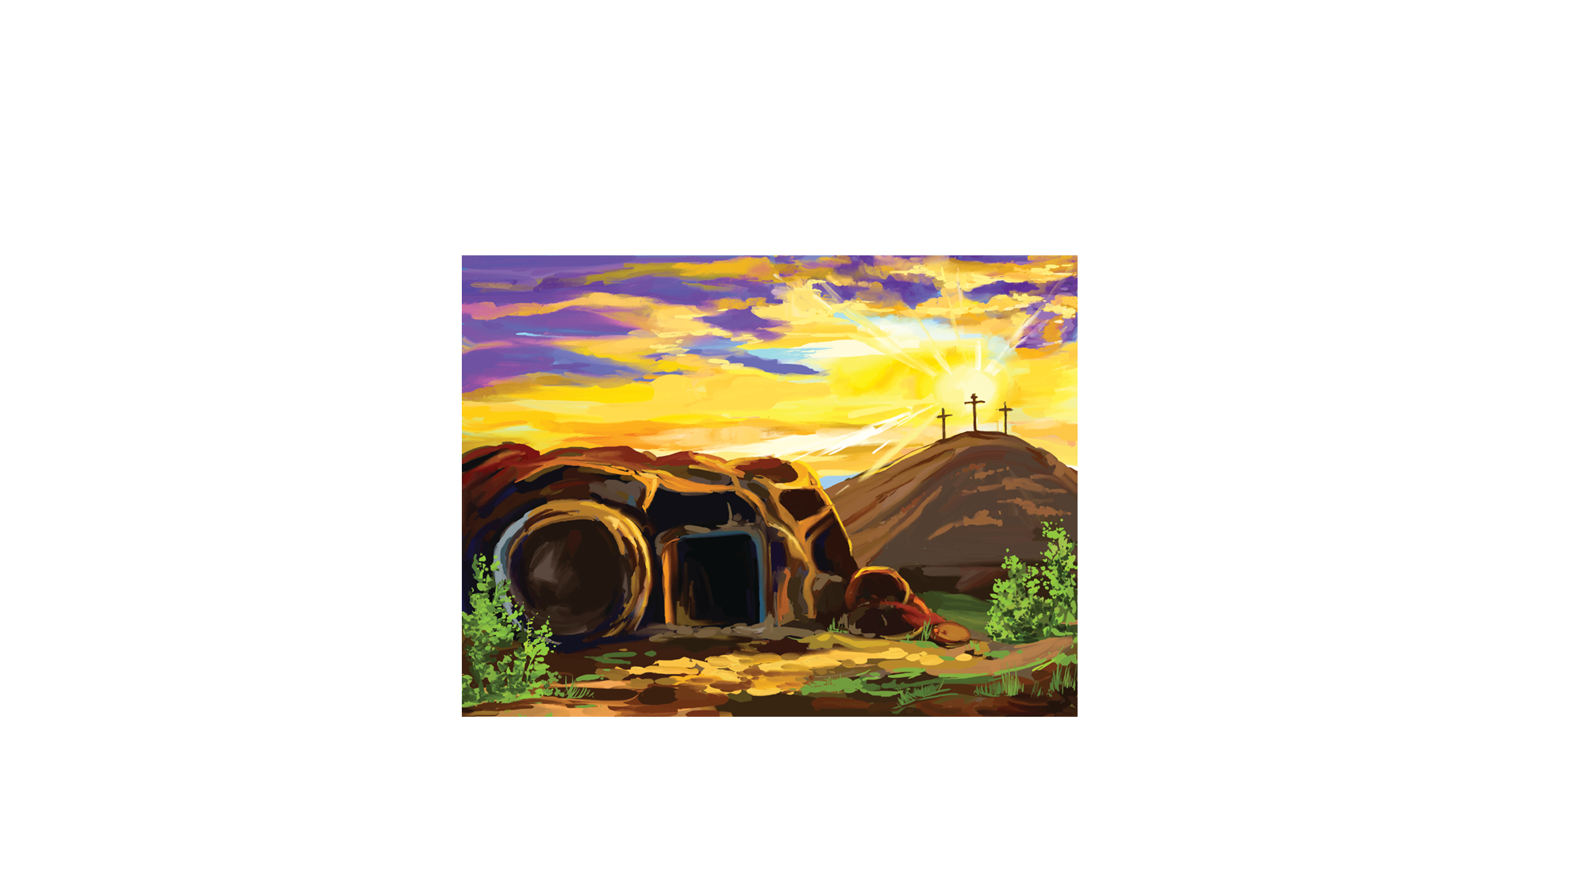
French Festivals
Every April, Christians around the World celebrate Easter. In France, this is known as Pâques.
It is a special day to celebrate the resurrection of Jesus.

Slide 6
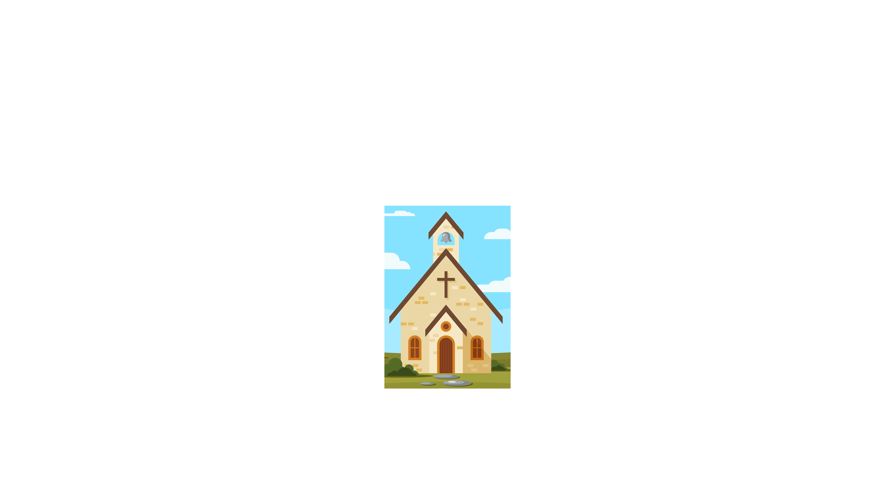
French Festivals
In the run up to Easter, bells from the churches ring at different times of the day.
They are said to bring happiness to people.
However, they remain silent from Maundy Thursday until the day after Good Friday as a way to remember the crucifixion.

Slide 7
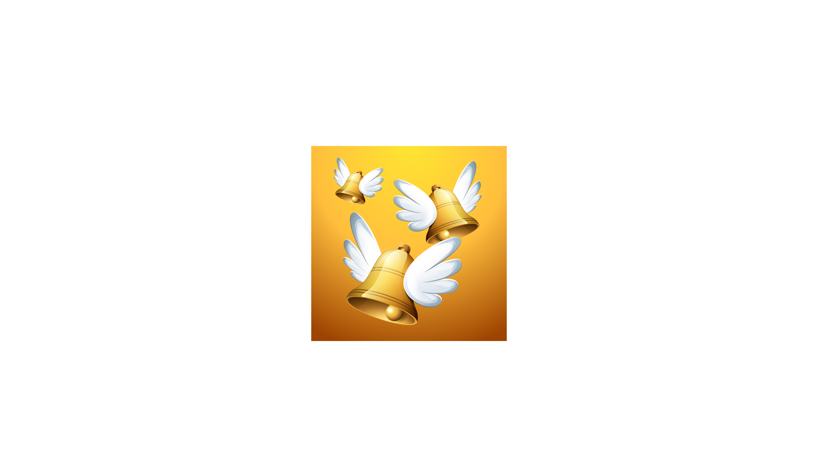
French Festivals
Legend says that when the bells stopped ringing, it was because they had sprouted wings and flown to see the Pope in Rome.
There, he gave them chocolate which they brought back to France on Easter morning for the children to find.

Slide 8
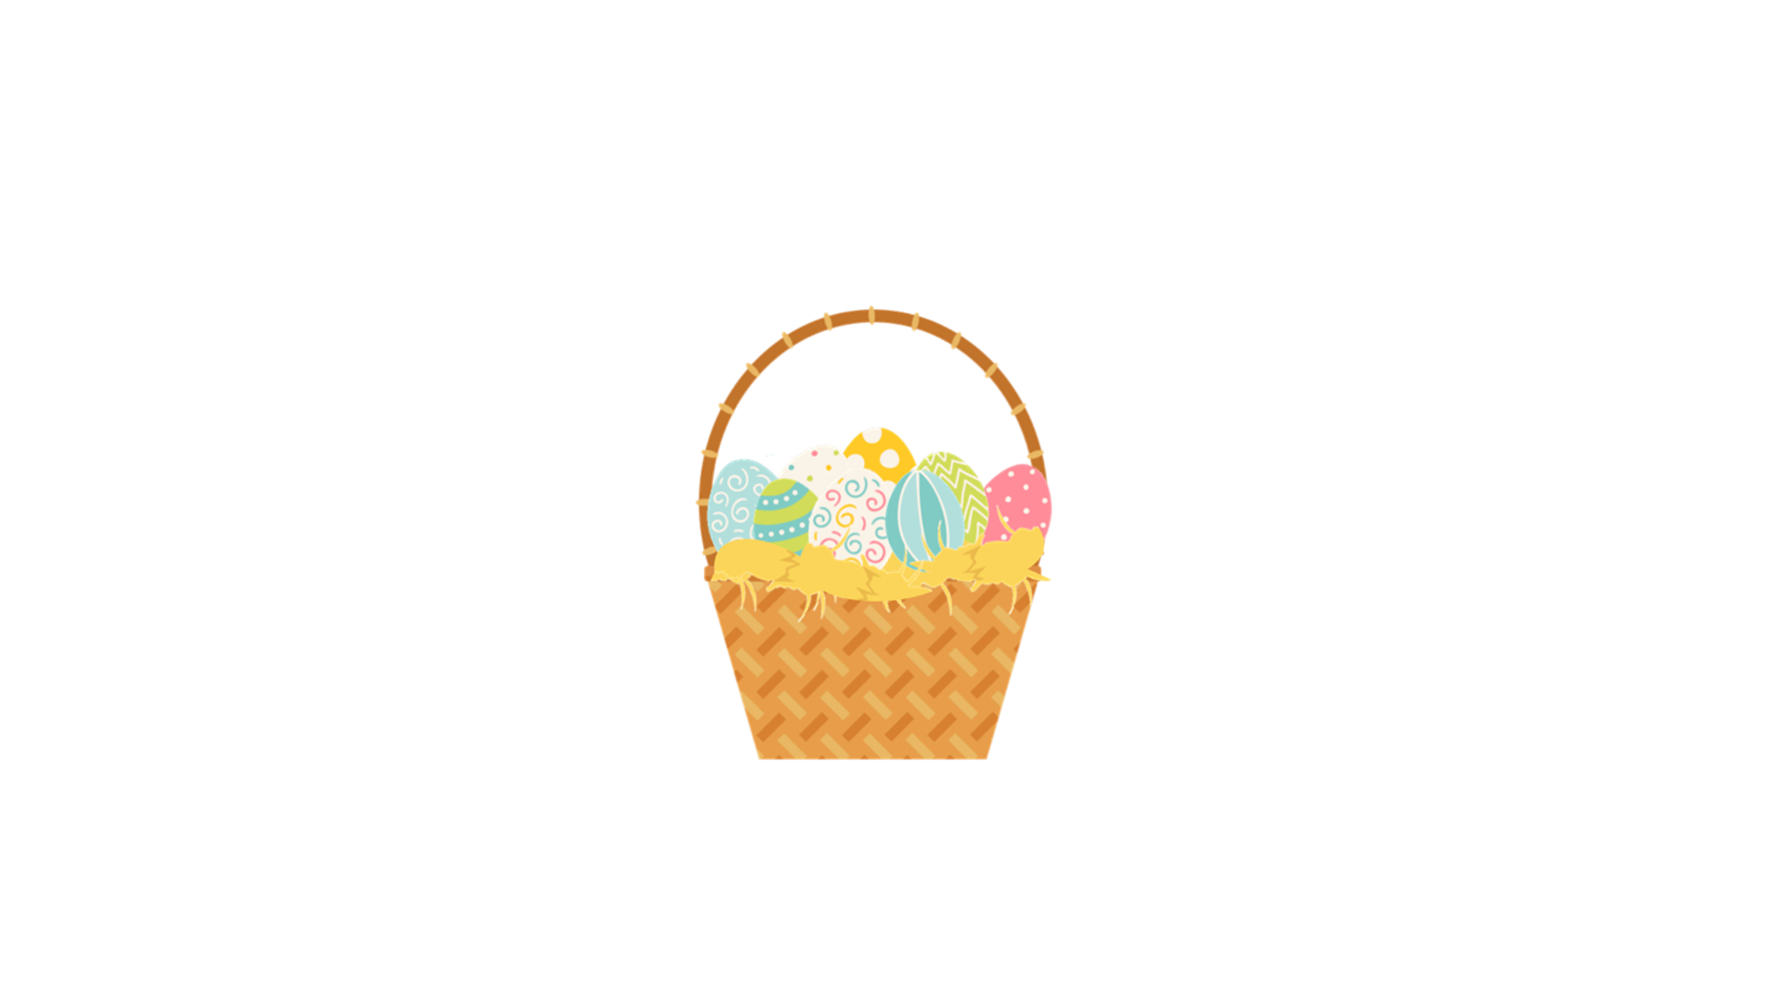
French Festivals
Similar to English traditions, children also believe that they are visited by the Easter bunny or ‘le lapin de Pâques’.
They are given baskets to collect chocolate eggs which are hidden around the house and in the garden.

Slide 9
French Festivals
‘La Fête des Voisins’ or ‘Neighbours Day’ is usually celebrated on the last Friday of May each year.
Neighbours come together to eat, drink and get to know each other better.

Slide 10
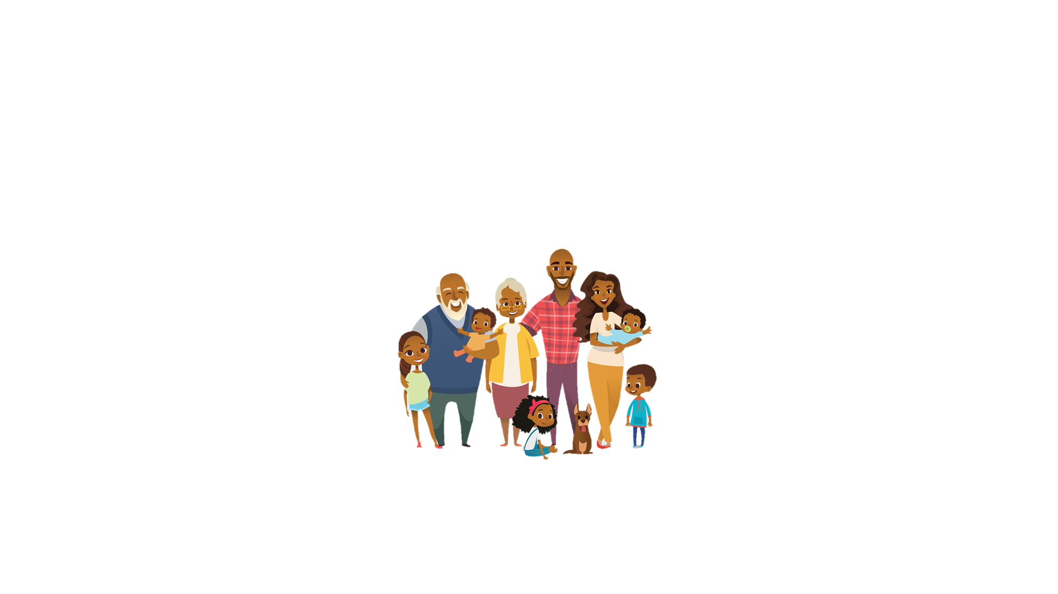
French Festivals
This tradition was founded in Paris in 1999 by a gentleman named Altanase Périfan.
An elderly woman had been missing for four months and nobody had noticed!
Altanase was extremely saddened by this and vowed to make a change.

Slide 11
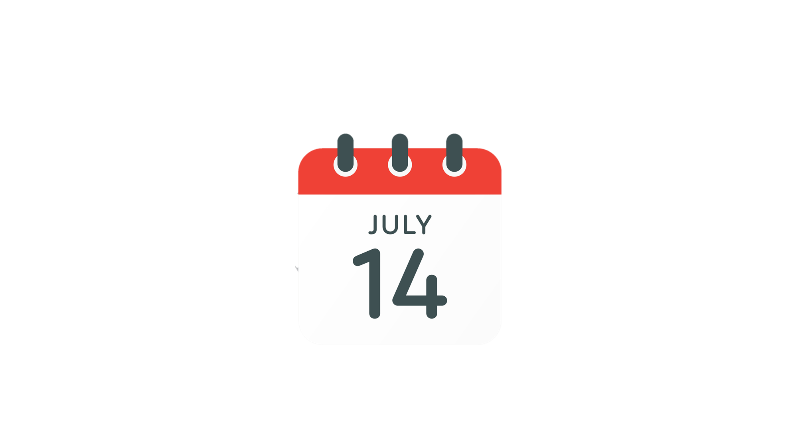
French Festivals
Le 14 juillet, or Bastille Day, is celebrated each year on le quatorze juillet.
The day celebrates the storming of an old prison in Paris known as ‘Bastille Saint Antoine’ or ‘la Bastille’.

Slide 12
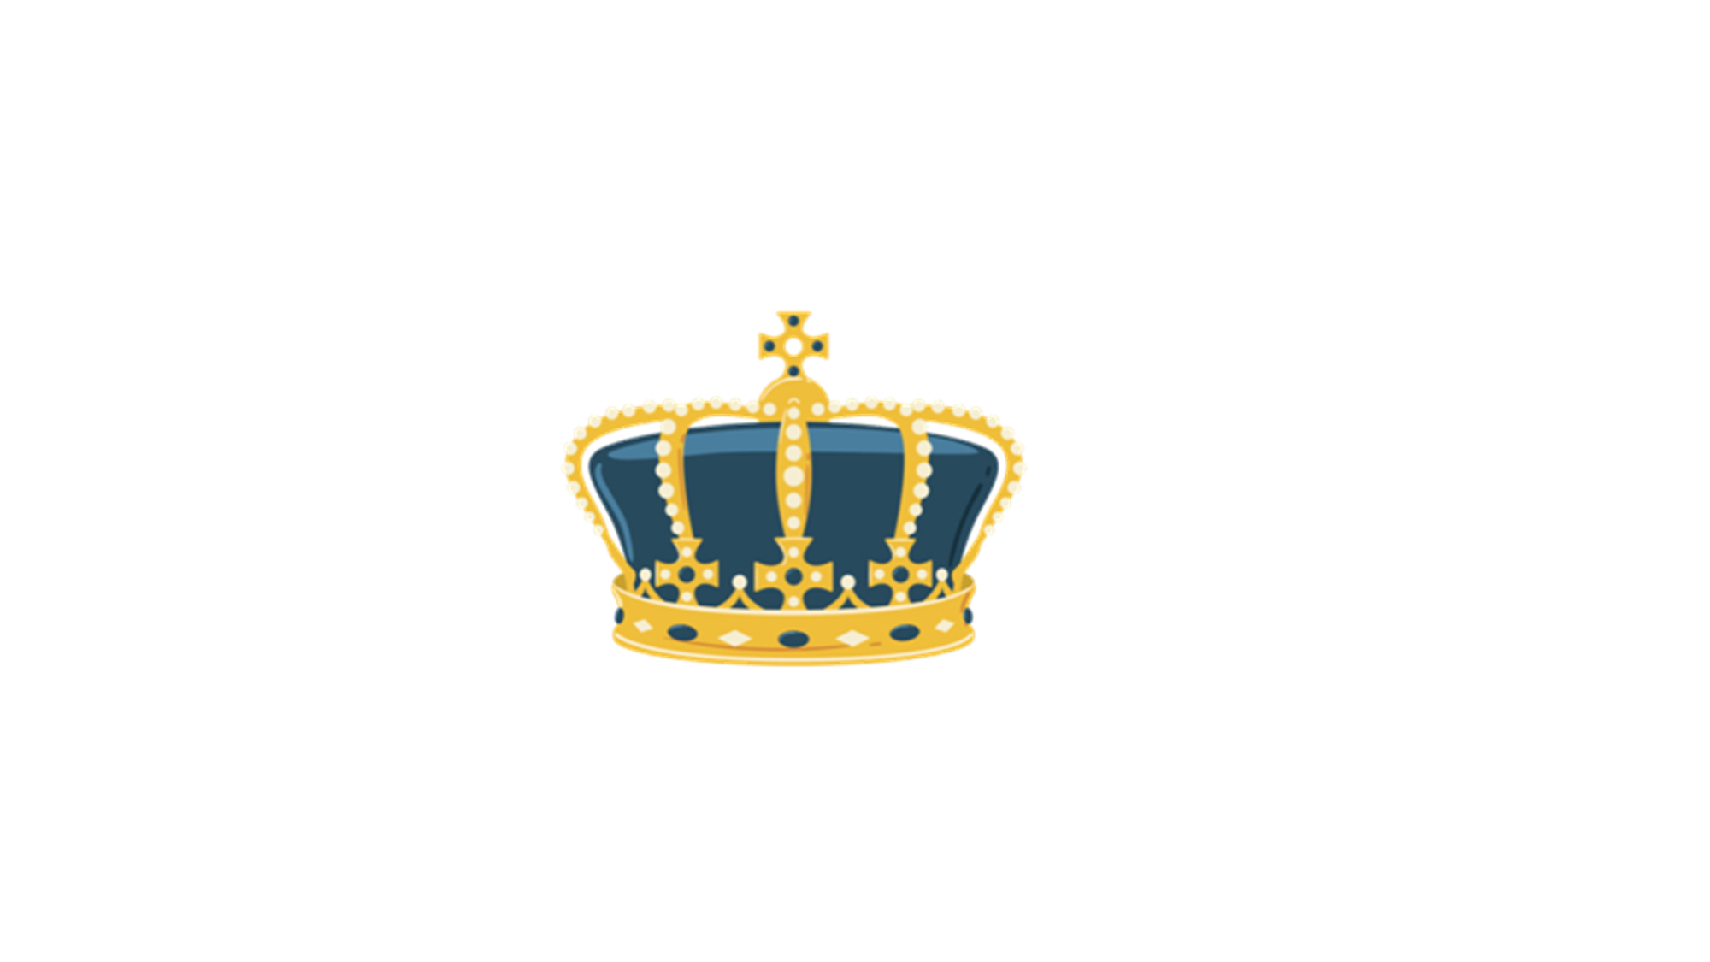
French Festivals
People believed that the prison represented everything they hated about the monarchy and how the king was running the country.
They felt that by destroying the Bastille, they were destroying the unfair rules they despised so much. They hated how the rich people didn’t pay taxes but they had to.

Slide 13
French Festivals
In 1789, soldiers invaded the prison and set the prisoners free.
Did you know?
People made bracelets and brooches from the old stones of the Bastille once it had been destroyed.
They also wore buckles and hats in the shape of towers.
Follow up question
Why do you think this was?

Slide 14
French Festivals
The people of Paris were declaring that they had gained freedom and sought justice.
Today, France and French-speaking countries remember the brave people who fought for this.
It is celebrated with large parades in Paris and fireworks can be seen all over France.

Slide 15
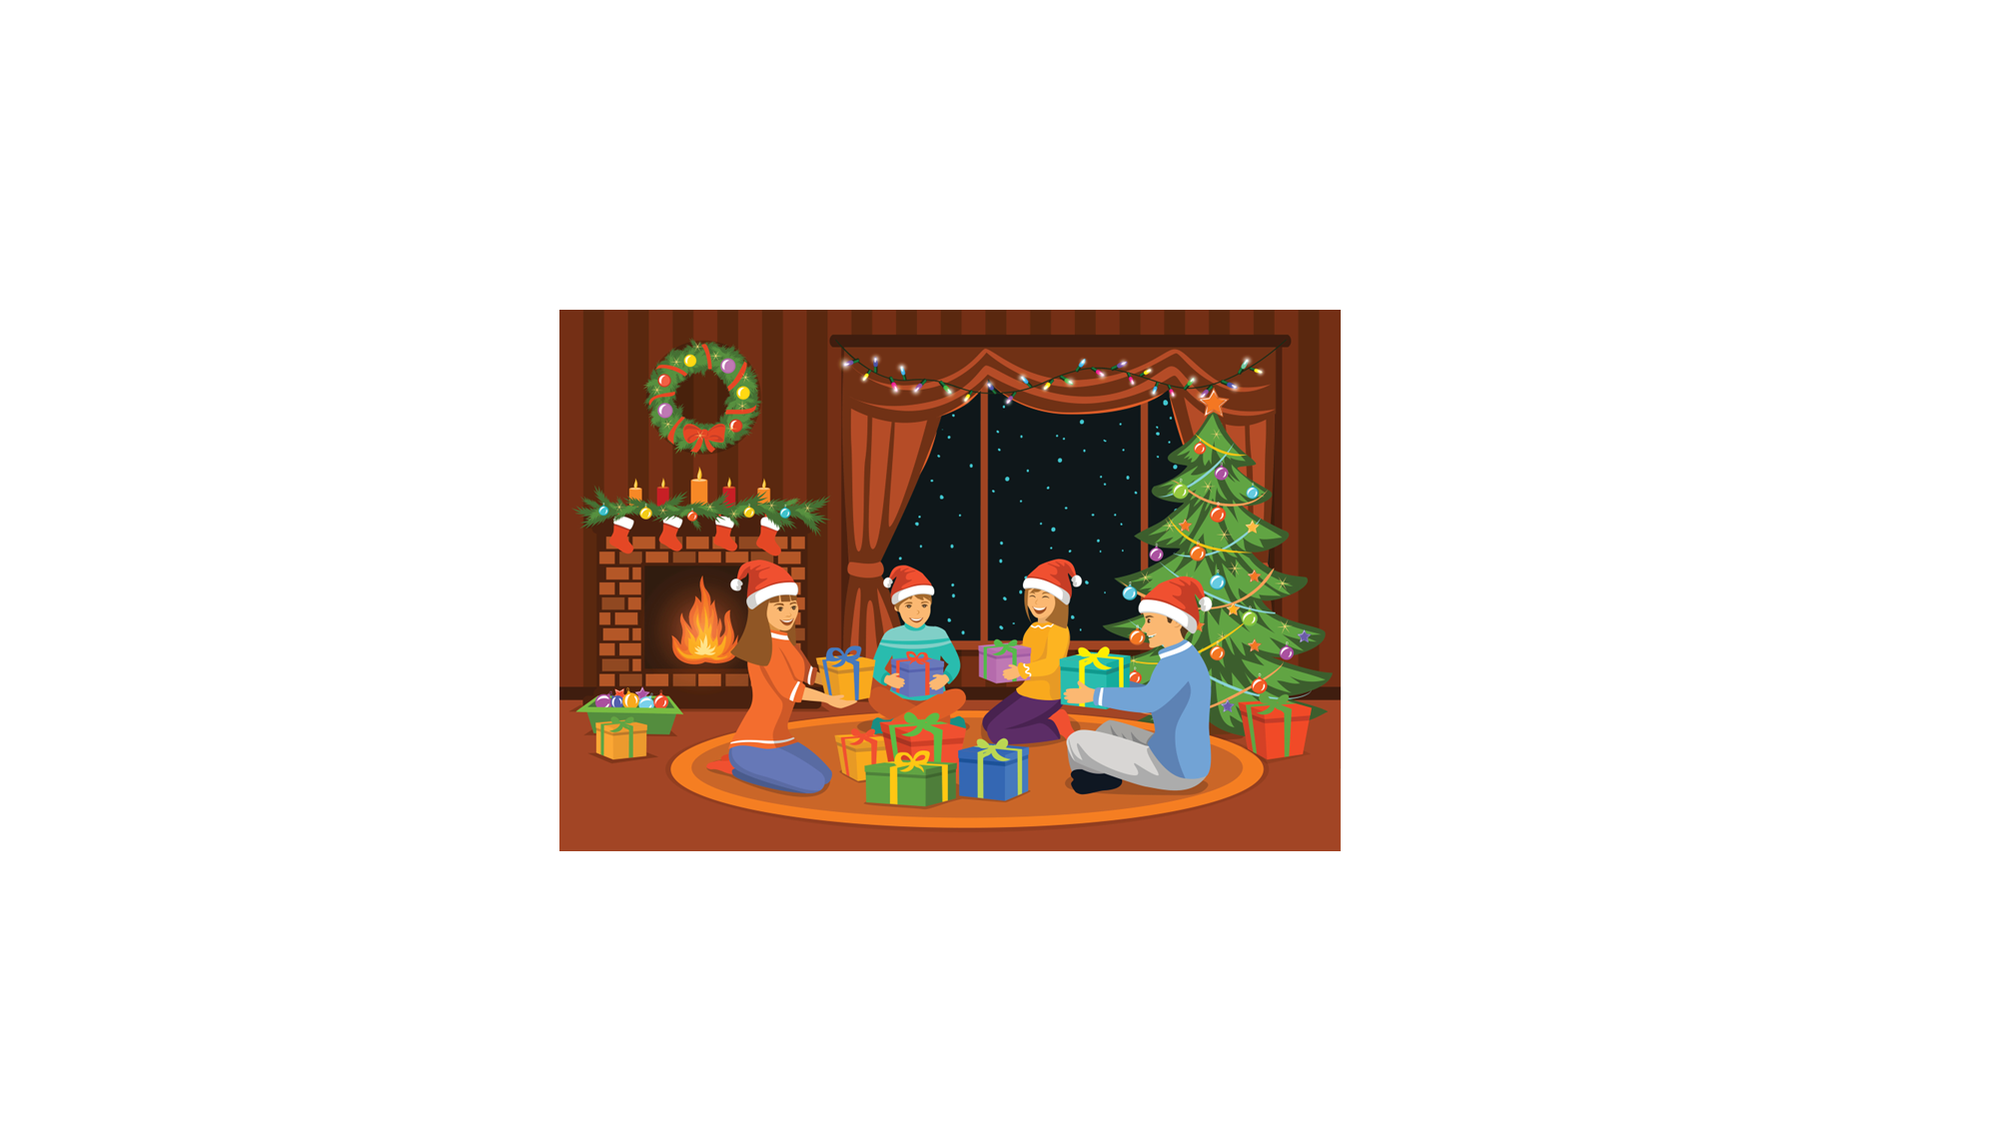
French Festivals
Noël, or Christmas, is celebrated on the 25th December (vingt-cinq décembre) just as it is in England.
It is a time for families and friends to come together to celebrate the birth of Jesus.

Slide 16
French Festivals
As England has its own traditions at Christmas time, so do France.
A. On Christmas Eve or ‘la veille de Noël’, families celebrate with a meal known as ‘le réveillon de Noël’.
B. Children leave their shoes on the fireplace in the hope that ‘le Père Noël’ will leave presents in or around them.
C. Christmas dinner sometimes comprises of duck or goose, seafood and cheese. Yule log is often eaten for pudding.

Slide 17
French Festivals
Use your knowledge of French festivals to answer the quiz questions below.
A. When is Bastille Day?
B. What is said to happen to the bells when they stop ringing?
C. Who founded ‘la Fête des Voisins’?
D. Why do children in France leave their shoes out on Christmas Eve?
E. Name two things that are eaten on Christmas Day in France.

Slide 18
French Festivals
Use your knowledge of French festivals to answer the quiz questions below.
A. When is Bastille Day? 14th July
B. What is said to happen to the bells when they stop ringing? They have flown to Rome to collect chocolate from the Pope.
C. Who founded ‘la Fête des Voisins’? Altanase Périfan
D. Why do children in France leave their shoes out on Christmas Eve? In the hope that ‘le Père Noël’ will leave presents in or around them.
E. Name two things that are eaten on Christmas Day in France.
Various answers, for example: duck and cheese.

