Slide 1
Y6
FRENCH
Formal, informal and apologies
Unit 1

Slide 2
Informal, formal and apologies
People use informal and formal language depending on who they are speaking to and for different purposes. Formal language is used to speak to elders or authority (think ‘Sir’) or to write for purposes like sending letters to an MP or the government. Informal language is used to speak to our friends or maybe at home. It’s more relaxed! In French, we use both informal and formal language too, so let’s have a look how!

Slide 3
Informal, formal and apologies
When we greet each other, we can informally say “Hi!” or a more formal “Hello!” To our friends, we can say: Now it’s your turn!
Hello!
Salut !

Slide 4
Informal, formal and apologies
To people we don’t know or who are in positions of authority, we speak more formally and say:
Hello!
Bonjour !
Follow up question
Who might we say “Bonjour" to in our day-to-day lives?

Slide 5
Informal, formal and apologies
Saying ‘Goodbye’ can be formal or informal. There are a number of phrases for saying goodbye, which get more and more formal. Two of the least formal are:
Tchao !
Salut !

Slide 6
Informal, formal and apologies
The most common goodbye is a little formal; that is:
And if you are never going to see them again, then we use:
Au revoir !
Adieu !

Slide 7
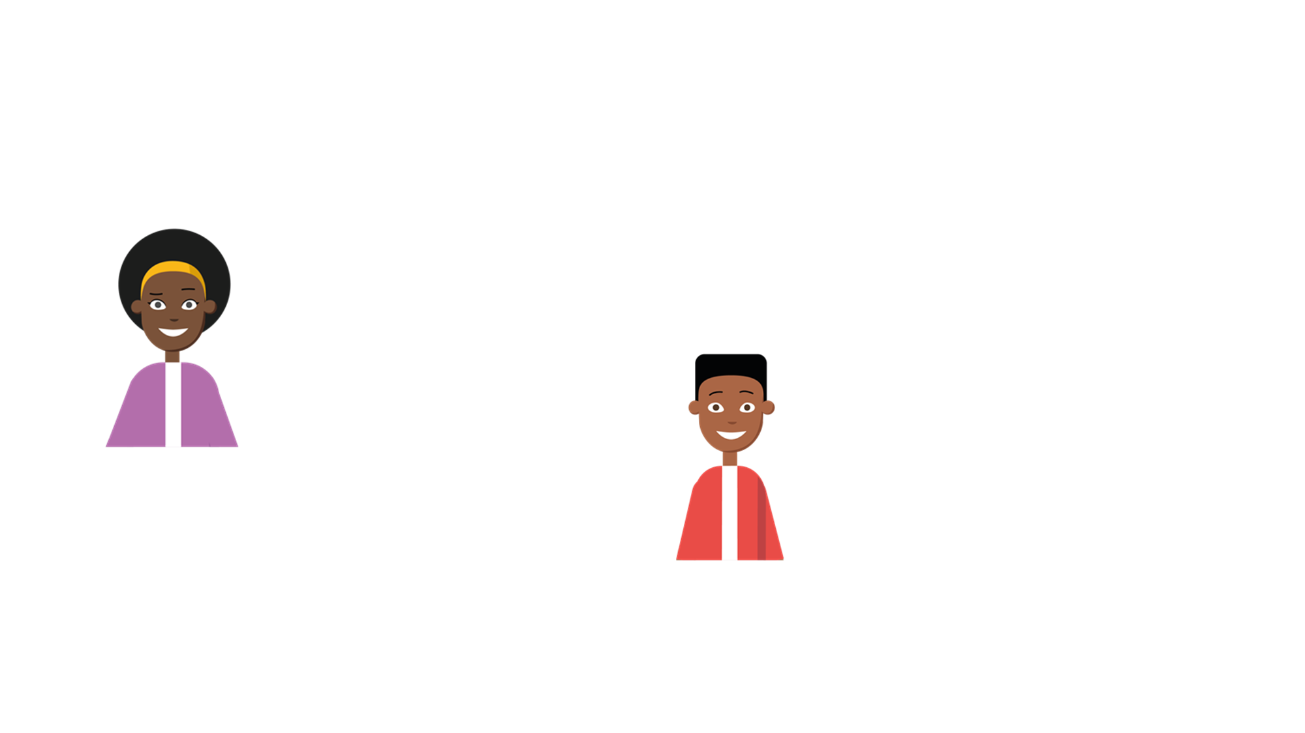
Informal, formal and apologies
When we are talking to people, we often say the word ‘you’. Here, ‘you’ could be referring to anybody, and could have been said by anybody, both formally and informally.
Where do you think are you going!?
I haven’t seen you in ages!

Slide 8
Informal, formal and apologies
In French, ‘you’ is used differently, depending on who you are talking to. When we speak to friends, people we know or people the same age as us, we use the word:
tu

Slide 9
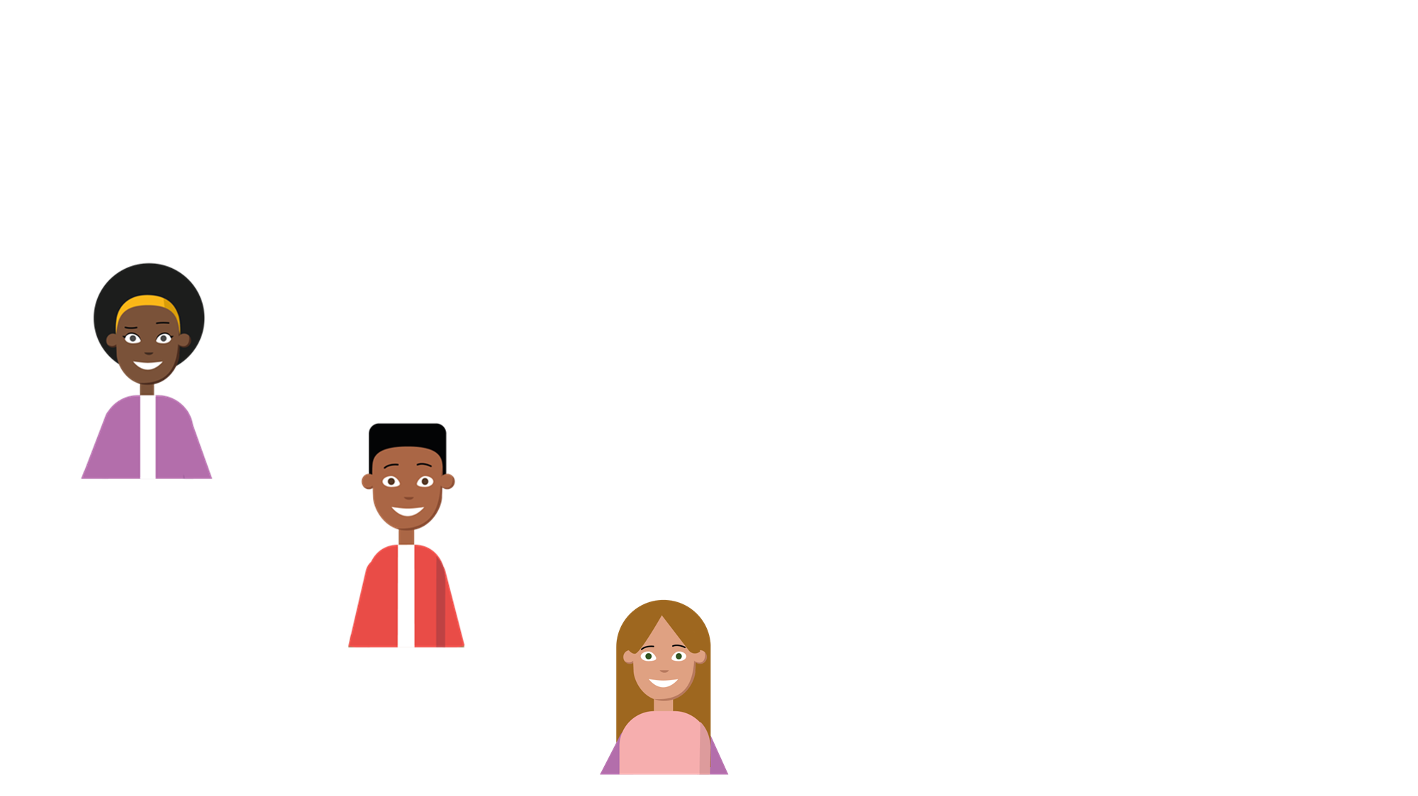
Informal, formal and apologies
When tu is used, this means these people are talking to someone they know or to someone their age.
Quel âge as-tu ?
Follow up question
Can you remember what these sentences mean?
Comment t’appelles-tu ?
Tu es mon ami !

Slide 10
Informal, formal and apologies
We may also hear the phrase ‘et toi’ which is also informal and a form of the word ‘tu’. This phrase can be used to continue a conversation when you want the person you are talking to to answer as well.
Comment ça va ?
Ça va bien, et toi ?
…

Slide 11
Informal, formal and apologies
When we speak to people that are older than us, that we don’t know or that are in positions of authority (like a headteacher), we use: (We also use vous when we talk to more than one person, but that’s a little bit different to informal and formal.)
vous

Slide 12
Informal, formal and apologies
Vous is used to show respect.
Pouvez-vous m'aider ?
Note
If you are ever unsure whether to use tu or vous, it’s a safer bet to use vous!
Où habitez-vous ?

Slide 13
Informal, formal and apologies
Tick the sentences that use informal language.
Tu as un chien ?
Voulez-vous visiter le musée avec moi ?
Tu manges beaucoup de desserts ?

Slide 14
Informal, formal and apologies
Tick the sentences that use informal language.
Tu as un chien ? |  | ✓
Voulez-vous visiter le musée avec moi ?
Tu manges beaucoup de desserts ? |  | ✓

Slide 15
Informal, formal and apologies
When we apologise, we use different phrases depending on the situation. The most common way to say sorry is usually for something you have done. Can you see the slight difference if ‘I’m sorry’ is said by a girl or a boy?
Je suis désolée.
Je suis désolé.
Note
Je suis désolé is a good one to learn to use in the classroom if you do something wrong.

Slide 16
Informal, formal and apologies
It is spelt ‘Je suis désolée’, with an extra e, if a girl says it. However, it is pronounced the same. If you bump into someone in the playground or the classroom, it is polite to apologise. Although it is the same word in English and French, it is pronounced slightly differently.
Pardon !

Slide 17
Informal, formal and apologies
If you want to get someone’s attention (for example, the teacher’s) instead of shouting “Oi!”, it is important to be polite. There is both a formal and informal version of “Excuse me!” To someone you know: To someone you don’t know:
Excuse-moi !
Excusez-moi !

Slide 18
Informal, formal and apologies
Select the correct apology for each situation.
You squeeze past someone and knock into them whilst getting on to the bus.
Pardon. | Excuse-moi. | Je suis desolé.
A girl has accidentally dropped a pot of paint on the floor.
Je suis désolé. | Excusez-moi. | Je suis désolée.
You are trying to catch the attention of a person you don’t know in the street.
Excuse-moi. | Excusez-moi. | Je suis désolé.

Slide 19
Informal, formal and apologies
Select the correct apology for each situation.
You squeeze past someone and knock into them whilst getting on to the bus.
Pardon. | Excuse-moi. | Je suis desolé.
A girl has accidentally dropped a pot of paint on the floor.
Je suis désolé. | Excusez-moi. | Je suis désolée.
You are trying to catch the attention of a person you don’t know in the street.
Excuse-moi. | Excusez-moi. | Je suis désolé.

