Slide 1
Y5
FRENCH
French History
Unit 1 - Culture

Slide 2
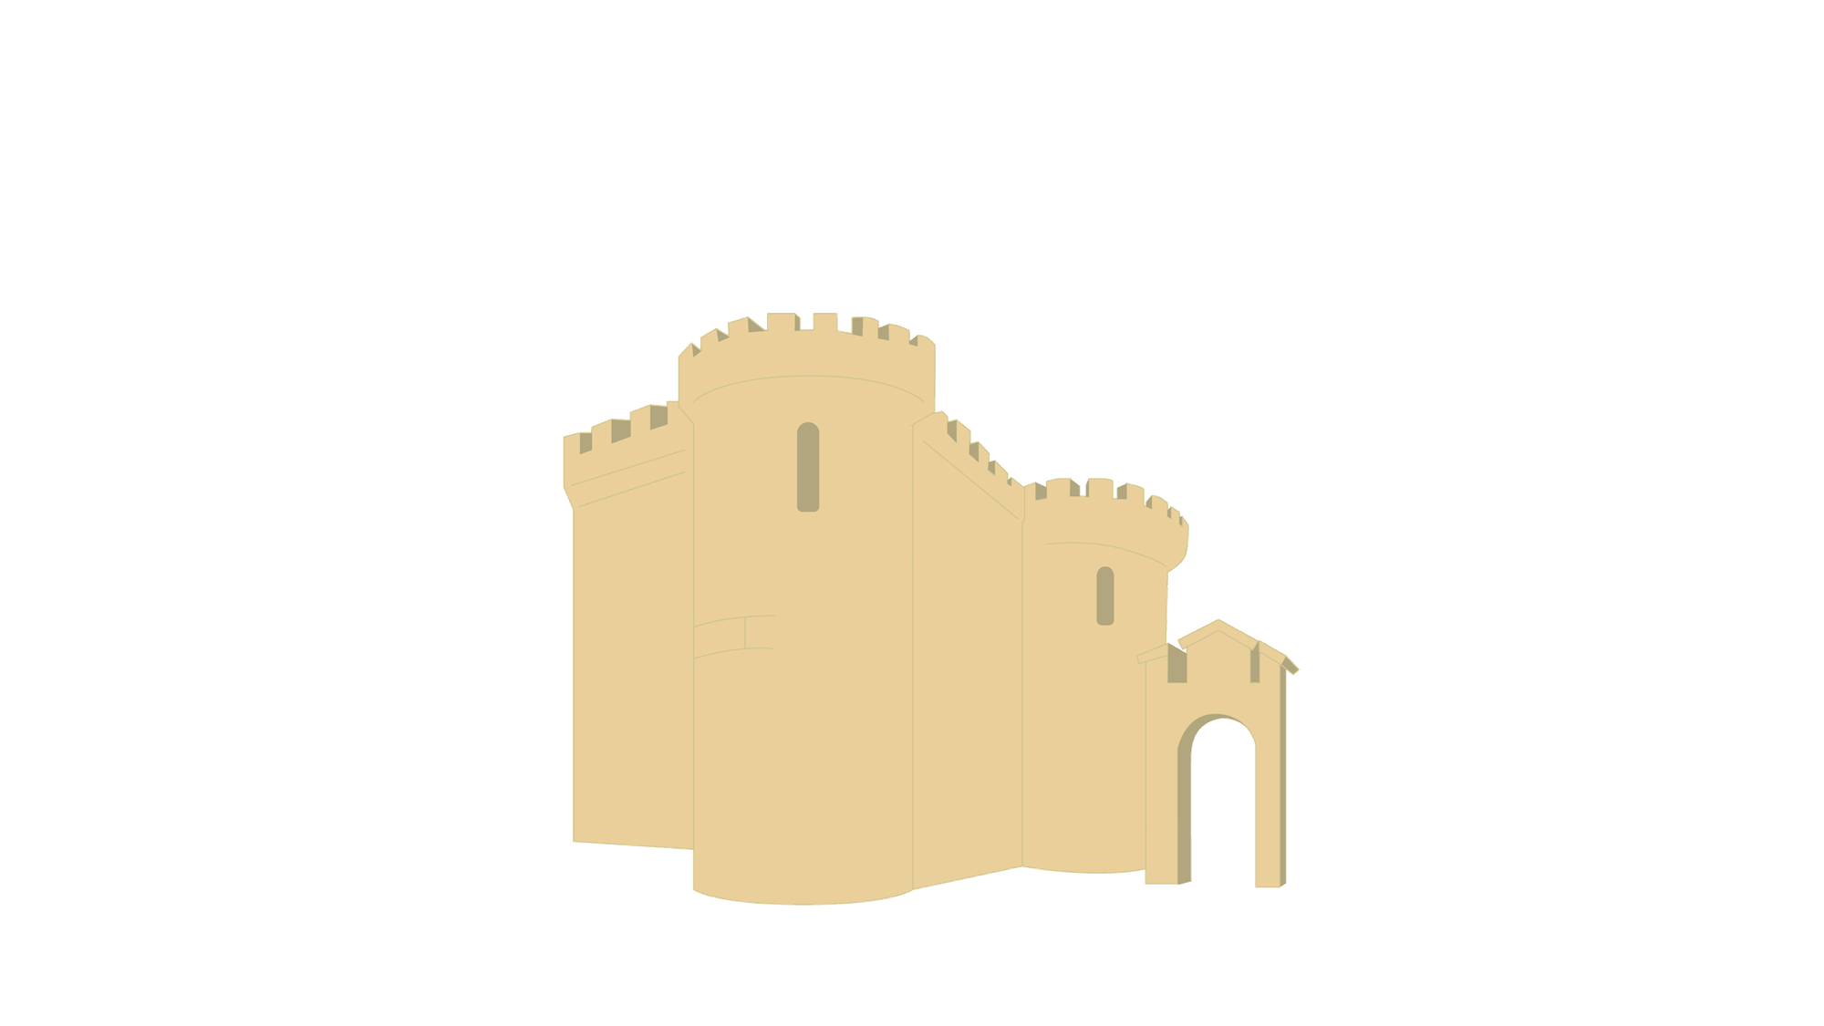
French History
Let’s start with a question about historical buildings and structures.

Slide 3
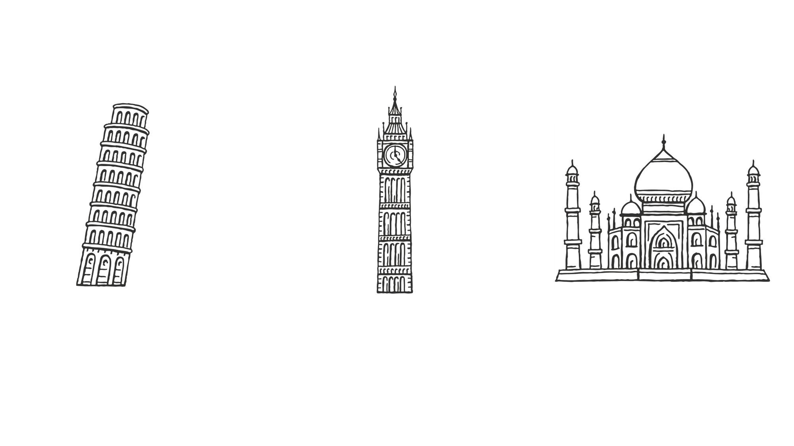
French History
Name the famous buildings and structures shown below.
Note
Can you identify which countries these can be found in? Can you name them in French?

Slide 4
French History
Name the famous buildings and structures shown below.
The Leaning Tower of Pisa
la Tour de Pise
Italie
Italy
Big Ben
Big Ben
Angleterre
England
The Taj Mahal
le Taj Mahal
Inde
India

Slide 5
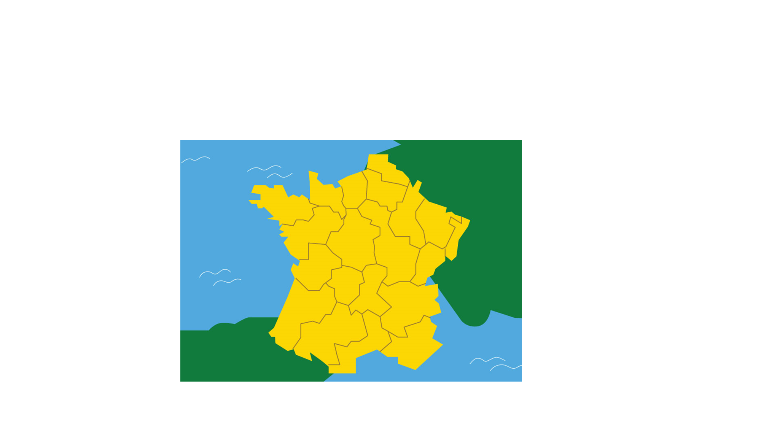
French History
Now that we are ready to move on, we can learn about French History.

Slide 6
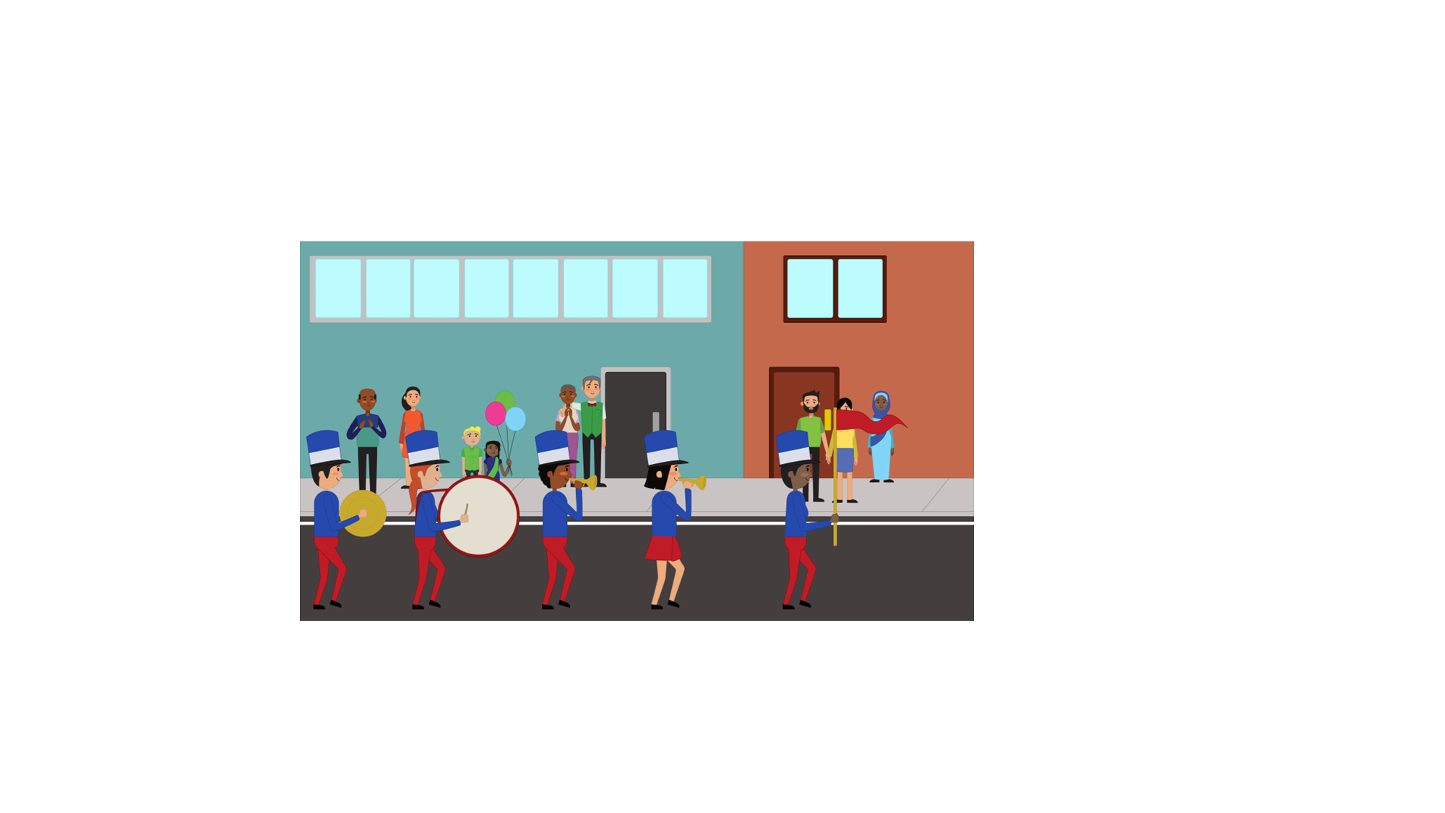
French History
Le Quatorze Juillet, also known as Bastille Day, is celebrated on 14th July every year with parades and firework displays.
It is held in celebration of the start of ‘la Révolution française’ (the French Revolution).

Slide 7
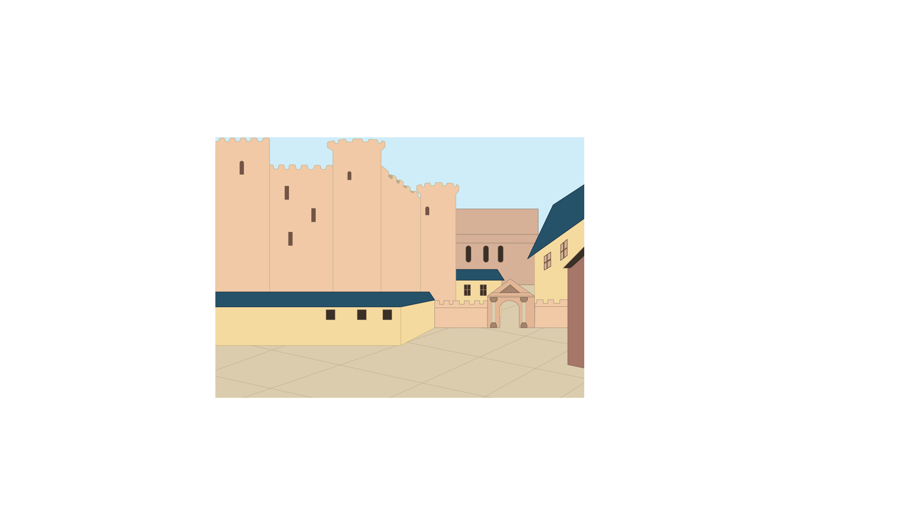
French History
In 1789, a prison in Paris, known as the Bastille, was stormed and all the prisoners were released.
This was to show the King how unhappy the French people had been with his rulings.

Slide 8
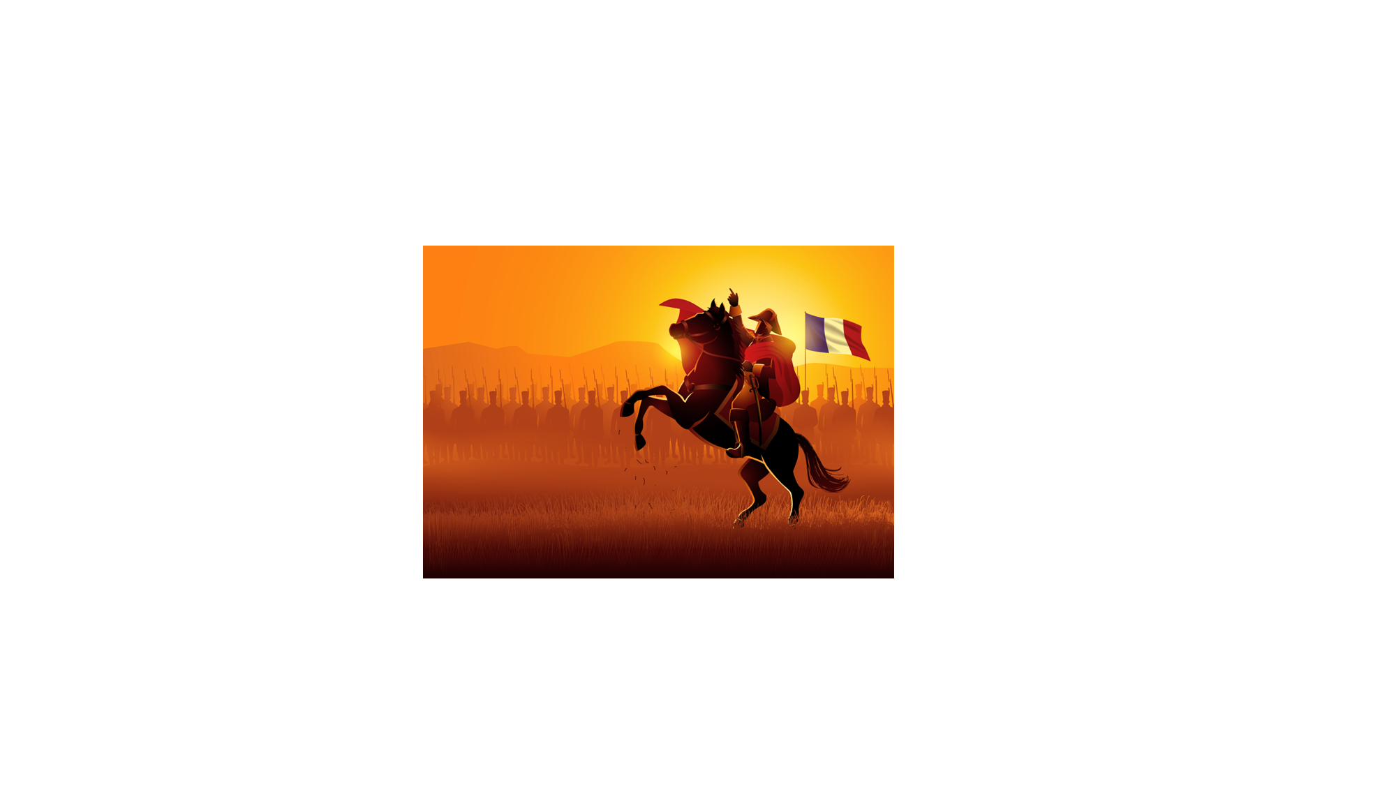
French History
In 1799, once the revolution had ended, Napoléon Bonaparte became the ruler of France.
He led France into a series of wars known as the Napoleonic Wars, or ‘les guerres napoléoniennes’.

Slide 9
French History
Although he was successful in taking over parts of Europe, he was eventually defeated at the Battle of Waterloo.
Did you know?
He is rumoured to have carried poison around his neck which he could drink in case he was ever captured!
Did you know?
Did you know?
Did you know?
Napoleon was known as ‘Le Petit Caporal’ meaning ‘The Little Corporal’ which was rumoured to be because of his height.
One of Napoleon’s soldiers discovered the Rosetta Stone in their invasion of Egypt!
Napoleon is often known for his short height, yet it was a typical height for men in the 19th century.

Slide 10
French History
Throughout history, France was involved in many wars, such as ‘la Première Guerre mondiale’ and ‘la Deuxième Guerre mondiale’.
Question Time!
What are the names of the wars in English?

Slide 11
French History
World War I and World War II.
Between 1914 and 1918, France were part of the Allies along with Britain, Belgium, Russia and America.
The Battle of the Somme and the Battle of Verdun both took place in France.

Slide 12
French History
During World War II, Britain and France declared war on Germany because of their decision to invade Poland.
Within a couple of years, Germany had invaded France and occupied the capital city of Paris.

Slide 13
French History
On 8th May 1945, the war ended but not without significant loss of life.
Similar to the UK, France also observes a minute silence to remember the soldiers who gave their lives for their country.

Slide 14
French History
Match the date to the correct event.
la Deuxième Guerre mondiale
le Quatorze Juillet
Bastille Day
1914 - 1918
la Première Guerre mondiale
onze novembre
la tombe du soldat inconnu
1939 - 1945

Slide 15
French History
Match the date to the correct event.
la Deuxième Guerre mondiale
le Quatorze Juillet
Bastille Day
1914 - 1918
la Première Guerre mondiale
onze novembre
la tombe du soldat inconnu
1939 - 1945

