Slide 1
LIFE/work balance
We have started a #LIFEworkbalance campaign and we need your help to complete our LIFE/work balance survey.
We hope to publish the results soon, so please give 15 minutes of your time to help us get a true picture of school life.
Want to be a part of this campaign? Take the survey on our website and share it with your colleagues!
© Classroom Secrets Limited 2020

Slide 2
Year 6 – Spring Block 4 – Converting Units – Metric Measures
About This Resource:
This PowerPoint has been designed to support your teaching of this small step. It includes a starter activity and an example of each question from the Varied Fluency and Reasoning and Problem Solving resources also provided in this pack. You can choose to work through all examples provided or a selection of them depending on the needs of your class.
National Curriculum Objectives:
Mathematics Year 6: (6M5) Use, read, write and convert between standard units, converting measurements of length, mass, volume and time from a smaller unit of measure to a larger unit, and vice versa, using decimal notation to up to three decimal places
Mathematics Year 6: (6M9) Solve problems involving the calculation and conversion of units of measure, using decimal notation up to three decimal places where appropriate
More Year 6 Converting Units resources.
Did you like this resource? Don’t forget to review it on our website.
© Classroom Secrets Limited 2019

Slide 3
Year 6 – Spring Block 4 – Converting Units
Step 1: Metric Measures
© Classroom Secrets Limited 2019

Slide 4
Introduction
Match the unit of measurements to their abbreviations.
kilogram
km
centimetres
ml
kilometres
kg
mililitres
cm
© Classroom Secrets Limited 2019

Slide 5
Introduction
Match the unit of measurements to their abbreviations.
kilogram
km
centimetres
ml
kilometres
kg
mililitres
cm
© Classroom Secrets Limited 2019

Slide 6
Varied Fluency 1
Match the unit of measurements to the correct categories.
millimetres
grams
litres
centilitres
weight
length
volume
© Classroom Secrets Limited 2019

Slide 7
Varied Fluency 1
Match the unit of measurements to the correct categories.
millimetres
grams
litres
centilitres
weight
length
volume
© Classroom Secrets Limited 2019

Slide 8
Varied Fluency 2
Circle the odd one out.
A. 5mm
B. 127cm
C. 2.5kg
D. The length of a football pitch
© Classroom Secrets Limited 2019

Slide 9
Varied Fluency 2
Circle the odd one out.
2.5kg is the odd one out; the others are all units of length.
A. 5mm
B. 127cm
C. 2.5kg
D. The length of a football pitch
© Classroom Secrets Limited 2019

Slide 10
Varied Fluency 3
Tick the noun that is more likely to be 100m long.
hall
running track
bench
© Classroom Secrets Limited 2019

Slide 11
Varied Fluency 3
Tick the noun that is more likely to be 100m long.
hall
running track
✓
bench
© Classroom Secrets Limited 2019

Slide 12
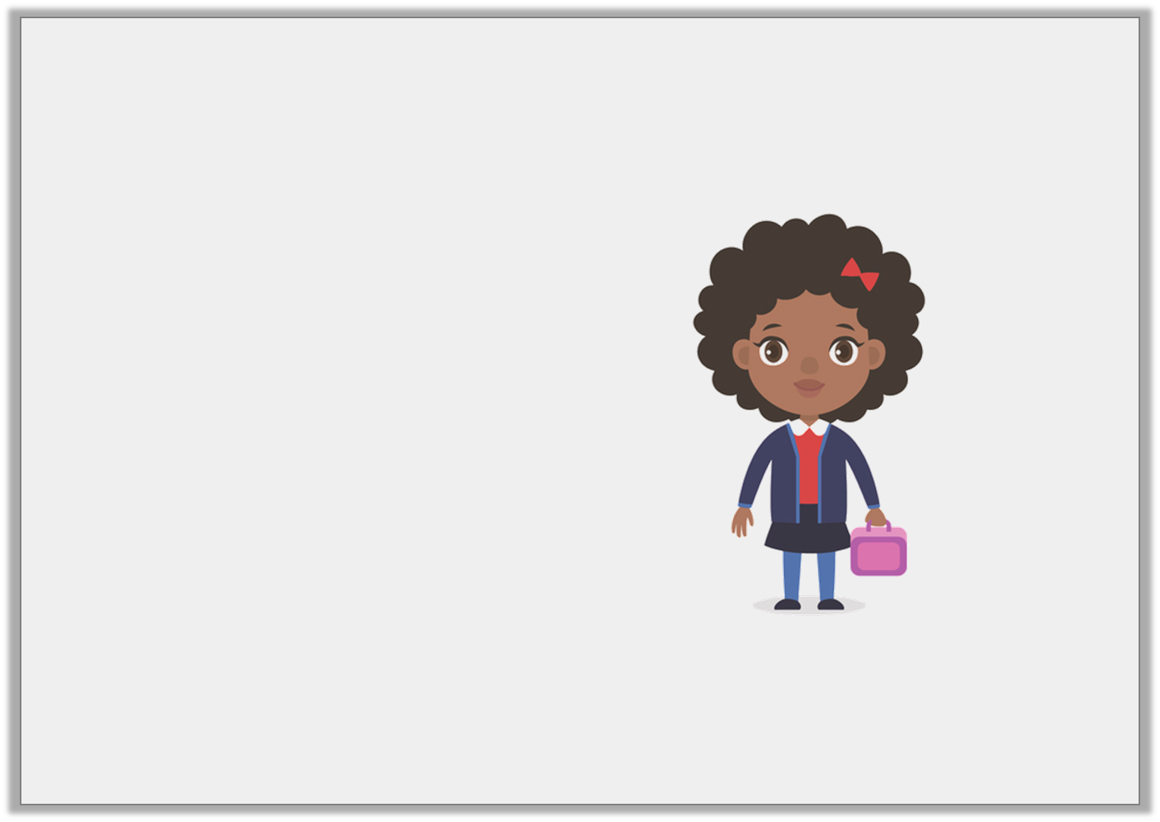
Varied Fluency 4
Estimate and underline the most accurate statements for a child.
She is 125 cm tall.
1
2
She weighs 20g.
She weighs 20kg.
© Classroom Secrets Limited 2019

Slide 13
Varied Fluency 4
Estimate and underline the most accurate statements for a child.
She is 125 cm tall.
1
2
She weighs 20g.
She weighs 20kg.
© Classroom Secrets Limited 2019

Slide 14
Reasoning 1
Felicity is measuring the height of her classmates’ and recording her results.
She has forgotten to write the unit of measurement.
Which unit of measure could she be using for each height? Convince me.
Peter | 1.1
Lizzy | 102
Isla | 0.9
© Classroom Secrets Limited 2019

Slide 15
Reasoning 1
Felicity is measuring the height of her classmates’ and recording her results.
She has forgotten to write the unit of measurement.
Which unit of measure could she be using for each height? Convince me.
Various answers, for example: as shown above.
All the heights are similar and in a class of children, there wouldn’t be too much difference in their heights.
Peter | 1.1 | m
Lizzy | 102 | cm
Isla | 0.9 | m
© Classroom Secrets Limited 2019

Slide 16
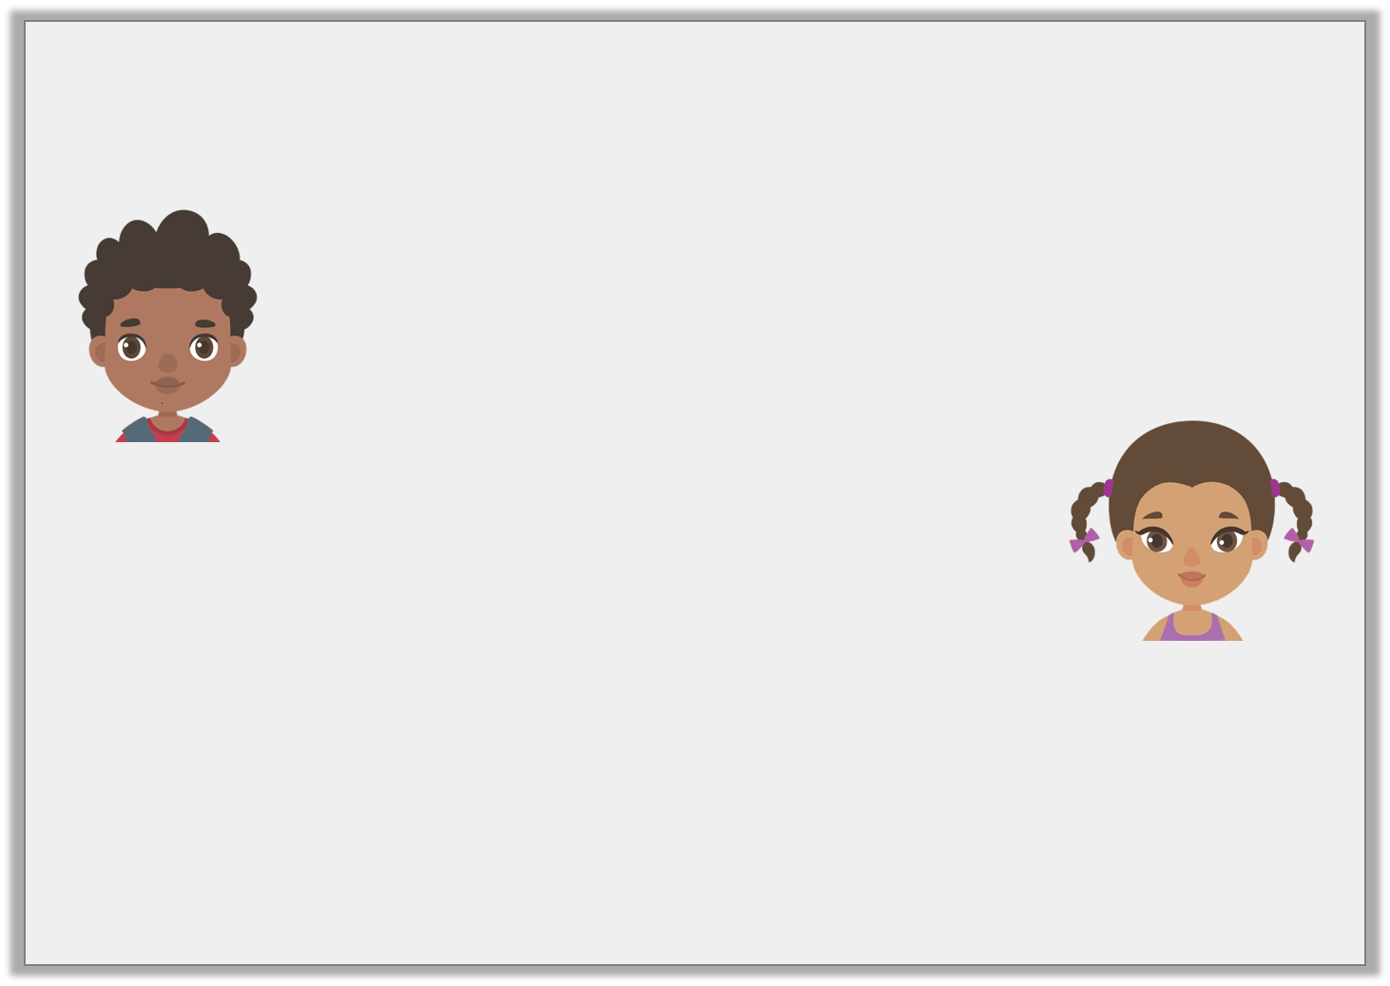
Reasoning 2
The children are estimating how far it is to walk to assembly.
Who do you agree with and why?
I think it will be around 117 m.
1
2
Sam
I think it will be around 117.5cm.
India
© Classroom Secrets Limited 2019

Slide 17
Reasoning 2
The children are estimating how far it is to walk to assembly.
Who do you agree with and why?
I agree with Sam because…
I think it will be around 117 m.
1
2
Sam
I think it will be around 117.5cm.
India
© Classroom Secrets Limited 2019

Slide 18
Reasoning 2
The children are estimating how far it is to walk to assembly.
Who do you agree with and why?
Various answers, for example:
I agree with Sam because metres greater unit of measure than cm. In context, 117.5 cm is about the length of a table.
I think it will be around 117 m.
1
2
Sam
I think it will be around 117.5cm.
India
© Classroom Secrets Limited 2019

Slide 19
Problem Solving 1
A bottle of lemonade has a volume of approximately 1 litre when half-full.
Estimate the volume for the following:
a bath that is full
a sink that is half-full
a full can of pop
a cup of coffee that is half-empty
© Classroom Secrets Limited 2019

Slide 20
Problem Solving 1
A bottle of lemonade has a volume of approximately 1 litre when half-full.
Estimate the volume for the following:
Various answers, for example: as shown above.
a bath that is full | 120L
a sink that is half-full | 5L
a full can of pop | 330ml
a cup of coffee that is half-empty | 0.2L
© Classroom Secrets Limited 2019

