Slide 1
Year 6 – Spring Block 6 – Ratio – Using Ratio Language
About This Resource:
This PowerPoint has been designed to support your teaching of this small step. It includes a starter activity and an example of each question from the Varied Fluency and Reasoning and Problem Solving resources also provided in this pack. You can choose to work through all examples provided or a selection of them depending on the needs of your class.
National Curriculum Objectives:
Mathematics Year 6: (6R1) Solve problems involving the relative sizes of two quantities where missing values can be found by using integer multiplication and division facts
More Year 6 Ratio resources.
Did you like this resource? Don’t forget to review it on our website.
© Classroom Secrets Limited 2019

Slide 2
Year 6 – Spring Block 6 – Ratio
Step 1: Using Ratio Language
© Classroom Secrets Limited 2019

Slide 3
Introduction
What would the 20th shape in the pattern be?
© Classroom Secrets Limited 2019

Slide 4
Introduction
What would the 20th shape in the pattern be?
A circle
© Classroom Secrets Limited 2019

Slide 5
Varied Fluency 1
Tick the statements which are correct.
For every triangle and 2 circles, there are 3 squares.
For every triangle there are 2 squares.
For every 2 circles there will be 1 triangle.
© Classroom Secrets Limited 2019

Slide 6
Varied Fluency 1
Tick the statements which are correct.
For every triangle and 2 circles, there are 3 squares.
For every triangle there are 2 squares.
For every 2 circles there is 1 triangle.


© Classroom Secrets Limited 2019

Slide 7
Varied Fluency 2
True or false?
For every triangle there are 2 circles.
© Classroom Secrets Limited 2019

Slide 8
Varied Fluency 2
True or false?
For every triangle there are 2 circles.
True
© Classroom Secrets Limited 2019

Slide 9
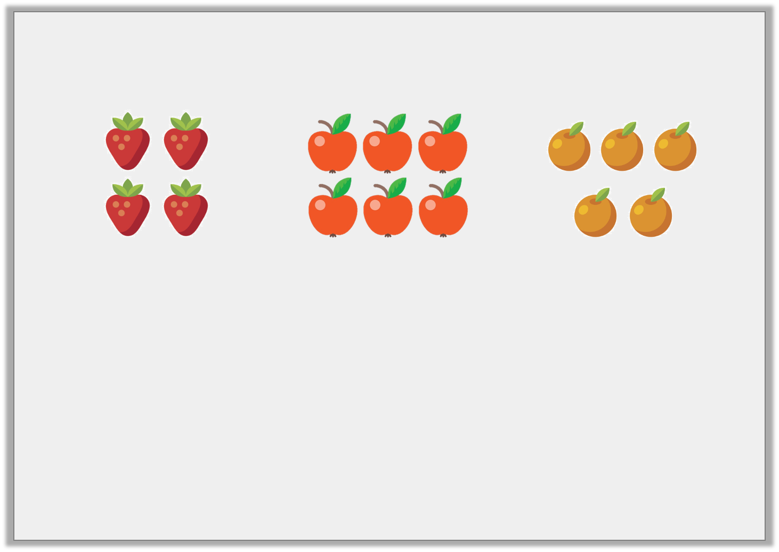
Varied Fluency 3
Complete the sentence.
There are 6 _____________ for every 5 _____________ .
© Classroom Secrets Limited 2019

Slide 10
Varied Fluency 3
Complete the sentence.
There are 6 _____________ for every 5 _____________ .
apples
oranges
© Classroom Secrets Limited 2019

Slide 11
Varied Fluency 4
Fill in the missing numbers.
There are 2 triangles for every 8 squares.
If there is 1 , there will be .
© Classroom Secrets Limited 2019

Slide 12
Varied Fluency 4
Fill in the missing numbers.
There are 2 triangles for every 8 squares.
If there is 1 , there will be .
4
© Classroom Secrets Limited 2019

Slide 13
Reasoning 1
Becky has different coloured counters.
There are 2 blue counters for every 8 green counters.
Becky says,
Is she correct? Explain how you know.
If there were just 1 blue counter, there would be 6 counters in total.
© Classroom Secrets Limited 2019

Slide 14
Reasoning 1
Becky has different coloured counters.
There are 2 blue counters for every 8 green counters.
Becky says,
Is she correct? Explain how you know.
Becky is incorrect because…
If there were just 1 blue counter, there would be 6 counters in total.
© Classroom Secrets Limited 2019

Slide 15
Reasoning 1
Becky has different coloured counters.
There are 2 blue counters for every 8 green counters.
Becky says,
Is she correct? Explain how you know.
Becky is incorrect because if there was 1 blue counter, there would be 4 green counters. 1 + 4 = 5.
If there were just 1 blue counter, there would be 6 counters in total.
© Classroom Secrets Limited 2019

Slide 16
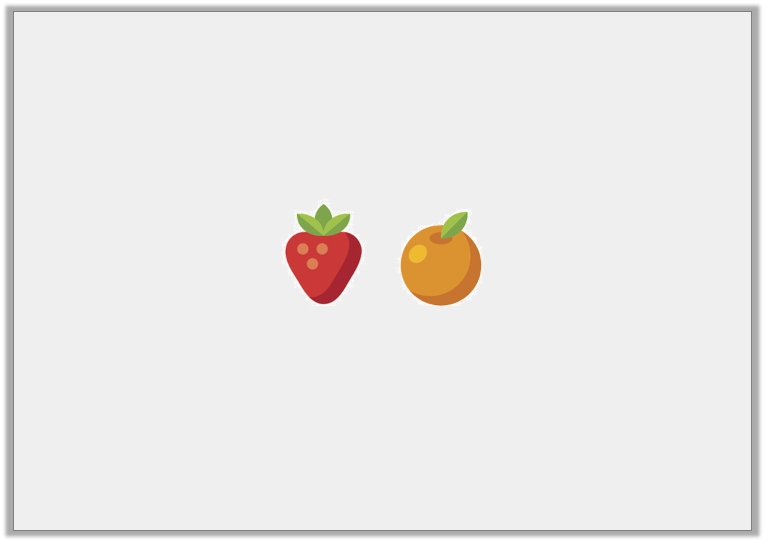
Problem Solving 1
Eesa has a bag of shopping containing strawberries and oranges.
There are 12 pieces of fruit altogether.
Write 3 different sentences which explain the possible ratios of the fruit.
© Classroom Secrets Limited 2019

Slide 17
Problem Solving 1
Eesa has a bag of shopping containing strawberries and oranges.
There are 12 pieces of fruit altogether.
Write 3 different sentences which explain the possible ratios of the fruit.
Various answers that add up to 12, for example:
1 and 11; 2 and 10; 3 and 9
© Classroom Secrets Limited 2019

Slide 18
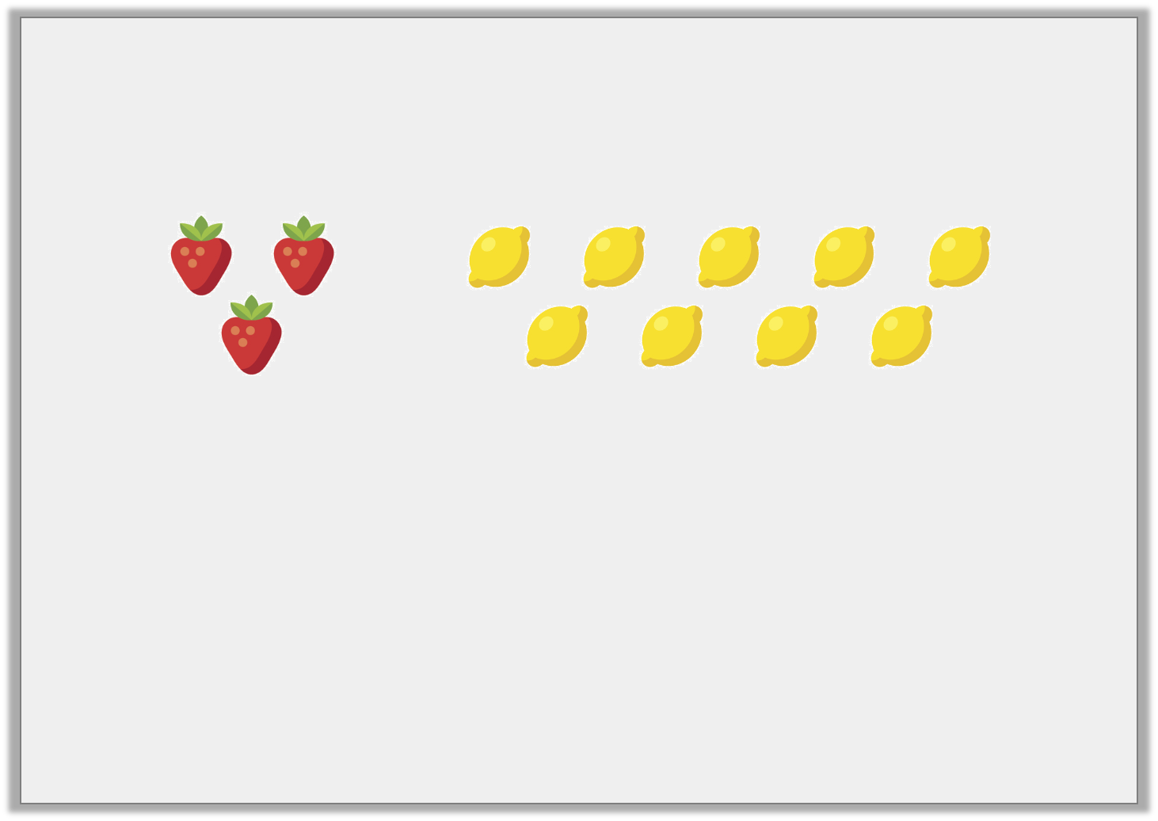
Reasoning 2
Harrison and Tobias are looking at the relationship between strawberries and lemons.
Harrison thinks that if there was one strawberry, there would be 2 lemons.
Tobias thinks that if there was 1 strawberry, there would be 3 lemons.
Who is correct? Explain how you know.
© Classroom Secrets Limited 2019

Slide 19
Reasoning 2
Harrison and Tobias are looking at the relationship between strawberries and lemons.
Harrison thinks that if there was one strawberry, there would be 2 lemons.
Tobias thinks that if there was 1 strawberry, there would be 3 lemons.
Who is correct? Explain how you know.
Tobias is correct because…
© Classroom Secrets Limited 2019

Slide 20
Reasoning 2
Harrison and Tobias are looking at the relationship between strawberries and lemons.
Harrison thinks that if there was one strawberry, there would be 2 lemons.
Tobias thinks that if there was 1 strawberry, there would be 3 lemons.
Who is correct? Explain how you know.
Tobias is correct because there are 3 strawberries for every 9 lemons, so if there were 1 strawberry, there would be 3 lemons.
© Classroom Secrets Limited 2019

