Slide 1
LIFE/work balance
We have started a #LIFEworkbalance campaign and we need your help to complete our LIFE/work balance survey.
We hope to publish the results soon, so please give 15 minutes of your time to help us get a true picture of school life.
Want to be a part of this campaign? Take the survey on our website and share it with your colleagues!
© Classroom Secrets Limited 2019

Slide 2
Year 6 – Summer Block 1 – Properties of Shapes – Measure with a Protractor
About This Resource:
This PowerPoint has been designed to support your teaching of this small step. It includes a starter activity and an example of each question from the Varied Fluency and Reasoning and Problem Solving resources also provided in this pack. You can choose to work through all examples provided or a selection of them depending on the needs of your class.
National Curriculum Objectives:
Mathematics Year 6: (6G2a) Compare and classify geometric shapes based on their properties and sizes
Mathematics Year 6: (6G3a) Draw 2-D shapes using given dimensions and angles
Mathematics Year 6: (6G4a) Find unknown angles in any triangles, quadrilaterals, and regular polygons
Mathematics Year 6: (6G4b) Recognise angles where they meet at a point, are on a straight line, or are vertically opposite, and find missing angles
More Year 6 Properties of Shapes resources.
Did you like this resource? Don’t forget to review it on our website.
© Classroom Secrets Limited 2018

Slide 3
Year 6 – Summer Block 1 – Properties of Shapes
Step 1: Measure with a Protractor
© Classroom Secrets Limited 2018

Slide 4
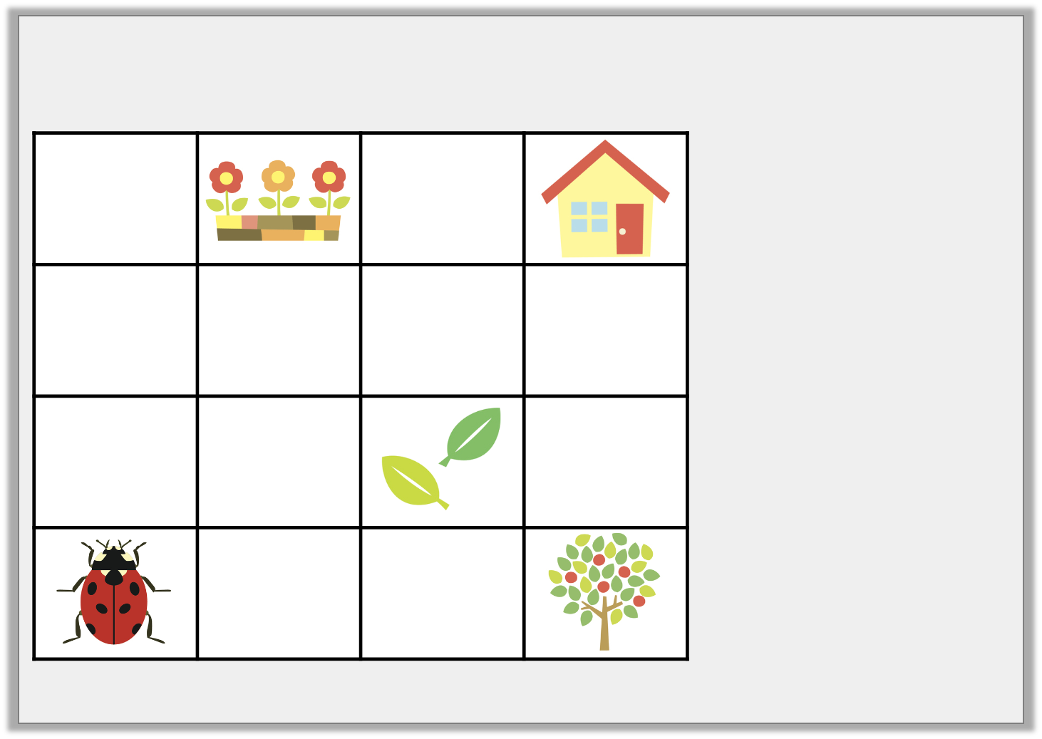
Introduction
Follow the directions to discover where the ladybird is going.
Can you plan your own route for the ladybird to follow?
1. Move forwards 2 squares.
2. Turn 90° clockwise and move forward 1 square.
3. Turn 360° anti-clockwise and move forward 1 square.
4. Turn 90° clockwise and move forward 2 squares.
5. Turn 90° anti-clockwise and move forward 1 square.
© Classroom Secrets Limited 2018

Slide 5
Introduction
Follow the directions to discover where the ladybird is going.
Can you plan your own route for the ladybird to follow?
1. Move forwards 2 squares.
2. Turn 90° clockwise and move forward 1 square.
3. Turn 360° anti-clockwise and move forward 1 square.
4. Turn 90° clockwise and move forward 2 squares.
5. Turn 90° anti-clockwise and move forward 1 square.
© Classroom Secrets Limited 2018

Slide 6
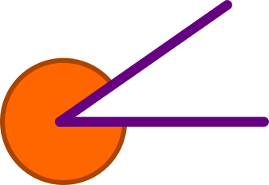
Varied Fluency 1
What type of angles are these?
a
b
c
acute | obtuse | reflex
© Classroom Secrets Limited 2018

Slide 7
Varied Fluency 1
What type of angles are these?
a
b
c
reflex
acute
obtuse
acute | obtuse | reflex
© Classroom Secrets Limited 2018

Slide 8
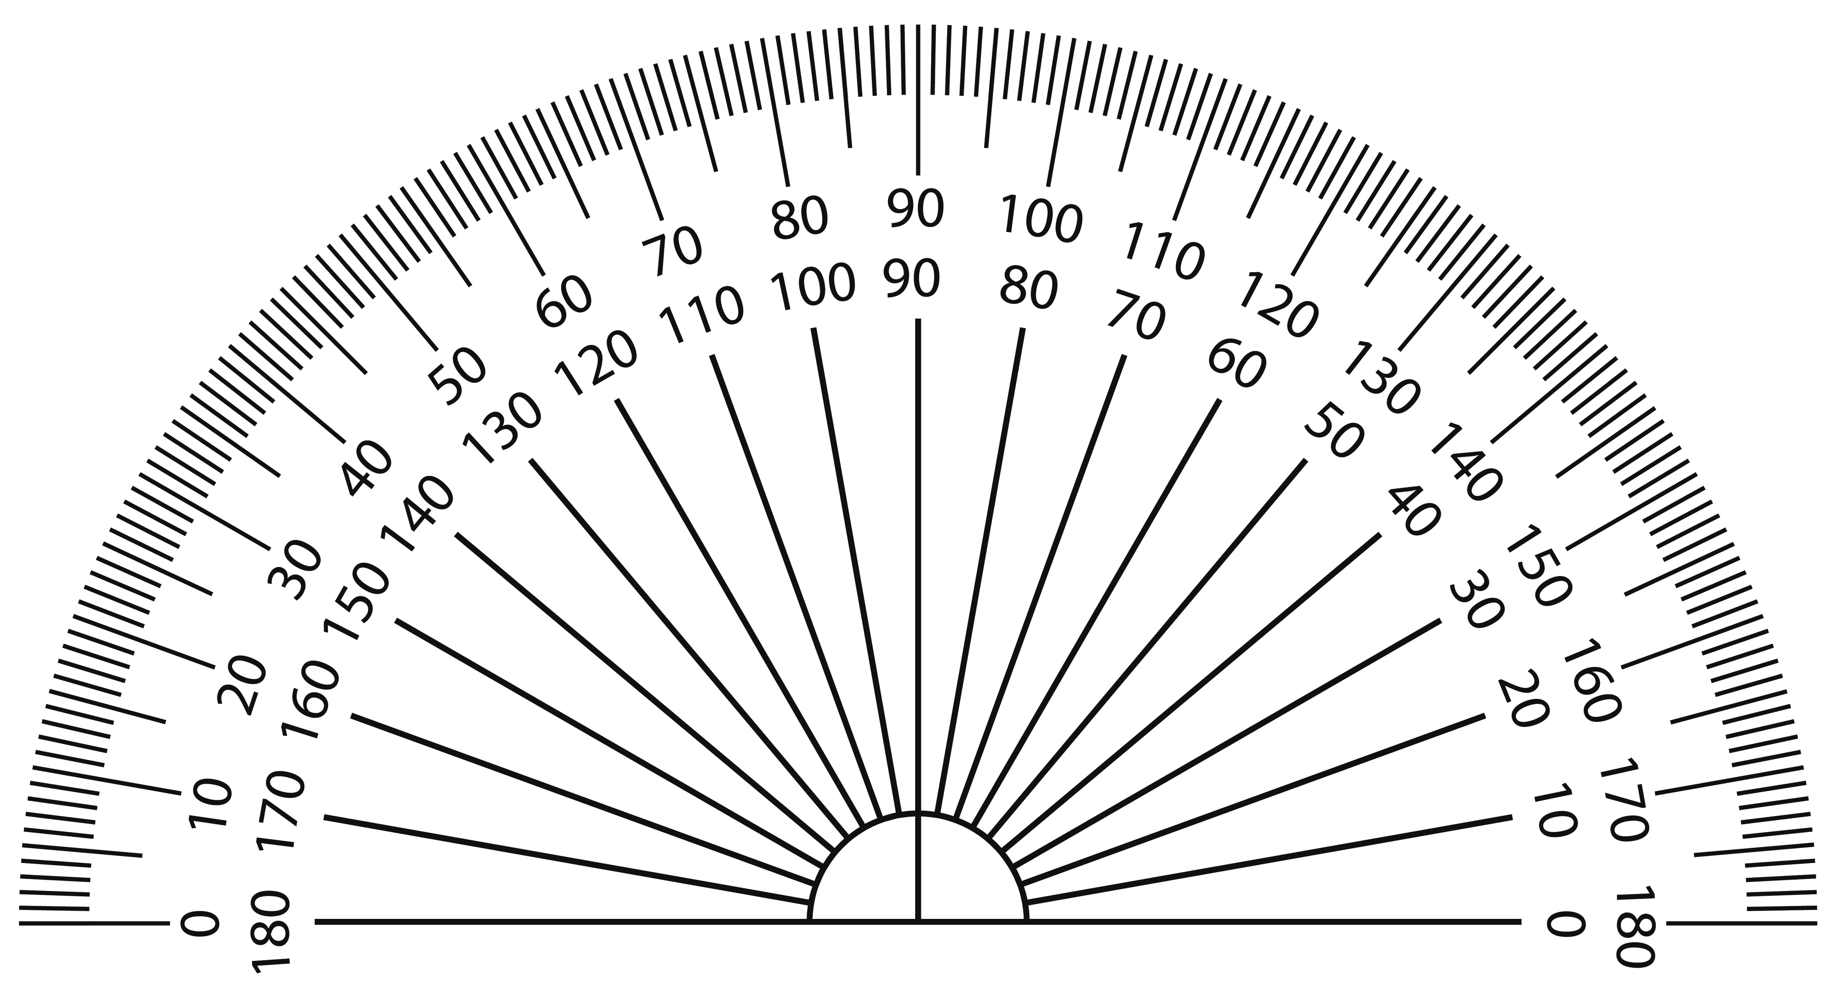
Varied Fluency 2
Estimate, then measure these angles.
a
b
© Classroom Secrets Limited 2018

Slide 9
Varied Fluency 2
Estimate, then measure these angles.
Estimations can be up to 20° either side of the answer.
a – 55°, b – 135°
a
b
© Classroom Secrets Limited 2018

Slide 10
Varied Fluency 3
Estimate, then measure the size of the angles a and b.
a
b
© Classroom Secrets Limited 2018

Slide 11
Varied Fluency 3
Estimate, then measure the size of the angles a and b.
Estimations can be up to 20° either side of the answer.
a – 75°, b – 105°
a
b
© Classroom Secrets Limited 2018

Slide 12
Varied Fluency 4
Fill in the blanks.
A reflex angle is between ______° and ______°.
© Classroom Secrets Limited 2018

Slide 13
Varied Fluency 4
Fill in the blanks.
A reflex angle is between 180° and 360°.
© Classroom Secrets Limited 2018

Slide 14
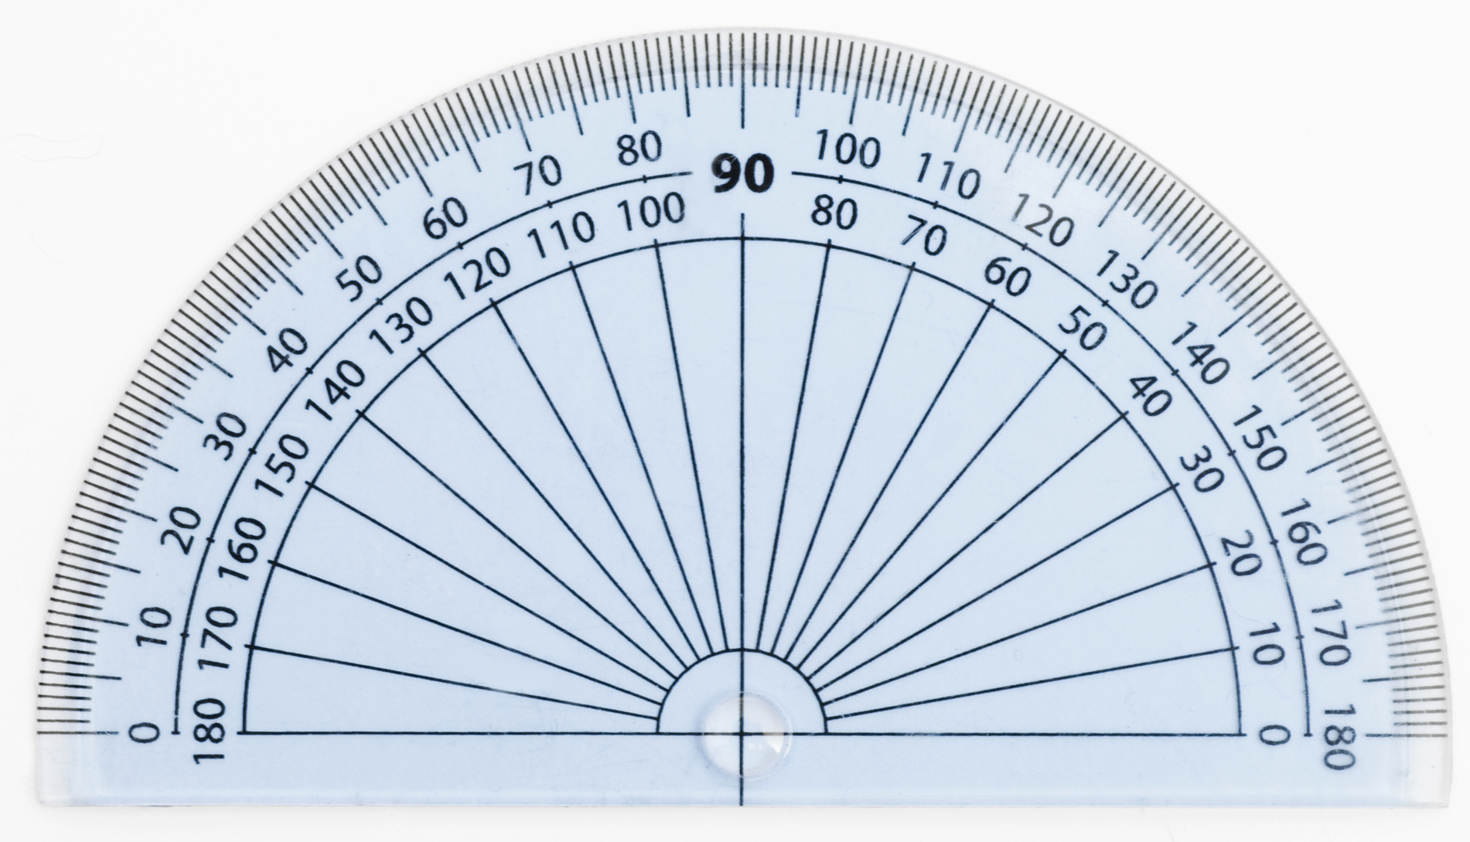
Problem Solving 1
Mum said Fay should get the most chocolate
tart and David should get the least.
Which pieces of tart should go to Fay, David and Chris?
b
a
c
© Classroom Secrets Limited 2018

Slide 15
Problem Solving 1
Mum said Fay should get the most chocolate
tart and David should get the least.
Which pieces of tart should go to Fay, David and Chris?
Fay – b, David – a, Chris – c
b
a
c
© Classroom Secrets Limited 2018

Slide 16
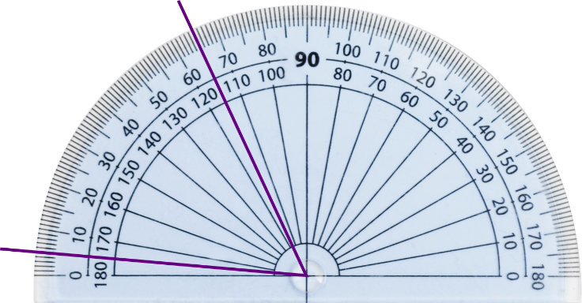
Reasoning 1
“My angle is 65°,” says Dev.
Has he measured his angle correctly? Explain your answer.
© Classroom Secrets Limited 2018

Slide 17
Reasoning 1
“My angle is 65°,” says Dev.
Has he measured his angle correctly? Explain your answer.
No because…
© Classroom Secrets Limited 2018

Slide 18
Reasoning 1
“My angle is 65°,” says Dev.
Has he measured his angle correctly? Explain your answer.
No because he has not lined up the bottom line of the angle with 0°.
© Classroom Secrets Limited 2018

Slide 19
Problem Solving 2
Which angle belongs to which person?
My angle is obtuse.
Kay
My angle is acute.
Fred
My angle is more than 40°.
Lucy
95° | 45° | 30°
© Classroom Secrets Limited 2018

Slide 20
Problem Solving 2
Which angle belongs to which person?
My angle is obtuse.
95°
Kay
My angle is acute.
30°
Fred
My angle is more than 40°.
45°
Lucy
95° | 45° | 30°
© Classroom Secrets Limited 2018

