Slide 1
LIFE/work balance
We have started a #LIFEworkbalance campaign and we need your help to complete our LIFE/work balance survey.
We hope to publish the results soon, so please give 15 minutes of your time to help us get a true picture of school life.
Want to be a part of this campaign? Take the survey on our website and share it with your colleagues!
© Classroom Secrets Limited 2018

Slide 2
Year 6 – Summer Block 3 – Statistics – Read and Interpret Line Graphs
About This Resource:
This PowerPoint has been designed to support your teaching of this small step. It includes a starter activity and an example of each question from the Varied Fluency and Reasoning and Problem Solving resources also provided in this pack. You can choose to work through all examples provided or a selection of them depending on the needs of your class.
National Curriculum Objectives:
Mathematics Year 6: (6S1) Interpret and construct pie charts and line graphs and use these to solve problems
More Year 6 Statistics resource.
Did you like this resource? Don’t forget to review it on our website.
© Classroom Secrets Limited 2018

Slide 3
Year 6 – Summer Block 3 – Statistics
Step 1: Read and Interpret Line Graphs
© Classroom Secrets Limited 2018

Slide 4
Introduction
What’s missing from this line graph?
© Classroom Secrets Limited 2018

Slide 5
Introduction
What’s missing from this line graph?
Label for the y axis – a dependent variable (what was measured)
Title: A Graph to Show...
5
4
3
2
1
0
Distance (km)
Scale – determine an appropriate scale that has equal gaps between numbers.
Label for the x axis – an independent variable (the thing that changes)
0 | 1 | 2 | 3 | 4 | 5
Time (minutes)
© Classroom Secrets Limited 2018

Slide 6
Varied Fluency 1
Which of the following could you show on a line graph?
A. Rainfall in two cities over a period of time.
B. Your classmates’ favourite sports.
C. How long it takes 2 children to run the same distance.
© Classroom Secrets Limited 2018

Slide 7
Varied Fluency 1
Which of the following could you show on a line graph?
A. Rainfall in two cities over a period of time.
B. Your classmates’ favourite sports.
C. How long it takes 2 children to run the same distance.
© Classroom Secrets Limited 2018

Slide 8
Varied Fluency 2
True or false?
On the weekend, more ice creams are sold at the park than the shopping centre.
© Classroom Secrets Limited 2018

Slide 9
Varied Fluency 2
True or false?
On the weekend, more ice creams are sold at the park than the shopping centre.
True
© Classroom Secrets Limited 2018

Slide 10
Varied Fluency 3
According to the graph, which statements are correct?
A. Both travelled the same distance because the lines both end at 3pm. B. The cyclist travelled about 4 times further than the person walking by 3pm.
© Classroom Secrets Limited 2018

Slide 11
Varied Fluency 3
According to the graph, which statements are correct?
A. Both travelled the same distance because the lines both end at 3pm. B. The cyclist travelled about 4 times further than the person walking by 3pm.
B is correct.
A has mixed up
what information is shown by each axis
on the graph.
© Classroom Secrets Limited 2018

Slide 12
Reasoning 1
Michaela is recording the amount of juice in 2 cartons throughout the week.
Which graph most likely shows her data?
Explain how you know.
A
B
© Classroom Secrets Limited 2018

Slide 13
Reasoning 1
Michaela is recording the amount of juice in 2 cartons throughout the week.
Which graph most likely shows her data?
Explain how you know.
B most likely shows her data because...
A
B
© Classroom Secrets Limited 2018

Slide 14
Reasoning 1
Michaela is recording the amount of juice in 2 cartons throughout the week.
Which graph most likely shows her data?
Explain how you know.
B most likely shows her data because it shows the amount in each carton decreasing over time as the contents are drunk.
A
B
© Classroom Secrets Limited 2018

Slide 15
Reasoning 2
Noel and Mei are interpreting this graph. Noel says, “The flowers are exactly the same height in September.”
Mei says, “The flowers were the same height in June, but then Flower 2 grew slightly taller than Flower 1.”
Who is correct? Explain.
© Classroom Secrets Limited 2018

Slide 16
Reasoning 2
Noel and Mei are interpreting this graph. Noel says, “The flowers are exactly the same height in September.”
Mei says, “The flowers were the same height in June, but then Flower 2 grew slightly taller than Flower 1.”
Who is correct? Explain.
Mei is correct because...
© Classroom Secrets Limited 2018

Slide 17
Reasoning 2
Noel and Mei are interpreting this graph. Noel says, “The flowers are exactly the same height in September.”
Mei says, “The flowers were the same height in June, but then Flower 2 grew slightly taller than Flower 1.”
Who is correct? Explain.
Mei is correct because in June, both flowers are 4ft in height and in July, Flower 2 is about 1ft taller than Flower 1.
© Classroom Secrets Limited 2018

Slide 18
Problem Solving 1
Henri and Georgia are choosing a site to go camping.
Which site is the warmest throughout the night?
They each need extra warm socks for any temperatures under 6˚C, and a hot water bottle each for any temperatures under 4˚C. What extra supplies will they need for each site?
© Classroom Secrets Limited 2018

Slide 19
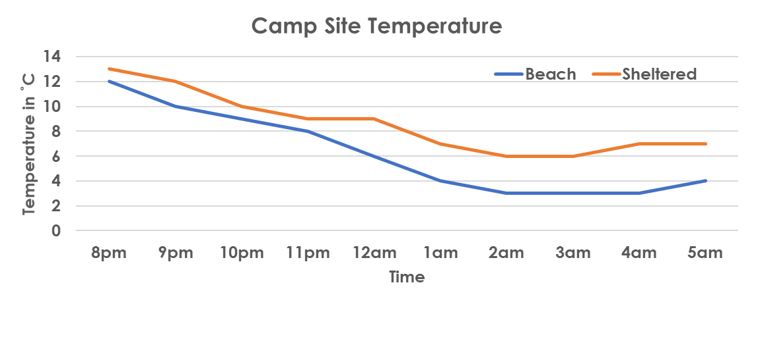
Problem Solving 1
Henri and Georgia are choosing a site to go camping.
Which site is the warmest throughout the night?
The sheltered site is warmer throughout the night.
They each need extra warm socks for any temperatures under 6˚C, and a hot water bottle each for any temperatures under 4˚C. What extra supplies will they need for each site?
On the beach, they will each need one pair of socks and one hot water bottle. On the sheltered campsite, they won’t need any extra supplies
© Classroom Secrets Limited 2018

